Slide 1
MOTIVATE STUDENTS TO COME PREPARED TO CLASS USING THESE TOOLS
Notes:
TEMPLATE: Dutch Market Investment Consulting

Slide 3
PROGRAMME
1
What is active blended learning?
4
Differences between the tools
2
FeedbackFruits and Perusall
5
Best ways to use these tools
3
Advantages & disadvantages
6
Where to get help?

Slide 4
We encourage you to
ask questions!
Notes:
Delete this slide, adjust it to a “ask your questions whenever” slide

Slide 5
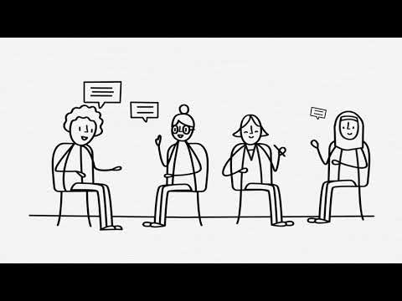
ACTIVE BLENDED LEARNING

Slide 6
ACTIVE BLENDED LEARNING
“Through active learning, students acquire profound knowledge and skills that sticks. This results in a higher chance of study success.”

Slide 7
ACTIVE BLENDED LEARNING

Slide 8
ACTIVE BLENDED LEARNING
“Blended learning is a mix of face-to-face and ICT-based (often online) learning activities. Ideally, the mix of elements reinforce each other: the best of both worlds.”

Slide 9
MOTIVATE STUDENTS TO PREPARE
WITH
FeedbackFruits
Interactive Document/Video
Perusall

Slide 10
What does FeedbackFruits look like?

Slide 11
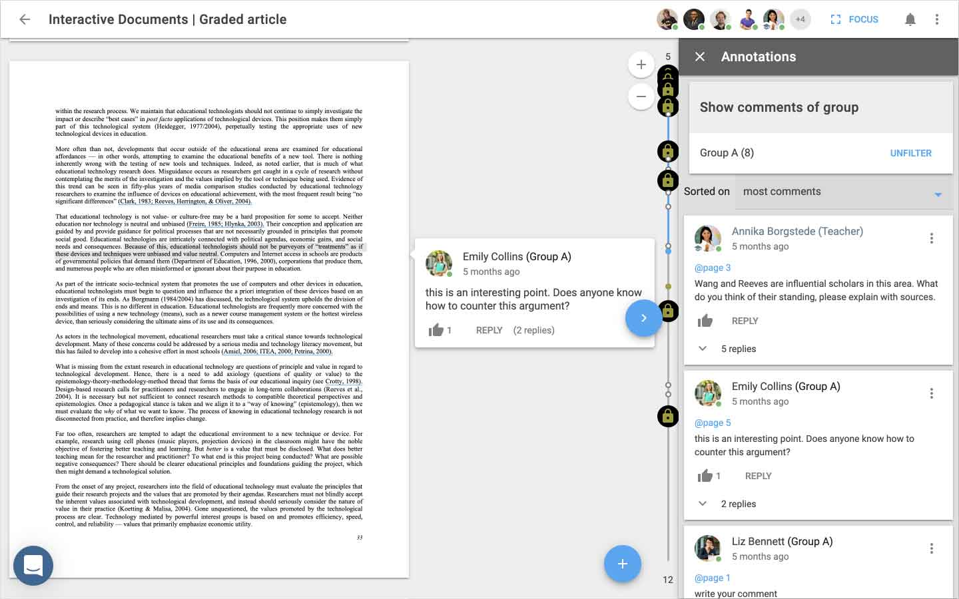

Slide 12
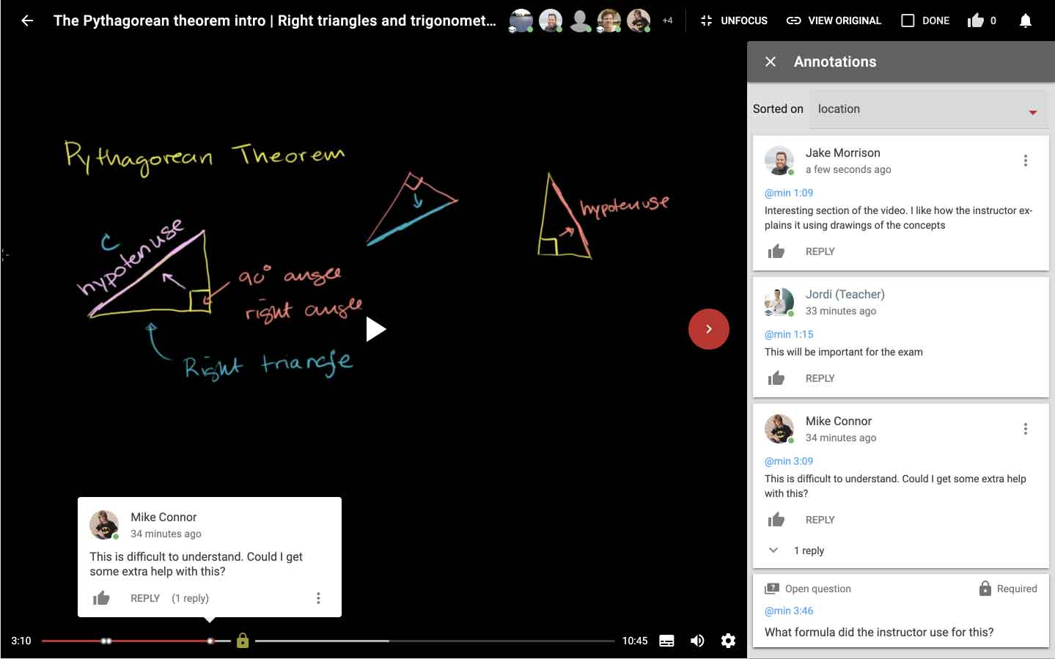

Slide 13
What does
Perusall look like?

Slide 14
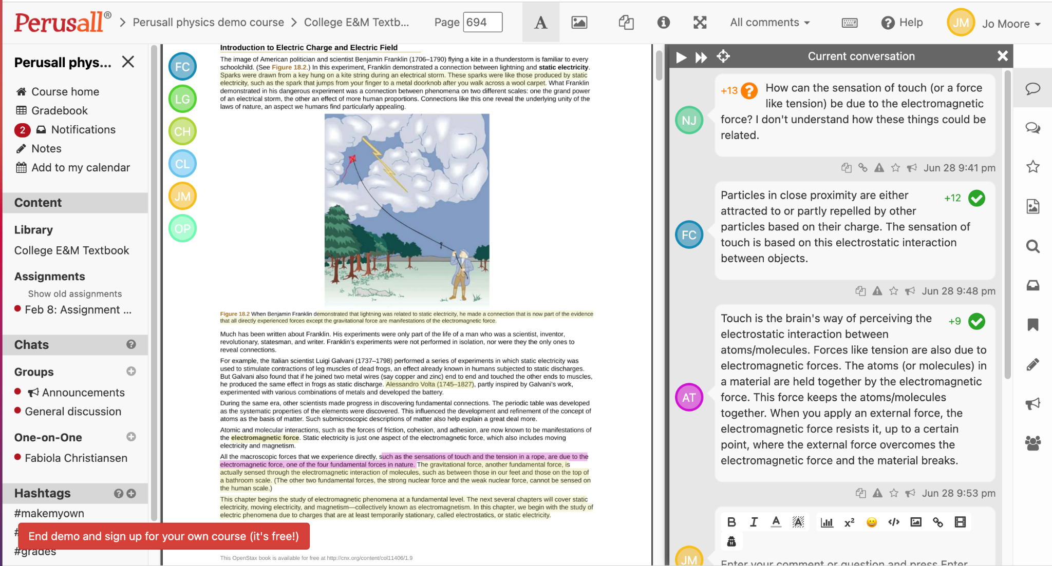
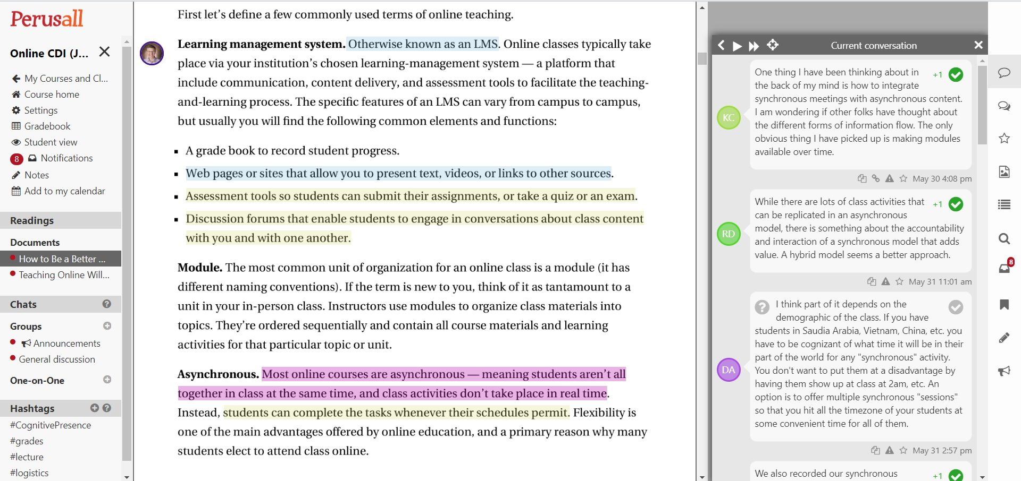

Slide 15
ADVANTAGES OF THESE TOOLS
Stimulates social learning
(students can learn from observations and imitation)
Stimulate interactions: student-material and student-student
1
6
Stimulate higher engagement
2
5
Give insight in topics that need additional explanation
3
4
Help students understand the material better
Give insight in who prepared for class

Slide 16
DISADVANTAGES OF THESE TOOLS
Time required to understand the tools
Timing challenges in student interactions
Beware of copyright!
→ 70% of all literature is in the VU’s database
→ your faculty library liaison can help
https://vu.nl/en/about-vu/divisions/university-library/more-about/subject-librarians

Slide 17
LET’S TRY YOURSELF!
FEEDBACKFRUITS:
https://canvas.vu.nl/courses/47759/assignments/291378
*Make sure you are part of this course, otherwise it won’t work

Slide 18
LET’S TRY YOURSELF!
PERUSALL:
https://canvas.vu.nl/courses/47759/external_tools/659?display=borderless
*Make sure you are part of this course, otherwise it won’t work

Slide 19
WHAT DO YOU THINK OF THESE TOOLS?
Notes:
What were your experiences?
What went through your head?

Slide 20
HOW TO GET TO THESE TOOLS?
Both integrated in Canvas
FeedbackFruits: Canvas assignment → choose “External tool” as submission type
Perusall: Canvas settings → navigation → turn on Perusall as menu option

Slide 21
FeedbackFruits demonstration

Slide 22
FeedbackFruits
Notes:
No need to show this video, but remind them that they can look back and watch it.

Slide 23
Perusall
demonstration

Slide 24
COMPARISONS BETWEEN THESE TOOLS
 | FeedbackFruits (interactive doc) | Perusall
Integration with Canvas | operates directly on Canvas | operates on Perusall
Grade-syncing | grades synced with Canvas | grades synced with Canvas
Group-syncing | groups synced with Canvas | groups partially synced Limitation: Group 2 in Canvas, might appear as Group 7 in Perusall. But students remain the same.
Notes:
Double check everything in this slide is the same. Change info if needed.

Slide 25
COMPARISONS BETWEEN THESE TOOLS
 | FeedbackFruits (interactive doc) | Perusall
Aim
User-friendliness
Ways to promote learning
Analyzing students’ contributions
Teacher-driven
Student-driven
High
Medium
Students can annotate readings or figures.
Can comment on classmates’ contributions.
Open questions or multiple choice.
Students can annotate readings or figures.
Can comment on other students’ contributions.
Learn how to make high-quality annotations (teach them first!)
Manual
Students can highlight their best annotations and reflect on the assignment.
AI-grading.
Automatically provide confusion reports. Limitation: not always accurate, need 10+ annotations.
Notes:
Same as slide 24.

Slide 26
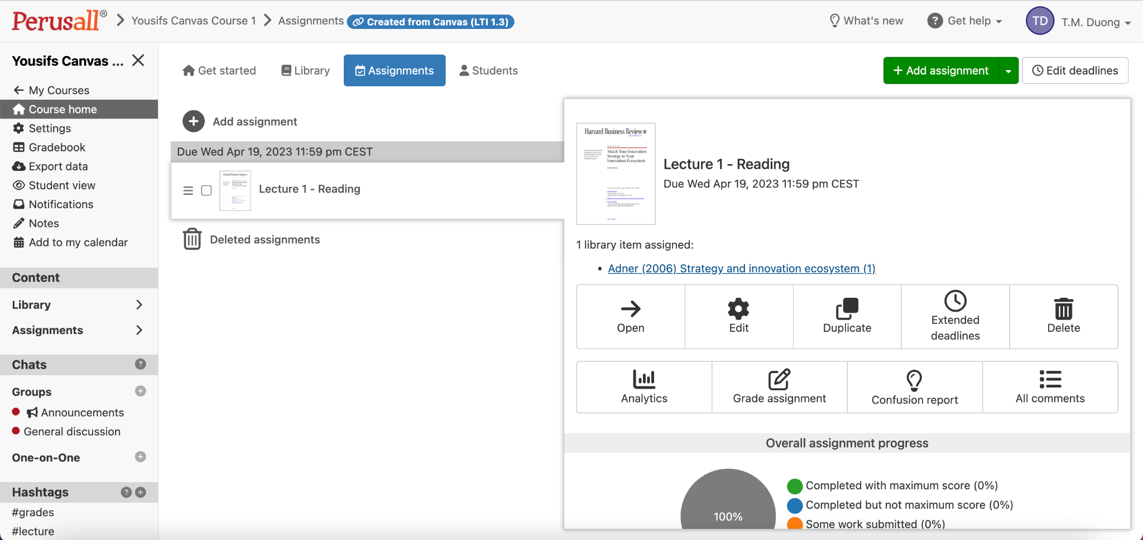
Perusall uses its algorithm to identify topics of engagement, and the best annotations.
Perusall - confusion report
Notes:
Maybe show an example of a confusion report.

Slide 27
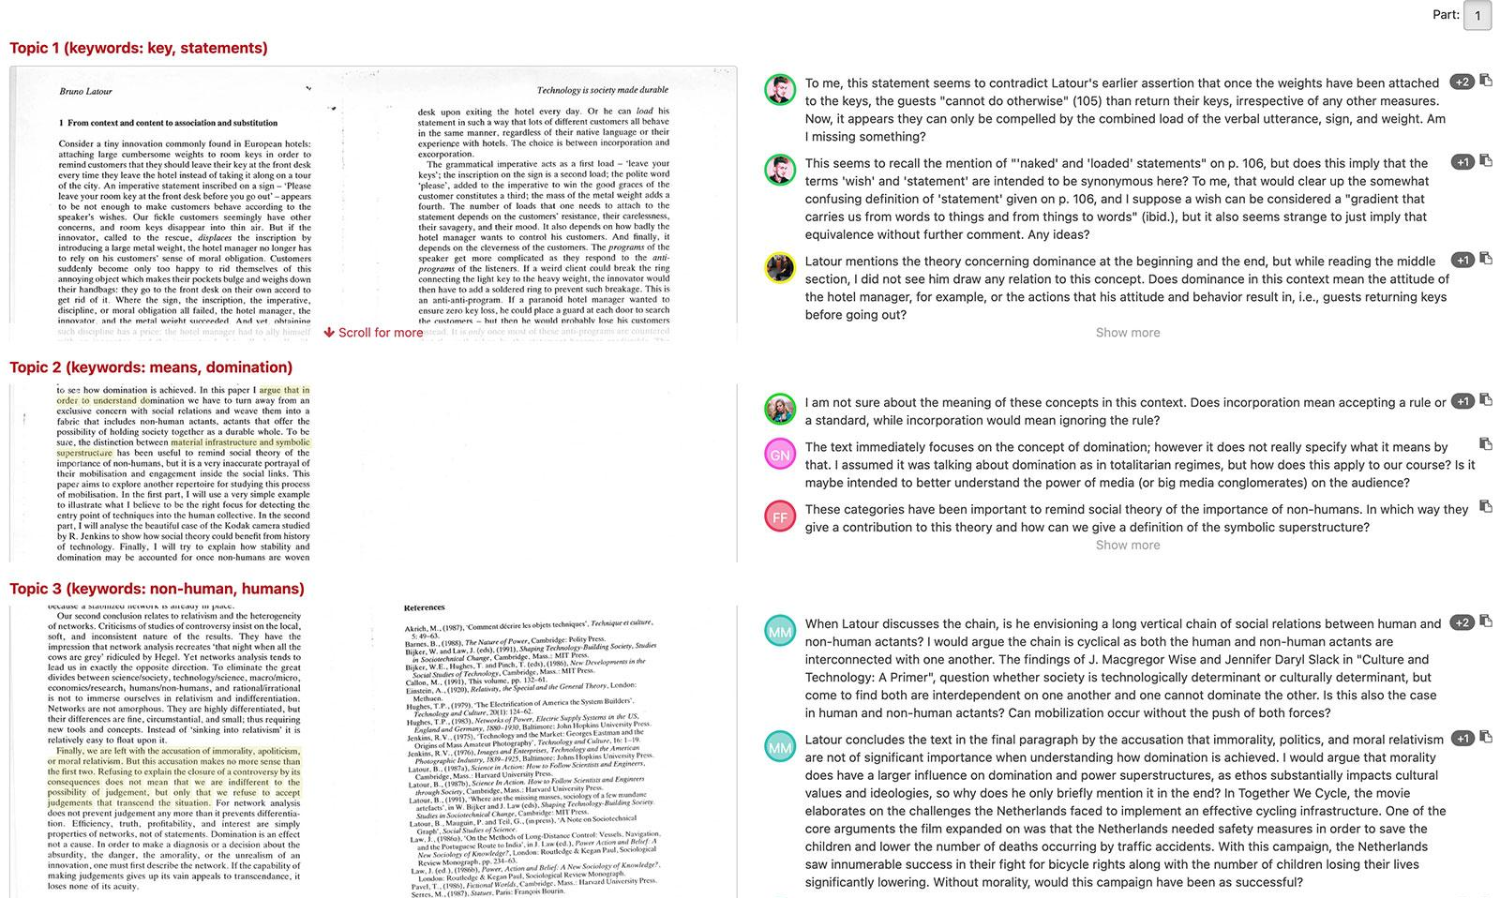
Relevant topics, keywords.
Annotations with most engagement
Perusall - confusion report

Slide 28
ACTIVITY 1:
How would you best use these tools?
Notes:
Split them into small groups
After discussion ended, make one big group and discuss as a whole.

Slide 29
HOW TO USE THESE TOOLS BEST?
1. Communicate why you’re using this tool
2. Communicate your expectations
3. Set a minimum of required annotations: 7
4. Divide students in groups: 20
5. Do not interfere
6. Let students use the thumbs up button (upvotes)
7. Use as input for contact time

Slide 30
ACTIVITY 2:
Are there any challenges you are expecting? Reflecting thoughts?
Notes:
They might not feel ready to open up right away so start with a small group.
Give them post-it’s notes, let everyone write one, and then the small group chooses one problem to troubleshoot.
Then bring it back as a group discussion.

Slide 31
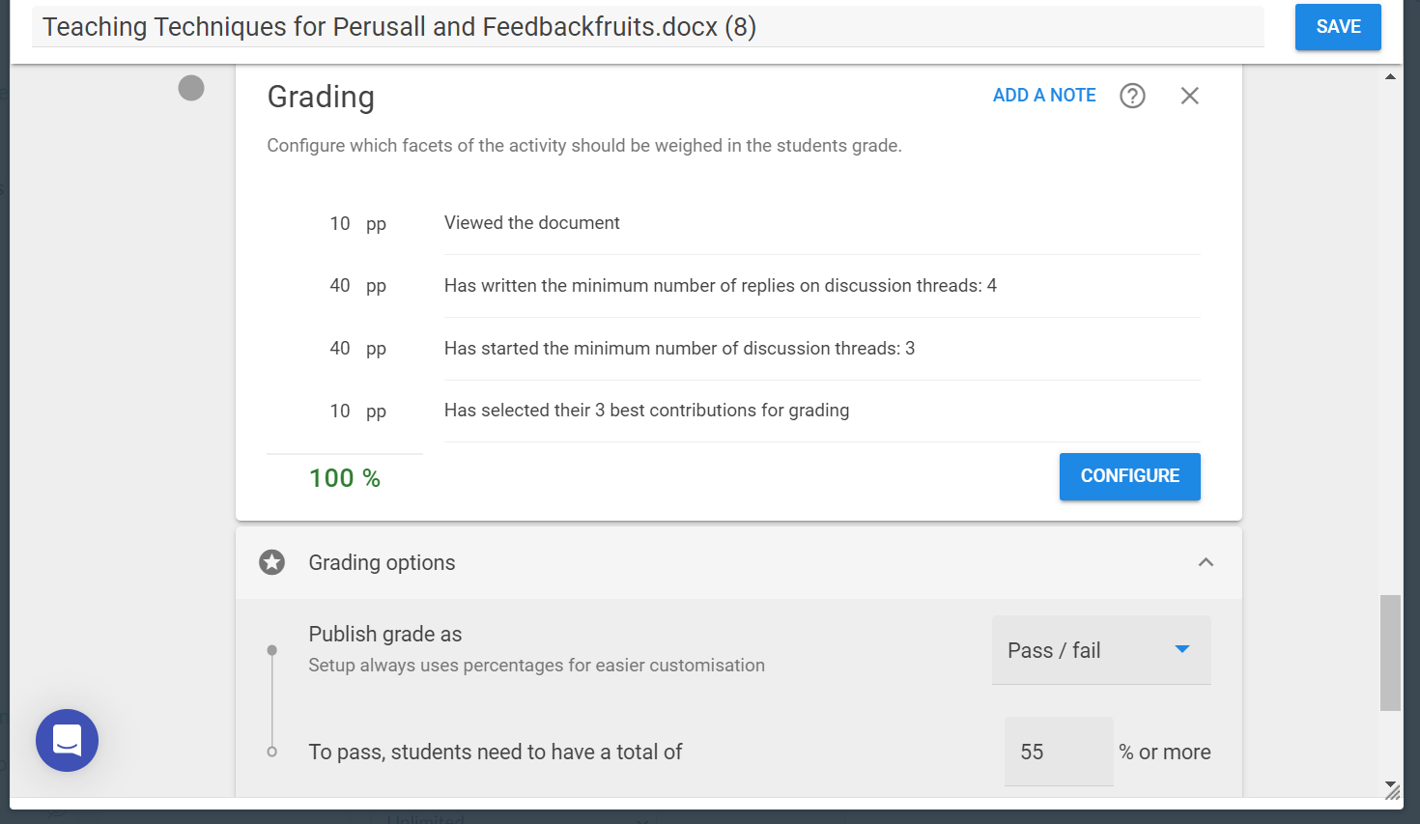
Settings for 7 annotations: FbF

Slide 32
NEED HELP?
Email: onderwijswerkplaats@vu.nl
VU Tools for education: sign up

Slide 33
MORE INFORMATION:
FeedbackFruits Interactive Document
FeedbackFruits Interactive Video
Perusall

