Slide 1
How to make Canvas Student Friendly
Workshop

Slide 2
Why Canvas should be student friendly…

Slide 3
What will be discussed?
Examples of real Canvas courses
How to make Canvas Student Friendly
Examples Canvas courses we made
Put it into practice
Where to get help?

Slide 4
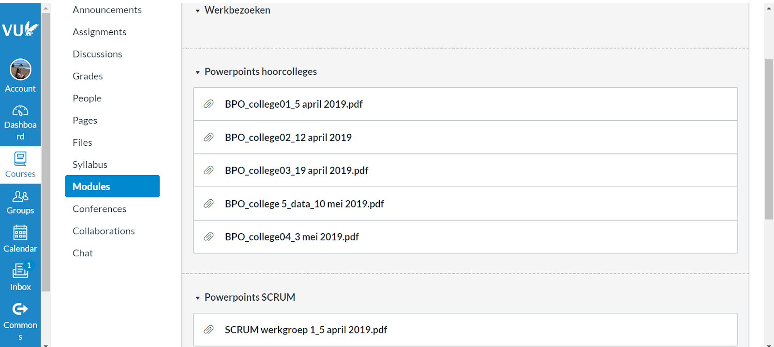
What do you think? Pros and Cons

Slide 5
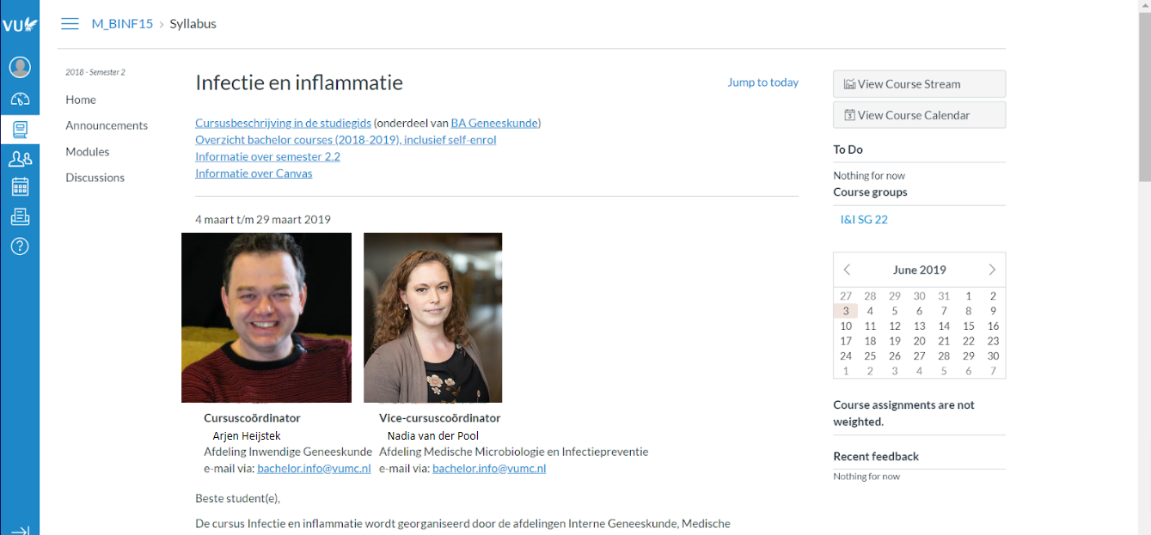
What do you think? Pros and Cons

Slide 6
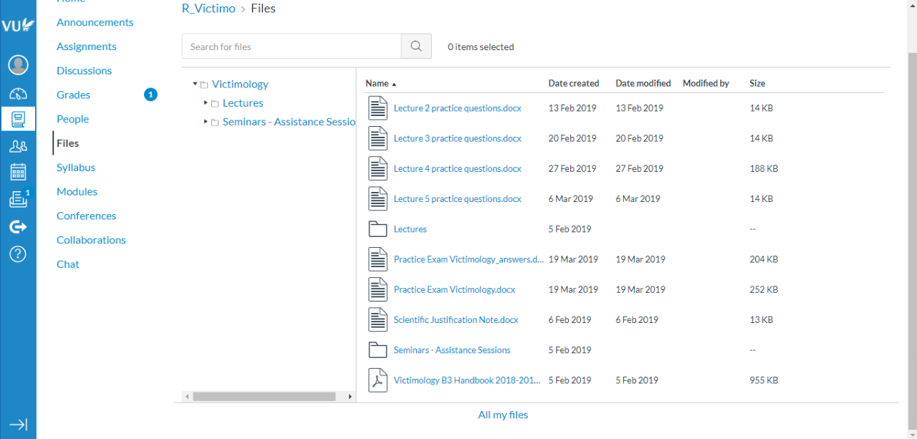
What do you think? Pros and Cons

Slide 7
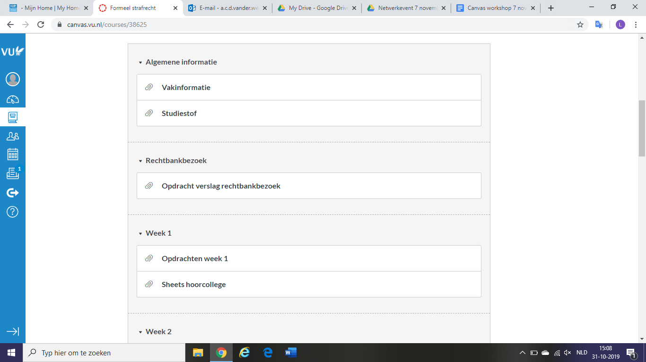
What do you think? Pros and Cons

Slide 8
How to make Canvas Student Friendly
Simplicity

Slide 9
How to make Canvas Student Friendly
Simplicity
Front page = Syllabus page
Link to syllabus
Introducing the lecturer
Picture and email
How to contact lecturer
Word of welcome

Slide 10
How to make Canvas Student Friendly
Simplicity
Front page = Syllabus page
Link to syllabus
Introducing the lecturer
Picture and email
How to contact lecturer
Word of welcome
Clear modules
Course information
Distinguish on the basis of
weeks or themes

Slide 11
How to make Canvas Student Friendly
Publish your course in time
1 week beforehand

Slide 12
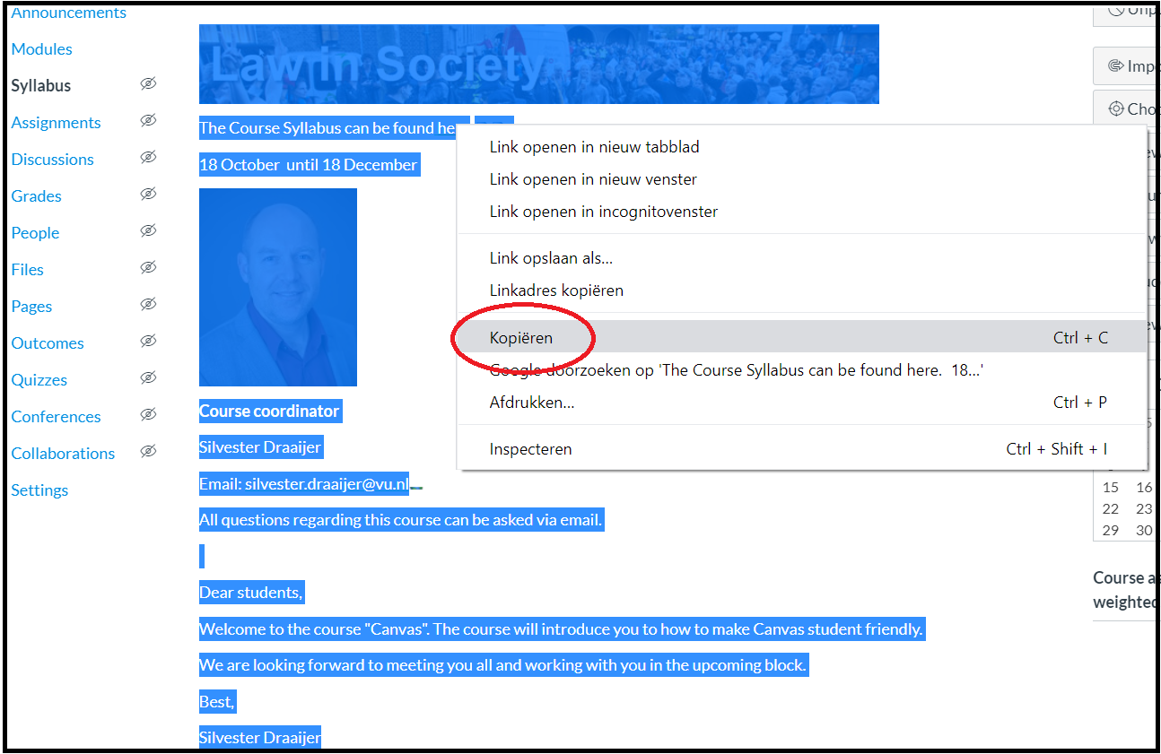
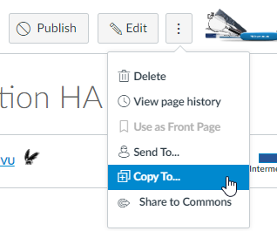
How to make Canvas Student Friendly
Publish your course in time
1 week beforehand
Reuse good Canvas courses

Slide 13
How to make Canvas Student Friendly
Publish your course in time
1 week beforehand
Reuse good Canvas courses
Standardize a template for your program/faculty
Talk to your program director
Contact us for help

Slide 14
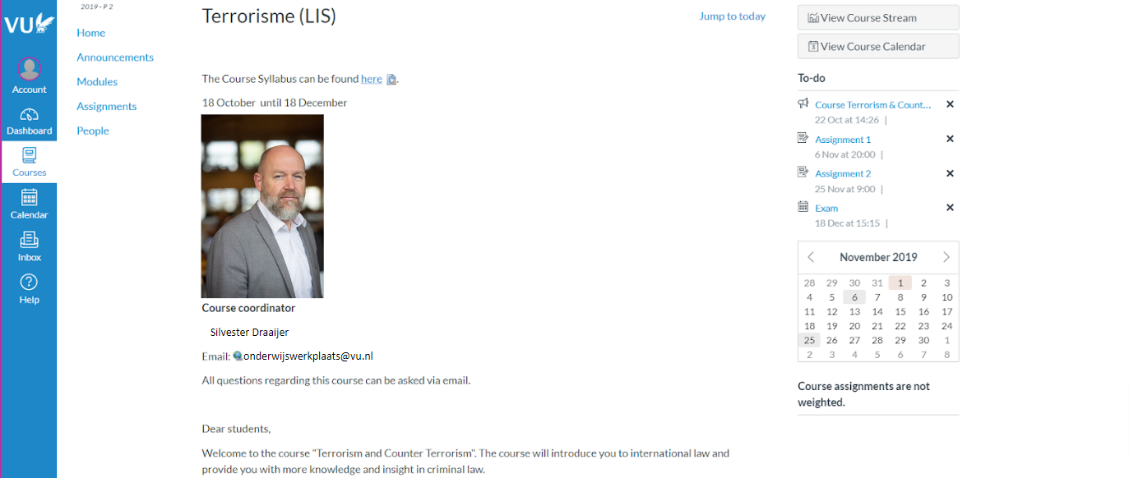
Examples Canvas courses we made

Slide 15
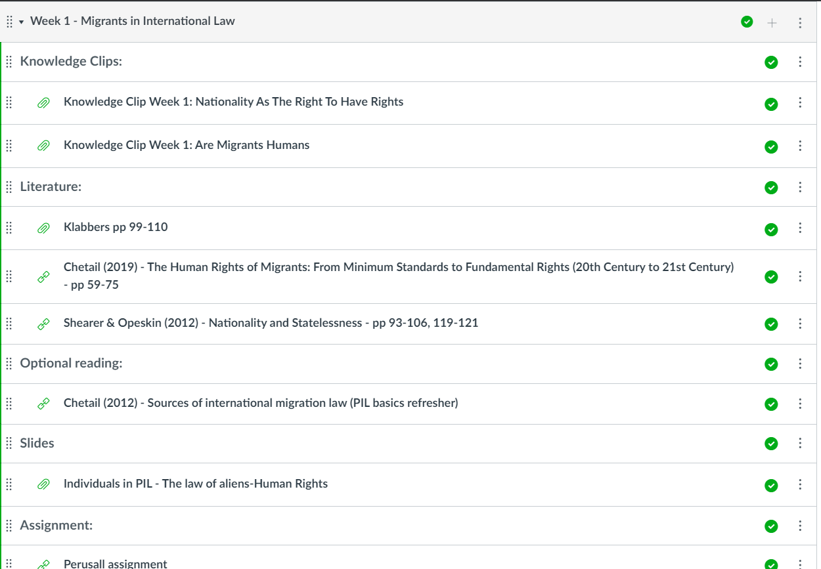
Examples Canvas courses we made

Slide 16
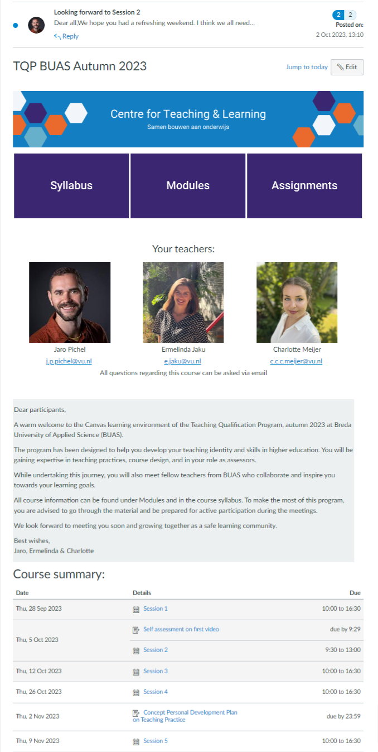
Examples Canvas courses we made

Slide 17
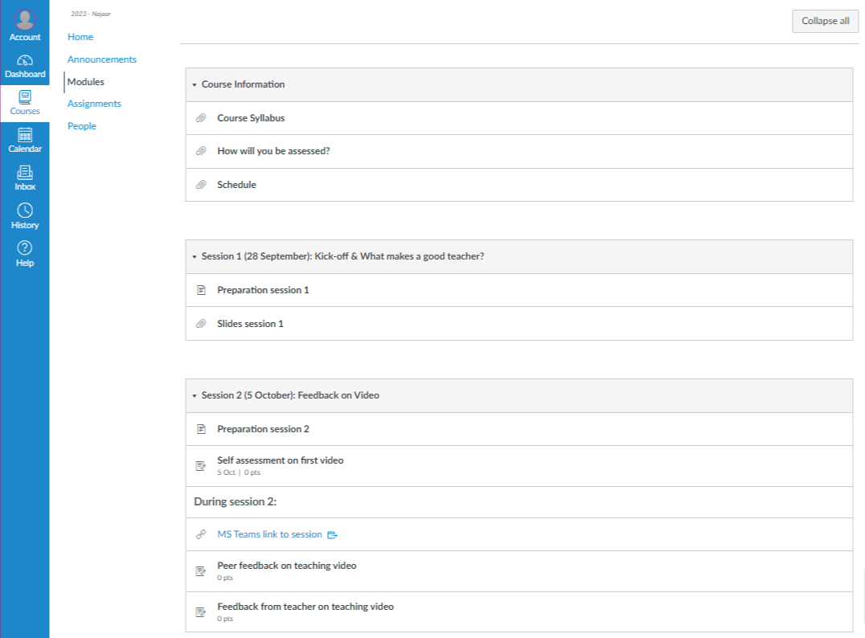
Examples Canvas courses we made

Slide 18
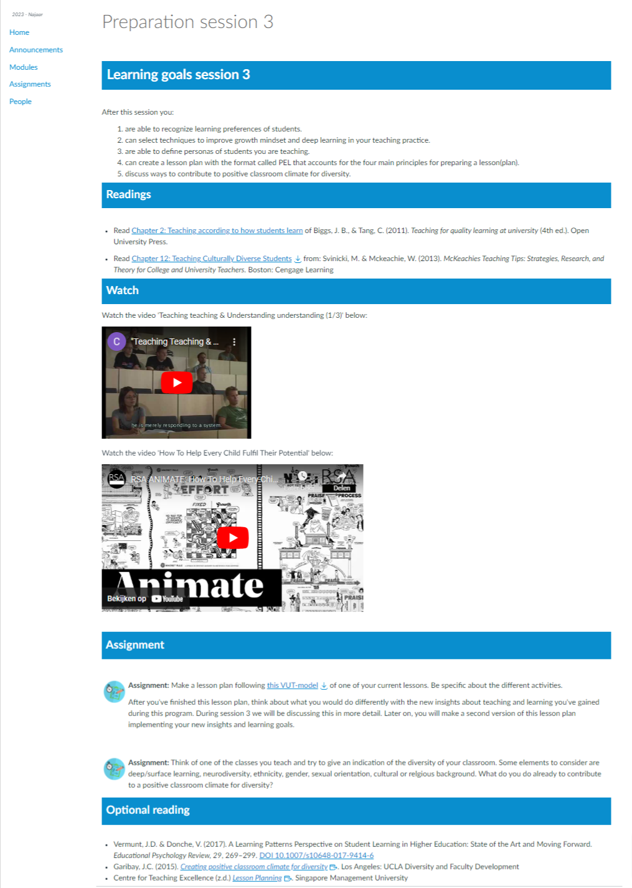
Examples Canvas courses we made

Slide 19
Questions?

Slide 20
Let’s put this into practice
Have a look at your own Canvas course: are there things you can change immediately to make it more student friendly?

Slide 21
Where to get help?
Our Canvas Student Friendly website
For individual help from one of our student assistants, email:
onderwijswerkplaats@vu.nl
Copyright help from the university library, email
steunpuntleermaterialen.ub@vu.nl

Slide 22
Questions?

