Slide 1
Cluster 3: Civil Security for Society
Boy Dacier & Victor Hartong
Notes:
Welcome!
Introduction NCP’s Cluster 3

Slide 2
Programme
CL3: Civil Security for Society
Calls
How can RVO help you
2
2

Slide 3
Cluster 3: Civil Security for Society
Aims to meet EU goals on:
A resilient EU prepared for emerging threats, the safeguarding and promotion of cultural heritage
A secure, open and democratic EU society
Promoting an open strategic autonomy by leading the development of key digital, enabling and emerging technologies, sectors and value chains
Highlighted topics require the effective contribution of Social Science and Humanities disciplines (in 21 topics required for 2021/2022)
Notes:
Cluster 3, ‘Civil Security for Society’ aims to meet EU goals and priorities on
A resilient EU prepared for emerging threats the safeguarding and promotion of cultural heritage,
on A secure, open and democratic EU society, and to
Promoting an open strategic autonomy by leading the development of key digital, enabling and emerging technologies, sectors and value chains
Cluster 3 projects will develop new knowledge, technologies and/or other solutions to the identified
requirements. Projects will involve practitioner end-users which are targeted to their needs.
Furthermore synergies exist with EDF, Digital Europe, Integrated Border Management Fund, International Security fund, European Regional Development fund.
Security research under Cluster 3 requires a specific approach towards international
cooperation to achieve the right balance between the need to exchange with key international
partners (including with relevant international organizations) while at the same time ensuring
the protection of the EU security interest and respecting the need for open strategic autonomy
in critical sectors.
The EU is strongly committed to the UN Sustainable Development Goals (SDGs), many of which have an important impact on Secure society: SDG 16 (Peace, justice and strong institutions) and SDG 17 (Partnerships to achieve goals)

Slide 4
Importance social sciences
Importance of integration of social sciences and humanities into the topics.
Human factors, Society, Policy
Validation of technological results
Data!
4
4

Slide 5
Destination 1 – Better protect the EU and its citizens against Crime and Terrorism
Call 2021-2022: Fighting Crime and Terrorism
Budget 56M
FCT01* – Modern information analysis for fighting crime and terrorism
FCT02 – Improved forensics and lawful evidence collection
FCT03 – Enhanced prevention, detection and deterrence of societal issues related to various forms of crime
FCT04 – Increased security of citizens against terrorism, including in public spaces
FCT05 – Organised crime prevented and combated
FCT06* – Citizens are protected against cybercrime
Notes:
Destination 1: Better protect the EU and it’s citizens against crime and terrorism. One of the main purposes of this destination is to contribute to the implementation of the security union strategy. The goal is to bring improved prevention, investigation and mitigation of impacts of crime.
SSH Topics:
HORIZON-CL3-2021-FCT-01-03: Disinformation and fake news are combated and trust in the digital world is raised
HORIZON-CL3-2021-FCT-01-06: Domestic and sexual violence are prevented and combated
HORIZON-CL3-2021-FCT-01-07: Improved preparedness on attacks to public spaces
HORIZON-CL3-2021-FCT-01-08: Fight against trafficking in cultural goods
HORIZON-CL3-2021-FCT-01-11: Prevention of child sexual exploitation
HORIZON-CL3-2021-FCT-01-12: Online identity theft is countered
HORIZON-CL3-2022-FCT-01-02: Better understanding the influence of organisational cultures and human interactions in the forensic context as well as a common lexicon
HORIZON-CL3-2022-FCT-01-03: Enhanced fight against the abuse of online gaming culture by extremists
HORIZON-CL3-2022-FCT-01-04: Public spaces are protected while respecting privacy and avoiding mass surveillance
HORIZON-CL3-2022-FCT-01-05: Effective fight against corruption
HORIZON-CL3-2022-FCT-01-07: Effective fight against trafficking in human beings

Slide 6
Destination 2 – Effective management of EU external borders
Border and Travel - Thales
Call 2021-2022 Effective management of EU external borders
Budget 30,5M
BM01 – Efficient border surveillance and maritime security
BM02 – Secured and facilitated crossing of external borders
BM03 – Better customs and supply chain security
Notes:
Destination 2. Effective management of EU external borders. This destination addresses objectives identified by the security union strategy and from the border management and security dimensions of the new pact on migration and asylum. The topics in this destination are aimed at ensuring strong external borders.

Slide 7
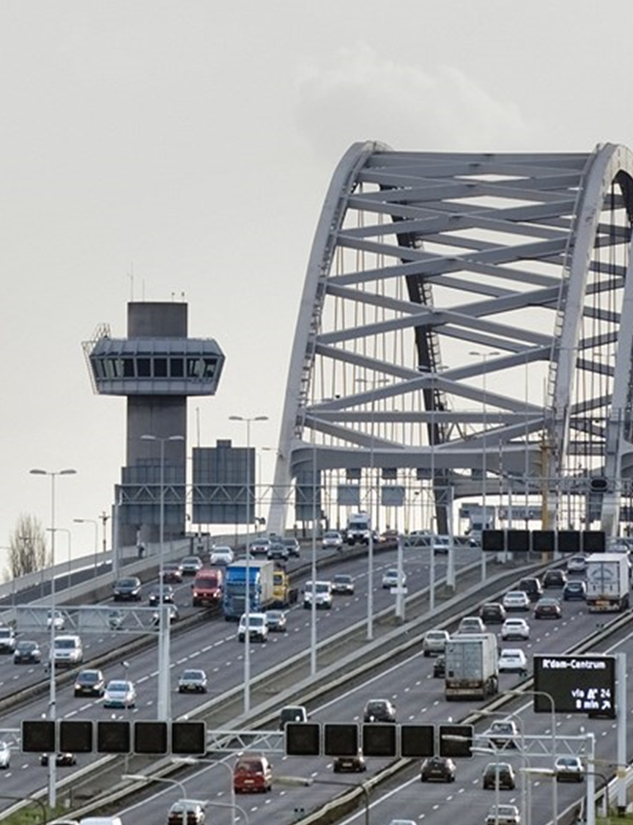
Destination 3 - Resilient infrastructure
Infrastructuur –
TNO Bouw, Maritiem & Infra
Call 2020-2021 Resilient
Infrastructure
Budget 20M
INFRA01* – Improved preparedness and response for large-scale disruptions of European infrastructures
INFRA02** – Resilient and secure smart cities
Notes:
Destination 3. Resilient infrastructure. A resilient, robust and reliable infrastructure provides the basis for our daily lives. It is vital for the security, well-being and economic prosperity of people in Europe. Infrastructures in the EU are high value targets for terrorist groups as well as agencies of third countries. The Security Union Strategy identifies the protection of critical infrastructures as one of the main priorities for the EU and its member states for the coming years.

Slide 8
Destination 4 – Increased Cybersecurity
Call 2021-2022: Increased Cybersecurity
Budget: 67,5M
CS01 – Secure and resilient digital infrastructures and interconnected systems
CS02 – Hardware, software and supply chain security
CS03 – Cybersecurity and disruptive technologies
CS04** – Smart and quantifiable security assurance and certification shared across Europe
CS05* – Human-centric security, privacy and ethics
Notes:
Destination 4. Increased Cybersecurity. Digital tech is changing our daily life, way of working and doing business. Digital disruption not only threaten our economies but also our way of life, our freedoms and values. The digital transformation requires improving cybersecurity substantially. Europe must build resilience to cyber-attacks and create effective cyber deterrence, while making sure that data protection and freedom of citizens are strengthened.
SSH Topics:
HORIZON-CL3-2021-CS-01-01: Dynamic business continuity and recovery methodologies based on models and prediction for multi-level Cybersecurity

Slide 9
Destination 5 – A Disaster-Resilient Society for Europe
Call 2021-2022: Disaster-Resilient Society for Europe
Budget 26M
DRS01 – Societal Resilience: Increased risk Awareness and preparedness of citizens
DRS02 – Improved Disaster Risk Management and Governance
DRS03 – Strengthened capacities of first and second responders
Notes:
Destination 5. A disaster-resilient society for Europe. This Destination supports the implementation of policy from the EU Disaster Risk Reduction and policies tackling natural and man-made threats, the Climate Adaptation Strategy as well as the Security Union Strategy and the Counter-Terrorism Agenda. The European societies are facing growing risks from anthropogenic and natural hazards. Our societies nowadays have to deal with complex and transboundary crises within which a more systemic approach with strict interconnection between risk reduction and sustainable development is needed.
SSH Topics:
HORIZON-CL3-2021-DRS-01-01: Improved understanding of risk exposure and its public awareness in areas exposed to multi-hazards
HORIZON-CL3-2021-DRS-01-02: Integrated Disaster Risk Reduction for extreme climate events: from early warning systems to long term adaptation and resilience building
HORIZON-CL3-2021-DRS-01-03: Enhanced assessment of disaster risks, adaptive capabilities and scenario building based on available historical data and projections
HORIZON-CL3-2022-DRS-01-01: Enhanced citizen preparedness in the event of a disaster or crisis-related emergency
HORIZON-CL3-2022-DRS-01-02: Enhanced preparedness and management of High-Impact Low-Probability or unexpected events

Slide 10
Destination 6 – SSRI (Strengthened Security Research and Innovation)
Call 2020-2021: Strengthened Security Research and Innovation
Budget 16M
SSRI01 – Stronger pillars of security Research and Innovation
SSRI02 – Increased Innovation uptake
SSRI03 – Cross-cutting knowledge and value for common security solutions
Notes:
Destination 6. Strengthened Security Research and Innovation. The EU-funded security research and innovation framework was launched with the Preparatory Action for Security Research. A key challenge remains in improving the uptake of innovation. To that aim, there is a need to create a favourable environment that is designed with the main purpose of increasing the impact of security Research and Innovation. The Strenghtened Security Research and Innovation Destination has therefore been designed with this purpose to serve equally to all the expected impacts of Cluster 3.
SSH Topics:
HORIZON-CL3-2021-SSRI-01-02: Knowledge Networks for Security Research & Innovation
HORIZON-CL3-2021-SSRI-01-05: Security research technologies driven by active civil society engagement: transdisciplinary methods for societal impact assessment and impact creation
HORIZON-CL3-2022-SSRI-01-02: Knowledge Networks for security Research & Innovation
HORIZON-CL3-2022-SSRI-01-04: Social innovations as enablers of security solutions and increased security perception

Slide 11
More information
Publication Work Programme: June 2021
Calls open: 30 June 2021 / 30 June 2022
Deadlines: 23 November 2021 / 23 November 2022 Deadlines CyberSecurity: 21 October 2021 / 16 November 2022
Total budget for cluster 3 2021-2022: 405.8 mEuro
Total budget €1,7 billion for the period 2021-2027.
Provisional information:
All single stage calls
32 IIA’s + 23 RIA’s + 9 CSA’s + 1 PCP
Mostly 1 project to be funded per call
Notes:
Read from slide: Publication Work Programme: June 2021
Calls open: 30 June 2021 / 30 June 2022
Deadlines: 23 Novemeber 2021 / 23 November 2022 Deadlines CyberSecurity: 21 October 2021 / 16 November 2022
Total budget for cluster 3 2021-2022: 405.8 mEuro
Total budget €1,7 billion for the period 2021-2027.
Provisional information:
All single stage calls
32 IIA’s + 23 RIA’s + 9 CSA’s + 1 PCP
Mostly 1 project to be funded per call

Slide 12
The Key to success:
Ask the EU to fund your project
Help the EU to solve its problems

Slide 13
How can RVO help you?

Slide 14
Further RVO support
Liaison role of NCP
Support Dutch delegation in Horizon Programme Committees
Gather input for work programmes via “klankbordgroepen”
Receive & analyse evaluation results
Communication about calls via newsletters, social media…
Infodays & webinars
Partner search, matchmaking
Proposal proofreading
Financial & legal advice
Training (January)

Slide 15
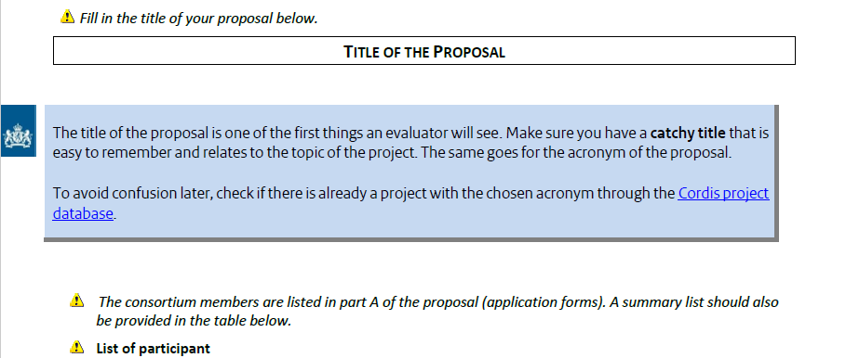
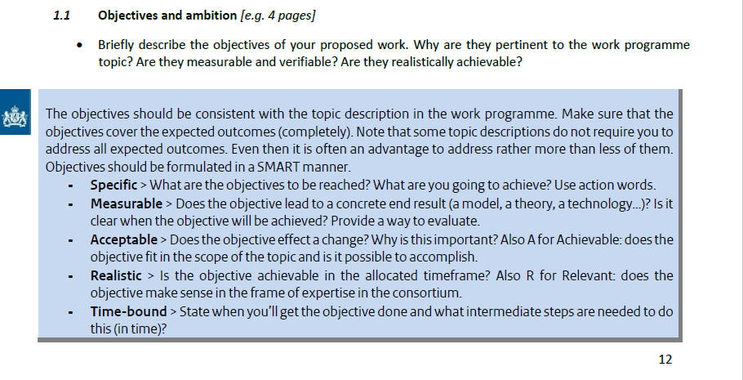
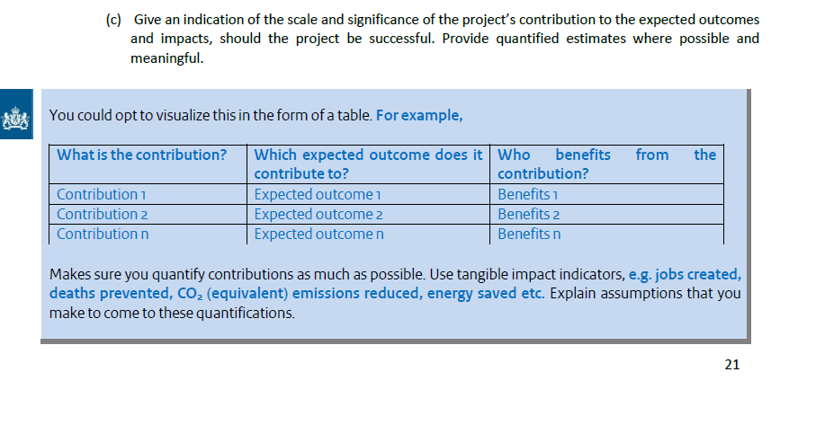
Further RVO support HEU Annotated Template

Slide 16
Further RVO support HEU Annotated Template
Get yourself one!
(via Lieke or Boy)

Slide 17
National contact points:
Boy.Dacier@RVO.nl
Victor.Hartong@RVO.nl
www.rvo.nl/horizon-europe
Teamiris-rvo.nl
088-0424210

