Slide 1
HR Service Desk Practical information

Slide 2
Agenda
1. Finding your way online
2. Important topics
3. Contact information

Slide 3
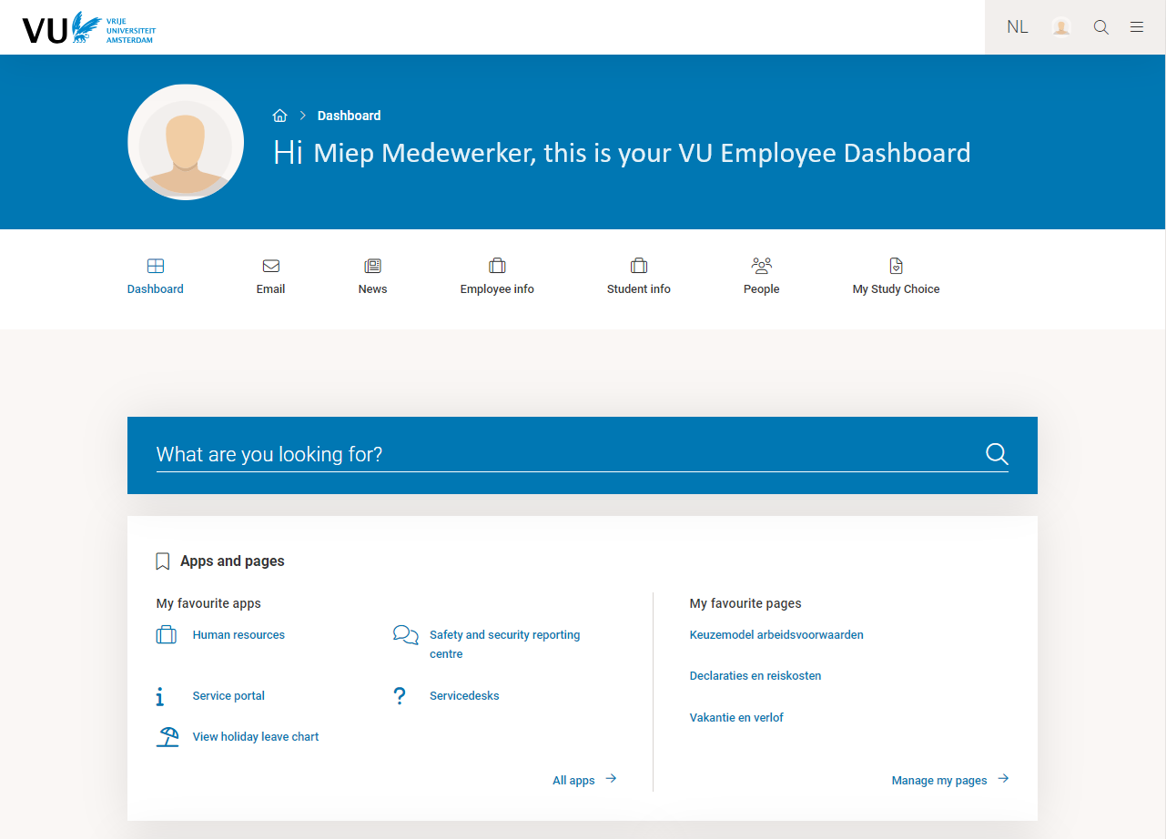
VU.NL/DASHBOARD

Slide 4
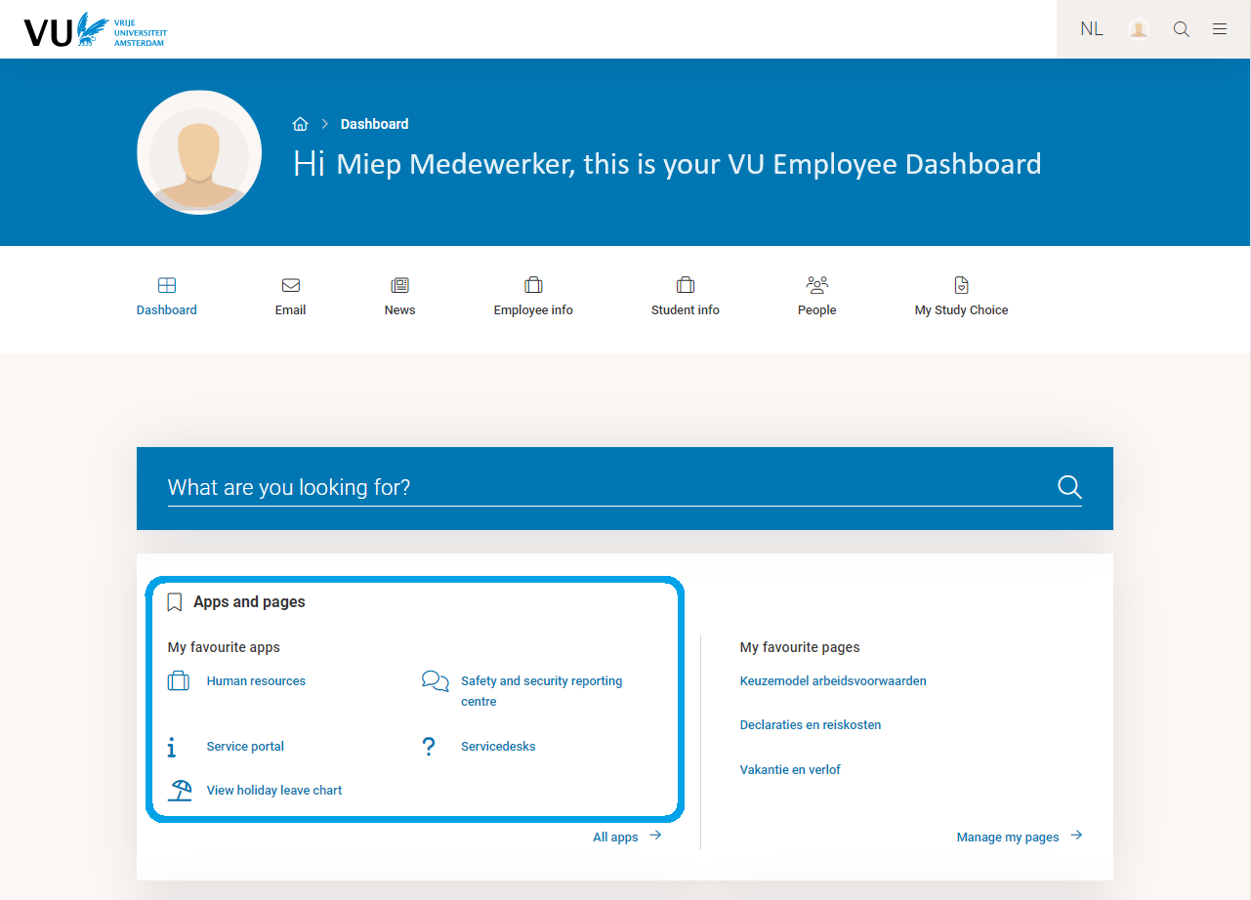
VU.NL/DASHBOARD - APPS

Slide 5
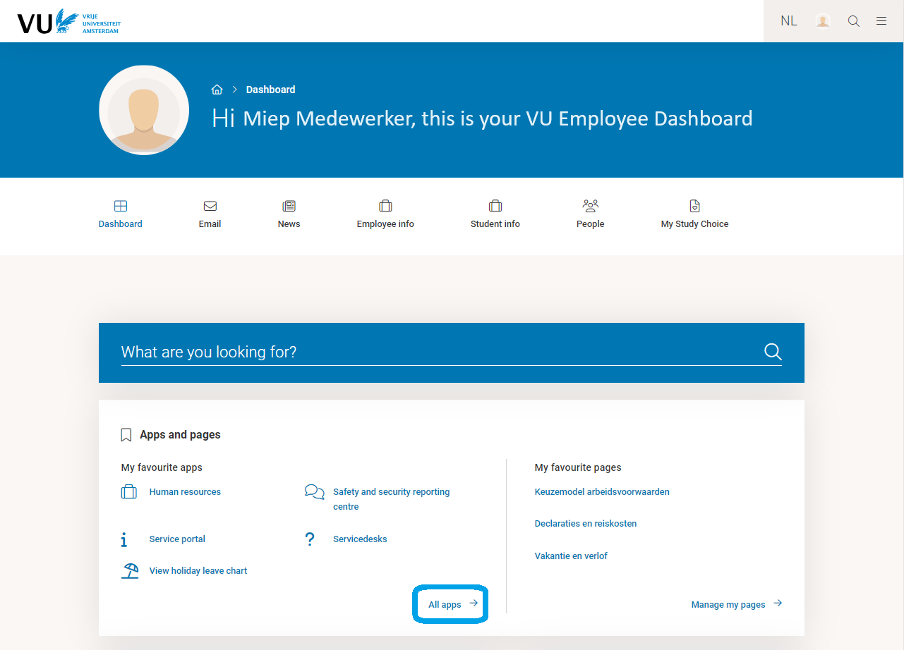
VU.NL/DASHBOARD - APPS

Slide 6
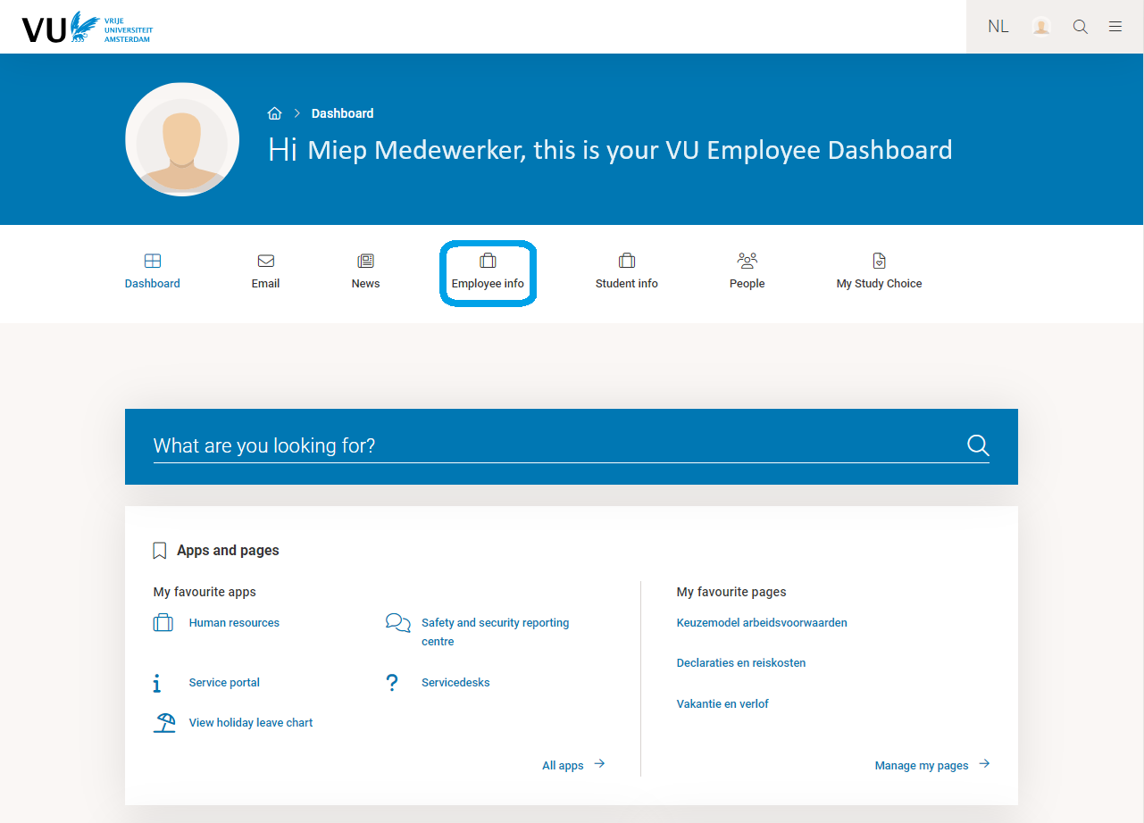
VU.NL/DASHBOARD - EMPLOYEE INFORMATION

Slide 7
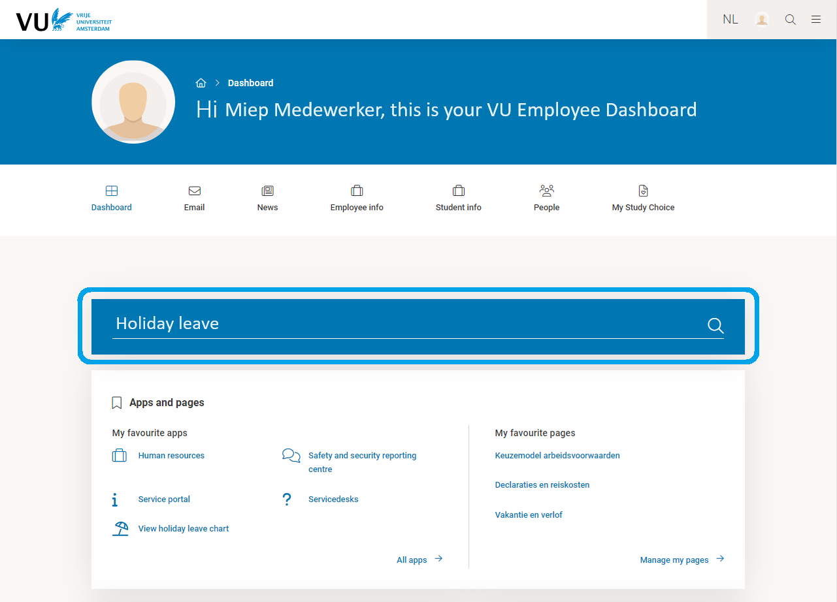
VU.NL/DASHBOARD - SEARCH BAR

Slide 8
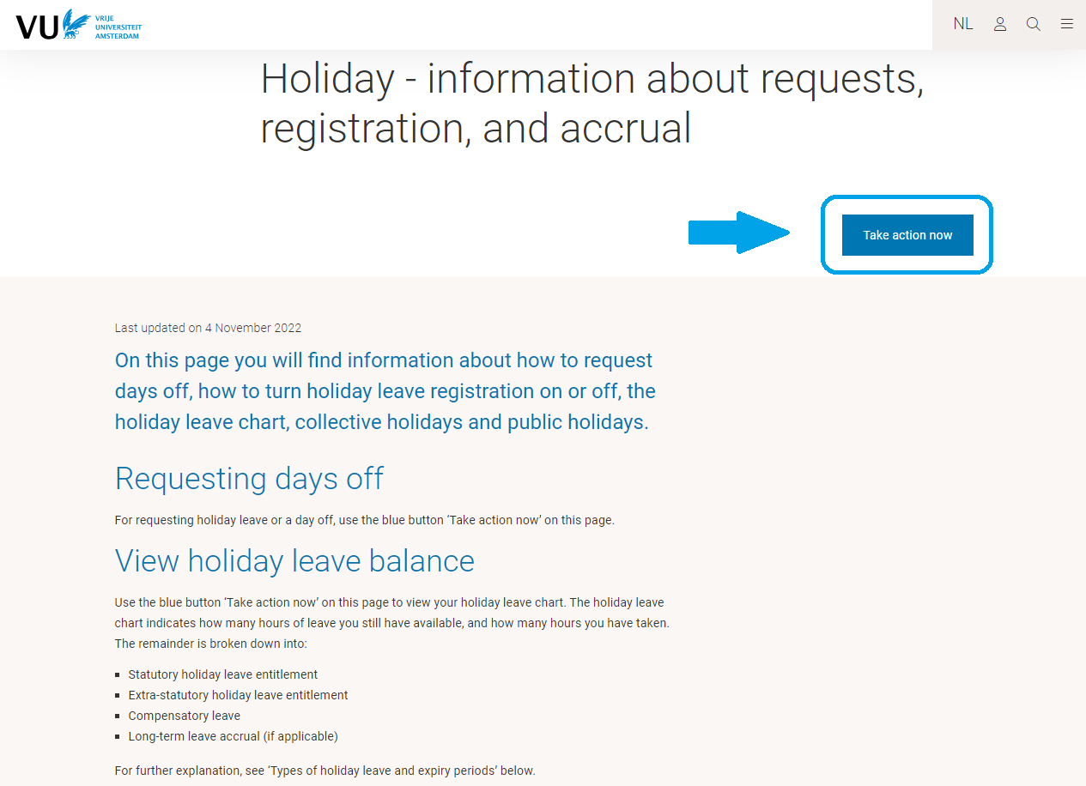
Vu.nl: information page and take action now

Slide 9
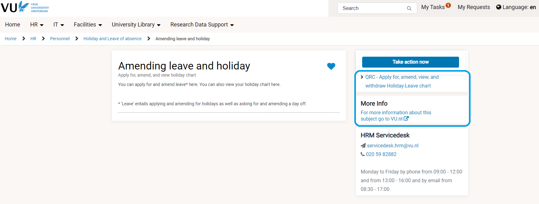
Vu.nl: information page and take action now

Slide 10
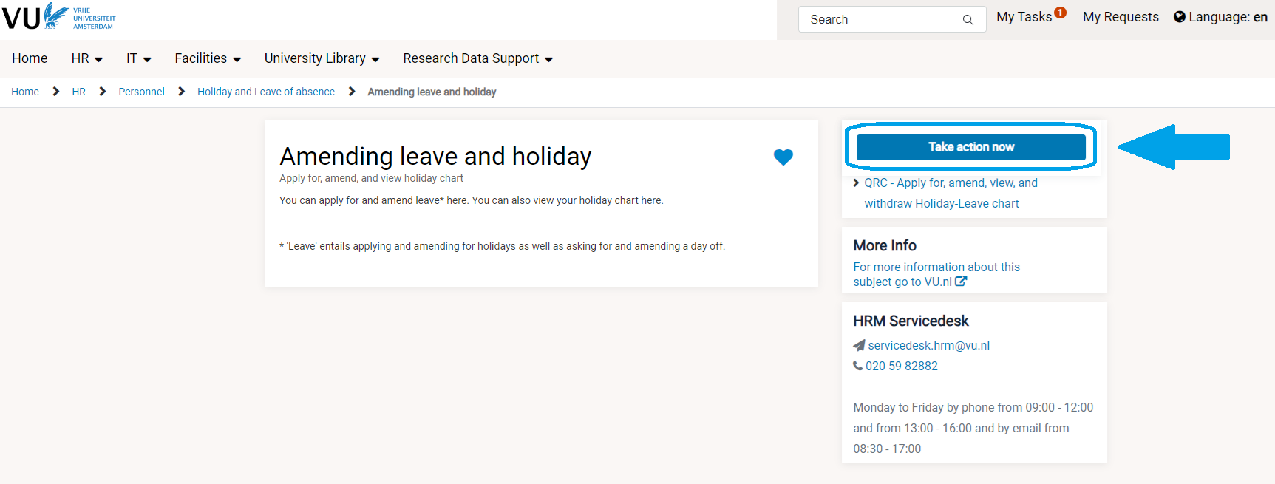
Vu.nl: information page and take action now

Slide 11
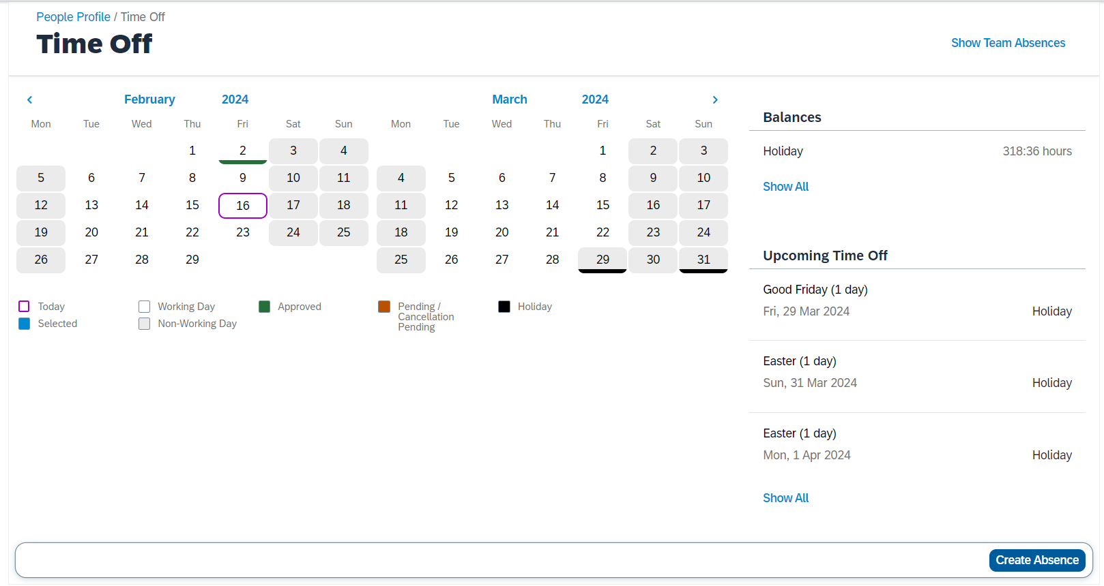
Vu.nl: holiday leave

Slide 12
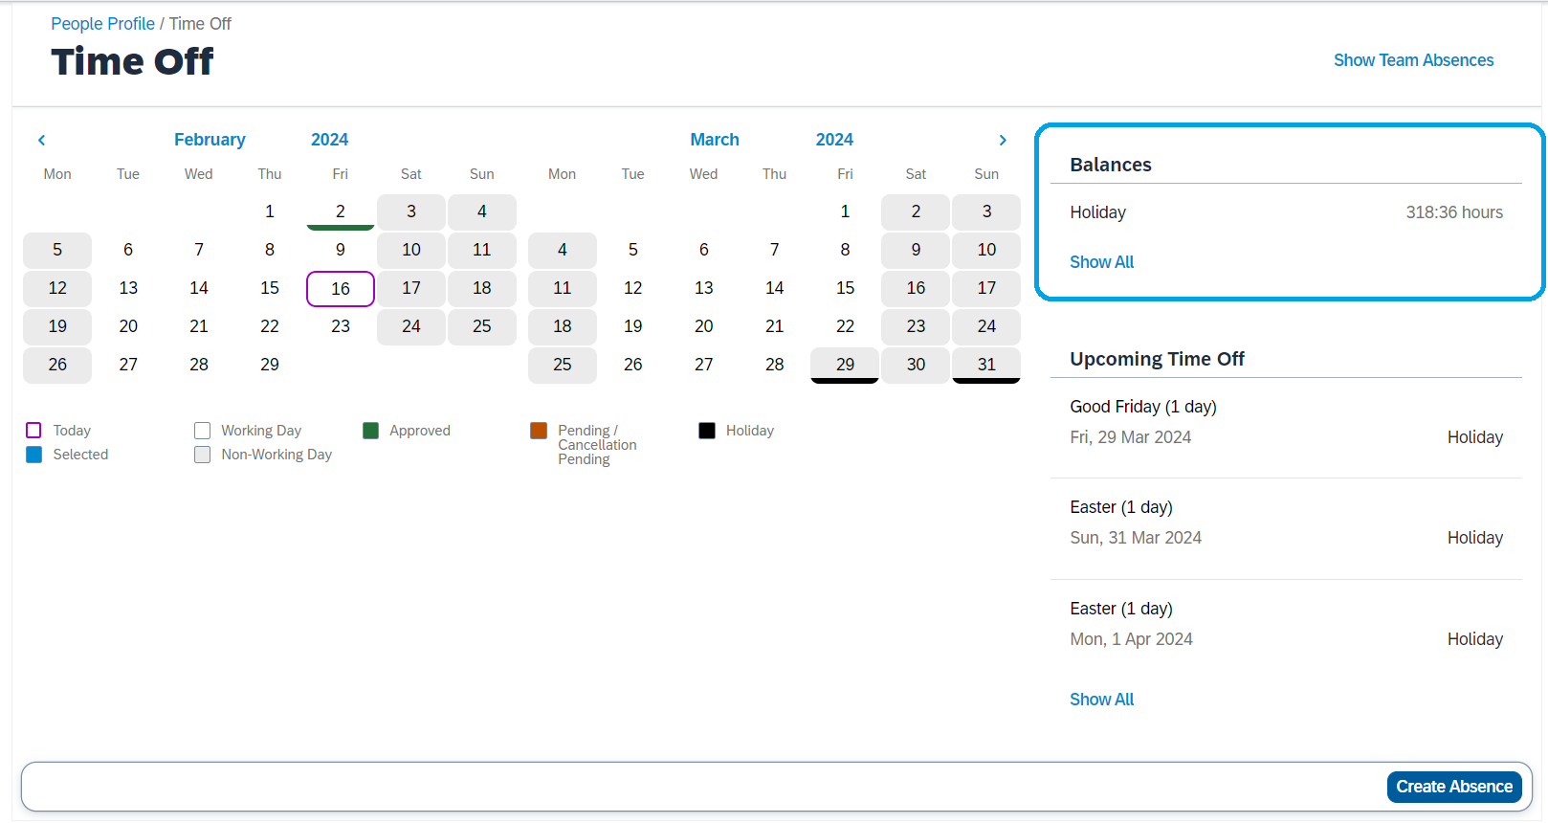
Vu.nl: holiday leave

Slide 13
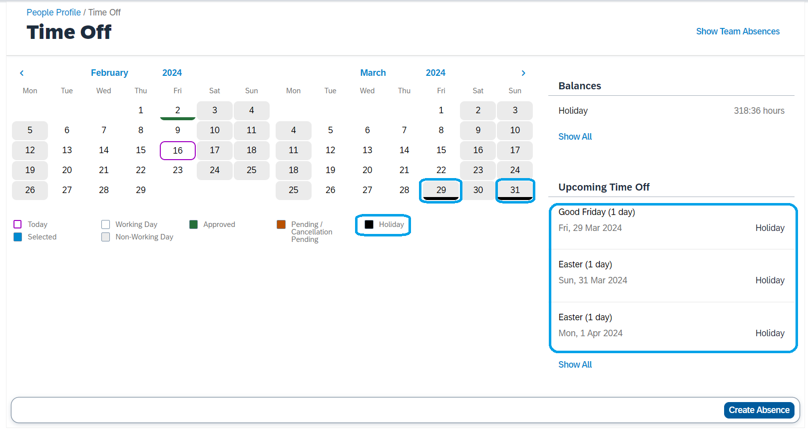
Vu.nl: holiday leave

Slide 14
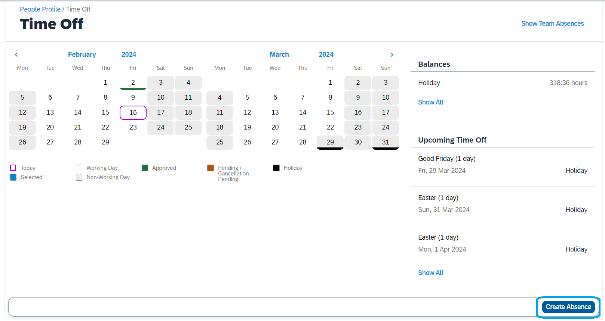
Vu.nl: holiday leave

Slide 15
2. Important Topics HR services
Commuting Statement
Insurances
Health
Disability
Other
Individual Choices Model (Keuzemodel)
Business Travel
Health, Safety and Wellbeing

Slide 16
travel statement – commuting allowance
No statement = No allowances
Fill in the commuting travel statement to receive the commuting and work-from-home allowances.
VU.nl/dashboard > Search for: Commuting allowance (Reiskosten)

Slide 17
Health Insurance
Basic health insurance is mandatory when working in the Netherlands
Basic insurance is mandatory
Supplementary packages are optional
Three companies have a collaborative agreement with VU
Discount on supplementary insurance packages
Zilveren Kruis
OHRA
Nationale Nederlanden
VU.nl/dashboard > Search for: Health Insurance (Zorgverzekering)

Slide 18
Disability Insurance
Disability insurance gives you the opportunity to protect your income level, in case of disability
Three types of coverage:
Partial disability
Complete disability
Partial and complete disability
No health questionnaire required within 6 months after starting employment.
VU.nl/dashboard > Search for: Disability Insurance (Arbeidsongeschiktheidsverzekering)
Loyalis.nl

Slide 19
Other group insurances
VU Amsterdam offers various group insurance policies through Aon Insurance:
Car insurance
Travel insurance
Liability insurance
Home contents insurance
Legal assistance insurance
More information: aonverzekeringen.nl/vua

Slide 20
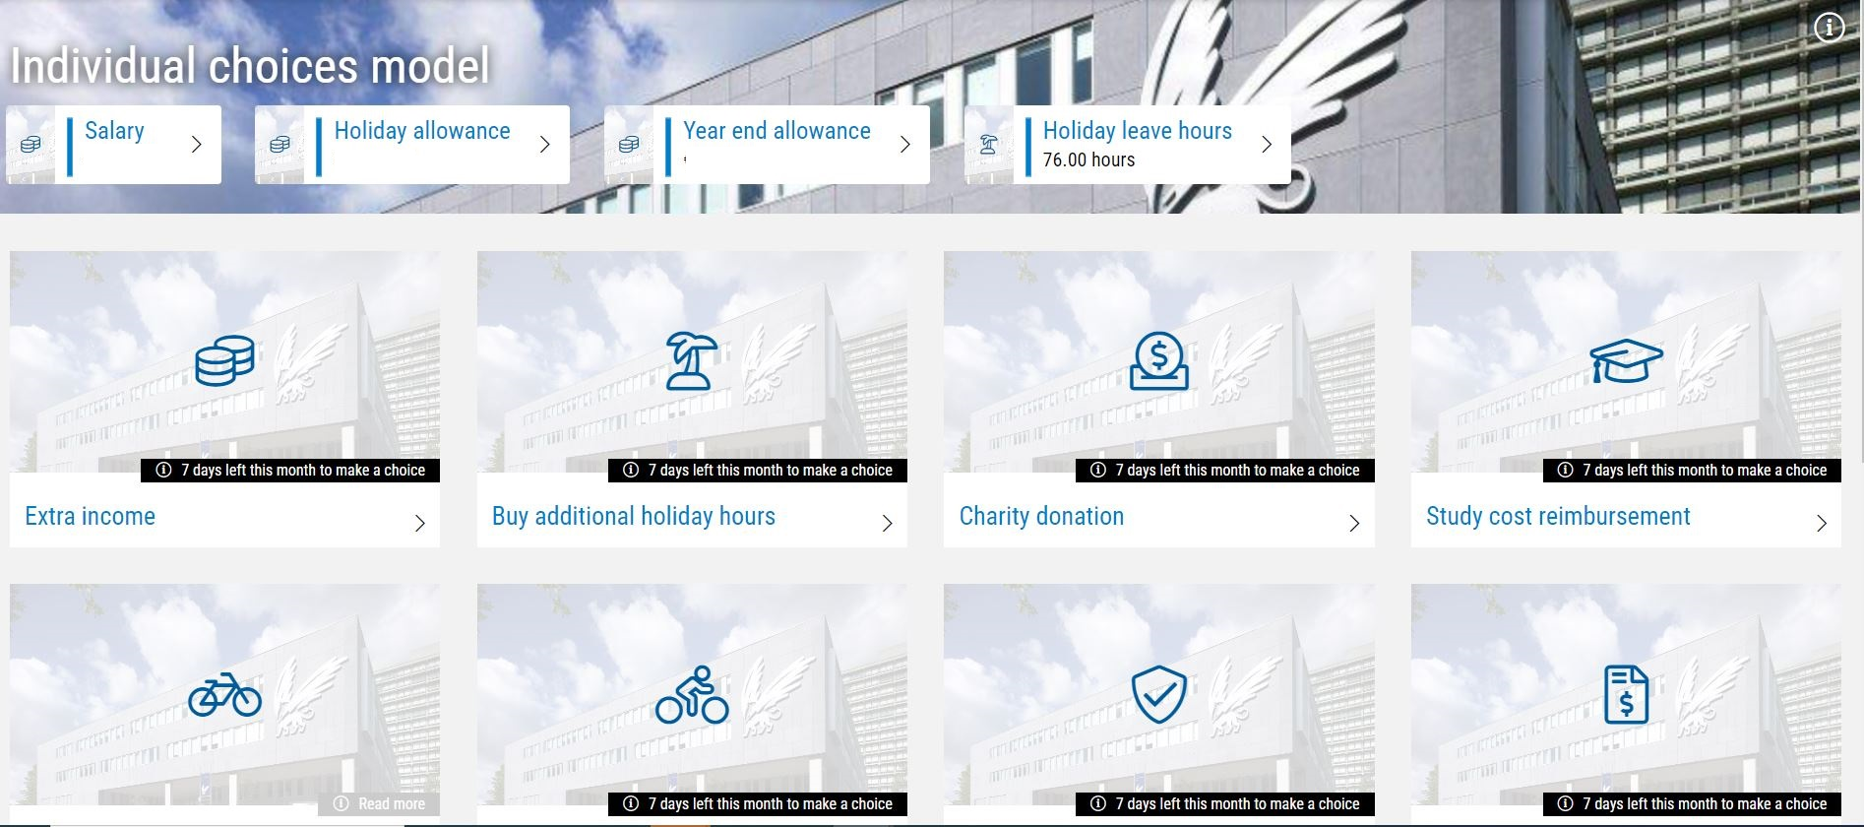
Individual choices model
This scheme allows you to exchange certain portions of your existing employment benefits in favour of another benefit, however you see fit.
Your benefits will keep their original form and worth if you don’t want to apply the Keuzemodel.
Before applying the Keuzemodel, make sure you have accrued sufficient funds.
VU.nl/dashboard > Search for: Individual choices model (Keuzemodel)

Slide 21
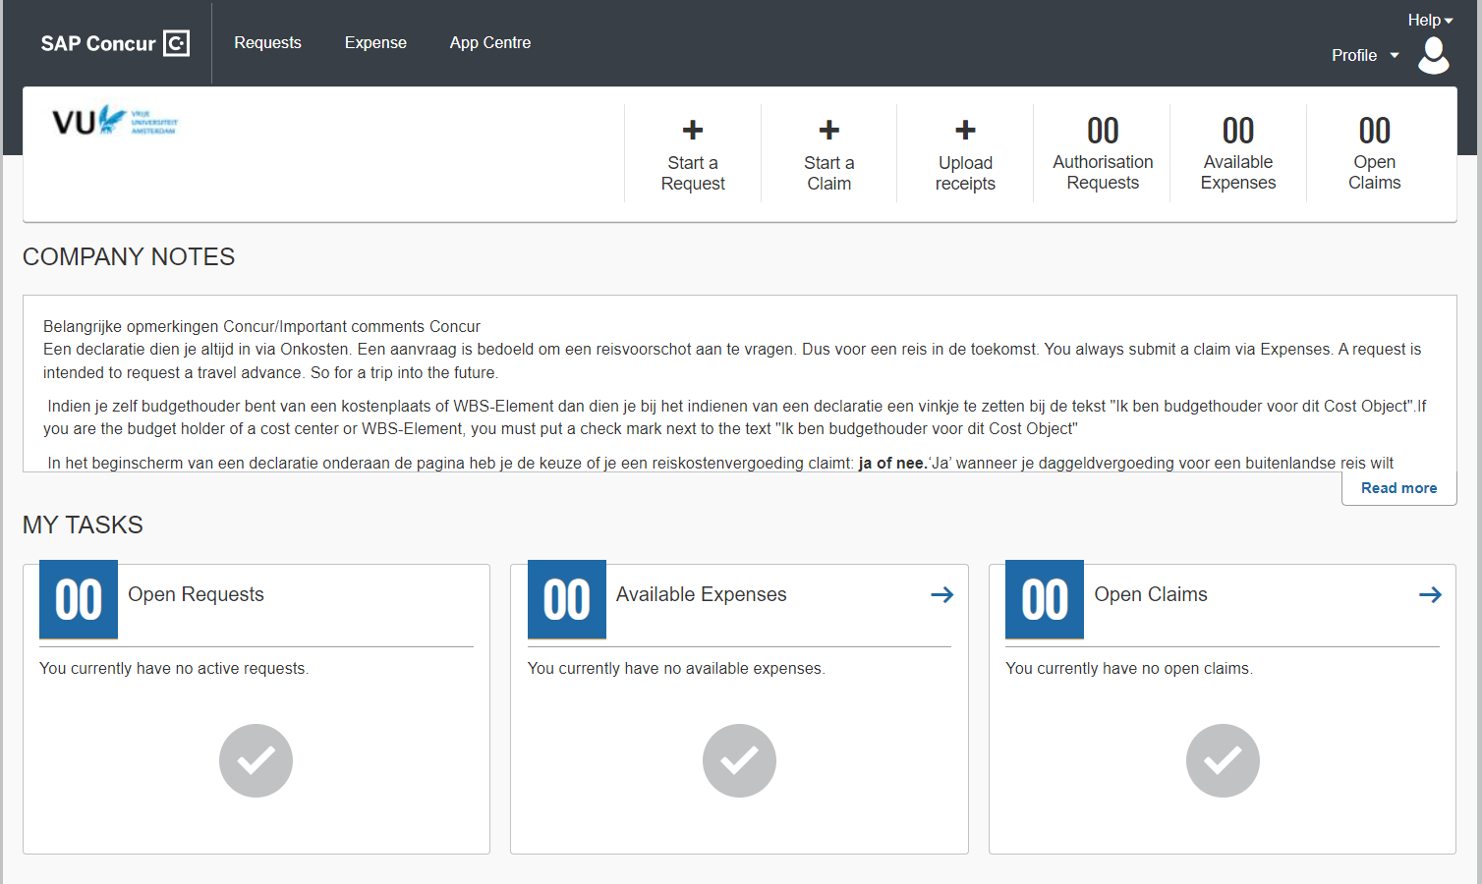
International Business Travel
International travel and accommodation expenses will only be reimbursed if a budget has been pre-approved by the manager
The request needs to be approved in advance (Concur)
VU.nl/dashboard > Search for: Business Travel

Slide 22
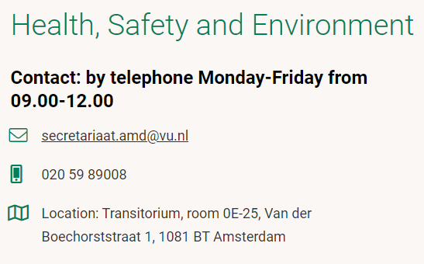
Occupational Health, Safety and environment (HSE)
The aim of Health, Safety and the Environment (HSE) is to enhance and safeguard working conditions, health, and welfare of VU employees
For example: workplace examination & eye test for computer glasses
VU.nl/dashboard > Search for: Health, Safety and Environment

Slide 23
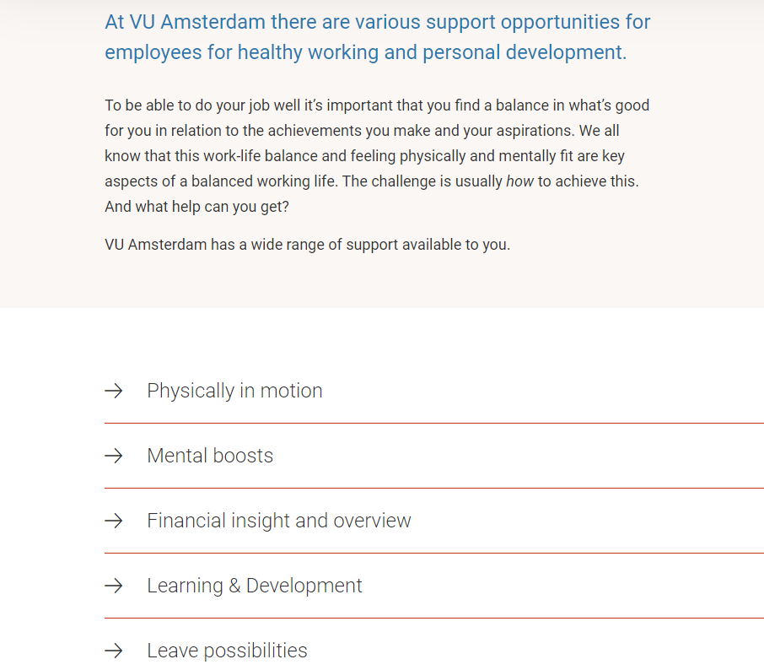
Sustainable employability – Work on yourself

Slide 24
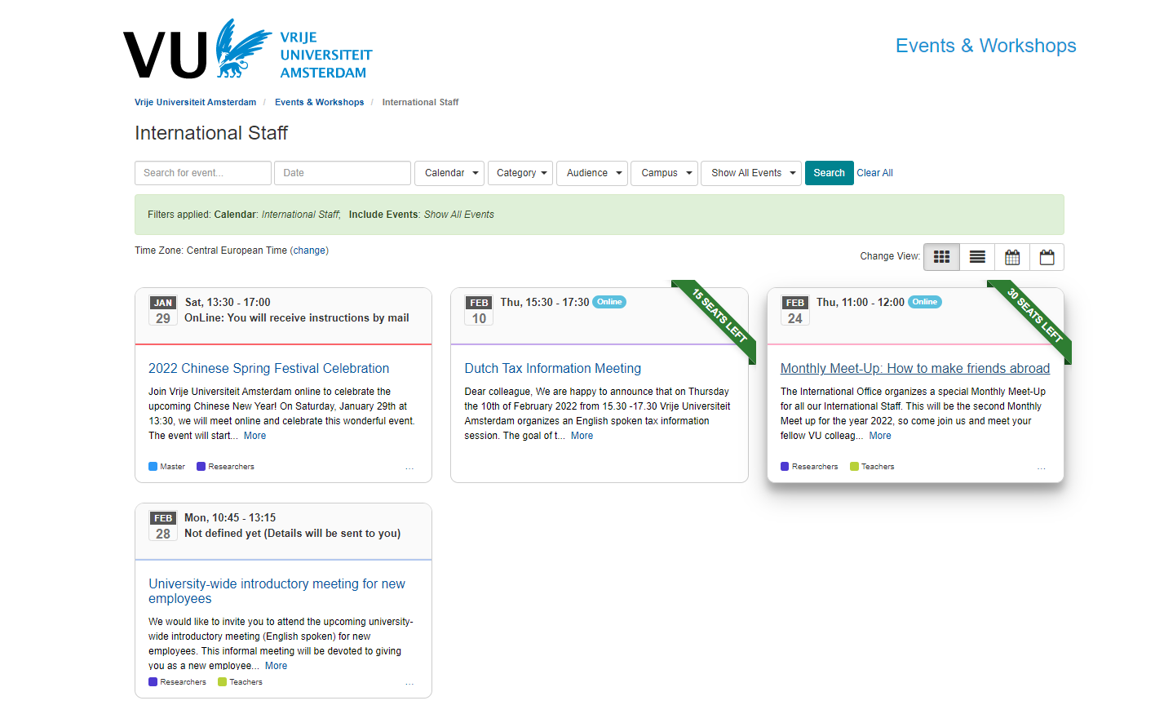
International STAFF
Giving support for non-Dutch employees
VU.nl/dashboard > Search for: New employees
Partner/Spouse Career Workshops
Network events
Information about Dutch childcare
Information about schools
Dutch language courses
International lunches
Tax workshops
Housing
Visa
Check events calendar for international staff
internationalstaffsupport@vu.nl

Slide 25
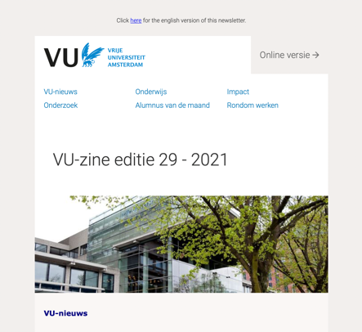
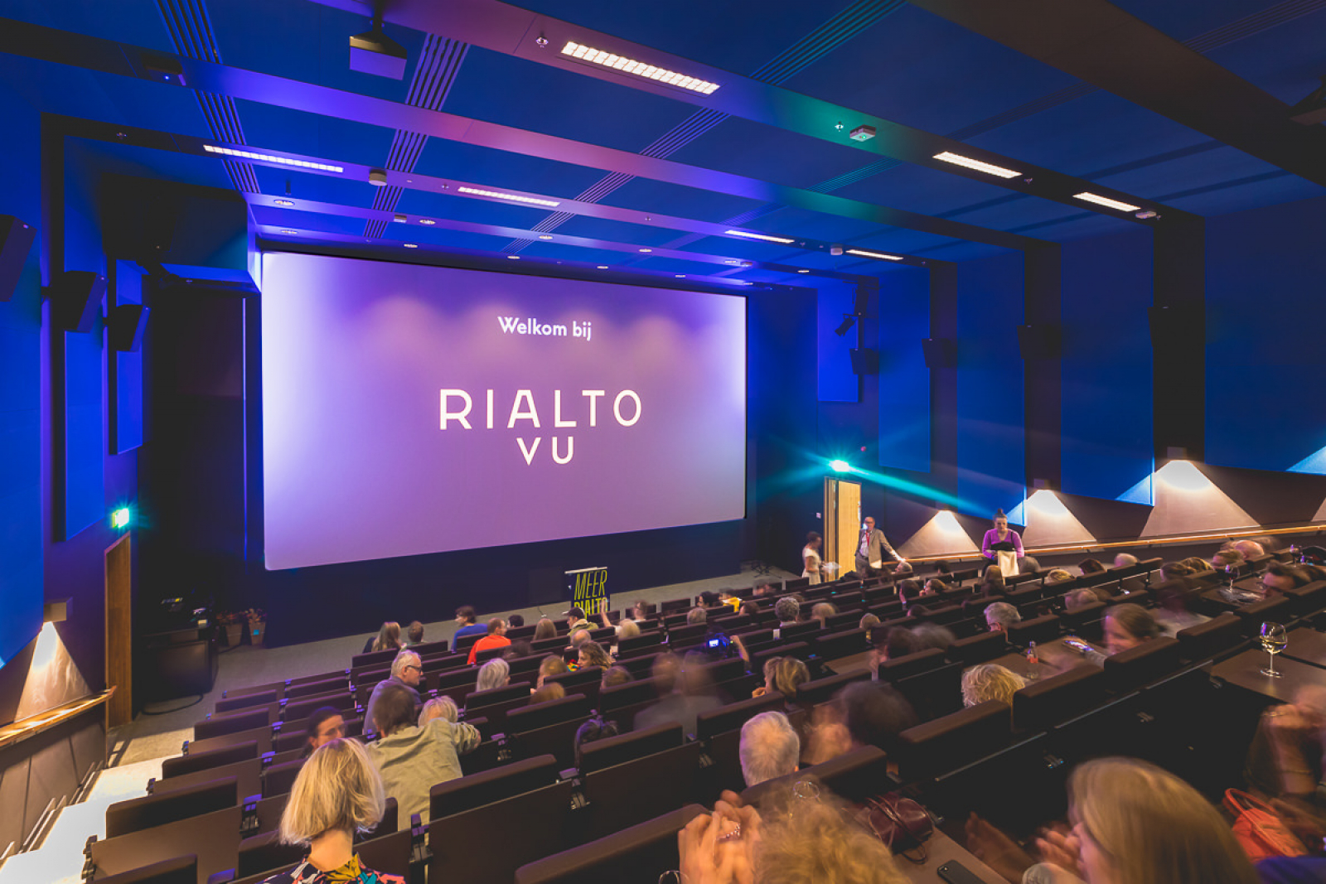
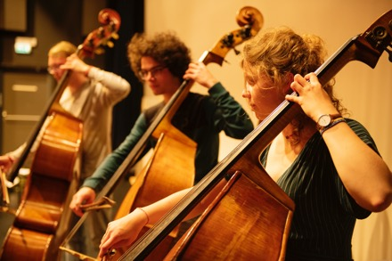
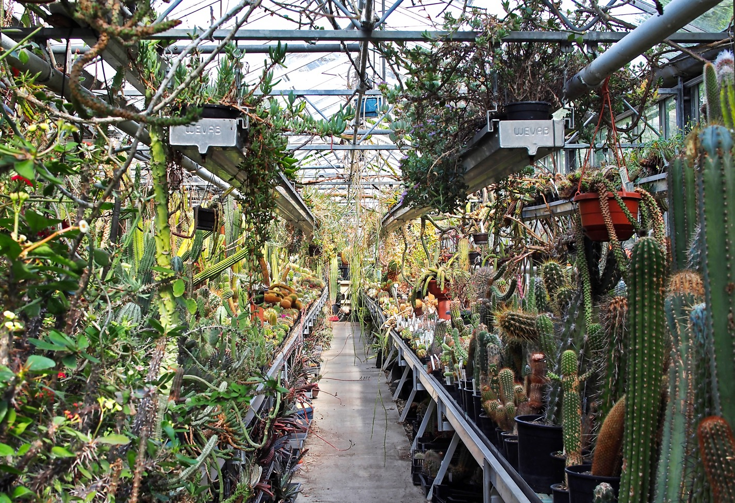
Alongside your work
VU-zine keep up to date
Free e-courses to develop yourself
Learning & Development - LMS
Network opportunities
VU in Motion free for employees
Rialto movie theatre
Griffioen for culture and more
Botanic garden Zuidas

Slide 26
Contact information – HR Advisors
All departments have their own dedicated HR Advisor
VU.nl/dashboard > Search for: HR Advisors

Slide 27
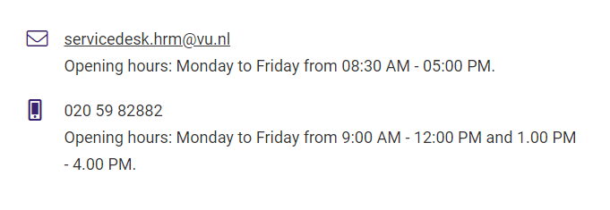
Contact Information – HR Service desk

Slide 28
Social safety
Social Safety Counsellor: The Social Safety Coordinators investigate and give advice regarding situations that involve (social)safety. The Social Safety Coordinators can also take action to tackle unsafe situations.
Mail for an appointment to: sociale-veiligheid@vu.nl.
Confidential counsellor: For support, advise and somebody to talk to. The confidential counsellor will take you through the options, such as initiating a complaints procedure, and can support you in this process.
Ombudsman: The ombudsman can give you information about relevant aspects of the law and procedures, and explain your rights, responsibilities and options with a view to resolving the issue that you are facing.
Are you in immediate danger? Call the university's emergency number:
020-5982222
VU.nl > Search for: Social Safety

Slide 29
Theatre and courses

Slide 30
VU Griffioen Theatre
130 shows a year, 2 auditoriums
comedy, drama, concerts, dance performances, lectures, circus, and more
big names, new talent
special selection for employees €5 + 3 guests
+ free drinks
griffioen.vu.nl

Slide 31
VU Griffioen Courses
70 types of courses
different levels
dance & movement, body & mind, image & visual, music & singing, theatre & writing
special selection €25
griffioen.vu.nl

Slide 32
Bar Boele
open daily from 14:00 - 00:00 (hours may vary)
drinks and snacks
vrijmibo
barboele.nl

Slide 33
Rialto VU Cinema
quality films and documentaries from all over the world
specials (fiction & science, pride cinema, expat, cinema)
festivals (cinemasia, IDFA)
4 screening rooms @ NU
open daily from 12 PM
Special rate €5 incl. A free drink at Bar Boele
(valid from Thurday 5pm until Sunday)
rialtofilm.nl

Slide 34
VU ART SCIENCE gallery
3 exhibitions every year
tue - sat from 12 - 6 PM
free admission
art science dialogues
artsciencegallery.nl

Slide 35
Thank you very much
and see you soon at

