Slide 1
Welcome to Vrije Universiteit Amsterdam

Slide 2
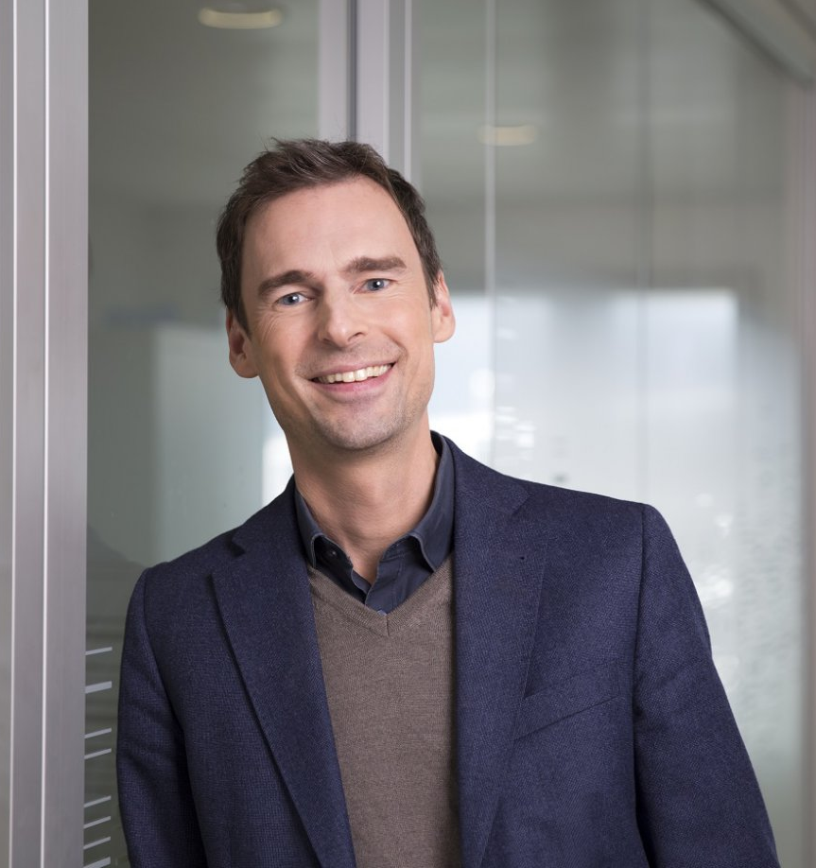
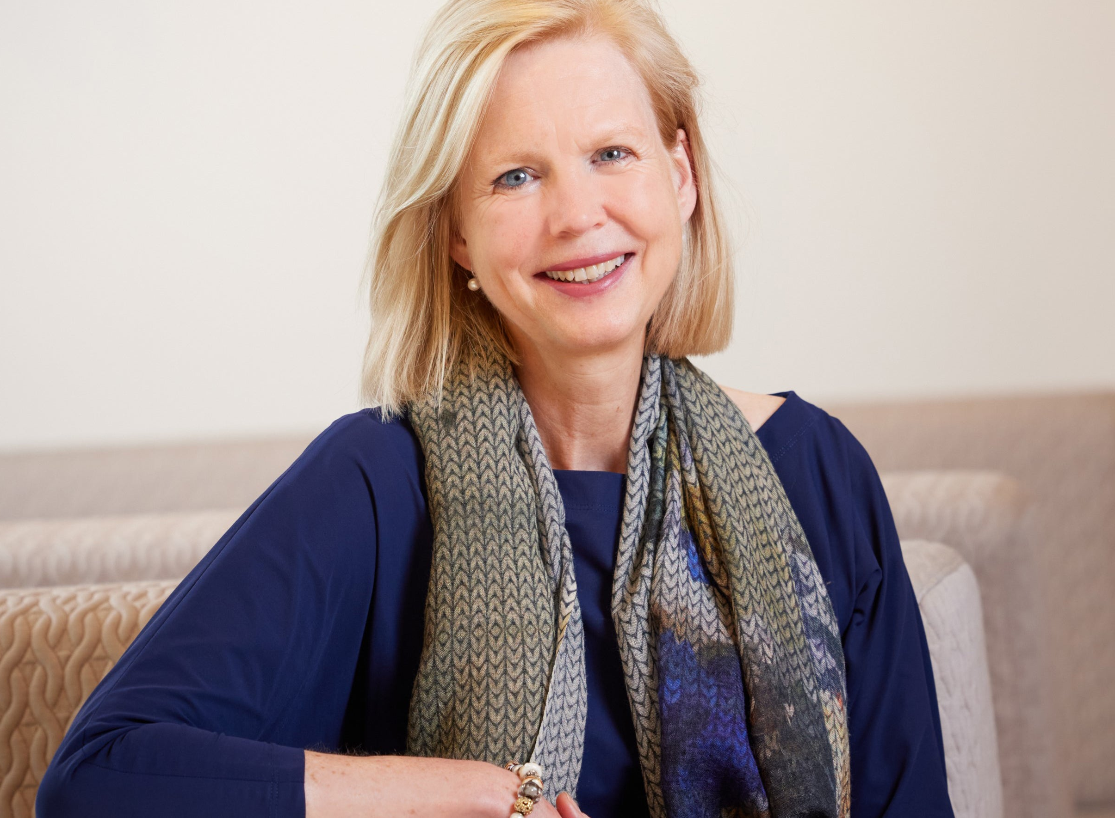
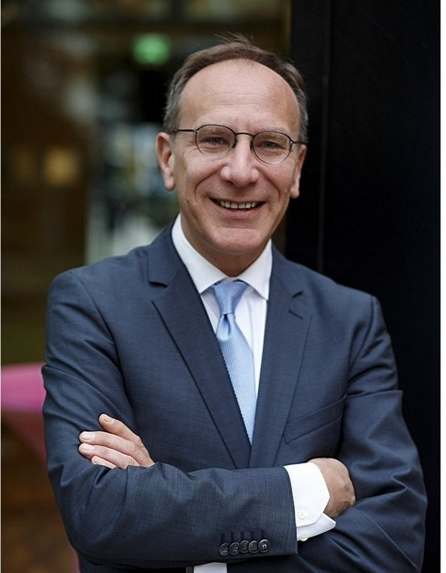
Executive Board
Margrethe Jonkman Chair
Jeroen Geurts Rector Magnificus
Marcel Nollen Member

Slide 3
Organisation
Supervisory board
Executive board
Participatory
bodies
Services
Faculties
IDR Institutes
9
9 16
Faculties
Services
Interdisciplinary research institutes (e.g. APH, Amsterdam Public Health)

Slide 4
History
Vrije Universiteit Amsterdam
Established by Abraham Kuyper in 1880
1st location main building: Keizersgracht
1973 official opening main building De Boelelaan
Vrije Universiteit stands for: freedom from church, state, and commercial interests.
The motives of the time are still leading today.
Freedom and responsibility
Pluralism
Room for diversity of beliefs
Intellectual education and citizenship
www.geheugenvandevu.nl

Slide 5
Official name: Vrije Universiteit Amsterdam
We have used one name nationally and internationally since 2015:
Vrije Universiteit Amsterdam
As an abbreviation of the name, 'VU Amsterdam' or 'VU' can be used.

Slide 6
Core values of VU Amsterdam
VU Amsterdam's basic philosophy guides the work and actions of staff and students.
Responsible We are committed to being of service to people and society.
Open We are accessible and receptive to diversity in disciplines, cultures, ideas, nationalities and beliefs.
Personal We pay attention to and respect each individual.

Slide 7
Art of Engagement
Working together for a better world is easier in a work environment that inspires, develops and engages.
To achieve this, we formulated 4 principles:
Contribute to the greater good;
Be brave and decisive;
Be transparent and clear;
Listen and give room for growth.

Slide 8
VU Strategy 2020-2025
Our strategy focuses on three VU-wide priorities:
Diverse
Sustainable
Enterprising
These priorities govern the essence of our actions.
vu.nl/strategy

Slide 9
Diverse
VU Amsterdam aims to provide an environment that promotes diversity and inclusion, where people feel comfortable and encouraged to share their unique perspectives.
Diversity Office
Networks
VU Pride
Wo/men Network @VU
Young.VU
International Academic staff network
vu.nl/diversity

Slide 10
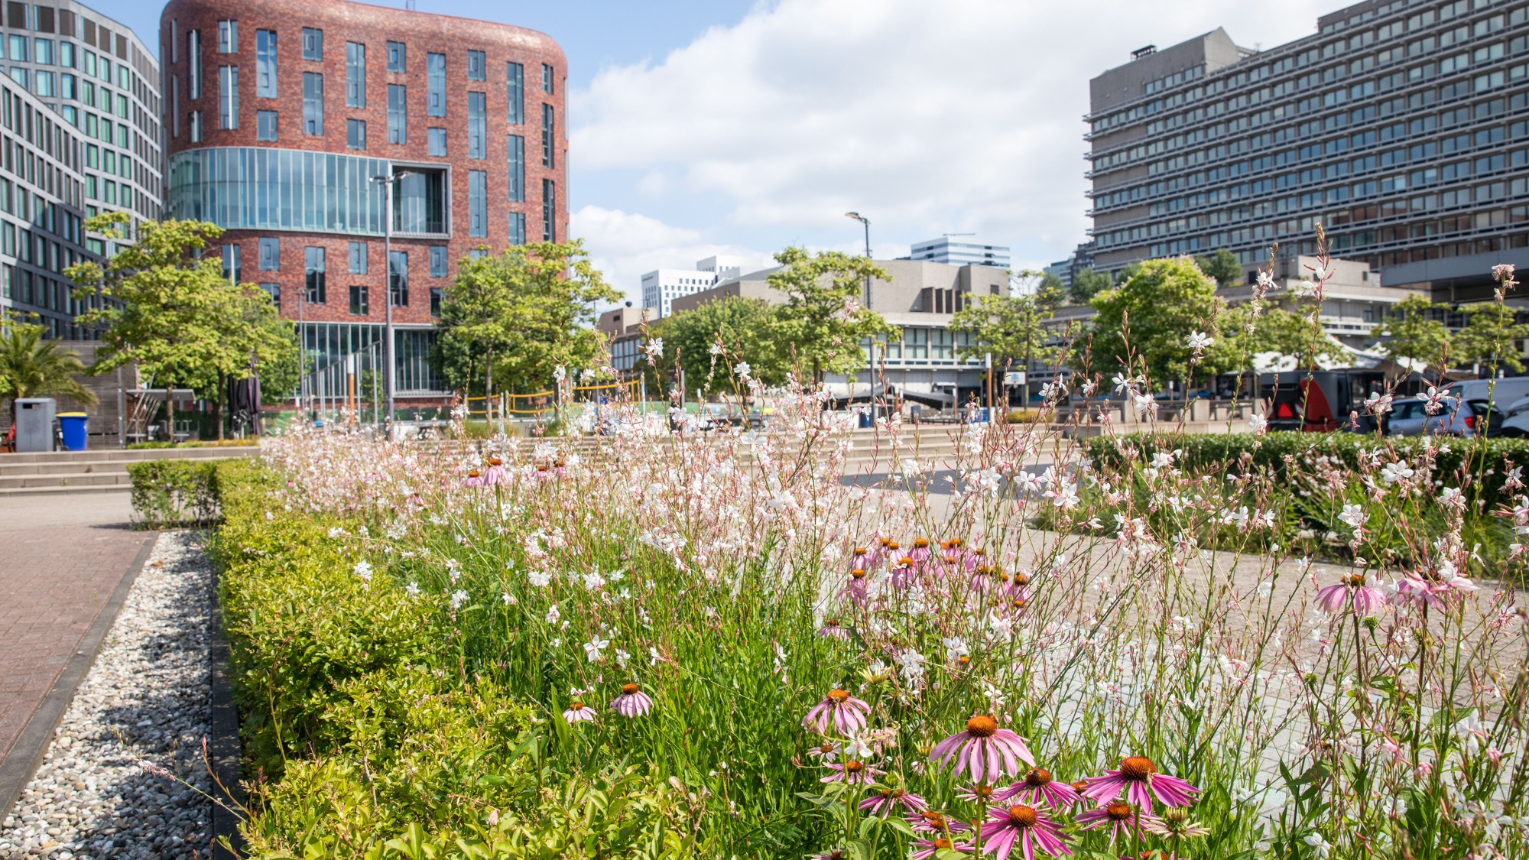
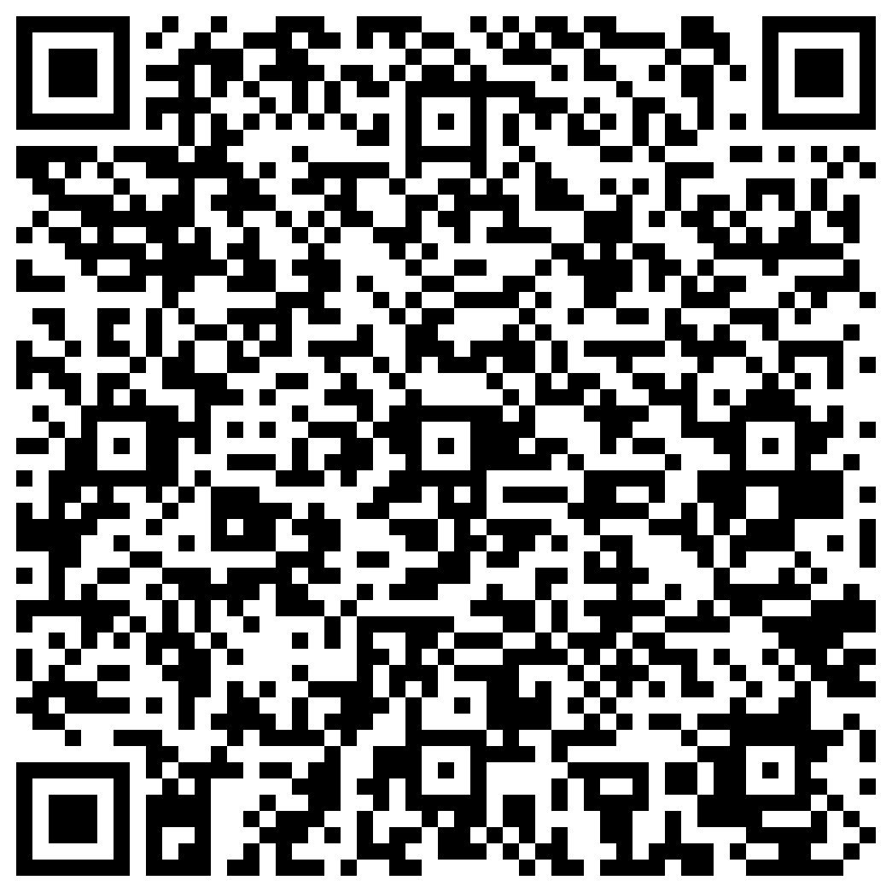
Sustainable
As the VU community, we contribute to the transition towards a sustainable campus, university, and society – every day.
We do this by implementing our sustainability ambition in operations, education, research, and valorization.
Questions? Ideas? Get in touch with Sustainability Office VU! sustainability@vu.nl
vu.nl/sustainable

Slide 11
Entrepreneurial
Collaborate, Innovate & Accelerate
VU Amsterdam encourages and facilitates an enterprising attitude among our students and staff to create added value for our society.
VU Starthub Community
Demonstrator Lab
Startup ACE Incubator
Innovation Exchange Amsterdam (IXA-GO)
vu.nl/enterprising

Slide 12
VU Amsterdam Campus
The VU Amsterdam campus now consists of 14 buildings. Our campus is a close-knit community.
We think it’s important that you feel at home!
vu.nl/campus (+ virtual tour)

Slide 13
VUture
Improvement program launched in September 2022 to create a future-proof VU Amsterdam.

