Slide 1

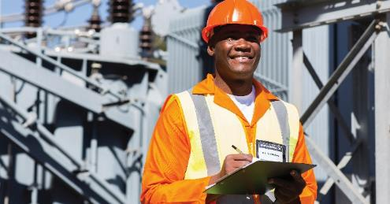
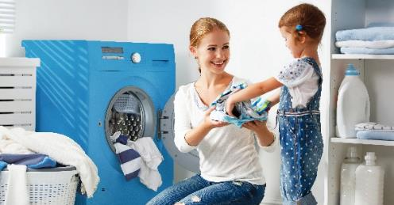

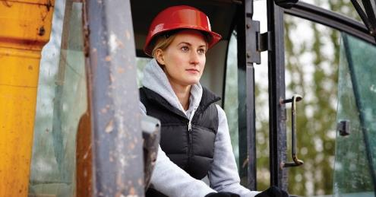


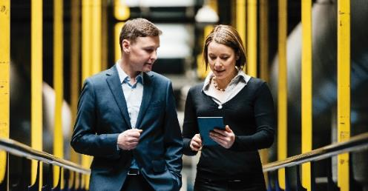
Industrial Coatings from PPG
October 2023

Slide 2
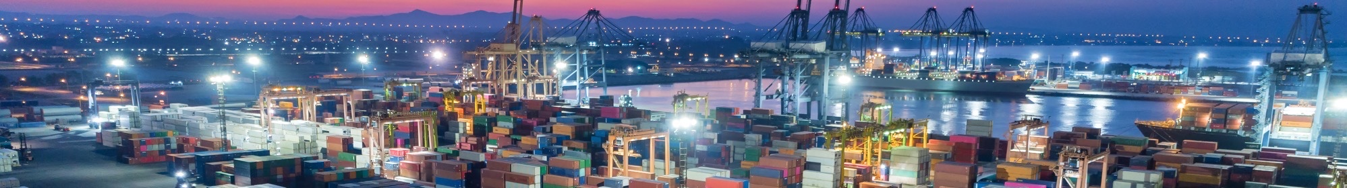
Industrial Coatings from PPG
Presenter Name or Date

Slide 3

PPG is a global maker of paints, coatings and specialty materials
Founded in 1883
Headquartered in Pittsburgh, PA
52,000+ Employees
Facilities in 70+ countries

Slide 4

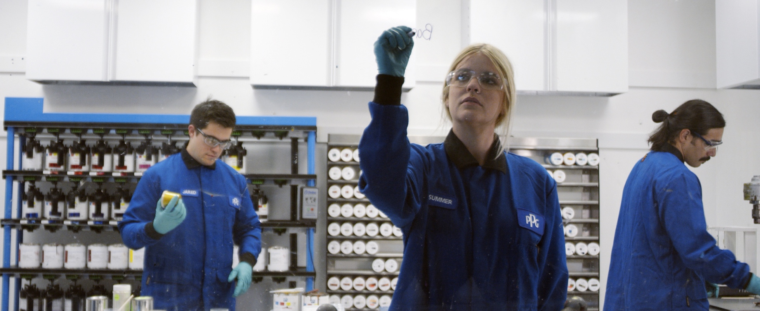


We are a recognized leader in…
Sustainability
Innovation
Color

Slide 5
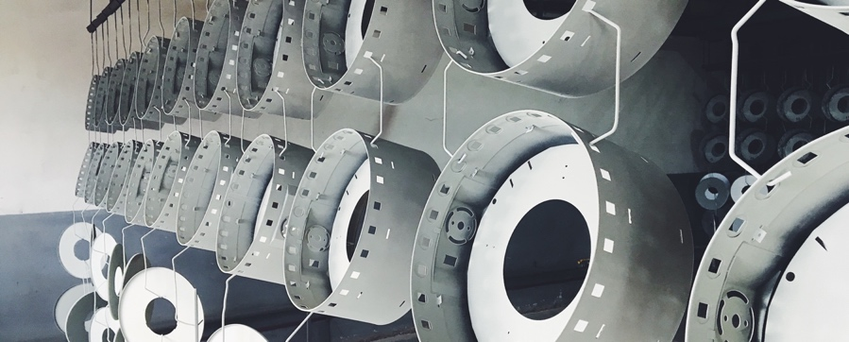
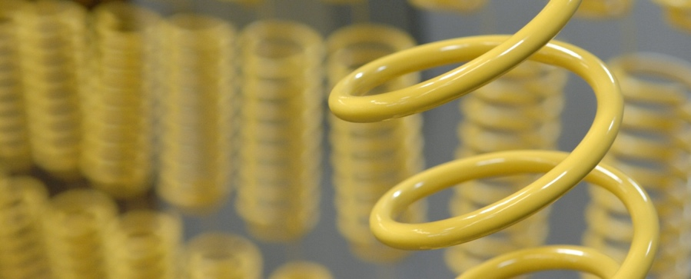
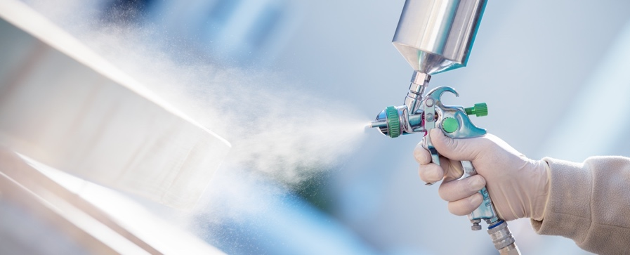
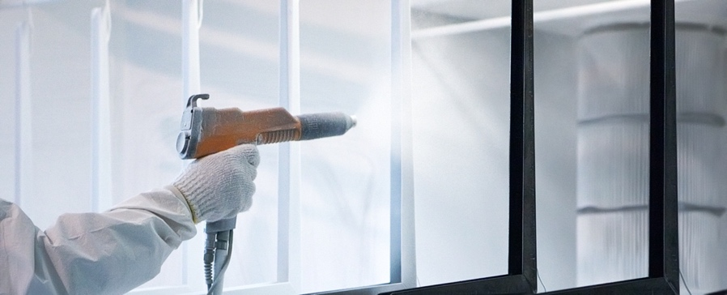
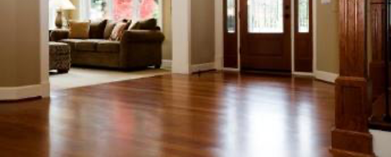
We are one of the few suppliers offering products and capabilities in every major coatings technology
Pretreatment
Electrocoat
Liquid Coatings
Powder Coatings
Ultraviolet & Electrobeam Coatings

Slide 6

Global Reach
Knowledge and expertise pooled from around the globe
Consistent formulation, delivered anywhere
Global sourcing that ensures a steady raw materials supply and competitive pricing
Economy of scale

Slide 7

Global powder manufacturing footprint
Renningen, Germany
Grand Haven, USA
Zuffenhausen, Germany
Strongsville, USA
Cieszyn, Poland
Nansha, China
Allison Park, USA
Chicago, USA
Jiading, China
Gainesville, USA
Greensboro, USA
Brazil, USA
San Juan del Rio, Mexico
Petaling Jaya, Malaysia
Sumaré, Brazil
14 Powder Plants
1 Powder Resin Plant
1 Global R&D Center
1 Global Center of Excellence
Auckland, New Zealand
5

Slide 8








EMEA Facilities
Location | Capabilities
Poland | Mfg + Lab + Resin + Warehouse
Germany | Mfg + Lab + Warehouse (ex Woerwag) Including Acrylics
Italy | Central Lab, Warehouse
France | Warehousing
UK | Warehousing
Spain | Warehousing
6

Slide 9
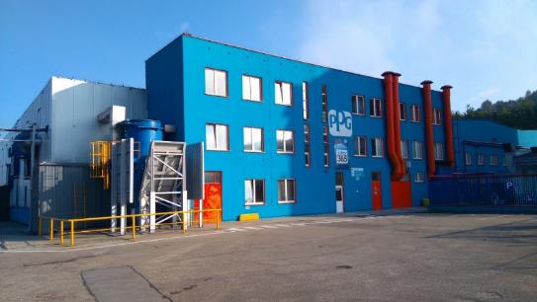
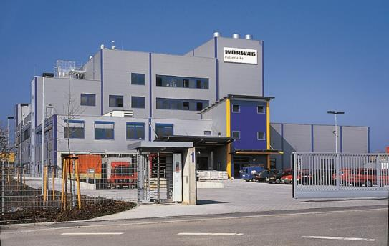
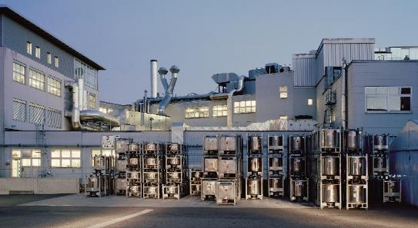

EMEA Powder Production Footprint
Cieszyn, Poland
Renningen, Germany
Zuffenhausen, Germany
  Capacity 10,000 tons/year
  Product range
    Epoxy
    Epoxy-Polyester
    Polyester
    Polyurethane
    Hybrid Acrylic
  Qualicoat / GSB Standards
  Capacity 8,000 tons/year
    Product range
      Epoxy
      Epoxy-Polyester
      Polyester
      Polyurethane
  Capacity 500 tons/year
    Product range
      GMA Acrylic
      Polyester Acrylic
7

Slide 10
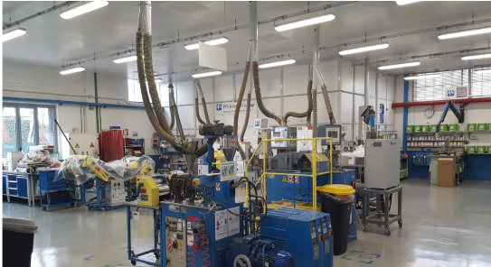

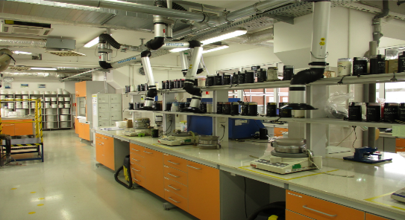
EMEA Powder Lab Footprint
Milan, Italy
Cieszyn, Poland
Zuffenhausen, Germany
  Customer Support & Development
  Specialty Development
      High transfer efficiency, scratch resistance, etc.
  Metallic Color Match
  Performance Testing
  Analytical Defect Analysis
  Color Match Support
  Customer Support
  Production Support
  Customer Support & Development
  New Product and Specialty Development
  Color & Metallic Color Matching
  Performance Testing
  Analytical Defect Analysis
  Production Support
Investment in Italy to upgrade lab in 2021
8

Slide 11



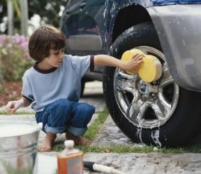
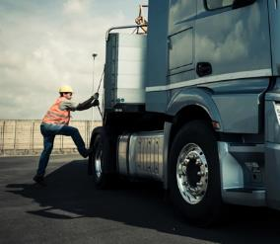





Segment Experience
Appliance
Extrusion Coatings
General Industrial
Automotive Parts and
Accessories (APA)
Transportation
Heavy Duty Equipment
Interior Building
Products
Consumer Electronics
Office Furniture
and Equipment
Market segments
with powder sales
9
Powder Coatings from PPG ©2023 PPG Industries, Inc. All rights reserved

Slide 12
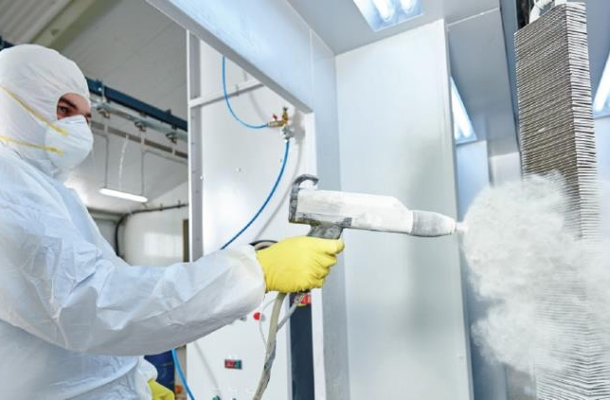
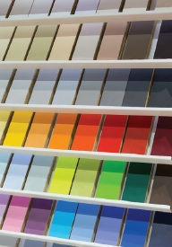
Powder Coatings from PPG
The PPG Benefit:
Global capability
Increased speed and convenience with color matching
Advanced styling and color trend consultation
Available in a wide variety of colors, glosses and finishes
Reduced energy costs, TGIC NIA*, BPA NIA*
Reclaimable
Extreme performance protection against weathering, chip and scratch, and high temperatures
Wide variety of specialty coatings: low-cure, high-transfer efficiency, high-edge, dielectric powder and ultradurable
* Non intentionally added
10
Powder Coatings from PPG ©2023 PPG Industries, Inc. All rights reserved

Slide 13
Product portfolio covering key market requirements
Chemistry
PPG Series
Woerwag Series
Application Areas
Benefits
Special Features
Epoxy
ENVIROCRON®
PCM
P5 Series
Inmotiq / Industriq
W800, W803,
W804
Protection of interior parts
Tanks, pipelines, structural steelwork, trucks, trailers & car parts
Primer usage against corrosion
Chemical resistance
Corrosion resistance
Low bake
ENVIROCRON
PCF
P8 Series
Inmotiq / Industriq
W806-08, W815, W817-18,
W822, W825-28
Domestic & industrial appliances
Indoor application e.g. shelving, office furniture, partitioning, white goods
Protection & decoration of interior parts
Good compromise for decorative parts with optimized price
Anti-Slip
Induction
Curable
Epoxy-Polyester
Low Bake
Thin Film
Anti-Graffiti
Abrasion
Polyester
ENVIROCRON
PCS
P4 & P7 Series
Inmotiq / Industriq
W889, W890,
W892, W895,
W898(H)
Urban furniture, steel or galvanized steel for cladding, Aluminum profiles and sheets
Verandas, doors, window frames, facades
Industrial outdoor application, e.g. HDE
Outdoor use with enhanced UV resistance
Qualicoat and GSB approved (P4 Series)
Fast cure / low bake
High edge
Thin layer
Polyester Superdurable
ENVIROCRON
PCS
P1 & P2 Series
Inmotiq / Industriq
W880, W883,
W885, W888
Tanks, pipelines, structural steelwork, trucks, trailers & car parts
Lighting equipment and construction
Industrial outdoor application e.g. agricultural machinery, garden furniture, fencing, electrical
Outdoor use with excellent ultradurable performance
Fast cure / low bale
High edge
Thin layer
Acrylic
ENVIROCRON
PCA
P0 Series
Inmotiq / Industriq
W841, W845, W847
Car parts
Bicycle frames
Outdoor use with excellent ultradurable performance & outstanding appearance
Low bake
Polyurethane
ENVIROCRON
PCU
P3 Series
Inmotiq / Industriq
W851, W852
Car parts
Machinery
Office furniture, shelving, etc.
Outdoor use with excellent chemical resistance
Anti-graffiti / chemical resistance
11
Powder Coatings from PPG ©2023 PPG Industries, Inc. All rights reserved

Slide 14
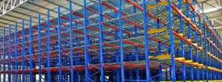

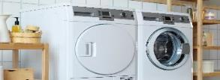
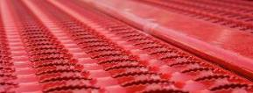

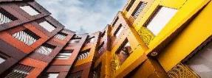
Powder innovative technologies responding to industry challenges
ENVIROCRON® HTE High Transfer Efficiency
Productivity
ENVIROCRON® ENERGXTM ULTRA Ultradurable Low Bake
Sustainable efficiency
ENVIROCRON® XMR Extreme Mar Resistance
Product lifetime
ENVIROCRON® EPE Extreme Protection Edge
Edge protection
ENVIROCRON® EPD Extreme Protection Dielectric
Insulation
CORAFLON® Platinum Hyper Durable
Durability
ENVIROCRON® HeatSense Thermal Sensitive Substrate
Substrate
12
Powder Coatings from PPG ©2023 PPG Industries, Inc. All rights reserved

Slide 15
Powder innovative technologies responding to industry challenges
ENVIROCRON® HTE High Transfer Efficiency
Productivity
ENVIROCRON® ENERGXTM ULTRA Ultradurable Low Bake
Sustainable efficiency
ENVIROCRON® XMR Extreme Mar Resistance
Product lifetime
ENVIROCRON® EPE Extreme Protection Edge
Edge protection
ENVIROCRON® EPD Extreme Protection Dielectric
Insulation
CORAFLON® Platinum Hyper Durable
Durability
ENVIROCRON® HeatSense Thermal Sensitive Substrate
Substrate
13
Powder Coatings from PPG ©2023 PPG Industries, Inc. All rights reserved

Slide 16

ENVIROCRON ENERGXTM ULTRA
Ultradurable low bake powder topcoat - efficient and sustainable
Ultradurable polyester with very good weathering and chemical resistance
Low bake system with reduced energy consumption and carbon footprint
Speedcure option for line speed and manufacturing capacity increase
Wide processing window with high process stability for thin- and thick-walled components
Good storage stability
Blooming-resistant
Specifically formulated without CMR NIA*
*CMR: Cancerogenic, Mutagenic and Reprotoxic
NIA: Not Intentionally Added
14
Powder Coatings from PPG ©2023 PPG Industries, Inc. All rights reserved

Slide 17


How EnergX ULTRA can help you?
Become safer!
Become stronger!
Become more efficient!
Become more sustainable!
You are currently using accelerated PT910 systems?
You are currently using standard durable systems?
You are using already ultradurable polyester systems, but have issues in terms of capacity
Today you are using ultradurable standard polyester systems?
Replace them by EnergX ULTRA and use a product formulated without CMR. Safe for health and applicator.
Grade your performance up to EnergX ULTRA, an ultradurable polyester system.
Get rid of your bottleneck and increase your capacity by using the speedcure option of EnergX ULTRA.
Switch to EnergX ULTRA
and take advantage of the low bake property to save energy and to reduce your
CO₂ footprint.
14
Powder Coatings from PPG ©2023 PPG Industries, Inc. All rights reserved

Slide 18
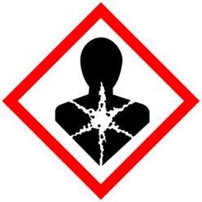

Become safer!
Protect your people and your products.
The issues of existing PT910 systems
The benefits of
EnergX ULTRA
Existing PT910 systems offer certain advantages for manufacturers with complex, thin- and thick-walled components, BUT
PT910 systems are classified as Repr. Cat. 1B
PT910 systems are a danger to the health of the applicator and the environment
EnergX ULTRA offers a wide curing window with a high process stability, retaining important product features for thick- and thin-walled components, AND
EnergX ULTRA is specifically formulated without CMR (NIA*)
EnergX ULTRA is no danger for the health of the applicator and the environment and is a safer option
*CMR: Cancerogenic, Mutagenic and Reprotoxic
NIA: Not Intentionally Added
15
Powder Coatings from PPG ©2023 PPG Industries, Inc. All rights reserved

Slide 19
Become stronger!
Weathering resistance at the highest level.
Gloss [GU] 60° Angle
*Xenon test DIN ISO 16474-2 performed on color grey
Weathering performance much higher than with standard systems and at the level of standard ultradurable systems.
16
Powder Coatings from PPG ©2023 PPG Industries, Inc. All rights reserved

Slide 20

Become more efficient!
EnergX ULTRA speedcure option – reduced curing time for increased line speed.
The Systems
The Process
The Benefits
Standard cure polyester
By reducing the target object temperature from 180°C to 160°C, the heating up time of the part, and thus the total curing time, can be significantly reduced. Depending on part thickness and oven temperature the savings can differ.
Shorter throughput times
Increase in line speed
Lower heating costs per
coated m² area
Possibly saving of a complete work shift with lower capacity utilization
Lower part temperature, thus parts can be handled after shorter time
Curing Conditions
10 min
180°C
Topcoat
Curing
Cooling
10 min
160°C
Topcoat
Curing
Cooling
Curing Conditions
EnergX ULTRA
-10-25%
Line speed can be significantly increased by time savings of 10-25%
for the complete curing process (depending on the part thickness).
17
Powder Coatings from PPG ©2023 PPG Industries, Inc. All rights reserved

Slide 21


Become more efficient!
EnergX ULTRA speedcure option – a case study
Customers Challenge
Solution
Agricultural and construction machinery segment
Ultradurable standard bake polyester powder topcoat as existing system
Situation
Long curing times of the powder coatings lead to recurring problems with short-term capacity increases
Powder coating line has become a bottleneck in the overall production of machineries
Extra shifts or weekend work must be introduced to create needed extra capacity
“Is there any product solution at the quality of existing ultradurable standard bake systems, but with reduced curing times?”
ENVIROCRON EnergX ULTRA
Speedcure Option
17
Powder Coatings from PPG ©2023 PPG Industries, Inc. All rights reserved

Slide 22
Become more efficient!
EnergX ULTRA speedcure option – a case study
System | ultradurable standard
Part thickness | 10 mm
Curing conditions | 10 min 180°C
Oven temperature | 230°C
Target object temperature after | 26 min
Dwell time at target object temperature | 10 min
Object completely cured after | 36 min
10 min
17
Powder Coatings from PPG ©2023 PPG Industries, Inc. All rights reserved

Slide 23

Become more efficient!
EnergX ULTRA speedcure option – a case study
System | ultradurable standard | EnergX ULTRA
Part thickness | 10 mm | 10 mm
Curing conditions | 10 min 180°C | 10 min 160°C
Oven temperature | 230°C | 230°C
Target object temperature after | 26 min | 18 min
Dwell time at target object temperature | 10 min | 10 min
Object completely cured after | 36 min | 28 min
160°C
10 min
10 min
-8 min
18
28
Savings - 8 min
~20% reduction
of curing time
EnergX ULTRA
17
Powder Coatings from PPG ©2023 PPG Industries, Inc. All rights reserved

Slide 24

Become more sustainable!
EnergX ULTRA low cure option – reduced curing temperature for energy savings.
The Systems
The Process
The Benefits
Standard cure polyester
Due to the reduced curing condition, the overall oven temperature can be reduced without extension of the total curing time.
Lower total oven temperature
Lower gas consumption, thus
lower energy costs
Reduced CO₂ emissions
Option to speedcure if capacity increase is needed
Curing Conditions
appr.
-10%
10 min
180°C
10 min
160°C
standard bake
EnergX ULTRA
Curing Conditions
EnergX ULTRA
Oven temperature
Oven temperature reduction of appr. 10% possible.
17
Powder Coatings from PPG ©2023 PPG Industries, Inc. All rights reserved

Slide 25
Become more sustainable!
EnergX ULTRA low cure option – a case study
Customers Challenge
Solution
Agricultural and construction machinery segment
Ultradurable standard bake polyester powder topcoat as existing system
Situation
Increasing energy costs making the coating line very expensive
Existing low bake systems are not in ultradurable quality
No capacity issues
“How can I save energy costs and reduce my CO₂ footprint without compromising on the ultradurable product performance?”
ENVIROCRON EnergX ULTRA
Low Cure Option
17
Powder Coatings from PPG ©2023 PPG Industries, Inc. All rights reserved

Slide 26
Become more sustainable!
EnergX ULTRA low cure option – a case study
oven temperature max. 230°C
System | ultradurable standard
Part thickness | 10 mm
Curing conditions | 10 min 180°C
Oven temperature | 230°C
Target object temperature after | 26 min
Dwell time at target object temperature | 10 min
Object completely cured after | 36 min
180°C
10 min
26
36
17
Powder Coatings from PPG ©2023 PPG Industries, Inc. All rights reserved

Slide 27

Become more sustainable!
EnergX ULTRA low cure option – a case study
oven temperature max. 230°C
System | ultradurable standard | EnergX ULTRA
Part thickness | 10 mm | 10 mm
Curing conditions | 10 min 180°C | 10 min 160°C
Oven temperature | 230°C | 202°C
Target object temperature after | 26 min | 26 min
Dwell time at target object temperature | 10 min | 10 min
Object completely cured after | 36 min | 36 min
-28 °C
oven temperature max. 202°C
180°C
160°C
10 min
Savings - 28ºC
~12% reduction
of oven temperature
26
36
EnergX ULTRA (oven 202°C)
17
Powder Coatings from PPG ©2023 PPG Industries, Inc. All rights reserved

Slide 28
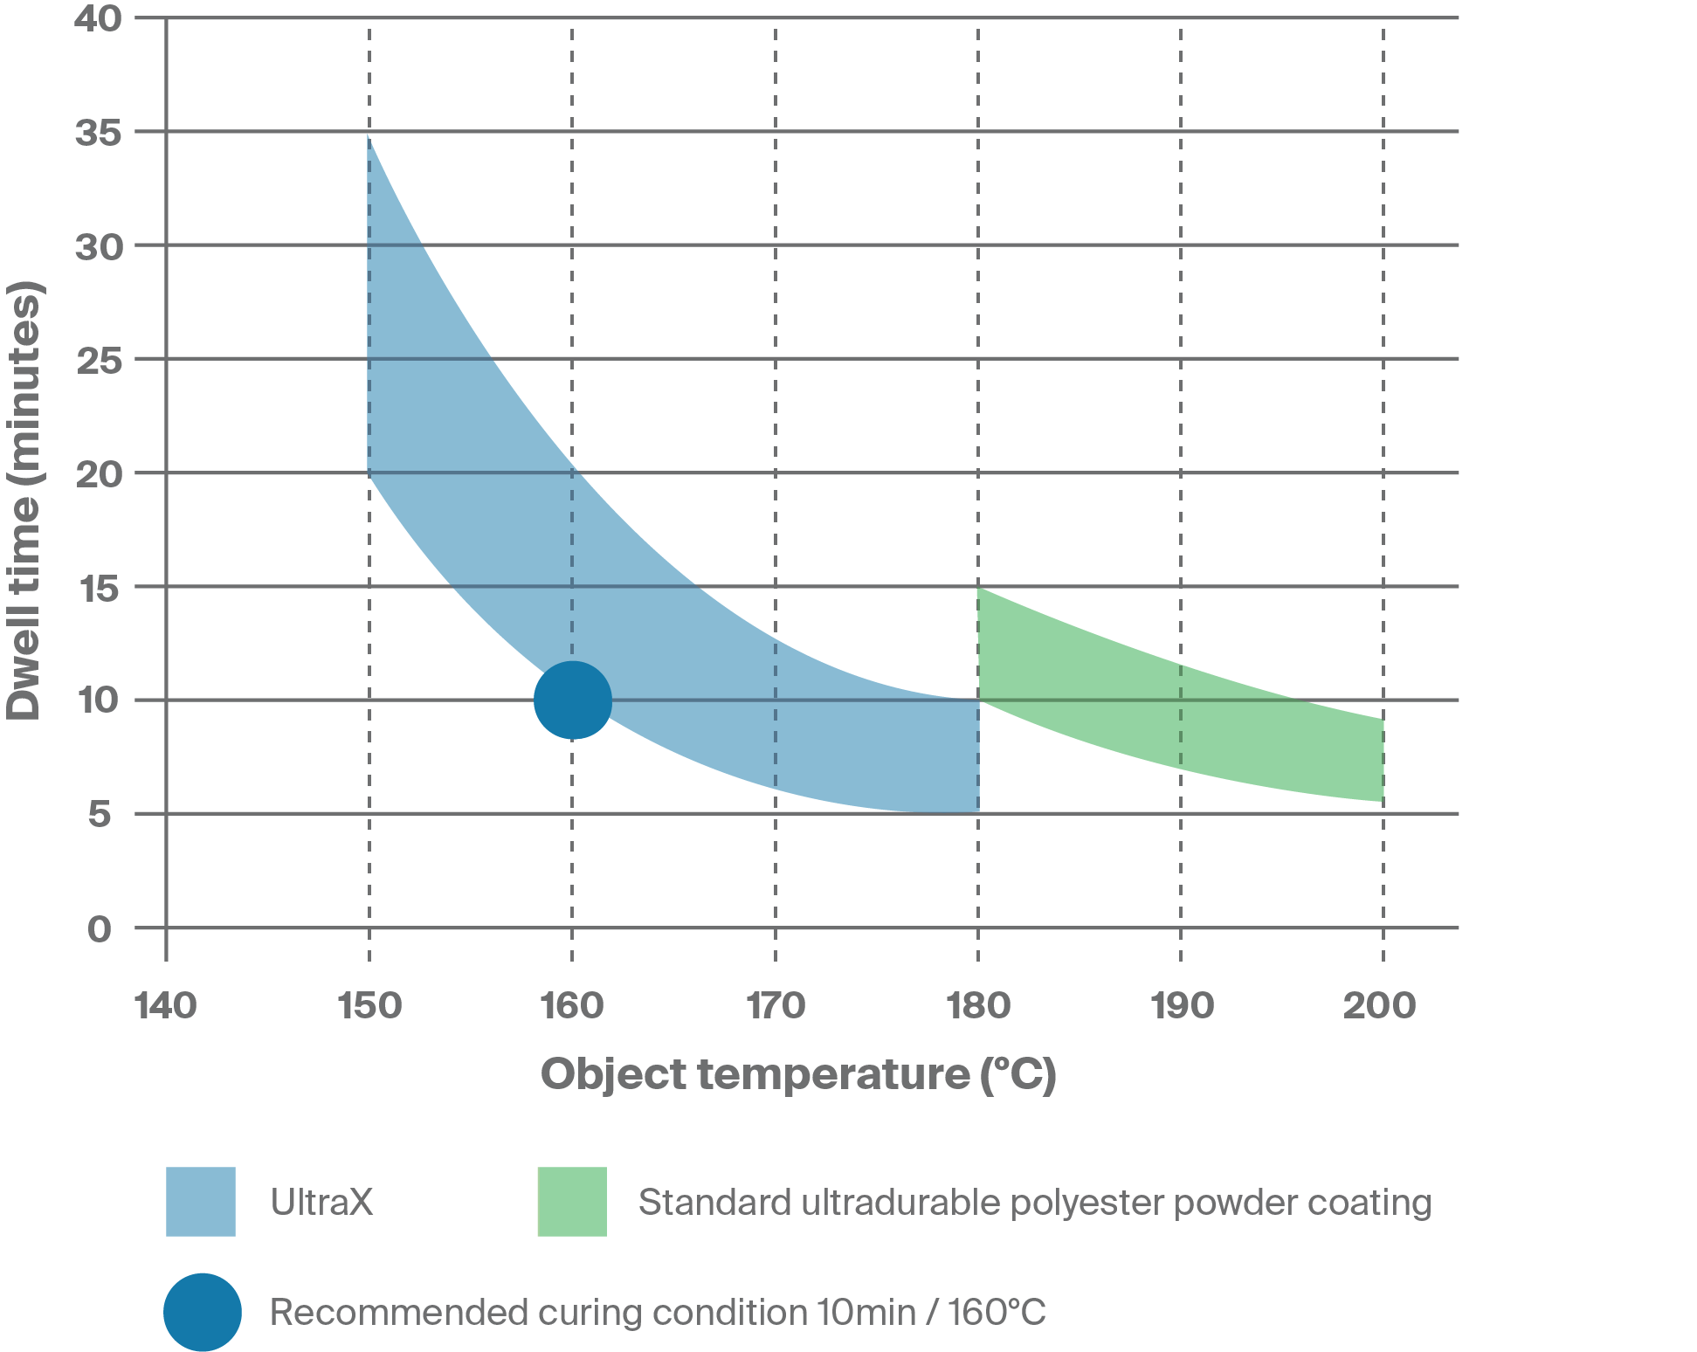
A curing window with high process stability
The Benefits
High process stability
Reduced rework and reject rate
Reduced risk of over- or underbaking
Retention of important performance features,
e.g. corrosion protection for thin- and thick-walled components
Possibility to mix different metal gages
No need to batch produce
EnergX ULTRA
21
Powder Coatings from PPG ©2023 PPG Industries, Inc. All rights reserved

Slide 29
Performance features at a glance
Property / Test | Test Standard | Result
Gloss level and surface variants | - | glossy semi gloss
Erichsen cupping | DIN EN ISO 1520 | on 0.8 mm steel degreased > 2 mm*
Weather resistance | DIN EN ISO 16474-2 DIN EN ISO 2813 | after 1500h residual gloss (60°) >80%**
Humidity test, condensation water constant climate test | DIN EN ISO 6270-2 DIN EN ISO 4628-2 DIN EN ISO 4628-3 DIN EN ISO 2409 | after 240h on steel degreased - degree of blistering 0 (S0) - degree of rust Ri 0 - adhesion GT 0
Corrosion resistance, neutral salt spray test | DIN EN ISO 9227 DIN EN ISO 4628-8 DBL 7391 | after 1000h on zinc-phosphated steel - corrosion creep*** ≤2 mm - edge rust KR 1
*strongly color-dependent, deviations upwards and downwards possible,
**color dependent, here tested on RAL 7035 as an example,
***test performed with Sikkens Scribe 1 mm
22
Powder Coatings from PPG ©2023 PPG Industries, Inc. All rights reserved

Slide 30

What can we do to enhance your products?
The PPG Logo, Coraflon, Envirocron and We protect and beautify the world are registered trademarks and EnergX is a trademark of PPG Industries Ohio, Inc. ©2023 PPG Industries, Inc. All rights reserved. IC304 10/23

