Slide 1
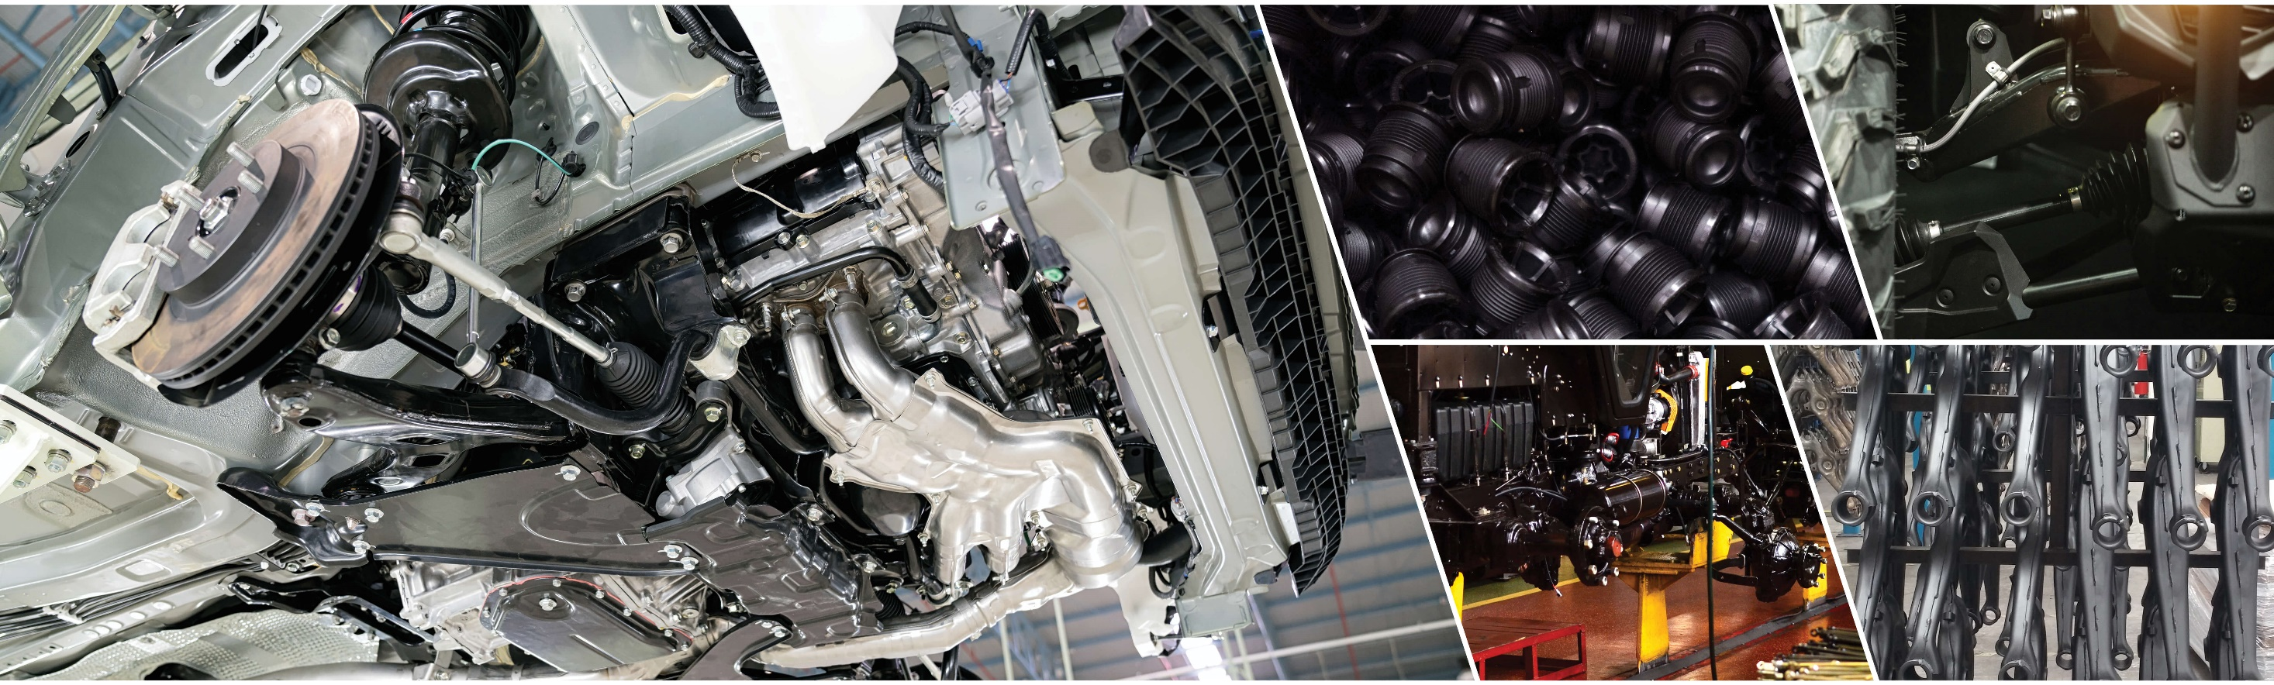
PPG POWERCRON® 6th-generation family of cationic epoxy electrocoats

Slide 2


Electrocoat organization
Thor Lingenfelter
Substrate Protection Technical Manager
Springdale, PA / Euclid, OH
25 years in Electrocoat
Andrea Gray
Substrate Protection Industrial
Coatings Team Leader
Springdale, PA / Euclid, OH
14 years in Electrocoat

Slide 3
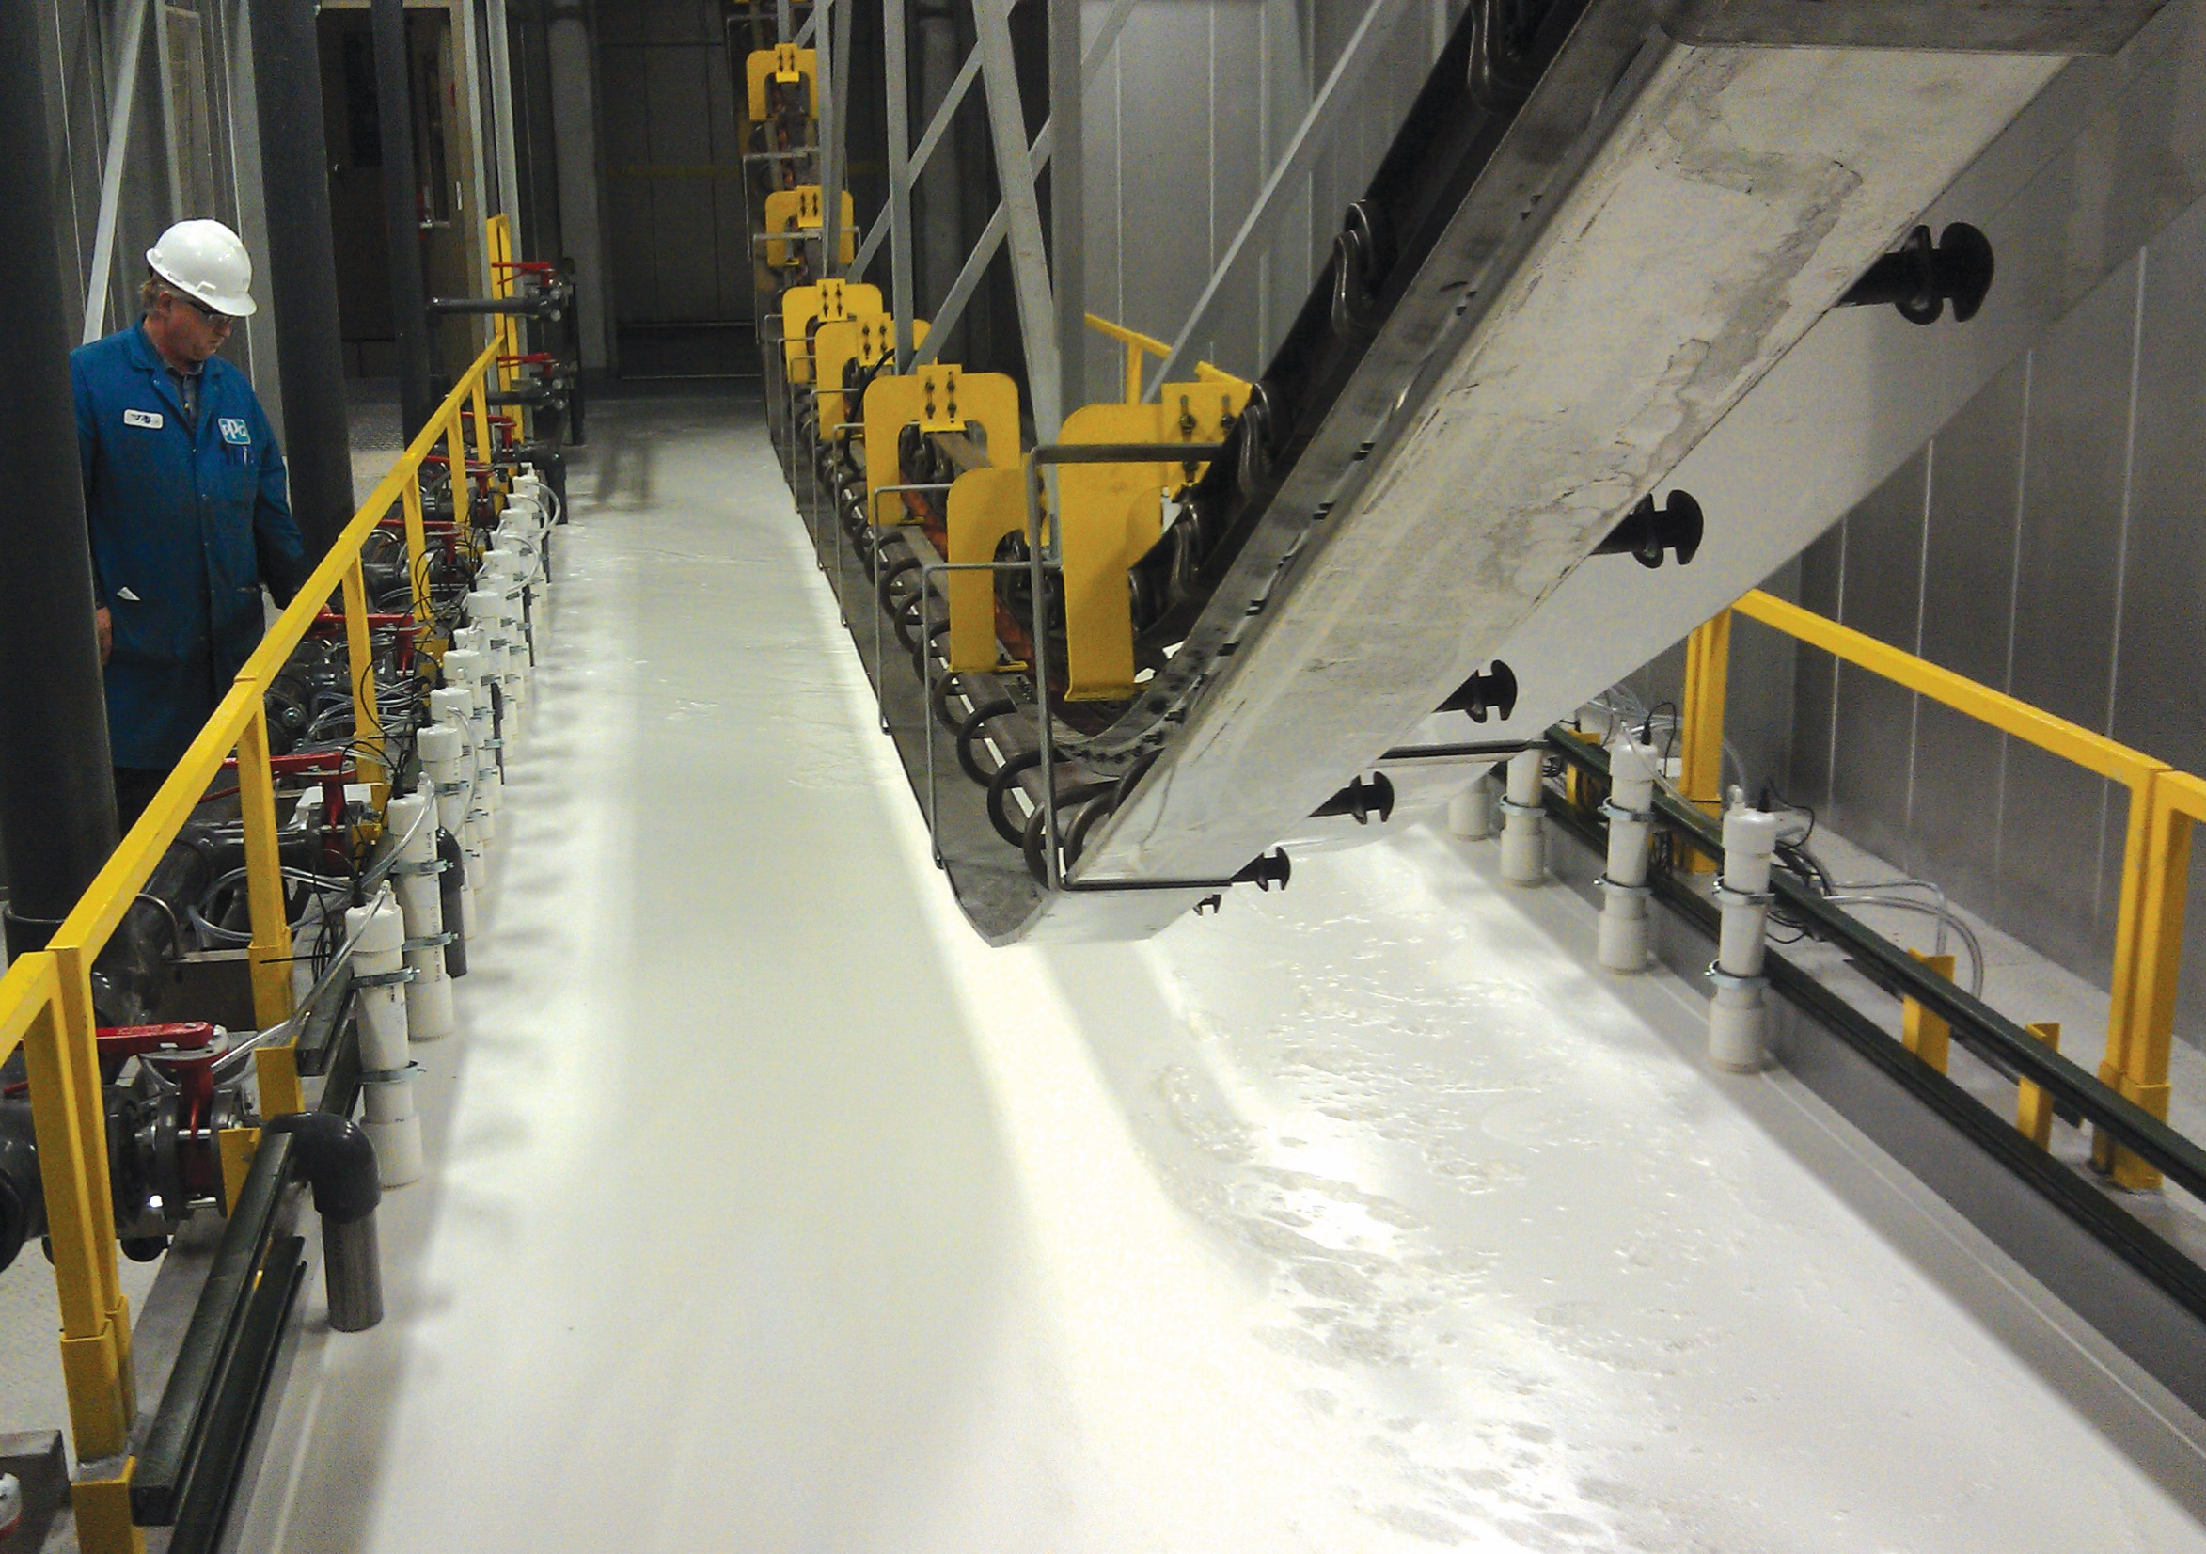
Electrocoat basics

Slide 4

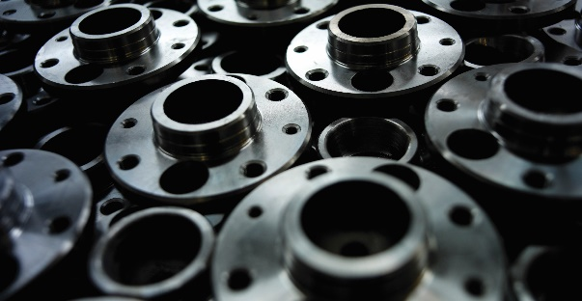

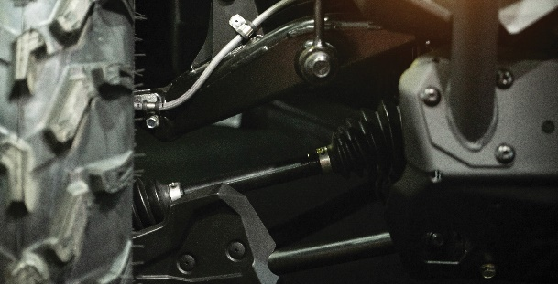
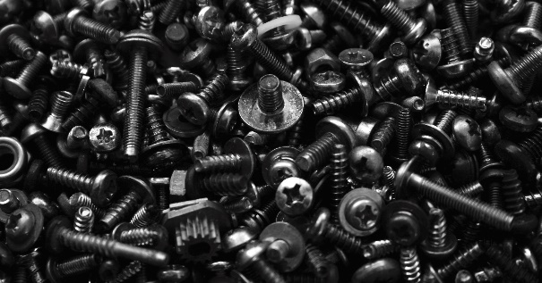
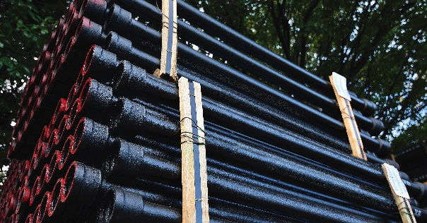
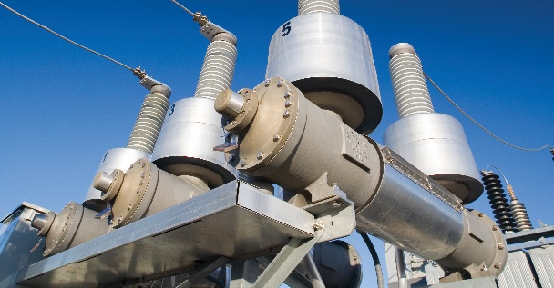
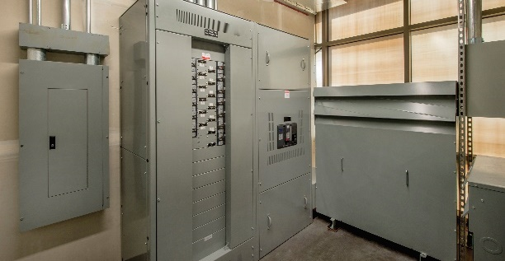
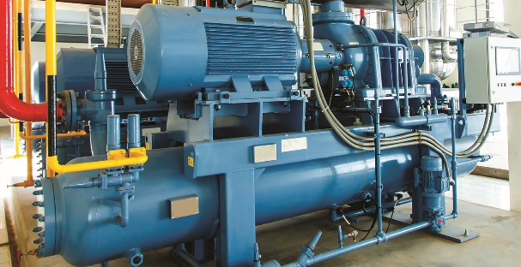
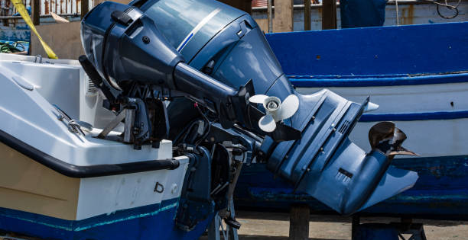
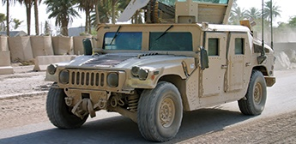

Where is electrocoat used?
Agriculture and Construction
Automotive parts
Trucks and buses
Suspension components
Fasteners
Castings and pipes
Transformers
Switchgear
Compressors
Marine engines
Military
HVAC

Slide 5
Why use electrocoat?
Economical
and Efficient
Environmentally
Conscientious
Excellent
Performance
Some
Disadvantages
High transfer efficiency
Precise film build control
100% coverage of
complex parts
Coats recessed areas
Automated system:
low maintenance and minimal labor
Dense racking of parts
Non-uniform line loading
Low VOC options available
Specifically formulated without HAPs
Minimal waste
discharge
Water-based formulations
Workers have minimal contact with materials
Controlled uniform film thickness
Improved aesthetics
No runs, drips or sags
100% coverage
One- or two-coat applications for optimal performance
Epoxy-based for corrosion, acrylic-based for durability
Capital expenditure
Color flexibility
(multiple colors)
Substrate must be conductive
Bake required (thermoset)

Slide 6
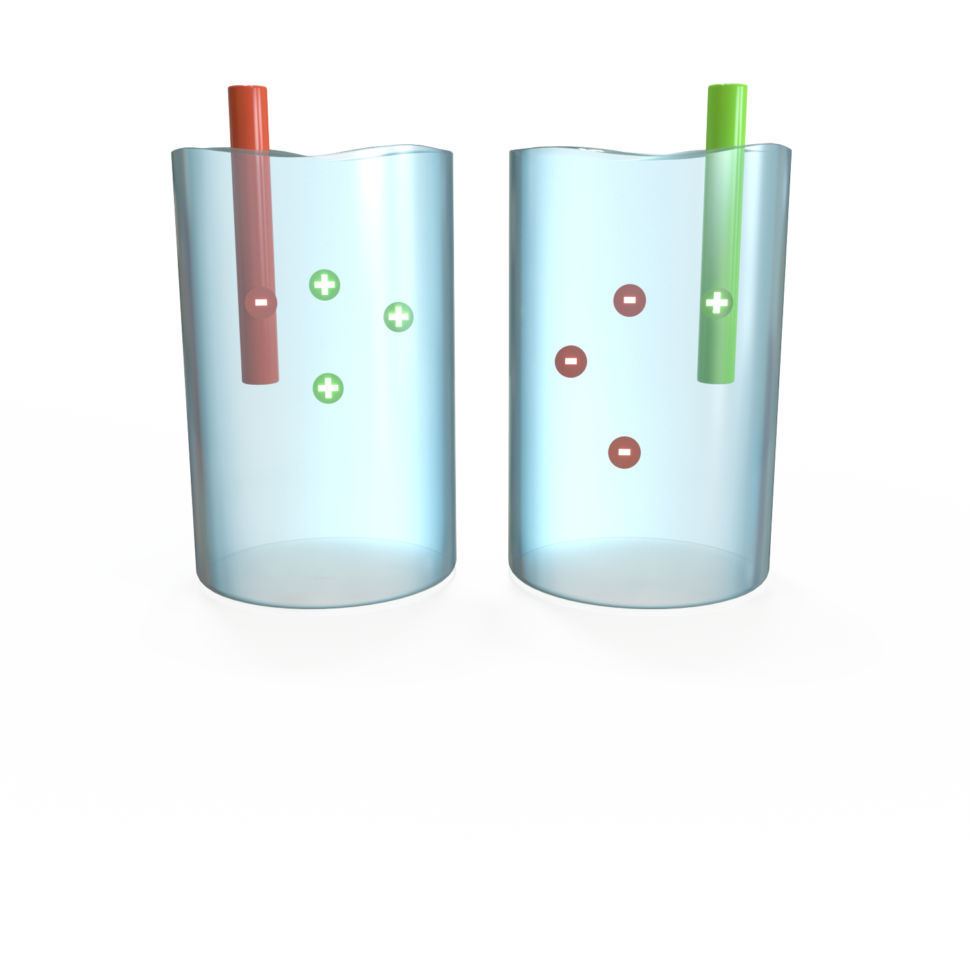
Electrocoat technologies
Cathodic
Anodic
Epoxy
Epoxy
Benchmark for corrosion and chemical resistance
Automotive parts, car bodies, heavy duty trucks, fasteners
Low-bake applications
Heavy-duty castings, compressors
Acrylic
Acrylic
High performance,
one-coat applications
UV durability and
detergent resistance
Color control
Color and gloss control for
interior products
Metal office furniture,
air diffusers, range hoods,
toolboxes
Electrocoat Product Choice – PPG 6th Generation

Slide 7
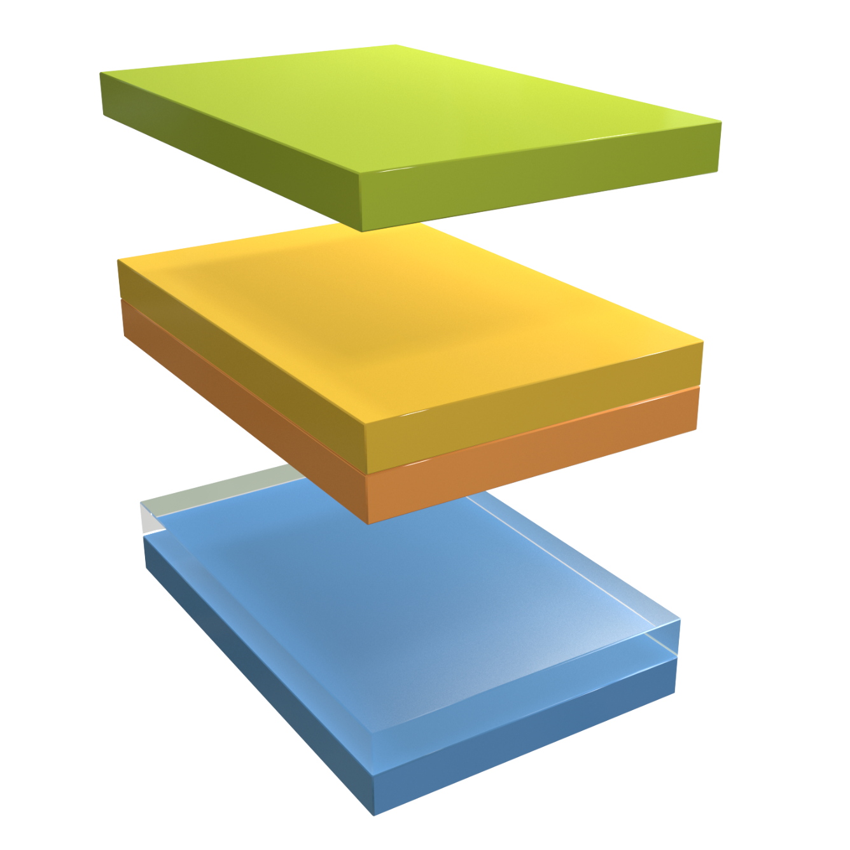
Versatile protection and performance options
Electrocoat monocoat
Electrocoat is the final finish – no UV exposure
Electrocoat dual-coat
Two electrocoat layers for high performance
E-coat primer + liquid or powder
Electrocoat + a liquid or powder topcoat produces exceptional performance properties

Slide 8
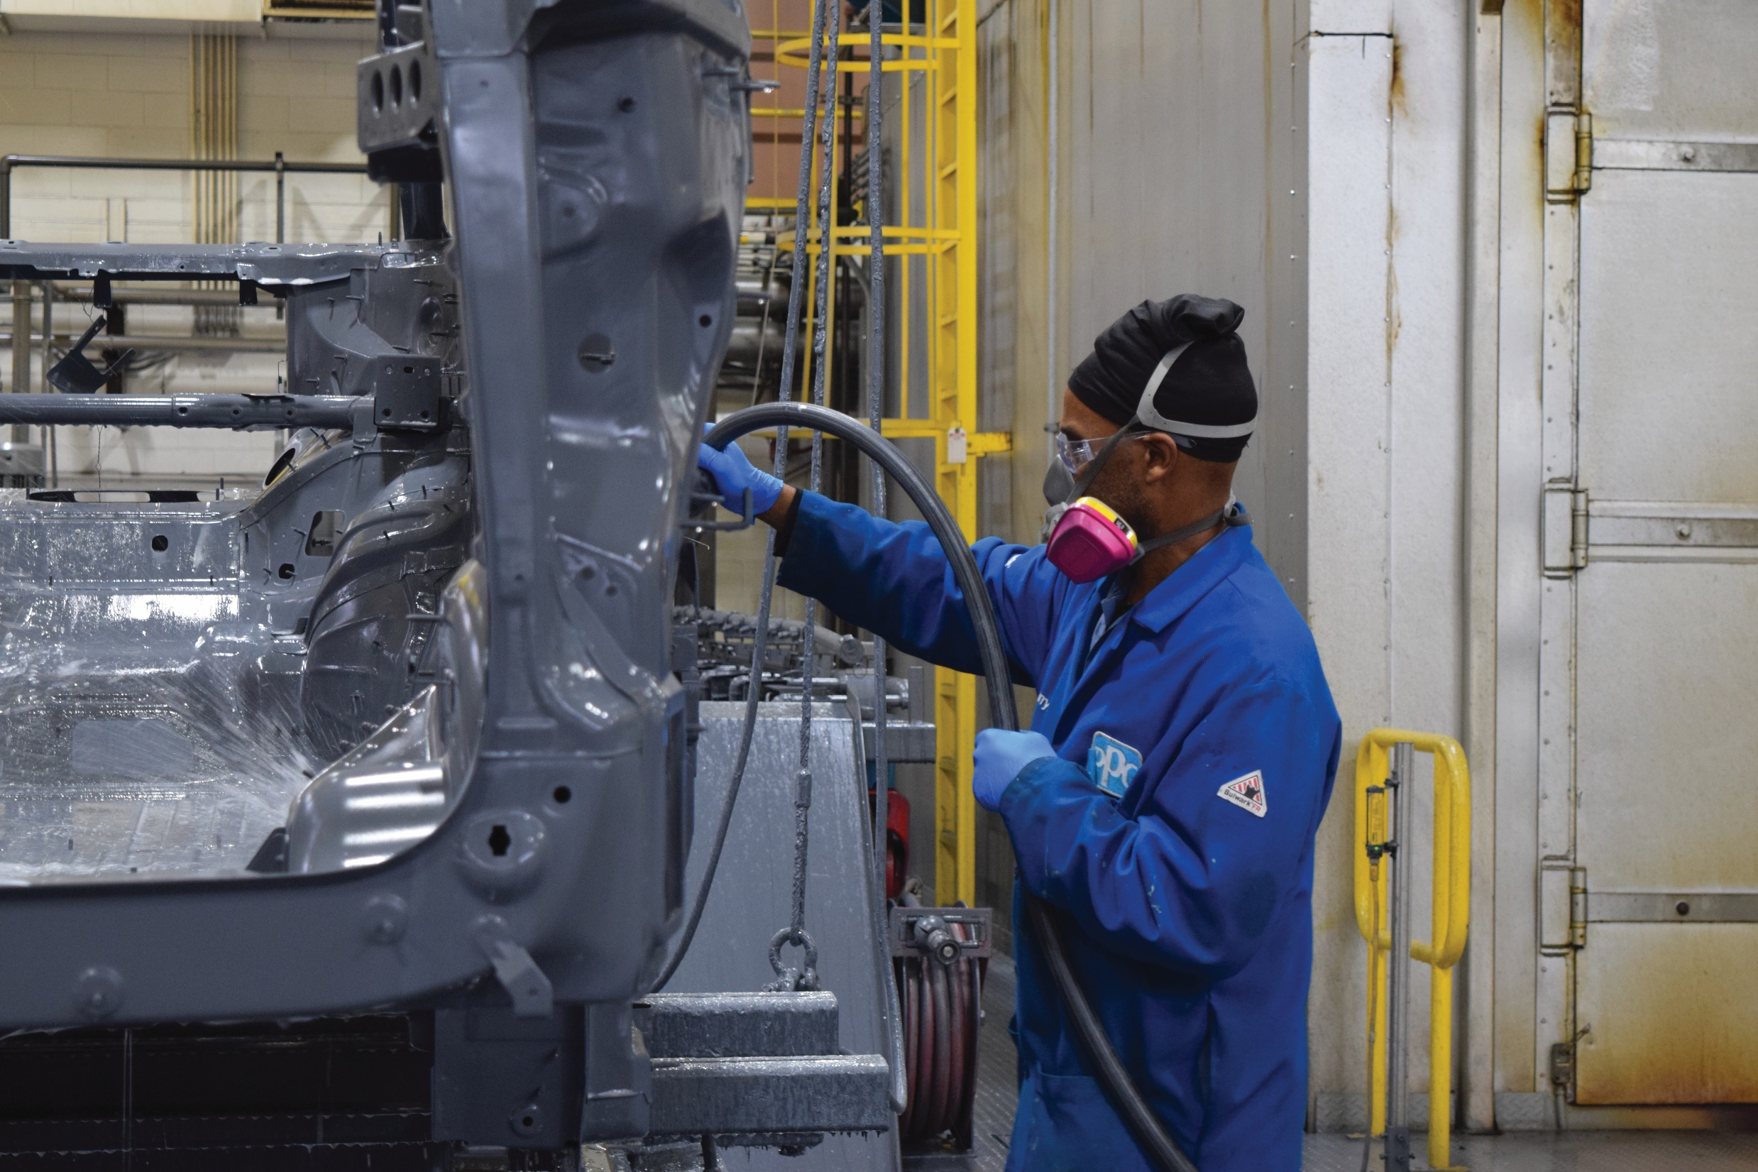
Powercron
6th-generation family of electrocoats

Slide 9
PPG historic cationic e-coat development
Cathodic epoxy: specifically formulated without HAPs and lead
Powercron 6000CX: Workhorse cationic epoxy product, noted for robust operation and workability
First automotive body tank (anodic)
Single component P590-534
POWERx®:
Comprehensive system
to control bacteria
Powercron 6100HE:
High edge coverage, cathodic epoxy electrocoat
PPG POWERCRON® ADVANTEDGE™:
Organic catalyst, reduced cure, one component, high edge product
Ultrafiltration
1960s
1970s
1990s
2000
2001
2006
2007
2009
2015
First cathodic auto
body tank
Improved corrosion
and throwpower
Powercron 8000: Lower VOCs and lower cure than previous generations
Powercron XP: Formulated specifically for fastener applications with built-in torque control
Single-Component Powercron 6000CX: Workhorse product now with improved quality, simplicity and reduced material handling
* Not intentionally added.

Slide 10
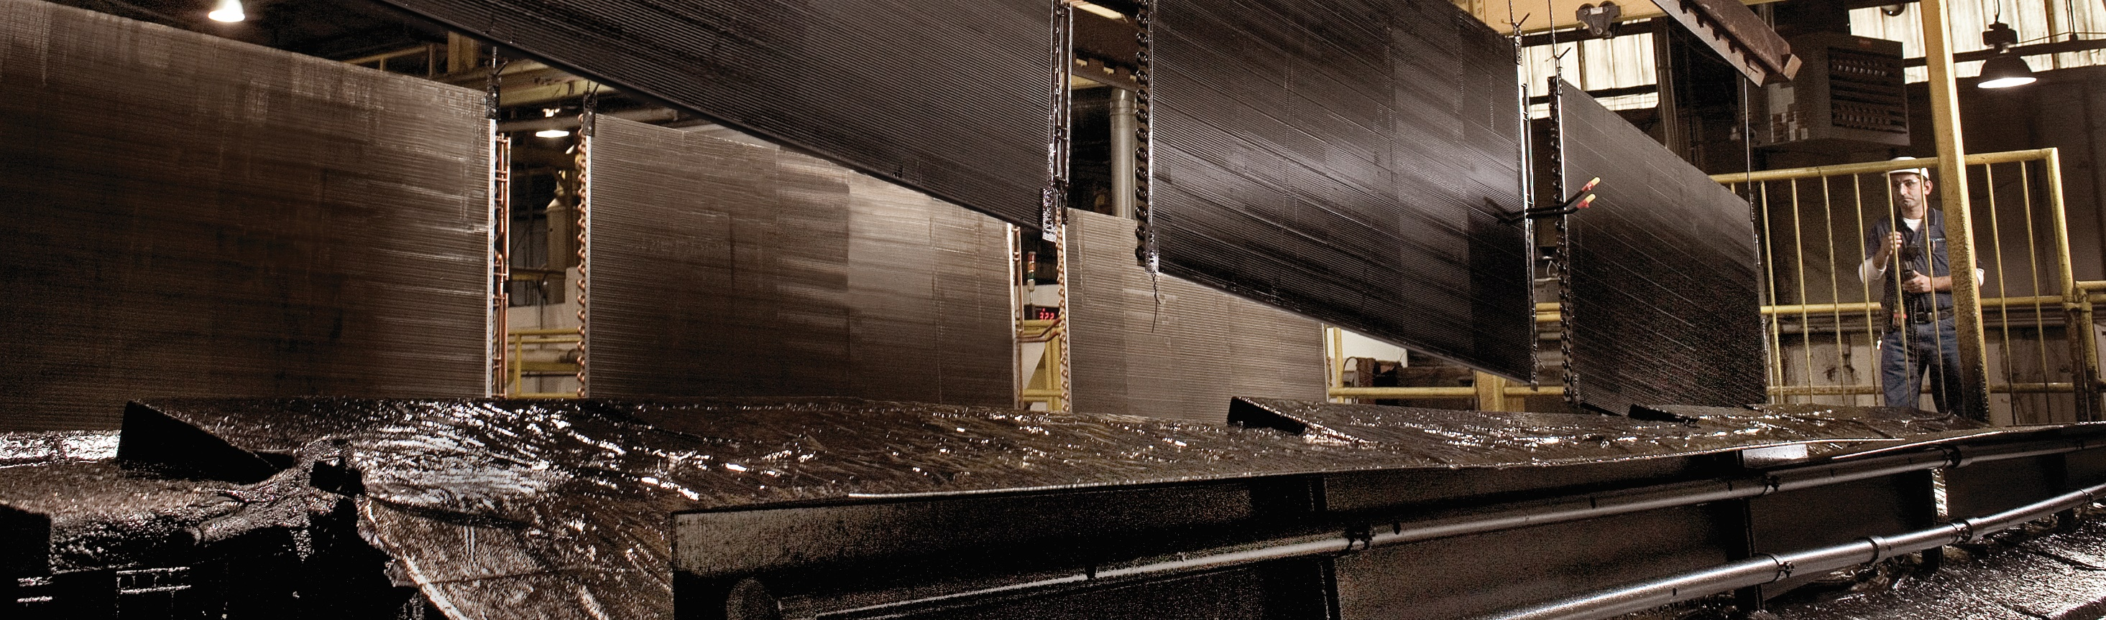
PPG Powercron 6th-generation family of cationic epoxy electrocoats
1K
2K
✔
Single- or two-component feed packages with metal-based catalysts
Range of products offering standard and high-edge protection of complex parts
Multiple
throwpower options
VOC options as low as
< 0.3 lbs./gal. (36 g/L)
as supplied
Low-cure products that may lower energy use
Black, gray and color options available
(not controlled)
Major OEM approvals simplify specification process and broaden potential customer base

Slide 11
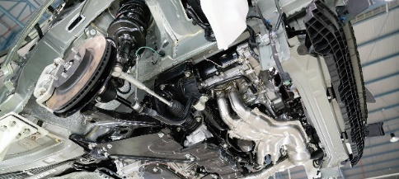
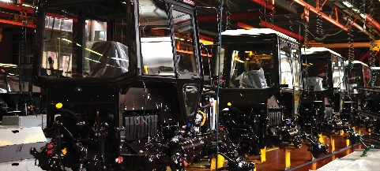
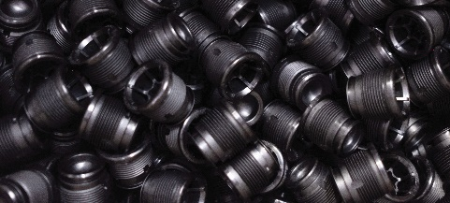
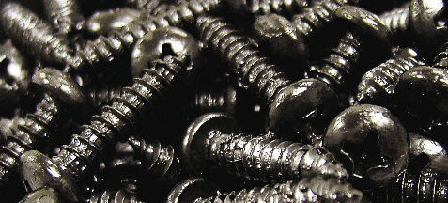
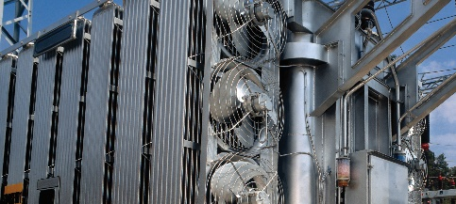
Full product family
 | Core Products |  |  | Specialty Products
 | FrameCoat II | Powercron 6100HE | Powercron 6000CX | Powercron XP/SL | Powercron CD
Markets | Automotive parts and accessories | Automotive parts and accessories General industrial Heavy duty equipment Transportation | Automotive parts and accessories General industrial Heavy duty equipment Appliance Transportation | General industrial (fasteners) | General industrial (power/electrical)
Special Benefits | Specially formulated for frames High-edge coverage of complex/sharp parts Improved surface profile versus competing electrocoats | High-edge coverage of complex/sharp parts NSF-approved and torque-modified formulations available | Standard coverage of densely racked parts | High-edge coverage of threads and edges Additives for lessening touch marks Torque-modified versions available | Conductive epoxy platform for 2-coat electrocoat Formulated for extreme environments

Slide 12
Core products
Product Characteristics | FrameCoat II | Powercron 6100HE | Powercron 6000CX
Feed package | 2K | 2K | 1K or 2K
Cure | 350˚ F (177˚ C) for 20 min. | 350˚ F (177˚ C) for 20 min. | 350˚ F (177˚ C) for 20 min.
VOCs as Supplied | VOCs < 0.3 lbs./gal. (36 g/L) | VOCs < 0.3 lbs./gal. (36 g/L) | VOCs < 0.2 lbs./gal. (24 g/L)
Color | Black or gray | Multiple colors (not controlled) | 1K: black 2K: multiple colors (not controlled)
Gloss at 60˚ (ASTM D523) | 50 – 80 | 50 – 80 | 65 – 85
Dry Film Thickness (ASTM D7091) | 0.5 – 1.5 mils | 0.5 – 1.5 mils | 0.4 – 1.5 mils
Performance Properties*
Pencil Hardness (ASTM D3363) | 2H minimum | 2H minimum | 2H minimum
Direct Impact (ASTM D2794) | 100 in.-lbs. minimum | 100 in.-lbs. minimum | 100 in.-lbs. minimum
Reverse Impact (ASTM D2794) | 60 in.-lbs. minimum | 60 in.-lbs. minimum | 60 in.-lbs. minimum
Humidity Resistance (ASTM D1735) | 1,000 hours minimum | 1,000 hours minimum | 1,000 hours minimum
Gravelometer (OEM performance standard) | 6 minimum | 6 minimum | 6 minimum
Rust Spot (OEM performance standard) | <5 average | <5 average | 40 – 60
Crosshatch Adhesion (ASTM D3359) | 4B – 5B | 4B – 5B | 4B – 5B
Water Immersion (ASTM D870) | 250 hours minimum | 250 hours minimum | 250 hours minimum
Throwpower (OEM performance standard) | 12 – 15 inches | 12 – 15 inches | 12 – 15 inches
Corrosion Performance (1,000 Hrs. ASTM B117) | 1 – 2 mm | 1 – 2 mm | 1 – 2 mm
* Testing performed on cold-rolled steel lab panels with zinc-phosphate pretreatment, 0.8 mils average film thickness, 20-minute cure at 320˚ F (160˚ C).

Slide 13
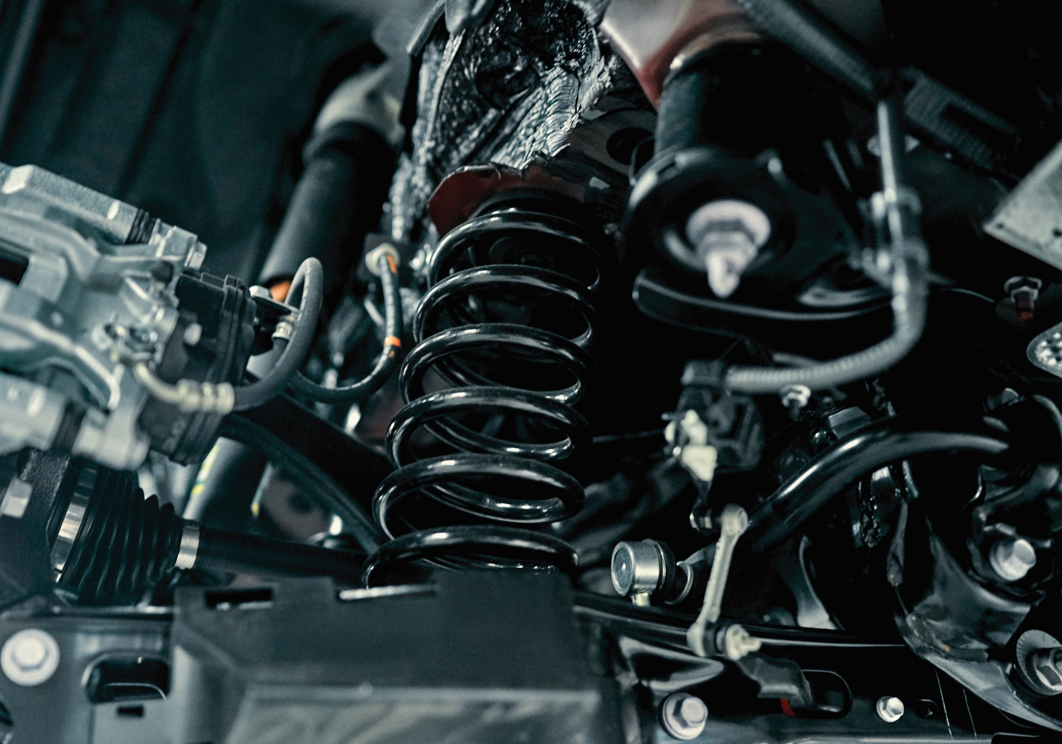
Corrosion performance

Slide 14
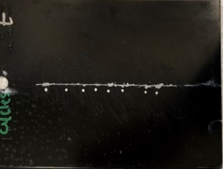
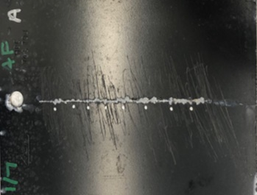
Corrosion performance*
OEM CCT Testing
(30 cycles)**
 | Salt Spray (1,000 hours) | OEM Scab Testing (28 cycles) | SAE J2334 (40 cycles)
Powercron 6100HE | 1.2 mm | 4.3 mm | 3.4 mm
Competitor A | 1.2 mm | 5.1 mm | 4.2 mm
 | Salt Spray (500 hours) | OEM CCT Testing (30 cycles)** ► | SAE J2334 (30 cycles)
FrameCoat II | 0.52 mm | 0.87 mm | 2.90 mm
Competitor B | 0.70 mm | 1.31 mm | 3.34 mm
FrameCoat II
Competitor B
* Tests performed on cold-rolled steel lab panels with zinc phosphate pretreatment, 0.9 mils average film thickness, unless otherwise noted.
** Test performed on galvanized steel lab panels with zinc phosphate pretreatment, 1.3 mils average film thickness.

Slide 15
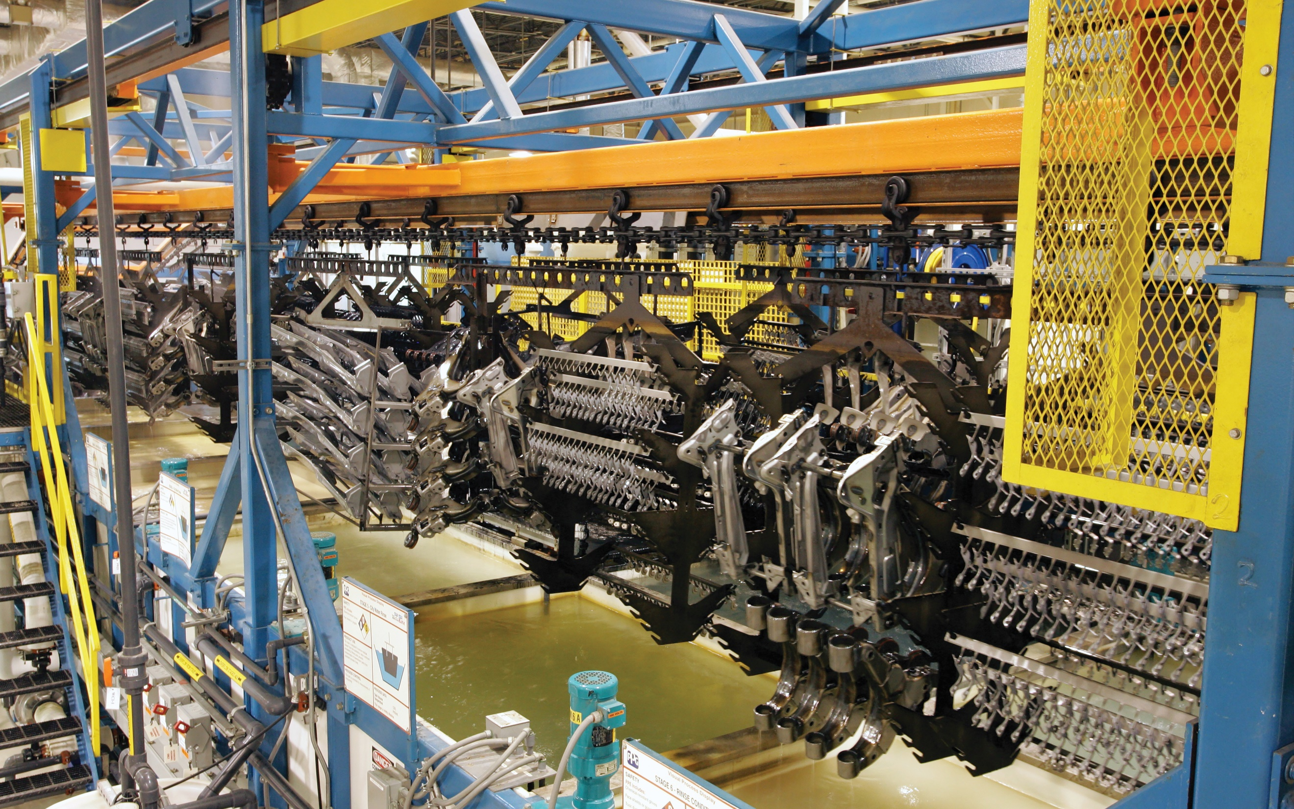
Throwpower

Slide 16
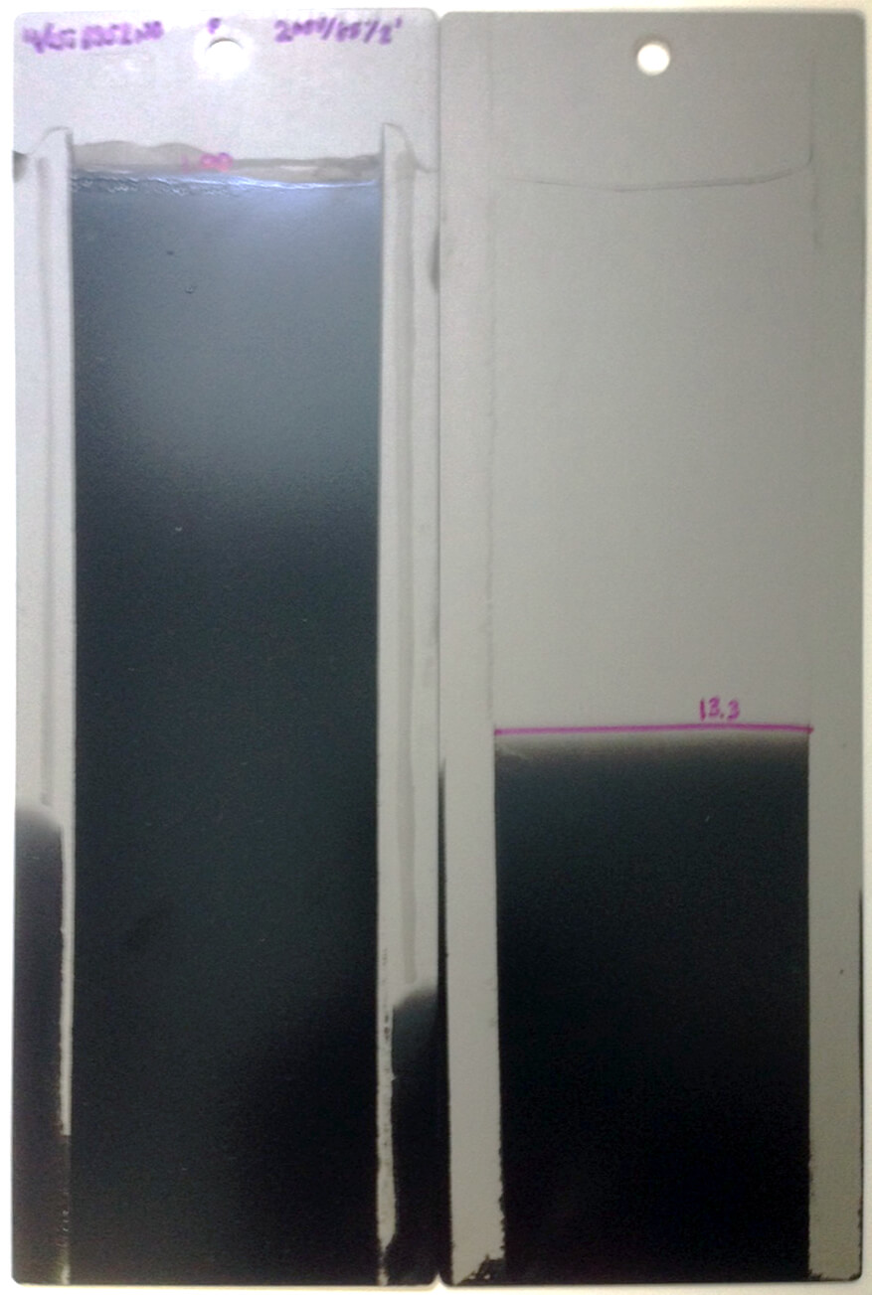
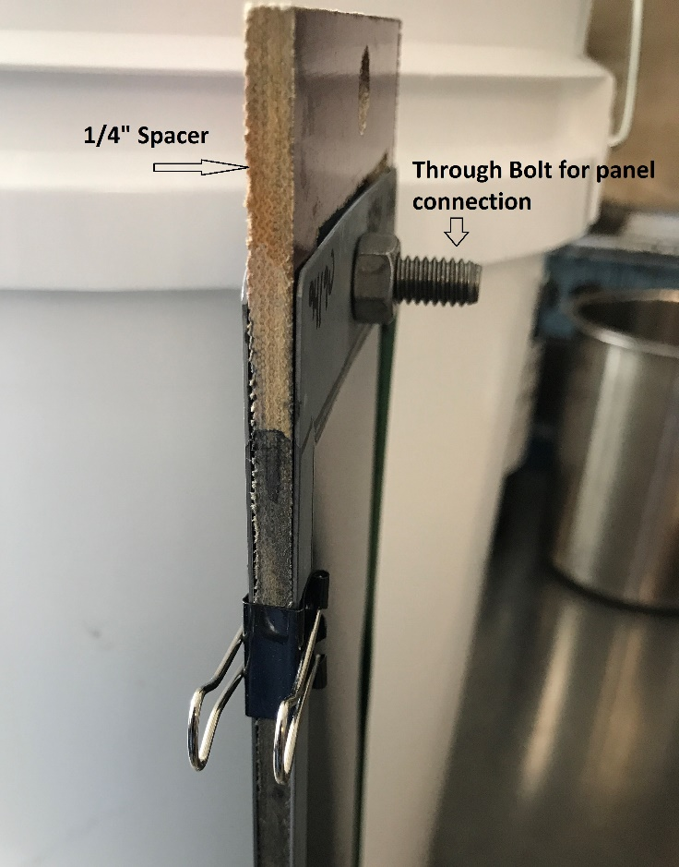
Throwpower performance
Shim Test Method
 | Throw
FrameCoat II | 65%
Competitor B | 57%
¼” spacer
Through bolt for panel connection
Outer panel
Inner panel

Slide 17
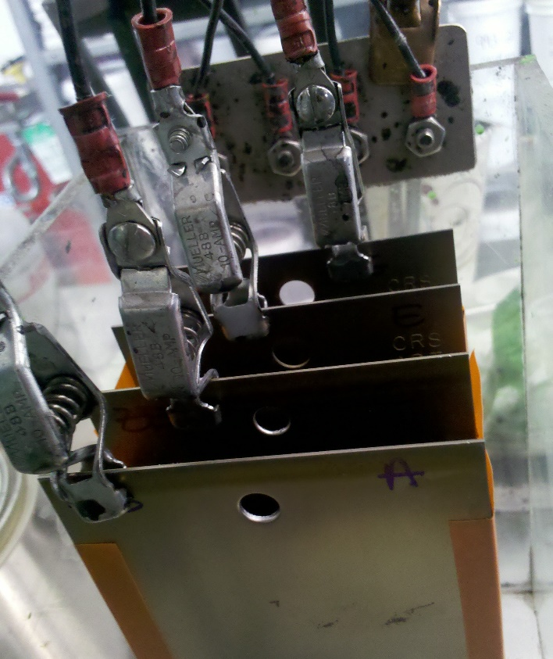
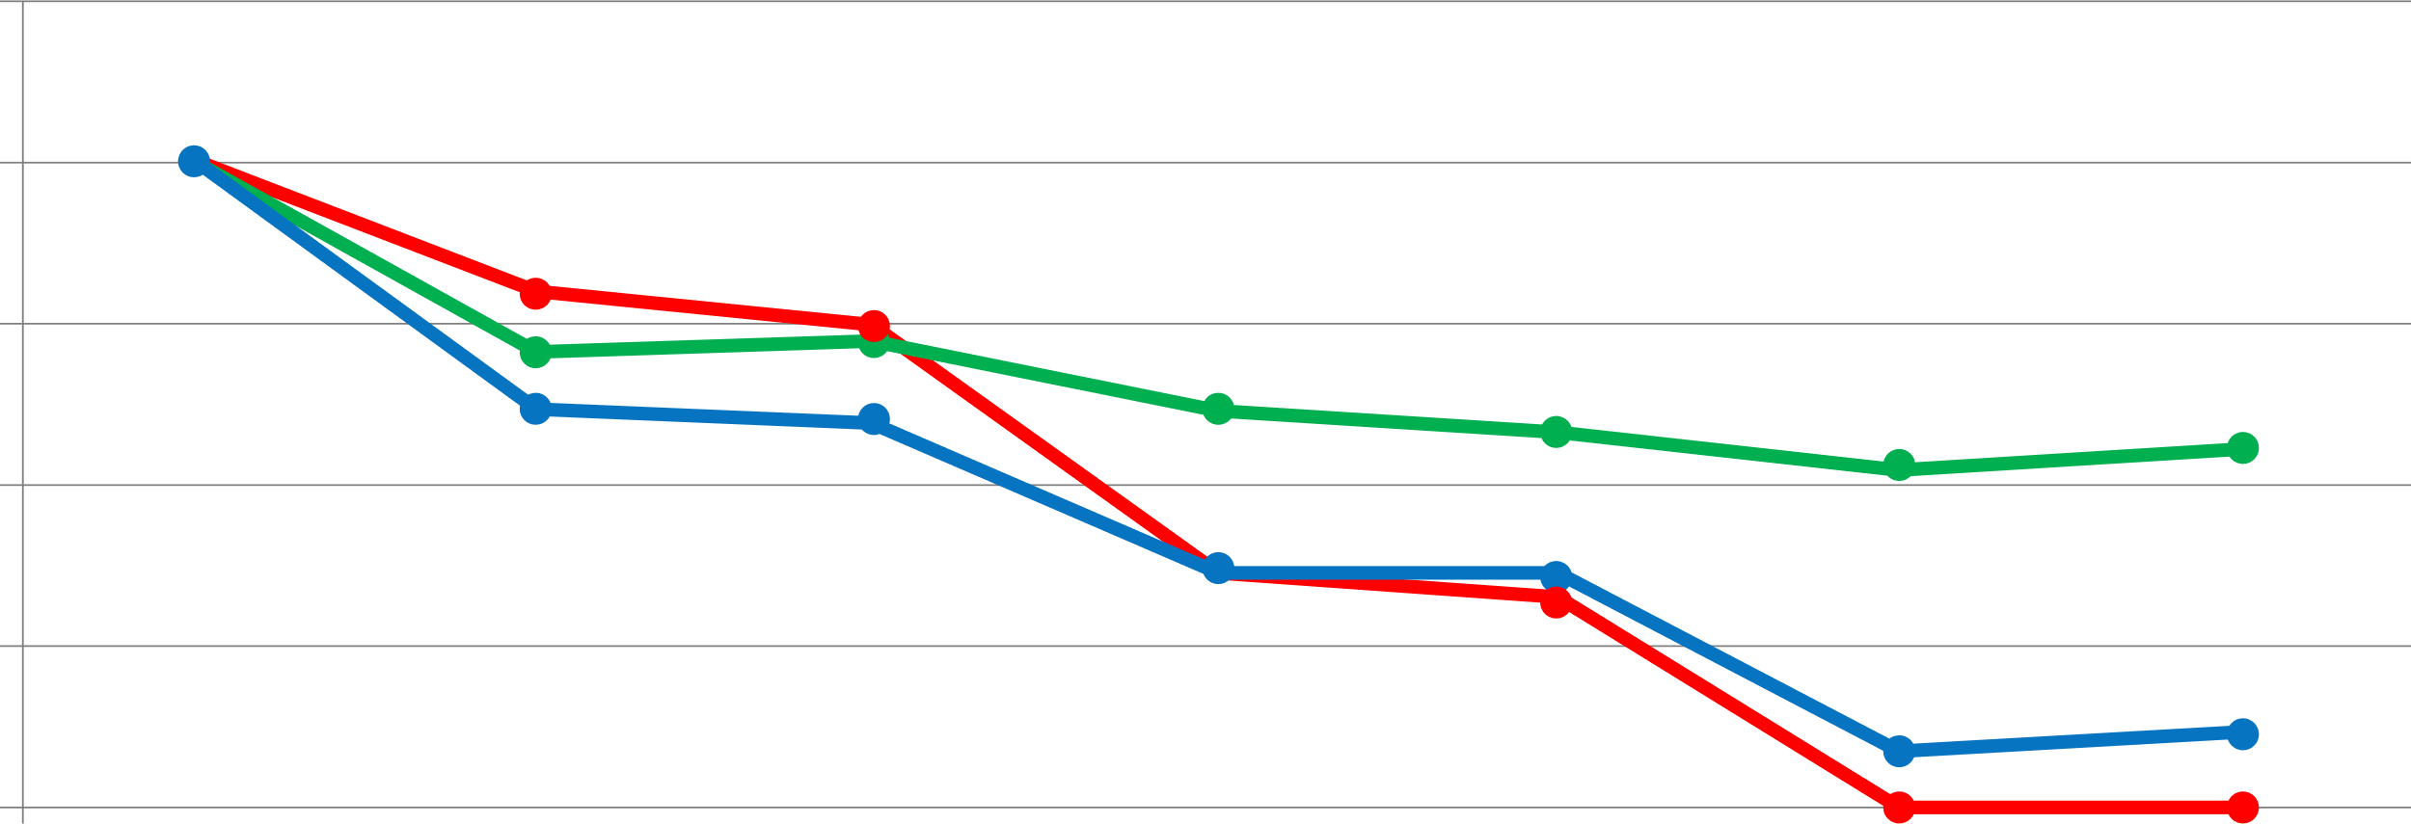
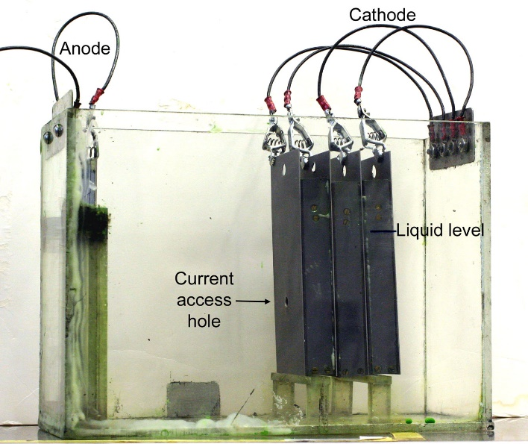
Throwpower performance
Box Throwpower Method
Faces A-G DFT • Comparison at A=20µ
25
Competitor N
20
Competitor K
Powercron
6100HE
15
10
5
0
A
B
C
D
E
F
G

Slide 18
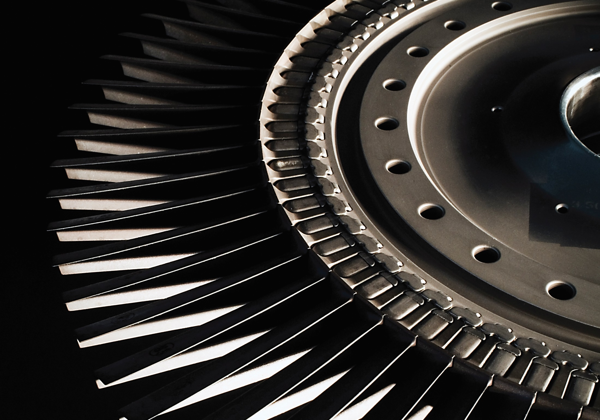
Edge
protection

Slide 19
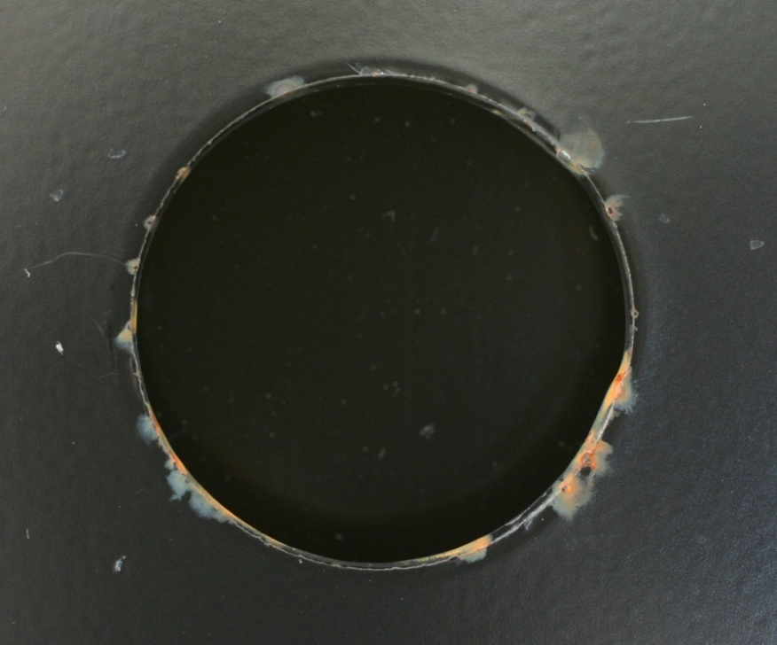
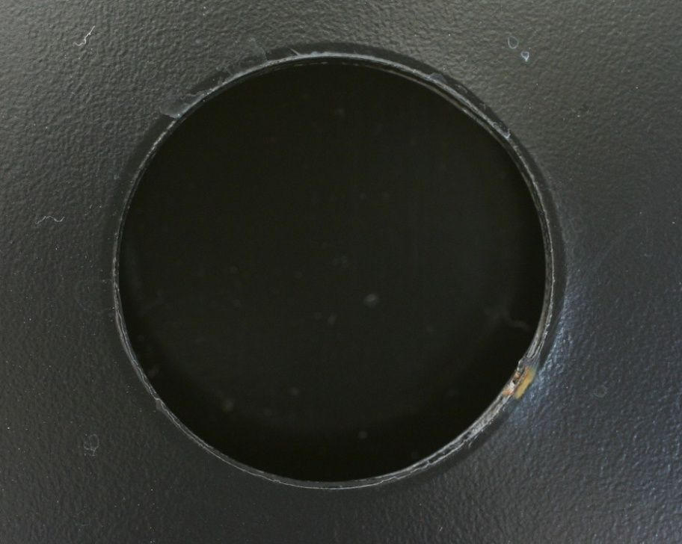
Edge corrosion performance
Punched Hole: 1,000 Hours in Salt Spray
Powercron 6000CX
Standard-edge electrocoat
Powercron 6100HE / FrameCoat II
High-edge electrocoat

Slide 20
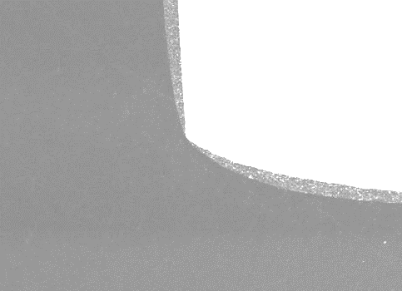
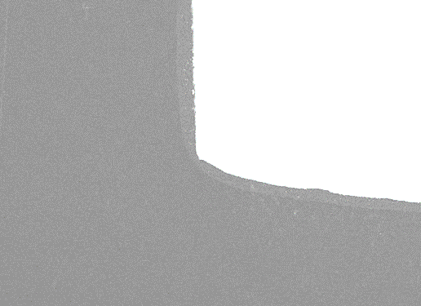

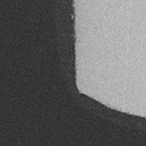
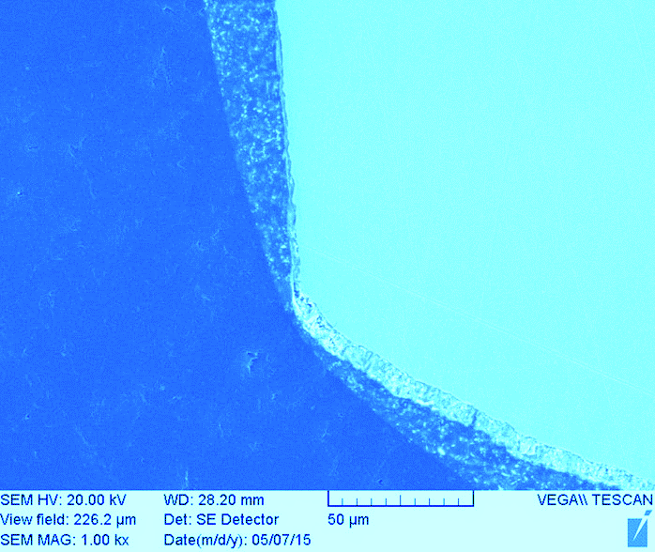
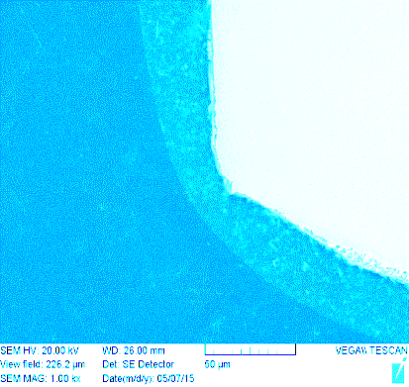
Edge corrosion performance
Cross-Section of Coated Edges
3 μm
20 μm
Powercron 6000CX
Standard-edge electrocoat
Powercron 6100HE / FrameCoat II
High-edge electrocoat

Slide 21
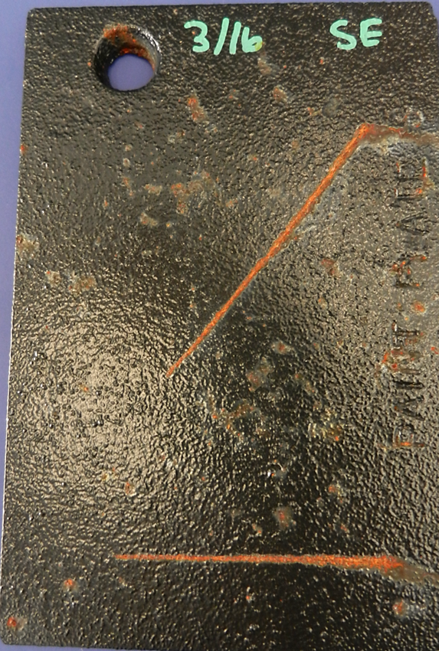
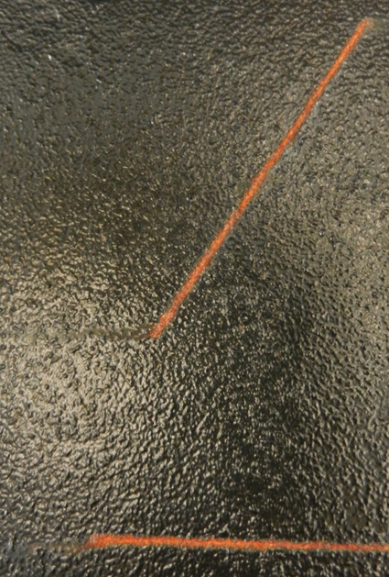
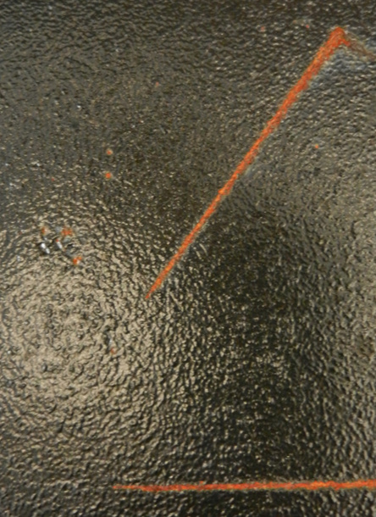
Edge corrosion performance
Cast-Iron Options / Success in Corrosion
20 μm DFT
40 μm DFT
20 μm DFT
Powercron 6000CX
Standard-edge electrocoat
Powercron 6100HE / FrameCoat II
High-edge electrocoat

Slide 22
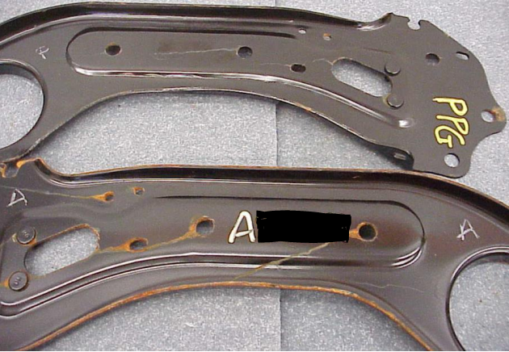
Edge corrosion performance
Salt Spray Testing
(720 hours, cold-rolled steel)
 | Knife Blade Edge Corrosion | Laser Cut Edge Panels
Powercron 6100HE | 6-10 rust spots | < 0.5% edge corrosion
Competitor A | 50-60 rust spots | > 50.0% edge corrosion
Powercron 6100HE vs. Competitor A

Slide 23
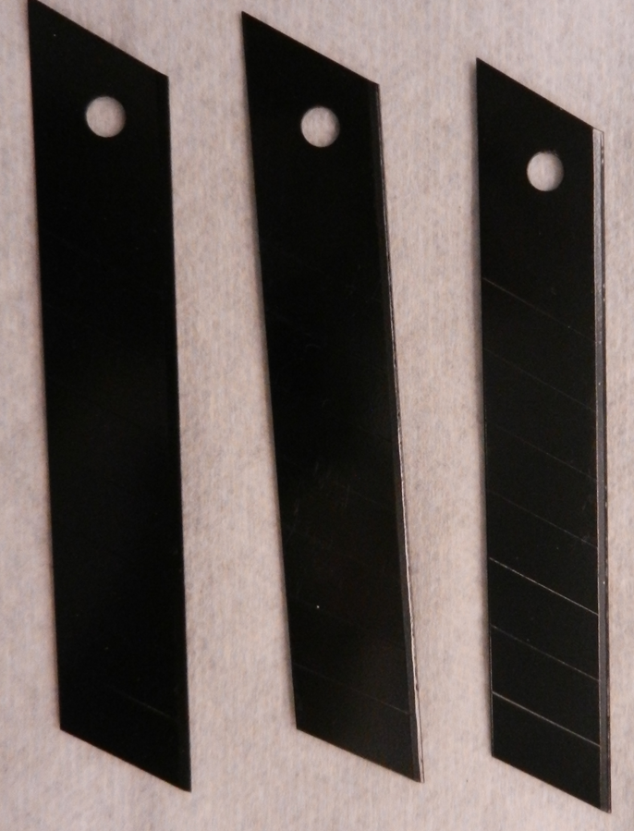
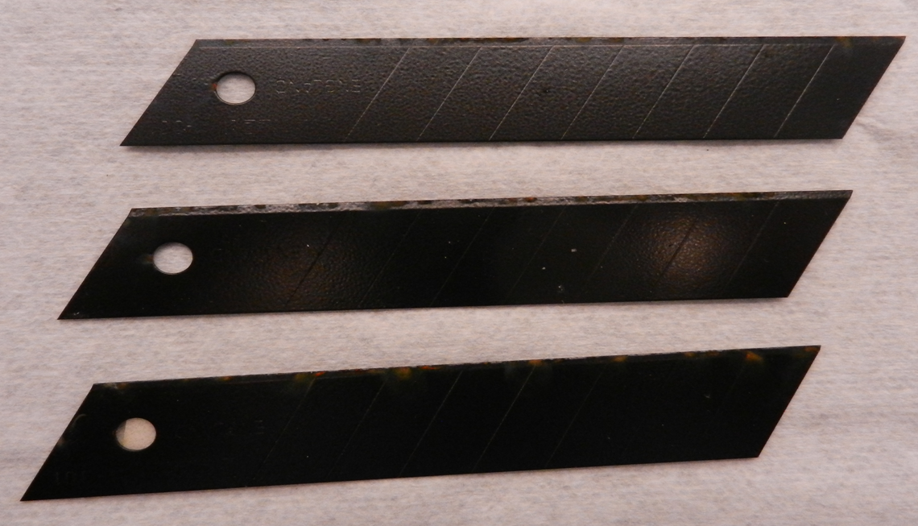
Edge corrosion performance
Salt Spray Testing
(1 week, 1.0 mil dry film thickness)
 | Knife Blade Edge Corrosion
FrameCoat II | 5-7 rust spots
Competitor A | 55-75 rust spots
FrameCoat II
Competitor A

Slide 24
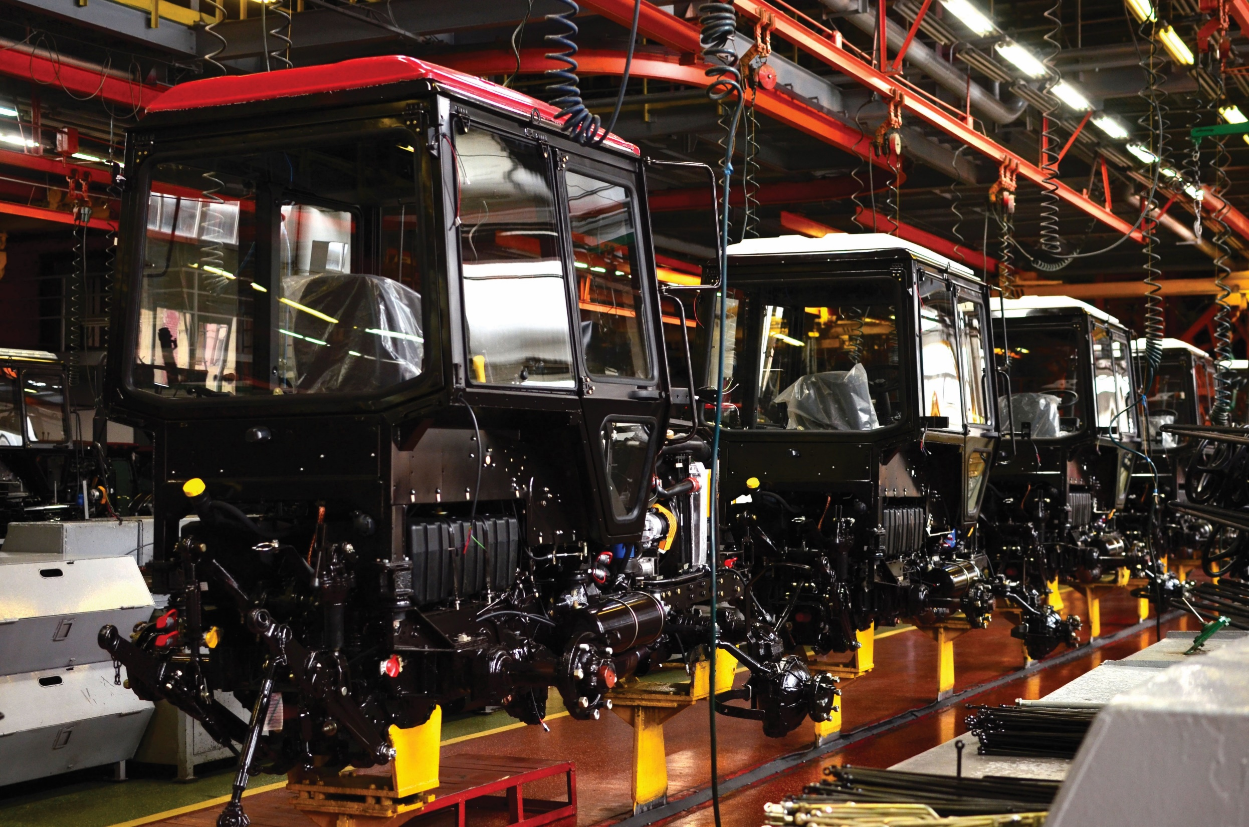
Other considerations

Slide 25

Powercron 6th-generation family operating versatility*
Wide solids range; can adjust outside typical range based on specific customer needs
Minimal over-the-side additions needed
(solvents, etc.)
Historically lower prevalence of bio-activity and appearance issues with preventative maintenance compared to other electrocoat generations
Two decades of proven excellence
* Normal operating ranges are always recommended for best performance.

Slide 26
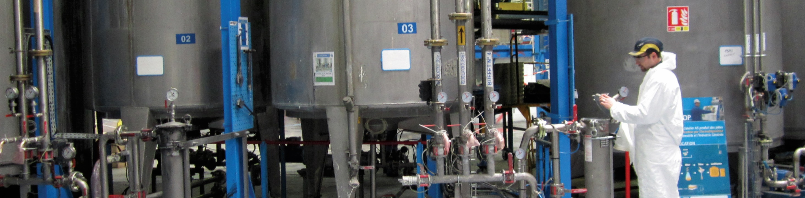
Conversions from competitors to Powercron family products
  Competitor A
  No conversion issues
  documented
  Competitor B
  May need solvent addition for smooth film during conversion process; some improved filterability as conversion continues
Successful top feeds
completed over:

Slide 27
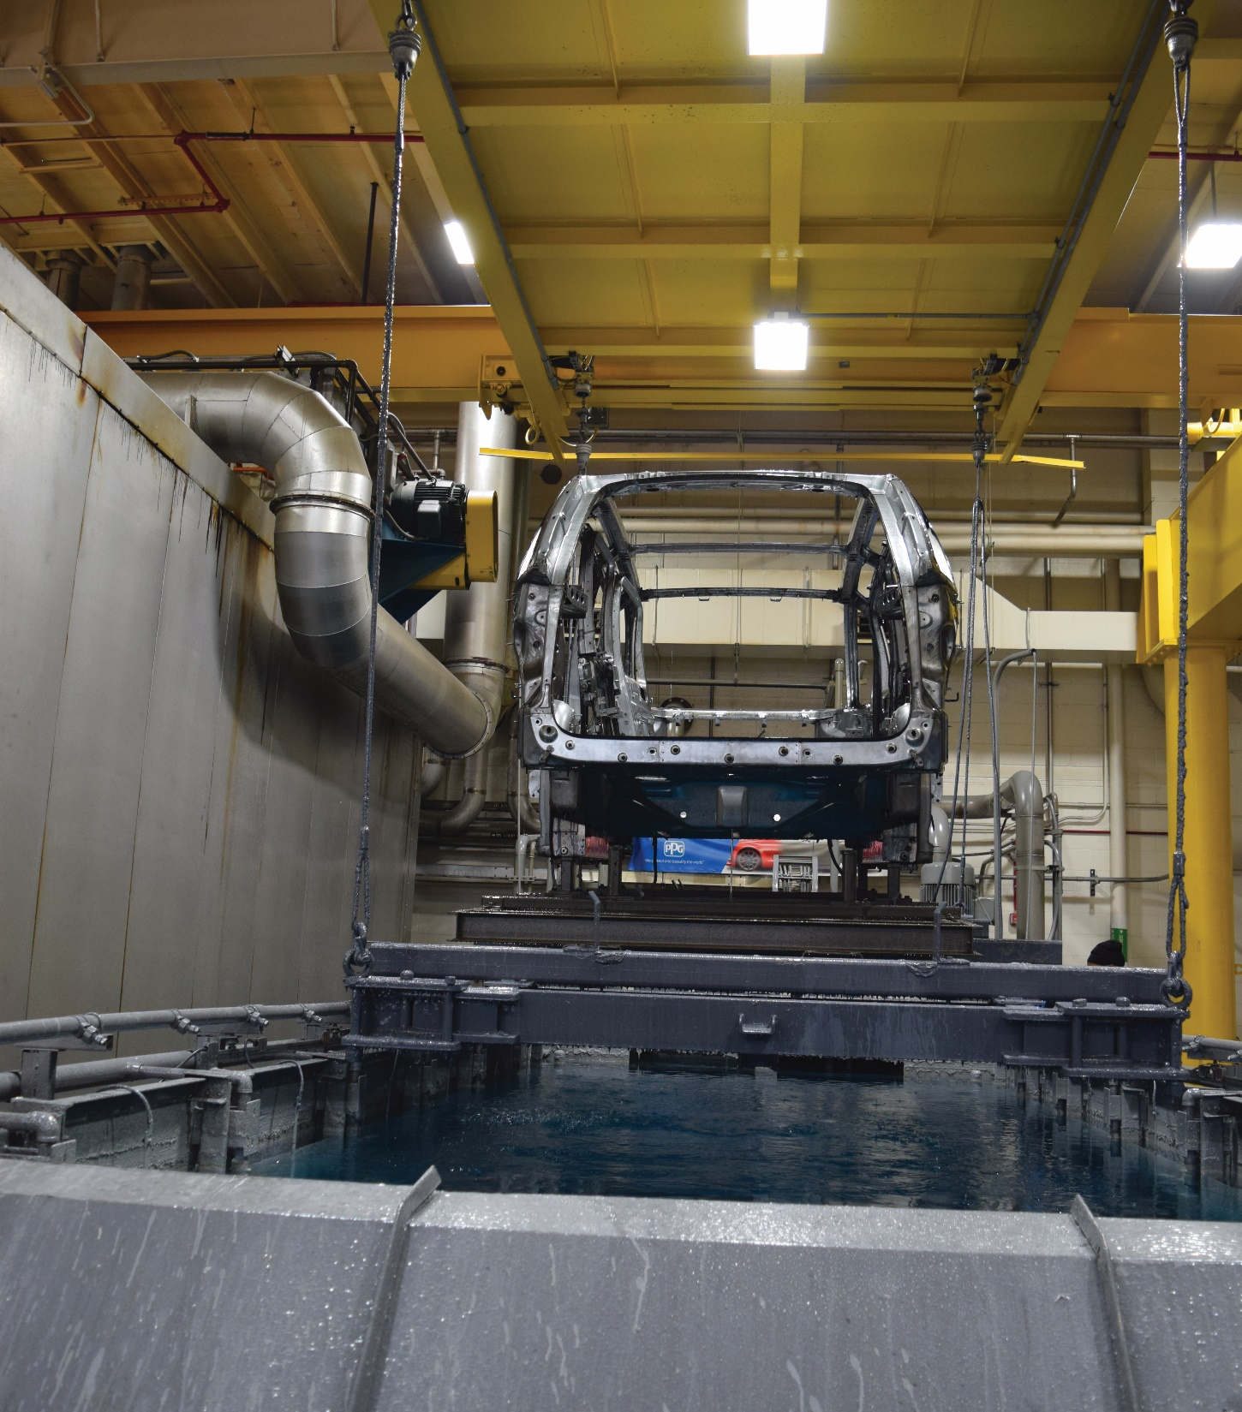
Electrocoat organization
Derek Kovacs
APA Team Leader
Dave Junker
Analytical / Tank Sampling
Kim Decheck
Performance Testing
Lisa Ventrano
Product Management Americas
Gary Orosz
Engineering / Equipment

Slide 28
Thank You
Thor Lingenfelter
Substrate Protection
Technical Manager
lingenfelter@ppg.com
Andrea Gray
Substrate Protection
Industrial Coatings Team Leader
agray@ppg.com

Slide 29


