Slide 1
The legal position of persons with dementia in a relationship Q23: appointment of representatives and support persons in State-Ordered Measures
Amber Jans | PhD Candidate at Hasselt University | Belgium

Slide 2
My PhD research

Slide 3
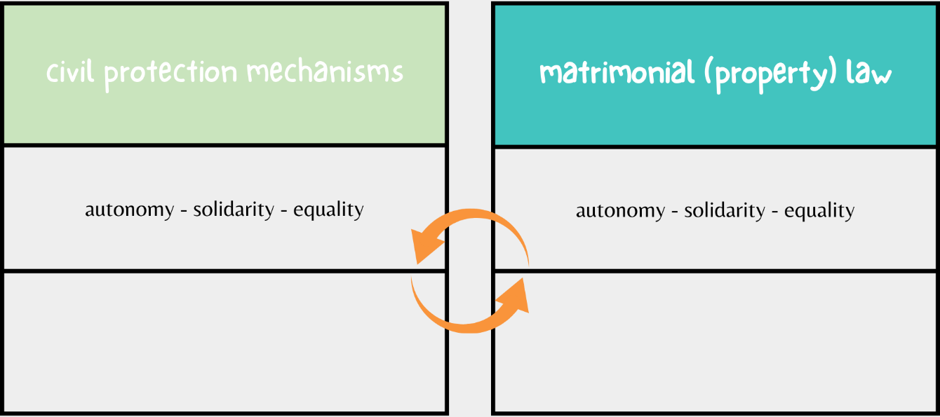
Belgium: two mechanisms, one relationship
Different rules, interests and protection
Interests person with dementia
Family interests
Interests other partner

Slide 4
Central research question
How can adults with dementia and their partner in a registered partnership best be supported in terms of matrimonial law (personal and property aspects) and adult protection law, starting from their right to respect for private and family life and the right to equal treatment before the law?
How does psychology and psychiatry view the relationship between partners in case one of the partners has dementia? (= factual reality)
Do the CRPD and the ECHR provide for protection of persons with dementia and their partner? (= human rights)
What is the current legal regime concerning persons with dementia and their partner in a relationship regarding civil law protection mechanisms and relational (property) law, and how do these mechanisms relate to each other? (= Belgian law)
1
2
3

Slide 5
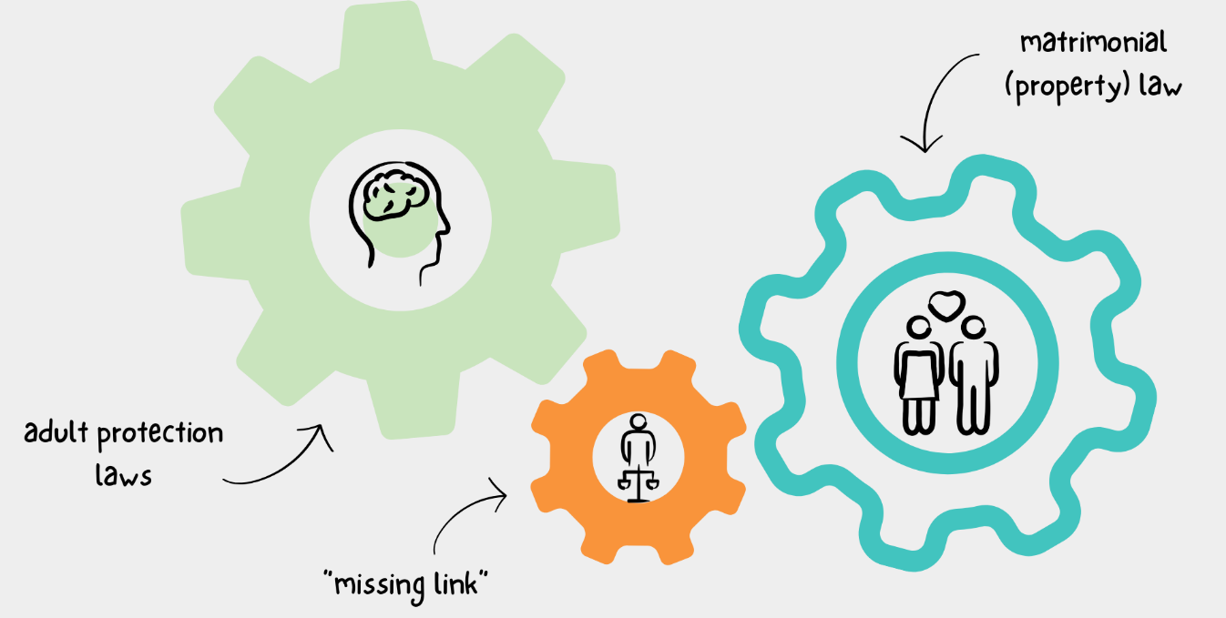
In search of the ‘missing link’

Slide 6
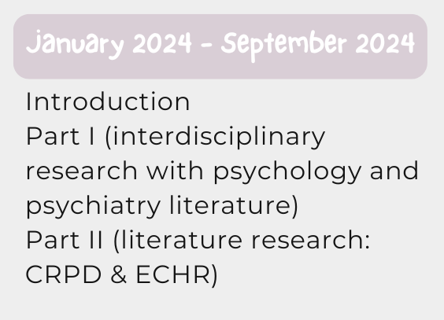
Methodology
Research Roadmap

Slide 7
Next up: comparative legal study
Germany, Ireland & Norway
Why? Potential attention for conflict of interests between healthy and unhealthy partner
Germany:
Big debate about will & preferences of a person: to what extent can you bring yourself damage?
Family interests taken into account next to individual interests when appointing a representative
Norway:
Scandinavian welfare system
Big acknowledgement for support instead of representation → maximal added value for the person with dementia, maybe…
Ireland:
Common law system → interesting
Assisted Decision Making Capacity Act: representative must take into account beliefs and values, past and present wishes, permit & encourage & facilitate the person to participate and improve the ability to participate

Slide 8
Still part of the family…

Slide 9
Use of FL-EUR data
Q23: appointment of representatives and support persons in State-Ordered Measures

Slide 10
Limitations
Available country reports (29; 27 on website)
Extensiveness of answers
Interpretation of questions (both ways)
Law in the books vs. law in action
Our own interpretation → from a Belgian perspective
Feedback received on draft versions (23 of 29 d.d. 28.04.2025)
Typology based on common characteristics can sometimes be (too) simplistic

Slide 11
Question nr. 23 FL-EUR report
General observations – State-Ordered Measures
Who can be appointed as a representative/support person (natural person, public institution, CSO’s, private organization, etc.)?
what kind of requirements does a representative/support person need to meet (capacity, relationship with the adult, etc.)?
to what extent are the preferences of the adult and/or the spouse/partner/family members taken into consideration in the decision?
is there a ranking of preferred representatives in the law? Do the spouse/partner/family members, or non-professional representatives enjoy priority over other persons?
what are the safeguards as to conflicts of interests at the time of appointment?
can several persons be appointed (simultaneously or as substitutes) as representative/support person within the framework of a single measure?
is a person obliged to accept appointment as representative/support person?

Slide 12
Question nr. 23 FL-EUR report
General observations – State-Ordered Measures
Who can be appointed as a representative/support person (natural person, public institution, CSO’s, private organization, etc.)?
what kind of requirements does a representative/support person need to meet (capacity, relationship with the adult, etc.)?
to what extent are the preferences of the adult and/or the spouse/partner/family members taken into consideration in the decision?
is there a ranking of preferred representatives in the law? Do the spouse/partner/family members, or non-professional representatives enjoy priority over other persons?
what are the safeguards as to conflicts of interests at the time of appointment?
can several persons be appointed (simultaneously or as substitutes) as representative/support person within the framework of a single measure?
is a person obliged to accept appointment as representative/support person?

Slide 13
Q23: Who can be appointed as representative / support person? (1)
e.g. Austria, Belgium, Czechia, England & Wales, France, Poland, Slovenia, The Netherlands
General observations
e.g. Bulgaria, Finland, Norway, Portugal, Serbia, Sweden, Switzerland

Slide 14
Q23: Who can be appointed as representative / support person? (2)
There exists a ‘cascade’
e.g. Czechia, France, Germany, Hungary, Serbia, Norway, Poland
Secondary option: legal person if suitable natural person is not found
e.g. Germany, Greece, Hungary, North Macedonia, Poland
Third option: rural municipality or city government or authority
e.g. Czechia, Serbia
Last resort: judicial agent
e.g. England & Wales, France, Norway
First option: natural person
General observations

Slide 15
Q23C: Ranking of preferred representatives in the law?
By the adult appointed person has priority
e.g. Austria, Belgium, France, Greece, Norway, Spain, Switzerland, The Netherlands
No ranking in the law
e.g. Finland, Serbia, Sweden, Switzerland
If the adult has not appointed a person: ranking in the law
e.g. Bulgaria, Czechia, France, North Macedonia, Spain, The Netherlands
A) By preference a person close to the adult; exception: professional or public institution
e.g. Czechia, Germany, North Macedonia, Slovenia
B) Priority for family members (or spouses / cohabitants / close relatives)
e.g. Austria, Belgium, Bulgaria, Hungary, Portugal, Poland, Ukraine
C) Last resort: professional (judicial agent, notary or lawyer)
e.g. Austria, Belgium, Czechia, England & Wales, Hungary
General observations
Notes:
.

Slide 16
Q23F: Obligation to accept?
Obligation to accept
e.g. Germany, Poland, Portugal, Spain
Only for social worker employed in SWC
e.g. Croatia, North Macedonia
No obligation when meeting certain requirements (e.g. professional: already a high number of appointments)
e.g. Austria
Depending on the legal person in question
e.g. Germany
No obligation to accept
e.g. Austria, Croatia, Czechia, Norway, Serbia, The Netherlands, Ukraine
Only when contractual appointed
e.g. Romania (?)
Only for family members / partners
e.g. Portugal
Only for public guardian
e.g. Czechia, Finland, Greece
General observations

Slide 17
Key take-aways
Prioritization of personal choice & personal relationships
Legal certainty and planning → ability to pre-appoint (e.g. advance directive)
Flexibility and adaptability to the specific circumstances possible → balancing familiarity and professionalism, sometimes together (several representatives)
Last resort mechanisms (legal persons, judicial agents, municipalities)
State or institutional bodies can play a role in representation of these adults, but mostly last resort
Most countries have a legal framework covering the appointment of a representative/support person

Slide 18
Extra question on draft version
Societal expectation or legal duty
“Is providing support or representation considered a legal duty or societal expectation for the spouse or legally cohabiting partner? If yes, how is this obligation defined and enforced?”
Why?
Research: holistic aim → shift in relationship → parent-child relationship
Emotional and practical impact on the partner
Quid relational context in the law?

Slide 19
Societal expectation or legal duty for spouse/partner to be representative/support person?
North Macedonia, Poland, Spain
General observations
Austria, Finland, The Netherlands, Slovenia, Serbia, Norway, England & Wales
Croatia, Sweden, Switzerland
Belgium, Bulgaria, Germany, Hungary, Portugal

Slide 20
Implications of framing support as a legal duty for spouse/partner
Tension between autonomy & legal duty: ‘healthy’ partner (own opinion; in need of further research)
v
1
2
Normative expectation on the partner
Pressure & emotional overload; risk undermining relational character of caregiving; potential conflict autonomy & affection
v
Partner as duty-bearer
Own vulnerability? Emotional crisis? Parent-child relationship? Stress, fatigue, (social) isolation, lack of emotional and physical intimacy, quality of life
3
4
v
v
Traditional gender/relationship roles
Women more likely to get dementia → quid caregiving, power dynamics
Legal duty means enforcability
How to do that in intimate setting? Possible tension with matrimonial (property) law
Better: societal expectation?

Slide 21
Core elements of my research

Slide 22
Thank you!
Amber Jans
PhD researcher person and family law
Hasselt University
Belgium
amber.jans@uhasselt.be
Let’s stay in touch!
Scan for LinkedIn

