Slide 1
Procedural safeguards during legal capacity and guardianship proceedings for adults in European legal systems
Fiore Schuthof
PhD candidate - f.schuthof@uu.nl

Slide 2
Procedural safeguards
Definition
Importance for persons involved in guardianship proceedings
Source: Open Verse Creative Commons

Slide 3
European Court of Human Rights
“Special procedural safeguards may prove called for in order to protect the interests of persons who, on account of their mental disabilities, are not fully capable of acting for themselves.”
Winterwerp v The Netherlands, para. 60.
Practice in Europe?

Slide 4
Comparative law research
Based on 27 national reports
Preliminary findings (!)

Slide 5
Main question
To what extent do particular European legal systems comply with certain human rights law requirements for procedural safeguards in legal capacity and guardianship proceedings for adults?

Slide 6
Focus of presentation
Statutory measures
A) Jurisprudence of the European Court of Human Rights
B) Recommendation No. R (99) 4 on ‘Principles Concerning the Legal Protection of Incapable Adults of the Committee of Ministers’
Three procedural safeguards:
What are the legal grounds for ordering a measure?
What evidence is the judgement based on?
Are individuals heard in person by judges?

Slide 7
1) The legal grounds to order the measure
European Court of Human Rights:
“The existence of a mental disorder, even a serious one, cannot be the sole reason to justify full incapacitation” (Shtukaturov v Russia, para. 94)
Authorities must show that “the person concerned is either unable to care for his or her own needs, rights and interests, or presents a risk to the rights and interests of others.” (X and Y v Croatia, para. 107)

Slide 8
1) The legal grounds to order the measure
Recommendation No (99) 4:
No reference to ‘rationality’
‘Incapable of making decisions and protecting their interests by reason of an impairment or external coercion’
Physical impairments, prodigality & substance abuse?
Causal link between ground and consequence

Slide 9
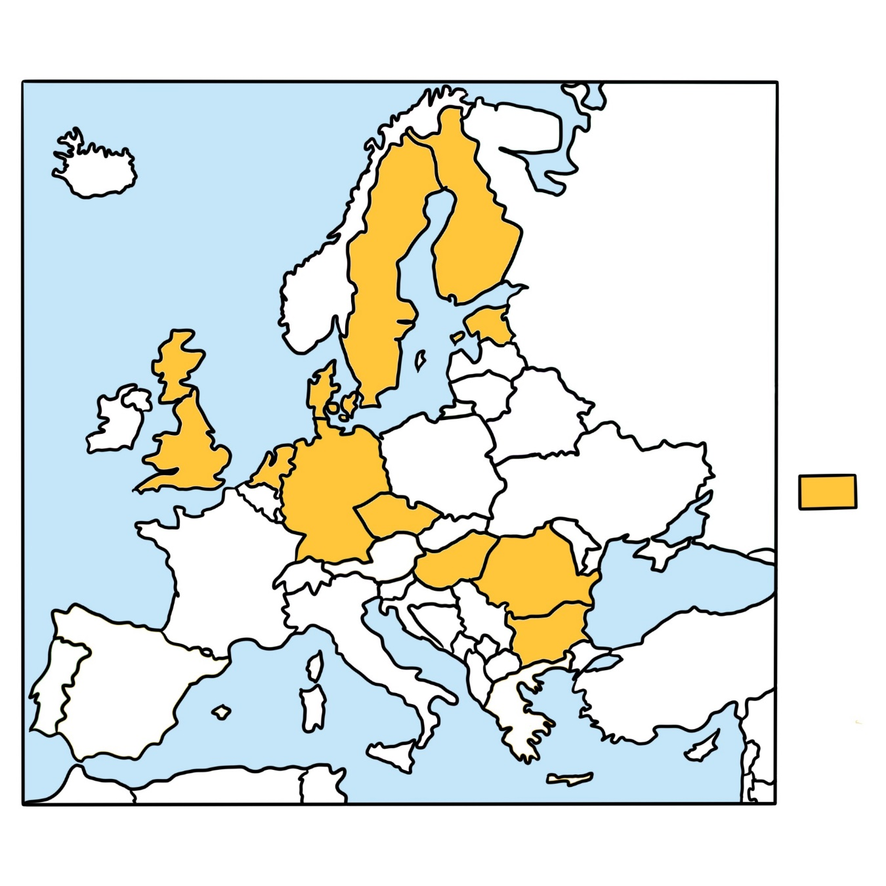
1) A casusal link between ground and consequence
Required
(12)

Slide 10
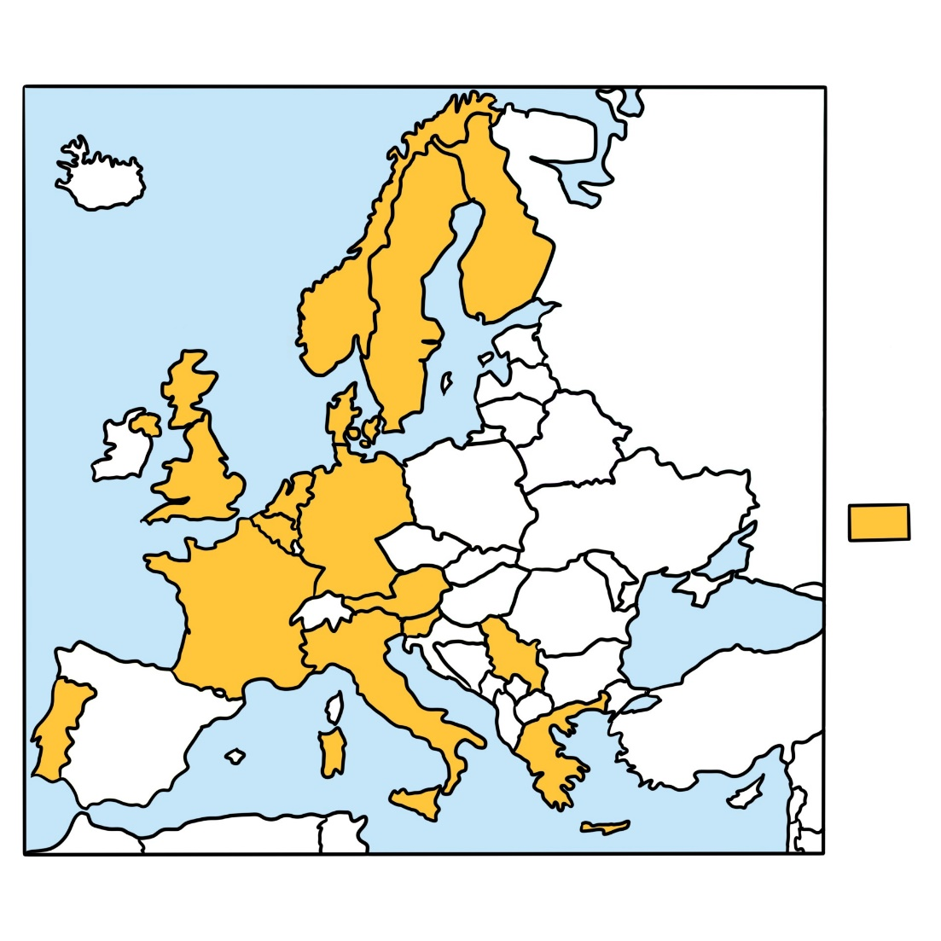
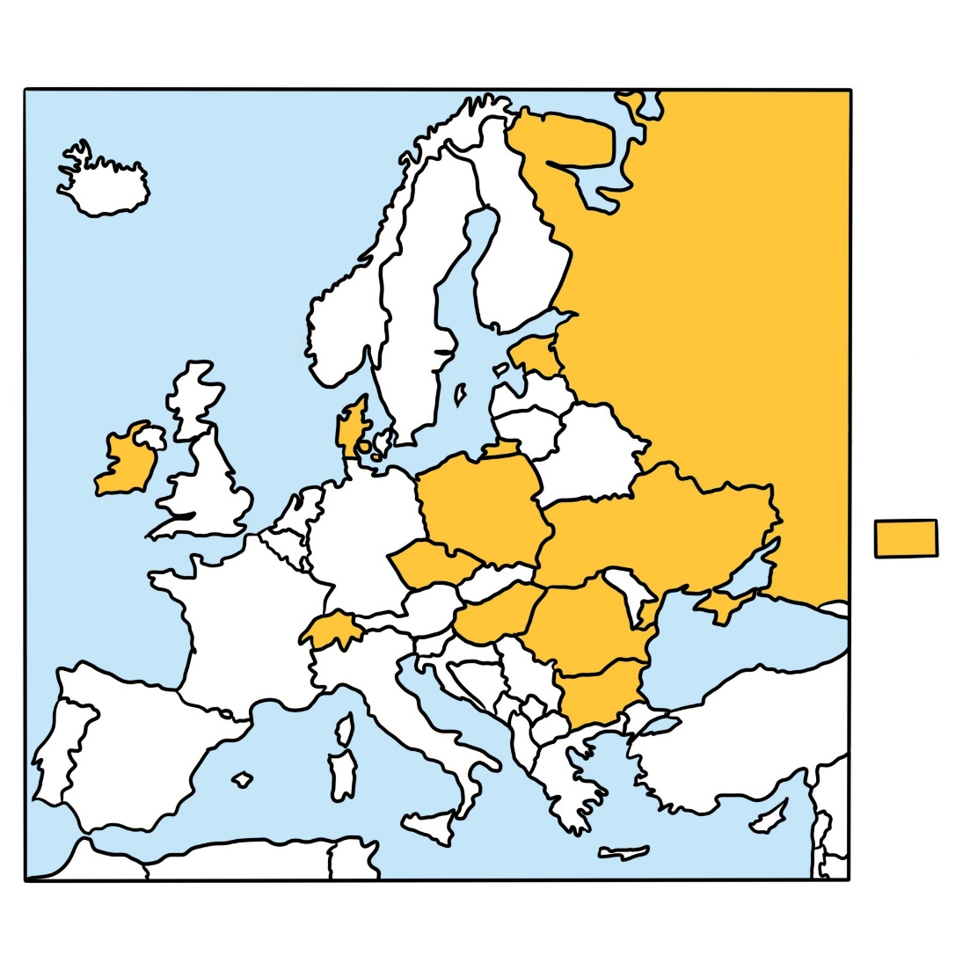
1) Physical condition as a ground?
Yes (15)
No – only mental condition
(11)

Slide 11
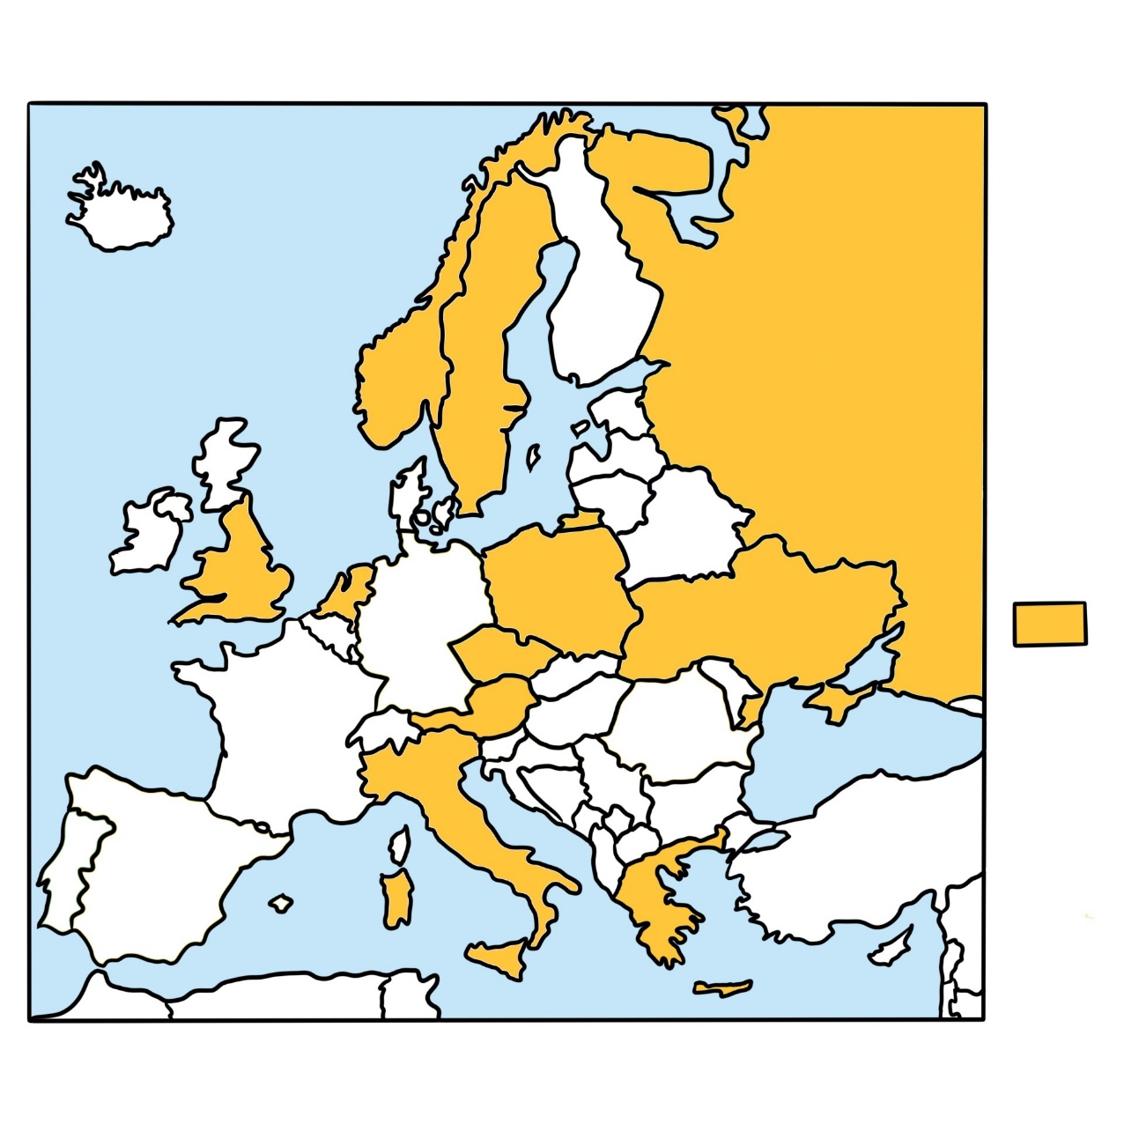
1) Substance abuse as a ground?
Yes
(11)

Slide 12
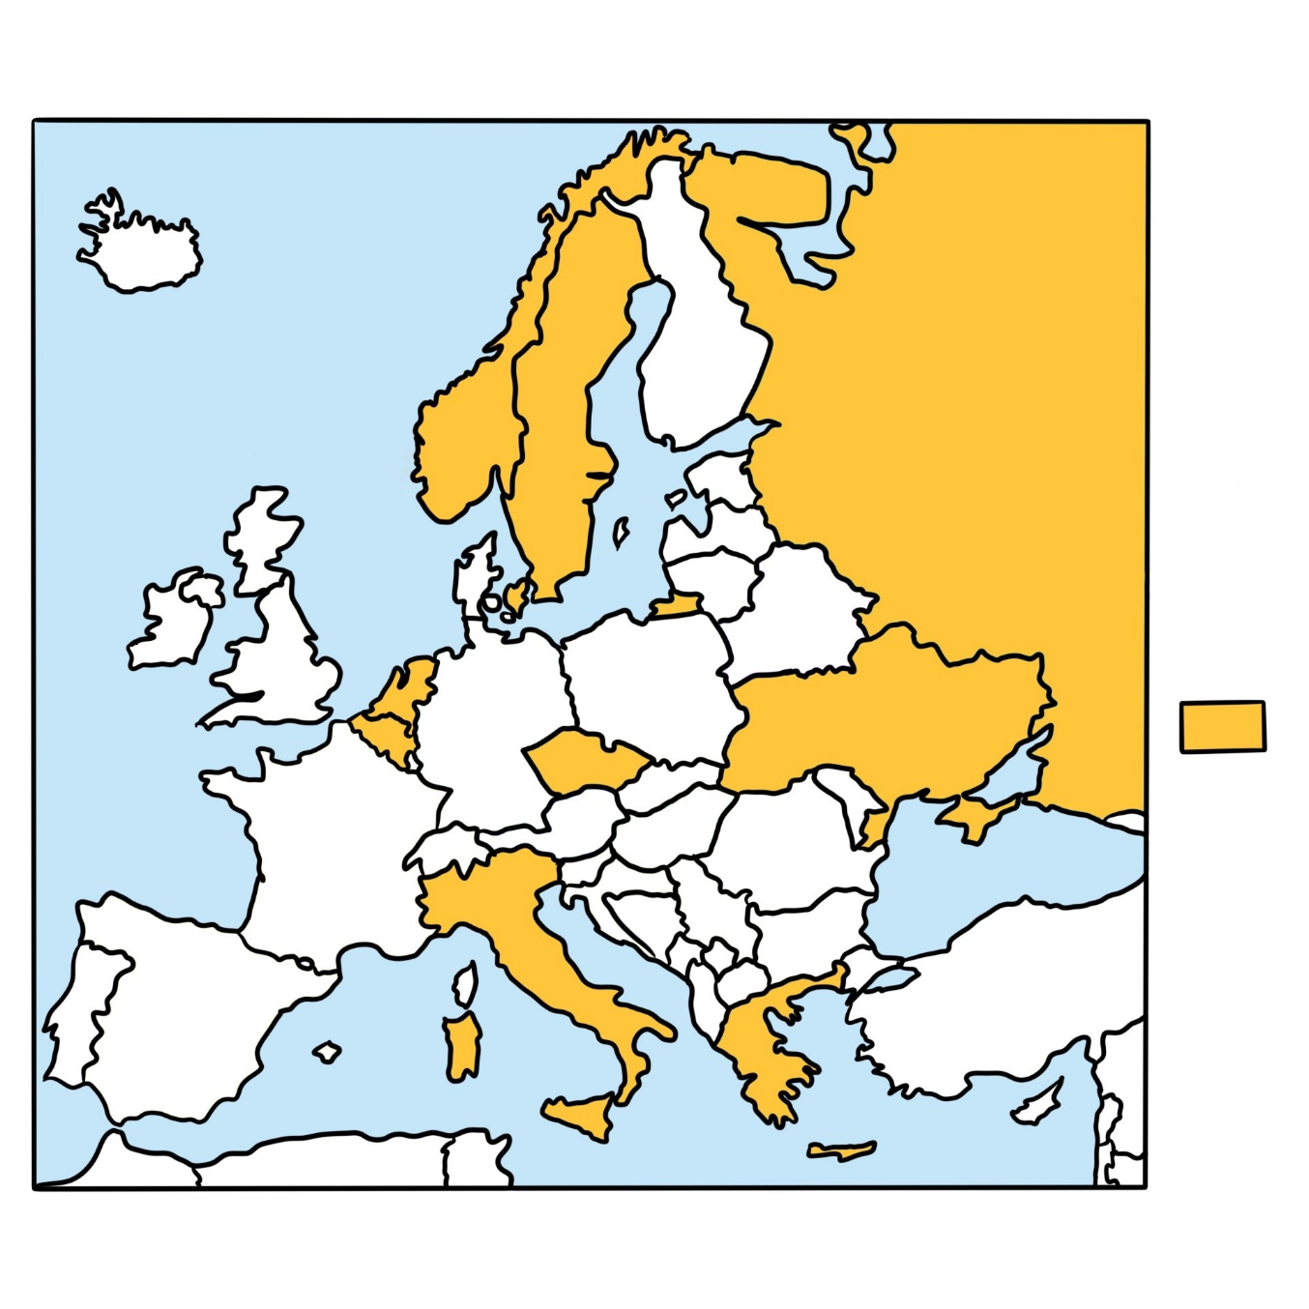
1) Prodigality as a ground?
Yes
(9)

Slide 13
2) The use of evidence
European Court of Human Rights:
Authorities must show that “the person concerned is either unable to care for his or her own needs, rights and interests, or presents a risk to the rights and interests of others. This cannot be done on the basis of general statements but only on the basis of specific facts.” (X and Y v Croatia, para. 107)
Recommendation No (99) 4:
At least one report from qualified expert

Slide 14
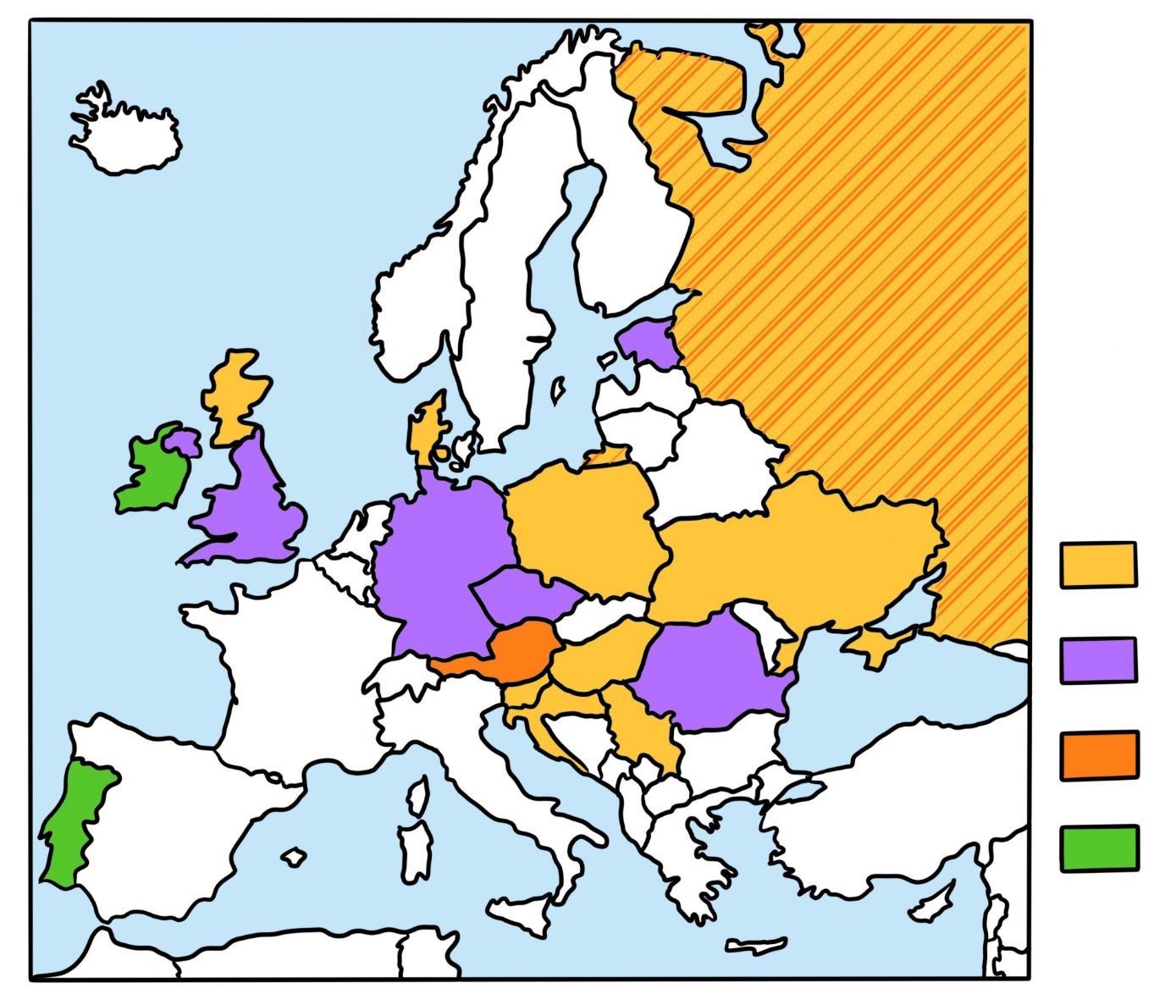
2) Use of a direct medical assessment
Required (9)
Required but subject to exceptions (5)
Right of adults to request (2)
Up to consideration of court (2)
Right to refuse medical assessment?

Slide 15
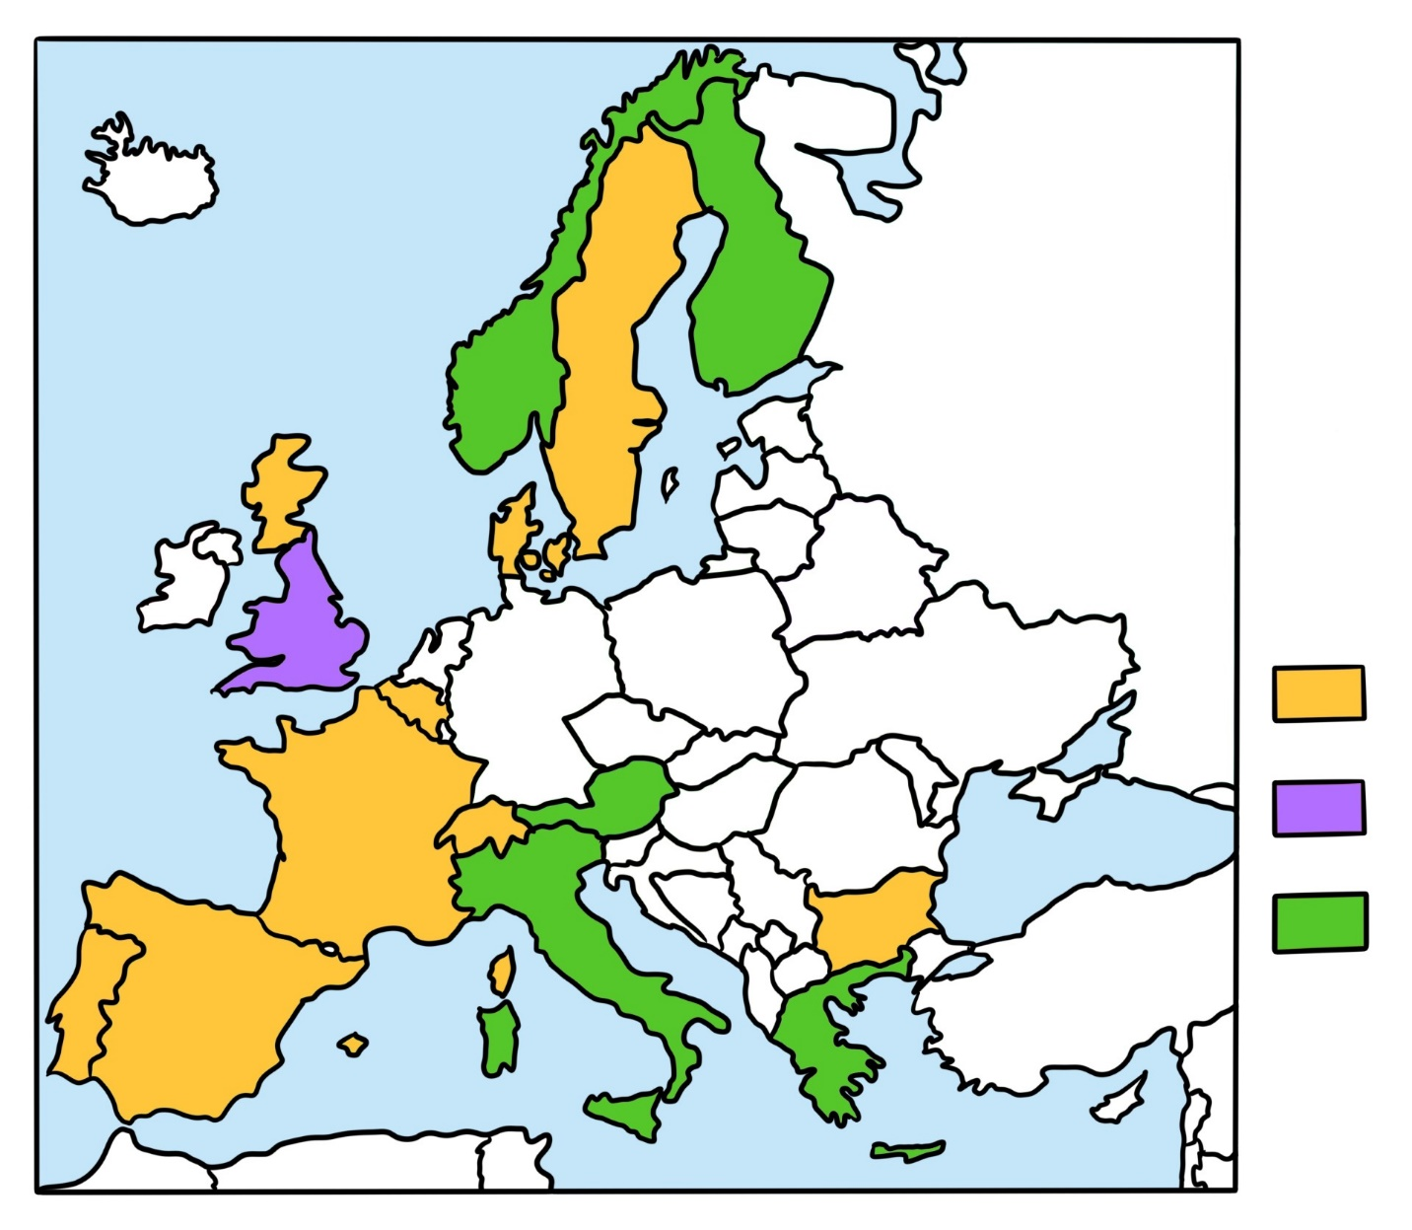
2) Use of a medical report
Required (9)
Required but subject to exceptions (1)
Up to consideration of court (5)

Slide 16
Use of a direct assessment by a medical professional
Required
Required but subject to exceptions
Right of adults to request
Up to consideration of court
Use of a medical report
Required
Required but subject to exceptions
Up to consideration of court

Slide 17
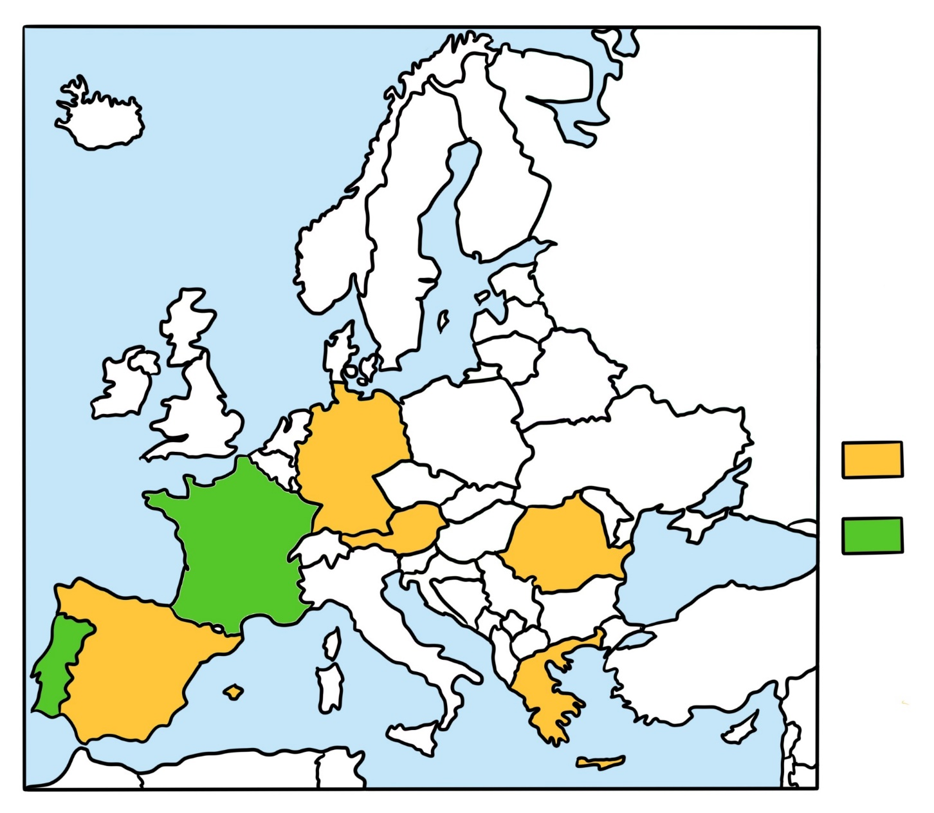
2) Use of a social report
Required (5)
Up to consideration of court (2)

Slide 18
3) A hearing of the adult
European Court of Human Rights:
“It is essential that the person concerned should have access to a court and the opportunity to be heard either in person or, where necessary, through some form of representation.” (Shtukaturov v Russia, paras. 71-73)
Recommendation No (99) 4:
Right to be heard in person in proceedings which could affect legal capacity

Slide 19
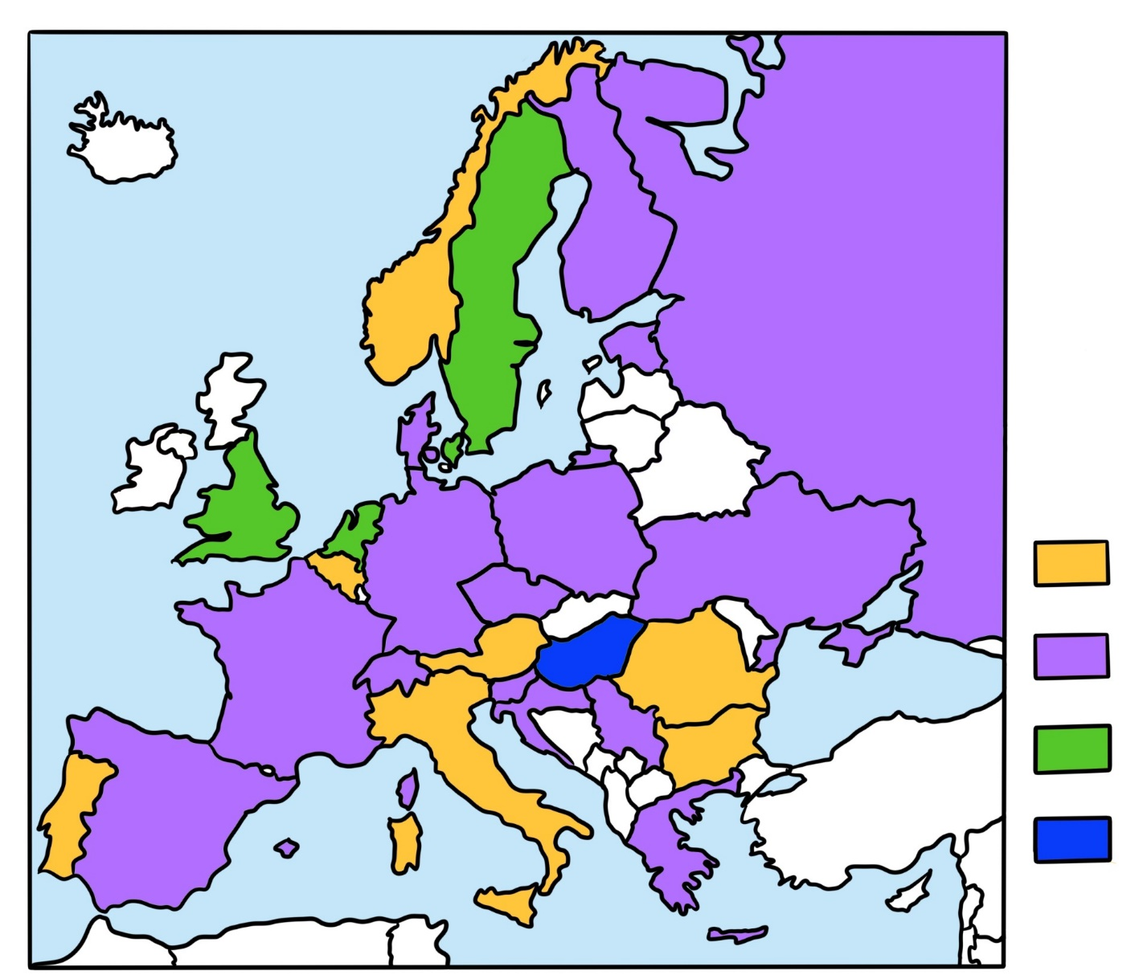
3) A hearing of the adult
Required (7)
Required but subject to exceptions (15)
Up to consideration of court (3)

Slide 20
Concluding remarks
Great variety between legal systems → new questions
Need for empirical research
Input is welcome!

Slide 21
Questions or remarks? Fiore Schuthof – PhD candidate
Utrecht Centre for European Research into Family Law
f.schuthof@uu.nl

