Slide 1
Continuing Powers of Attorney: Current status and future directions – an overview of the European Landscape based on the FL-EUR Reports
European pathways for supporting and protecting adults: insights and best practices across Europe
2 May 2025
Katrine Kjærheim Fredwall
Jordi Ribot
Rieneke Stelma-Roorda
Paula Távora Vítor

Slide 2
QuickScan on Continuing powers of attorney
The Council of Europe has defined a Continuing Power of Attorney as:
‘A mandate given by a capable adult with the purpose that it shall remain in force, or enter into force, in the event of the granter’s incapacity’
Advance Directives have been defined as:
‘Instructions given or wishes made by a capable adult concerning issues that may arise in the event of his or her incapacity’
The difference between the two is not always straightforward! The QuickScan looked at CPAs that include the appointment of an attorney to act on behalf of the adult in the event of incapacity, including wishes and instructions addressed to the attorney

Slide 3
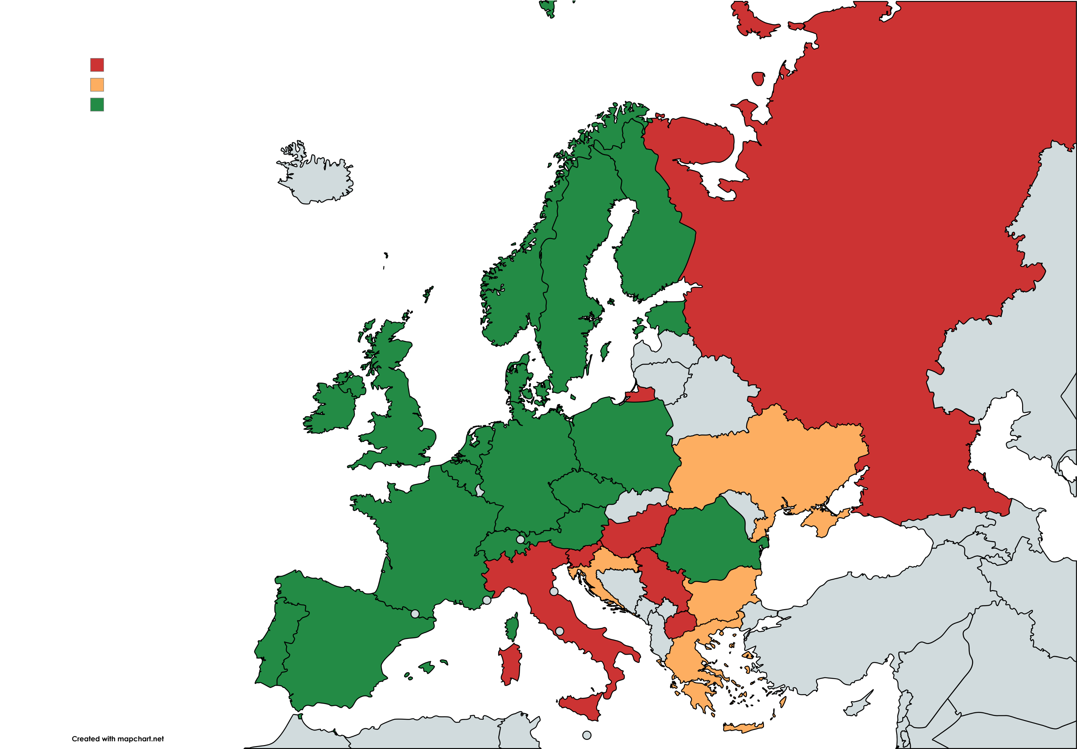
FL-EUR Jurisdictions with a CPA
Jurisdictions with a CPA: Austria, Belgium, Czechia, Denmark, England and Wales, Estonia, Finland, France, Germany, Ireland, Norway, Portugal, Romania, Scotland, Spain, Sweden, Switzerland, The Netherlands
Jurisdictions not falling under the definition: Bulgaria, Croatia, Greece and Ukraine
Jurisdictions without a CPA: Hungary, Italy, North Macedonia, Russia, Serbia and Slovenia
18 jurisdictions included in the QuickScan

Slide 4
Structure of our paper and presentation based on the QuickScan
Using the information gathered through the QuickScan, we will look at the current state of CPAs in the FL-EUR jurisdictions through the lens of the UNCRPD and Recommendation CM/Rec(2009)11.
Four focus points:
Legal nature and legal embedding of CPAs
Autonomy
Safeguards and Supervision
Law in action
After describing the current state, we zoom in on best practices, based on which we indicate the direction the development of CPAs in Europe should take in the future.

Slide 5
Structure of our paper and presentation based on the QuickScan
Using the information gathered through the QuickScan, we will look at the current state of CPAs in the FL-EUR jurisdictions through the lens of the UNCRPD and Recommendation CM/Rec(2009)11.
Four focus points:
Legal nature and legal embedding of CPAs – Jordi Ribot
Autonomy – Katrine Kjærheim Fredwall
Safeguards and Supervision – Paula Távora Vítor
Law in action – Rieneke Stelma-Roorda
After describing the current state, we zoom in on best practices, based on which we indicate the direction the development of CPAs in Europe should take in the future.

Slide 6
Normative framework - example
Article 12(3) UNCRPD - two forms of support:
Support enabling an adult to make a decision himself, and
Support in the absence of decision-making capacity of the adult, based on the adult’s will and preferences
Martin et al. 2016
Principle 10 of Recommendation CM/Rec(2009)11 on principles concerning continuing powers of attorney and advance directives for incapacity:
The attorney acts in accordance with the continuing power of attorney and in the interests of the granter.
The attorney, as far as possible, informs and consults the granter on an ongoing basis. The attorney, as far as possible, ascertains and takes account of the past and present wishes and feelings of the granter and gives them due respect.

Slide 7
Normative framework – A Ward’s report
Report to European Council:
«Proposal 3 That member states review laws relating to CPAs to ensure –
That in relation to all acts and decisions in their role as attorneys, attorneys are required to take all practicable steps to ascertain the will and preferences of the granter or failing that the best interpretation of the will and preferences of the granter.
(B) That in their acts and decisions on behalf of the granter attorneys are required to give effect to the will and preferences of the granter (or best interpretation thereof) except only where stringent criteria for doing otherwise, set forth in law, are satisfied.
(C) That the requirement to inform and consult the granter on an ongoing basis includes a requirement
(i) to present to the granter, in the form that the granter is most likely to understand, the information necessary to enable the granter to formulate and communicate his or her will and preferences,
(ii) to provide the granter with all reasonable support towards enabling the granter to formulate and communicate the granter’s will and preferences, and
(iii) to keep the granter informed of acts and decisions taken and implemented.»

Slide 8
Legal nature and legal embedding of CPAs
Two interrelated issues – questions raised and possible ways out
The categorisation of CPAs in the law
The regulatory answers for planning for future incapacity

Slide 9
Legal nature and legal embedding of CPAs
The categorisation of CPAs in the law
Diversity of approaches across European legal systems
Unilateral legal acts, bilateral agreements, mandates, trust-like relationships, unilateral plus bilateral ….
Add the different ways of handling interactions between ordinary powers of attorney (OPAs) and CPAs
How would an ‘ideal’ configuration look?
Assessment criteria
maximising adults’ autonomy
ensuring CPA’s operation, both internally and externally
Is a bilateral contract of representative mandate the best choice?
PROS
CONS
Finding the way out…

Slide 10
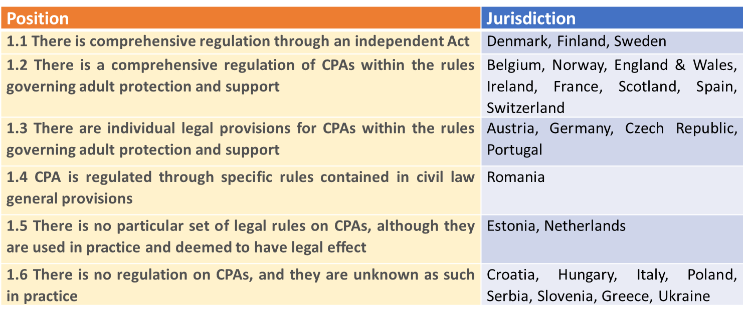
Legal nature and legal embedding of CPAs
The regulatory answers for planning for future incapacity
Diversity of approaches across European legal systems

Slide 11
Legal nature and legal embedding of CPAs
The regulatory answers for planning for future incapacity
Diversity of approaches across European legal systems
How would an ‘ideal’ legal framework look?
Assessment criteria
maximising adults’ autonomy
realising the subsidiarity principle
striking a fair balance between adults’ autonomy and protection
Finding the way out…
Promoting specific legal frameworks with default rules
Remaining/continuing effects confined to CPAs
Acceptance of the CPA or its operation triggers specific legal effects
Minimum legal framework including opt in / opt out provisions and mandatory effects and safeguards

Slide 12
Does the CPA secure autonomy – when granted – and when entered into force?
Normative framework: Article 12 UNCRPD and Principle 10 of Recommendation CM/Rec(2009)11
Autonomy is necessary to grant a Power.
Compared with statutory measures, granting of CPAs are based purely on autonomy.
However, can CPAs secure autonomy at later stages? Also, when the Power has entered into force?
following from the way the Power is drafted?
… the way the Power is limited; and which limitations secure autonomy – and which reduce autonomy?
… the way the decision-making is or is not regulated - in the law or the Power itself?
following from the requirements to inform and consult the granter when the Power is in force?

Slide 13
Autonomy – an analysis from 4 angels
4 angels:
Does the entry into force of the CPA limit the legal capacity of the granter?
Could limitations in the Power of Attorney possibly secure autonomy? Representation not possible:
Highly personal acts
Personal and family matters: When the adult still has capacity/when the adult’s consent is required
Care and medical matters: restrictions in certain (or all) medical matters
What are the criteria for decision-making? (Best interest /will and preferences or a mix?)
The duty to inform and consult

Slide 14
Autonomy – does the entering into force limit the legal capacity of the granter?
Position | Jurisdiction
The entry into force of a CPA does not (as such) limit the legal capacity of the adult | Austria, Belgium, Chech Republic, Denmark, Finland, Germany, the Netherlands, Norway, Portugal, Romania, Scotland and Spain
The entry into force of a CPA does not limit the legal capacity of the adult, but specific remedies are provided to annul the granter’s legal acts. (Not only ordinary rules on invalidity) | France
The entry into force presuppose incapacity and their decision-making power is transferred to the attorney | England and Wales, Switzerland, Sweden

Slide 15
Autonomy
Does the entry into force of the CPA limit the legal capacity of the granter? (Q 41)

Slide 16
When limiting the granter’s right to make a Power, could be a way of securing autonomy – or not?
Position | Jurisdiction
Representation is not possible for certain highly personal acts as for instance drafting a will, betrothal of marriage, confirming fatherhood, donating organ’s etc. | Austria, Belgium, Denmark, Finland, Germany, the Netherlands and Norway
Representation is not possible when the adult has capacity to decide - and a consent is required | Austria and Scotland (personal and family matters), Norway, Sweden and Spain (both personal, family and medical/care)
Representation through a CPA is not possible for certain or all medical matters on behalf of the adult. (Must for instance be a (co-)decision with a medical doctor etc.) | Norway, Spain and Sweden

Slide 17
Law in books, law in action
In 2023 32 year-old “Marita” with disabilities - was moved 450 km away from her home – since that would reduce costs for the municipality.
“Marita” was denied both the right to give a newspaper access to her medical files (related to living conditions) - and to have someone representing her in that matter – since this was deemed “highly personal”
The consequence was that Marita was excluded both from exercising her own rights and from receiving assistance to exercise her rights
Illustrates that limitations in representation intended to secure autonomy, can be misused
(Received an academic protest-storm and was obviously wrong)

Slide 18
Autonomy – criteria for decision-making
Position | Jurisdiction
The adult’s “best interest” | England and Wales
A mixed approach: the adult’s will and preferences, with a caveat – such as «so far as reasonable ascertainable» or without endangering the adult’s well-being or property etc. | Austria, Belgium, England and Wales, Finland, Ireland, Norway, Romania and Scotland
Will and preferences – or the adult’s assumed will and preferences, with only limited exceptions | Germany, Scotland and Spain
The law does not stipulate clear criteria for decision-making. | Portugal, Sweden, the Netherlands

Slide 19
Duty to inform and consult? (Q 42 C)
Position | Jurisdiction
Duty to inform and consult the adult | Austria, Belgium, England and Wales, Finland, Germany, Ireland, Norway, Scotland, Spain and Sweden
No duty to inform and consult the adult | -
Not specified in the law | Portugal, The Netherlands
.

Slide 20
Duty to inform and consult – some consequences
A duty to inform and consult necessary for an effective “will and preferences-approach”. The duty can be construed in different ways, follow from the Power itself or an agreement between the Granter and the Attorney
No duty to inform and consult will normally prove that “will and preferences” as decision-making criteria is not functioning

Slide 21
Main findings autonomy - common core
1. The entry into force of the CPA does not limit the legal capacity of the granter - which means that the CPA itself does not limit anyone’s capacity. In the light of the normative framework, this must be seen as the better rule
2. The Attorneys are often excluded from making highly personal decisions /medical questions. If this is the better rule or not, may depend on from whom we need to hinder exploitation and undue influence
3. Challenge: The relation between the Granter and the Attorney after the Power has entered into force is “a black box” – we have limited knowledge of the interactions between G and A in this phase. In need of more research…

Slide 22
Normative framework – Safeguards and Supervision Article 12 UNCRPD – Equal recognition before the law
4. States Parties shall ensure that all measures that relate to the exercise of legal capacity provide for appropriate and effective safeguards to prevent abuse in accordance with international human rights law. Such safeguards shall ensure that measures relating to the exercise of legal capacity:
respect the rights, will and preferences of the person,
are free of conflict of interest and undue influence,
are proportional and tailored to the person’s circumstances, apply for the shortest time possible and
are subject to regular review by a competent, independent and impartial authority or judicial body.
The safeguards shall be proportional to the degree to which such measures affect the person’s rights and interests.
Related to the functioning of systems of support (also VM and CPAs, in particular?)

Slide 23
Normative framework – Safeguards and Supervision Recommendation CM/Rec(2009)11 on principles concerning continuing powers of attorney and advance directives for incapacity
Principle 12 − Supervision
The granter may appoint a third party to supervise the attorney.
States should consider introducing a system of supervision under which a competent authority is empowered to investigate. When an attorney is not acting in accordance with the continuing power of attorney or in the interests of the granter, the competent authority should have the power to intervene. Such intervention might include terminating the continuing power of attorney in part or in whole. The competent authority should be able to act on request or on its own motion.
Principle 11 – Conflict of interest
States should consider regulating conflicts of the granter’s and the attorney’s interests.
Principle 10 – Role of the attorney
The attorney, as far as possible, informs and consults the granter on an ongoing basis. The attorney, as far as possible, ascertains and takes account of the past and present wishes and feelings of the granter and gives them due respect.
The granter’s economic and financial matters are, as far as possible, kept separate from the attorney’s own.
The attorney keeps sufficient records in order to demonstrate the proper exercise of his or her mandate

Slide 24
Safeguards and Supervision
Safeguards in a system of support
CPA’s – “based purely on autonomy”
CORE VALUE: Promotion of autonomy
2 levels
Respect for will and preferences (primary purpose – CG n.º 1)
Prevention of abuse - “conflicts of interest”, “undue influence” (secondary/instrumental purpose)
Yardsticks: international human rights law; principle of proportionality

Slide 25
Safeguards and Supervision
Safeguard systems
Diversity of approaches - different systems include different combination of elements of the following (but not necessarily all) categories. Absence of a common or clearly more dominant framework.
I) Preventive safeguards
Preventive nature
Primarily focused in red flag categories (unauthorised acts; ill-conceived acts; conflicts of interests)
On the account of the attorney (legal duties; limitation of action); on the account of an authority/Court
May function within or regardless of a formal supervision system
II) Reactive safeguards (framework of legal reactions)
Reactive nature
Types of legal reactions: consequences regarding the performed act; regarding the measure/powers of the attorney; liability for damages
May function within or regardless of a formal supervision system
III) Supervision system

Slide 26
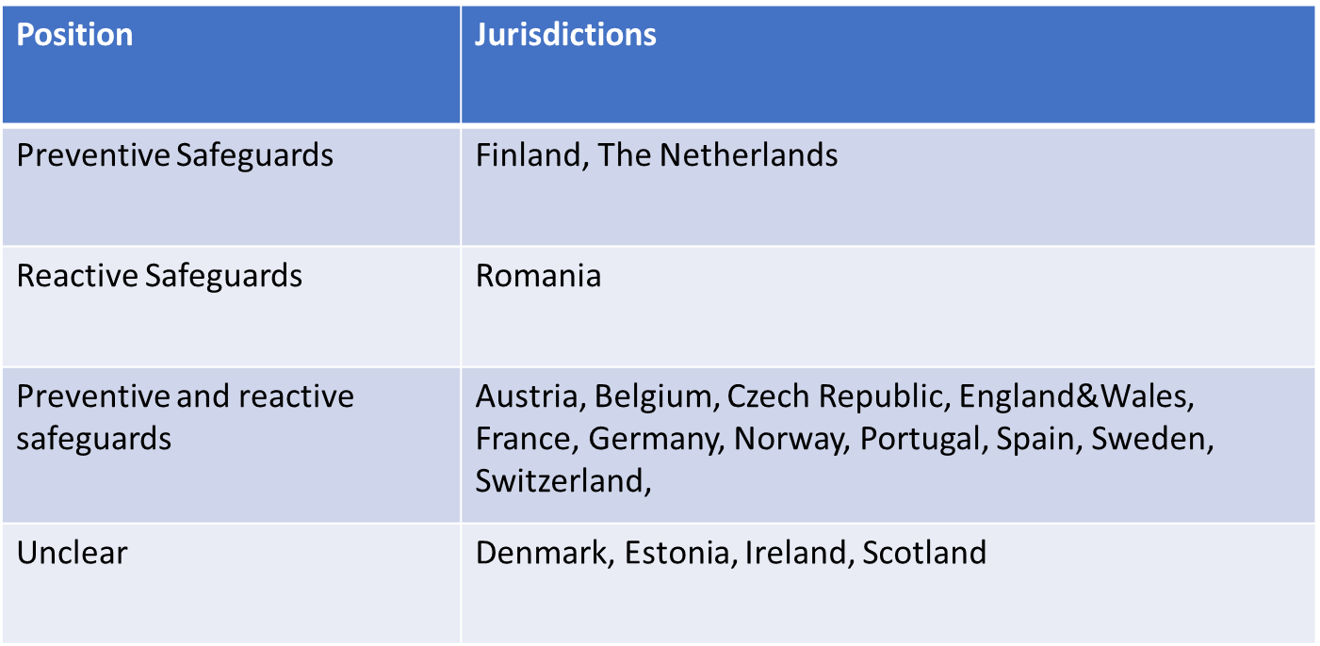
Safeguards and Supervision
Safeguard systems

Slide 27
Safeguards and Supervision
Supervision systems
Publicly conducted (operation)
Privately conducted (drafting+operation)
b. Supervision activities
“investigate”
“intervene” (ex ante; ex post)

Slide 28
Safeguards and Supervision
Supervision systems
Position | Jurisdictions
Preventive Safeguards | Finland, The Netherlands
Reactive Safeguards | Romania
Preventive and reactive safeguards | Austria, Belgium, Czech Republic, England&Wales, France, Germany, Norway, Portugal, Spain, Sweden, Switzerland,
Unclear | Denmark, Estonia, Ireland, Scotland

Slide 29
Safeguards and Supervision
A. Are CPAs compatible with:
1) Absence of a “safeguard system"?
Art. 12(4) UNCRPD – demand of “appropriate and effective safeguards”
“The safeguards shall be proportional to the degree to which such measures affect the person’s rights and interests.”
What degree of safeguards do CPAs demand?
How to ensure that the system does not lose the flexibility and informality associated to (and privileged by) voluntary measures?
2) Absence of a formal supervision system?
Art. 12(4) UNCRPD - demand of a “competent, independent and impartial authority or judicial body” in charge of review (also for voluntary measures/CPAs?)
B. If a “safeguard system” is demanded
What are the minimum requirements? Establishment of preventive safeguards? Establishment of reactive consequences? Which?
Is a formal system of supervision necessary? What are the organizational demands? What powers should be granted? What are criteria for intervention?
How to ensure that the “will and preferences” of the granter are safeguarded (and not the “best interest”)?

Slide 30
Law in Action
Aim of looking at the ‘law in action’:
Does the CPA work in practice as intended/provided for by legislation?
What are the strengths, weaknesses, problems and best practices of the CPA in the various jurisdictions?
Question 49 of the FL-EUR Questionnaire:
‘What are the problems which have arisen in practice in respect of the voluntary measures (e.g. significant court cases, political debate, proposals for improvement)? Has the measure been evaluated, if so, what are the outcomes?

Slide 31
Law in Action
Problems | Jurisdictions
The possibility to make a CPA is not sufficiently promoted and CPAs are therefore relatively unknown to the public | Belgium, Croatia, Scotland
Risk of abuse / lack of safeguards according to legislation / lack of safeguards included in the CPA | Belgium, Scotland, Switzerland, The Netherlands
Expectations towards attorneys are insufficiently known | Scotland
Problems with the enforceability of CPAs in practice (e.g. conflict between multiple attorneys, problems with the acceptance of CPAs) | Belgium, The Netherlands

Slide 32
Law in Action
Problems | Jurisdictions
Lack of tailor-made wishes and instructions in the CPA taking into account the possibility of future changes | Belgium, The Netherlands
Unclear or missing legal provisions regarding CPAs | Czechia, Finland, Portugal, Sweden
Problems with the accessibility of CPA forms (due to e.g. digitalisation) | England & Wales, Romania
Inadequate registration and/or publication | France, Norway, Sweden
The use of the so-called ‘status approach’ regarding capacity | Ireland
The (high) costs of drafting and/or registering a CPA | Scotland

Slide 33
Thank you for your attention!
Continuing Powers of Attorney: Current status and future directions – an overview of the European Landscape based on the FL-EUR Reports
Katrine Kjærheim Fredwall
Jordi Ribot
Rieneke Stelma-Roorda
Paula Távora Vítor

