Slide 1
Third FL-EUR Conference
Session 1: Statutory Measures
IRELAND: Decision-making assistance agreements &
Co-decision-making agreements
Áine Flynn,
Director, Decision Support Service
2 May 2025

Slide 2
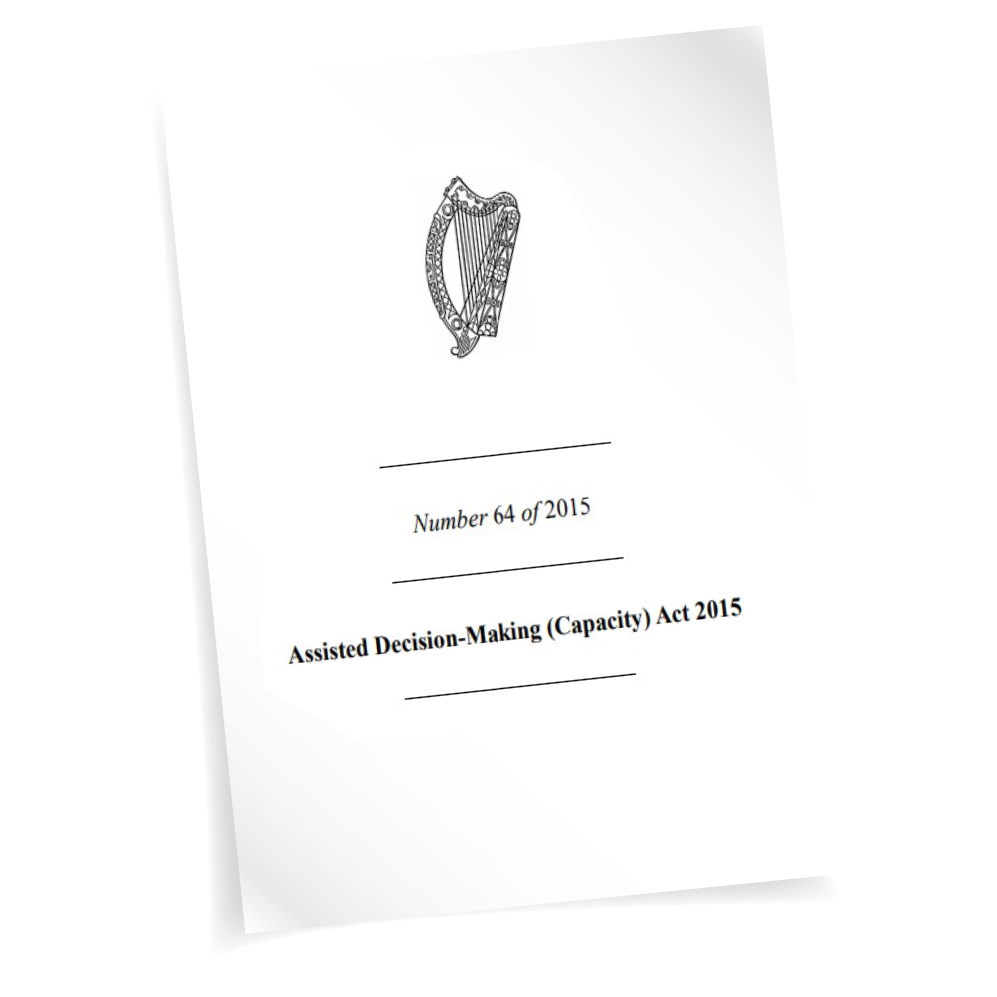
Assisted Decision-Making (Capacity) Act 2015
An Act to provide for the reform of the law relating to persons who require or may require assistance in exercising their decision-making capacity, whether immediately or in the future.
Enacted 30 December 2015
A seismic cultural shift towards a rights-based approach of choice, control and consent
- Inclusion Ireland, December 2015
Assisted Decision-Making (Capacity) (Amendment) Act 2022 enacted 17 December 2022
2015 Act (as amended) commenced 26 April 2023; Decision Support Service began operations

Slide 3
April 2023

Slide 4
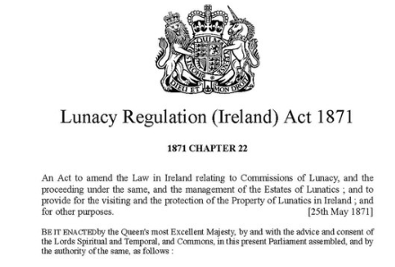
Structures pre-2015 Act
Wards of court system, Lunacy Regulation(Ireland) Act 1871
- ‘a person of unsound mind incapable of managing his money or property’
An order making a person a ward of court has real consequences. It can deprive a person of the power to make many of the choices which are fundamental and integral to day-to-day life.
HSE v. A.M., Supreme Court January 2019
2,100 (approx.) adult wards of court at commencement in April 2023
Enduring Power of Attorney under the Powers of Attorney Act 1996

Slide 5
New support framework - 3 tiers
3
Decision-making representative
New support framework
2
Co-decision-maker
1
Decision-making assistant

Slide 6
Statutory functional assessment of capacity
“A person’s capacity shall be assessed on the basis of ability to understand at the time that a decision is to be made, the nature and consequences of the decision in the context of available choices"
Not ‘a person of unsound mind’
Capacity time-specific and issue-specific, not binary
No diagnostic criteria or threshold; no reference to ‘mental capacity’
A person lacks capacity if unable to:
understand;
retain;
weigh up information;
communicate a decision, with appropriate assistance if necessary

Slide 7
Guiding Principles for Interveners
‘Interveners’ include the Director, the courts carrying out functions under the 2015 Act and all decision supporters
presumption of capacity for adults
a persons shall not be considered unable to make a decision unless all practicable steps have been taken to help him or her to do so
an unwise decision does not mean that the person lacks capacity
proportionality, minimal restriction of rights and freedom of action
dignity, bodily integrity, privacy, autonomy, right to control over own finances and property
give effect as far as practicable to past and present will and preferences
act in good faith and for the benefit of the person
No reference to best interests
United Nations Convention on Rights of Persons with Disabilities, ratified by Ireland in 2018-
UNCRPD Optional Protocol; came into effect 30 November 2024

Slide 8
What decisions may be supported?
Property and affairs, including:
Personal Welfare, including
Accommodation
Education and training
Social services
Healthcare
Participation in healthcare/social care research, not including clinical trials
“…other matters relating to the relevant person’s wellbeing”
Buying and selling property
Applying for benefits
Carrying on a business
Paying debt and liabilities
Providing for other persons
Court proceedings

Slide 9
Eligibility Criteria
A person is not eligible for appointment as a decision-making assistant or co-decision-maker if
convicted of offences in relation to the appointer or the appointer’s child
the subject of a barring order or safety order in relation to the appointer or the appointer’s child
an undischarged bankrupt or in debt settlement arrangements- ineligible in relation to property and affairs decisions only
previously removed by the court from acting as decision-making assistant or co-decision-maker for the appointer
the owner, registered provide or employee of a service in which the appointer resides
convicted of one of the specific offences created by the 2015 Act

Slide 10
Decision-making assistant (DMA)
1
‘Appointer’ is a person who considers that his or her capacity is or may shortly be in question
Relevant decisions are set out in a decision-making assistance agreement
Functions of decision-making assistant:
assist to obtain and explain relevant information
ascertain and help appointer to communicate will and preferences
assist appointer to make and express decisions
help to ensure that decisions implemented
The appointer still makes the decision
No capacity assessment required
Notified to but not formally registered with the Decision Support Service
Process is provided for by Regulation (S.I. No. 205/2023)- signing and witnessing formalities and requirements to give notice

Slide 11
DMAAs: an overview
112 active notified DMAAs*
33 pending review by the DSS
Gender of appointer | Total | %
Male | 38 | 42%
Female | 46 | 51%
Prefer not to say | 0 | 0%
Unknown | 7 | 8%
Civil Status | Total | %
Cohabitating | 1 | 1.1%
Married | 34 | 37.4%
Separated/Divorced | 0 | 0.0%
Single / Widowed | 53 | 58.2%
Unknown | 3 | 3.3%
*Data as of 30 April 2025

Slide 12
DMAAs: an overview
Communication/Other details | Total declared | %
Difficulty with learning, remembering, concentrating | 51 | 56%
Difficulty with basic physical activities | 50 | 55%
Other chronic illness | 28 | 31%
Psychological/Emotional condition/Mental health | 15 | 16%
Intellectual disability | 12 | 13%
DMA is: | Total | %
Daughter | 32 | 29%
Son | 19 | 17%
Sibling | 17 | 15%
Parent | 16 | 15%
Niece | 9 | 8%
Husband | 5 | 5%
Friend | 3 | 3%
Uncle | 2 | 2%
Nephew | 2 | 2%
Neighbour | 1 | 1%
Wife | 1 | 1%
Aunt | 1 | 1%
Cousin | 1 | 1%
Care Giver | 1 | 1%

Slide 13
Co-decision-maker (CDM)
2
‘Appointer’ is a person who considers that his or her capacity is or may shortly be in question
Co-decision-maker is a relative or friend in a pre-existing relationship of trust
Functions of co-decision-maker:
assist the appointer to obtain relevant information
advise the appointer, explain relevant information ascertain and
help to communicate will and preferences
make a relevant decision jointly
make reasonable efforts to ensure that decision is implemented
to acquiesce- unless serious harm is foreseeable, but this does not confer a right of veto
An appointer may appoint only one co-decision-maker in a single co-decision-making agreement

Slide 14
Registration of a co-decision-making agreement (CDMA)
Application to register must contain supporting statements, including:
from appointer that he or she understands and wish to enter into a co-decision-making agreement
from co-decision-maker that he or she understands and undertakes to comply with functions and guiding principles
statement as to why as to why the less intrusive measure of a DMAA was not chosen
capacity statement from a medical practitioner or prescribed healthcare professional to confirm
appointer has capacity to decide to enter into a co-decision-making agreement
requires the assistance of the co-decision-maker
has capacity to make decisions specified in the co-decision-making agreement
with the co-decision-maker
Notice parties- family members or other current decision supporters- may object on specified grounds
DSS must review to ensure compliance and consider any objections before registering
2
A decision taken in scope of a registered CMDA shall not be challenged for incapacity
A decision not taken jointly is null and void/ documents requiring signature must be co-signed

Slide 15
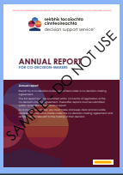
CDMA: After registration
Co-decision-maker reports to the DSS
Annual reports must detail any financial transactions
Co-decision-maker may not claim remuneration and may not make gifts
Non-compliance with reporting may lead to removal by the DSS- this determination is appealable to court
Section 26: DSS also conducts separate periodic reviews after 12-15 months and every 3 years- an updated capacity statement is required
Co-decision-maker is obliged to notify the DSS if the appointer’s capacity either deteriorates or improves
Matters giving rise to nullity include:
the appointer moves to a higher tier of support
the co-decision-maker becomes disqualified based on eligibility criteria
the co-decision-maker is the appointer’s spouse or partner and the relationship ends
the co-decision-maker enters into a decision support arrangement
2

Slide 16
CDMAs: an overview
94 active notified CDMAs*
60 pending review by the DSS
Gender | Total | %
Female | 48 | 48%
Male | 45 | 45%
Unknown | 7 | 7%
Prefer not to say | 0 | 0%
Civil Status | Total | %
Single / Widowed | 73 | 73%
Married | 21 | 21%
Unknown | 4 | 4%
Cohabitating | 1 | 1%
Separated/Divorced | 1 | 1%
*Data as of 30 April 2025

Slide 17
CDMAs: an overview
Communication/Other details | Total declared | %
Difficulty with learning, remembering, concentrating | 81 | 81%
Difficulty with basic physical activities | 50 | 50%
Intellectual disability | 35 | 35%
Other chronic illness | 35 | 35%
Psychological/emotional condition/mental illness | 26 | 26%
CDM is: | Total | %
Sibling | 26 | 26%
Son | 19 | 19%
Daughter | 17 | 17%
Parent | 10 | 10%
Wife | 7 | 7%
Nephew | 5 | 5%
Niece | 4 | 4%
Friend | 3 | 3%
Aunt | 2 | 2%
Uncle | 2 | 2%
Cousin | 2 | 2%
Grandchild | 2 | 2%
Cohabitant | 1 | 1%
Husband | 0 | 0%

Slide 18
Matters arising….
Section 138: nothing in this Act alters the existing law on capacity or consent in relation to specific matters, including
marriage
separation and divorce
placing a child for adoption
guardianship
sexual relations
Section 41(3) when the court declares that a relevant person lacks capacity unless assisted by a co-decision-maker but the relevant person dos not have a suitable co-decision-maker, then a decision-making representative appointed in default must endeavour to make decision jointly
Issues with wards who are discharged from wardship to register a co-decision-making agreement

Slide 19
Investigations of complaints about decision support arrangements
Grounds of complaint
Director powers – Section 96
Commission a special or general visitor
Summon witnesses
Take up evidence
Escalate to court
Temporarily suspend pending investigation
Escalate for criminal investigation, if necessary
Conduct own initiative investigations
Resolve informally
Acting outside scope
Unsuitability
Arrangement not in accordance with will and preferences
Fraud, coercion, undue influence
Capacity issues
Breach of function or a breach of Act, including guiding principles
Complaint may be raised by any person

Slide 20
Codes of Practice
13 codes published with Ministerial consent 2023
general guidance code on supporting decision-making and assessing capacity
guidance for decision-making assistants and co-decision-makers
A person concerned shall have regard to a code of practice when performing any function under the Act in respect of which the code provides guidance

Slide 21
Go raibh maith agaibh
Thank You
Dank je wel
Website: www.decisionsupportservice.ie
Email: queries@decisionsupportservice.ie
Telephone: (01) 2119750
This presentation is intended as an overview of aspects of the Assisted Decision-Making (Capacity) Act 2015 and related matters and should not be relied on as legal advice or opinion

