Slide 1
Procedural Safeguards in Adult Guardianship Proceedings A Comparative Perspective
Fiore Schuthof – PhD candidate
Utrecht Centre for European Research into Family Law f.schuthof@uu.nl

Slide 2
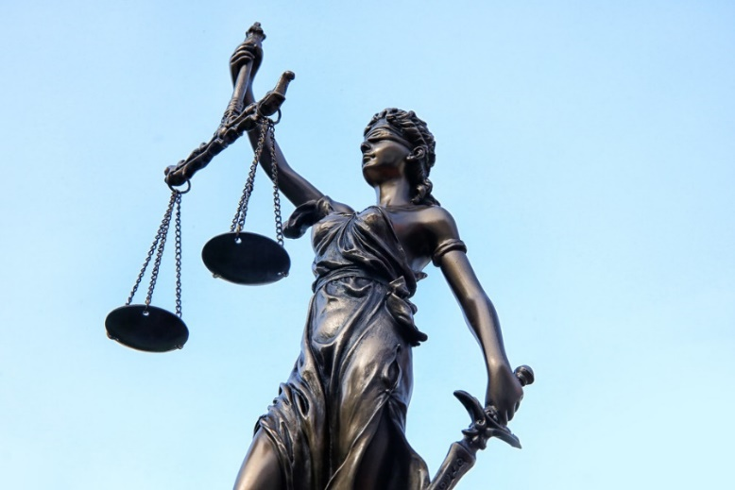
Procedural safeguards
Definition & Importance
Strict <> Flexible Safeguards
Practice in Europe?
Source: Open Verse Creative Commons

Slide 3
Today’s presentation
Research based on 28 national reports
Focus on three safeguards:
1 – Expert Reports
2 – Personal Hearings
3 – Legal Representation

Slide 4
1A The Use of Expert Reports
European Court of Human Rights:
Importance of expert reports (e.g. X and Y v Croatia, para 85)
‘Sufficiently detailed’ – but little guidance (e.g. Sykora v Czech Republic, para 103)
Margin of appreciation (e.g. Korošec v. Slovenia, para 45)
Refusing a psychiatric assessment? (e.g. Sýkora v. Czech Republic, para 62 & Nowicka v. Poland, para 61)

Slide 5
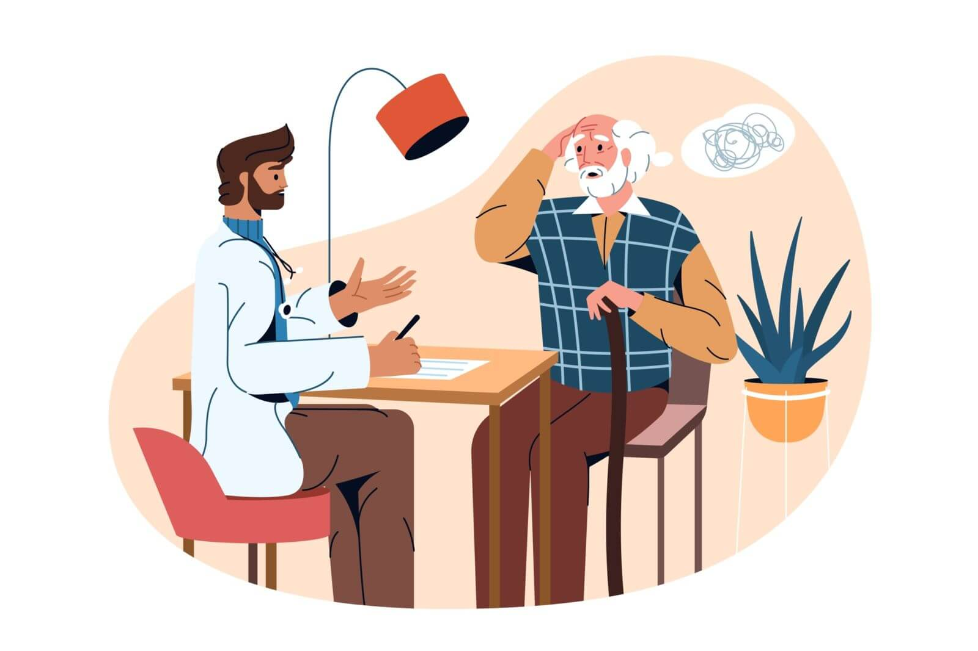
1B Expert Reports in Europe
Variation in expert report requirements
Some countries: forced assessements
Reflection on approaches

Slide 6
2A The Right to a Personal Hearing
European Court of Human Rights:
Important for both the judge and the individual (e.g. Lashin v Russia, para 82 & Salontaji-Drobnjak v. Serbia, para 147)
Margin of appreciation, but must concerns be demonstrated (e.g. Salontaji-Drobnjak v. Serbia, para 126-127)
Refuse personal hearing? (e.g. Pfeiffer and Plankl v. Austria, para 37)

Slide 7
2A Personal Hearings in Europe
Incorporated by most jurisdictions
In some: can be waived without evidence
Alternative ways of hearing
Forced attendance

Slide 8
3A Access to Legal Represenation
European Court of Human Rights:
Requirement may depend on
Individual’s ability to present own case (e.g. M.S. v Croatia, para 104)
Significance of decision (e.g. M.S. v Croatia, para 104)
Complexity of issues (e.g. DD v. Lithuania para 122)
Representation by a lawyer?
Legal aid (e.g. Airey v. Ireland, para 26 & P., C. and S. v. the United Kingdom, para 88-91)

Slide 9
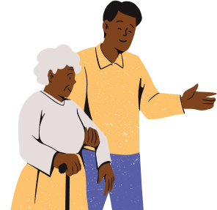
3A Legal Represenation in Europe
Varied approaches, strictly required in few
Role of representatives
Legal aid: free representation for all?

Slide 10
Concluding remarks
Great variety between legal systems → new questions
Reflects underlying aim of guardianship
Growing need for support with legal decision-making

Slide 11
In your view,
how should we decide when strict safeguards are necessary
and when flexibility might be needed and justified?

Slide 12
Questions or remarks? Fiore Schuthof – PhD candidate
Utrecht Centre for European Research into Family Law
f.schuthof@uu.nl

