Slide 1
Understanding the practical application of CPAs: Insights from empirical research in three European countries
European pathways for supporting and protecting adults: insights and best practices across Europe
2 May 2025
Katrine Kjærheim Fredwall
Jordi Ribot
Rieneke Stelma-Roorda

Slide 2
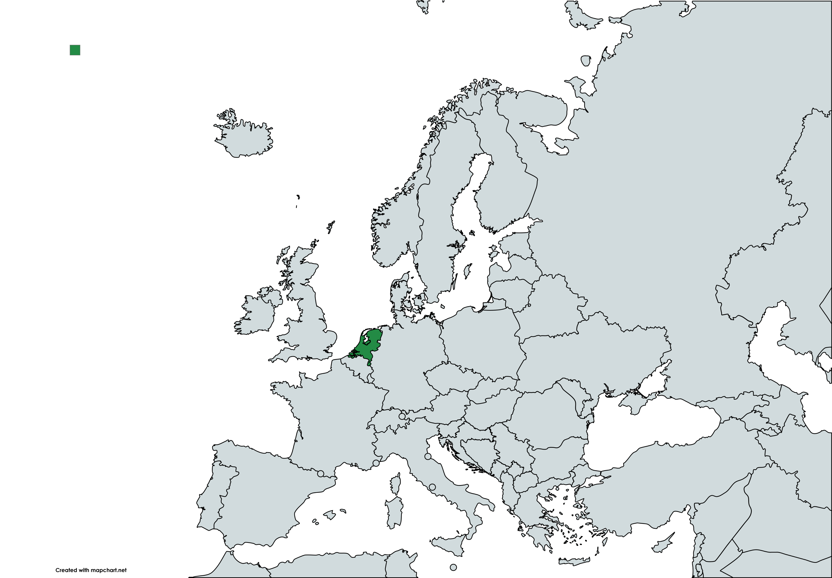
The Netherlands
CPA can be included in a so-called ‘levenstestament’
236.254 registered in 2024, an increase of 8% compared to the year before
Three exploratory research studies:
Survey study looking at the experiences of notaries (2019)
Analysis of published court cases (2021)
Interview study in cohort design with adults who had recently made a levenstestament, nominated attorneys and active attorneys (2021)
A fourth exploratory study is currently conducted
Interview study with professional attorneys (together with the University of Groningen)

Slide 3
The Netherlands – Survey study
Survey study (2019) looking at the experiences of professionals working at the beginning of the lifespan of the CPA: notaries
The survey was sent to all 3239 notaries in the Netherlands, 164 notaries (6,8%) fully completed the survey.
Active CPA
Entry into force
Drafting of a CPA

Slide 4
The Netherlands – Survey study
Most notaries indicated that the majority of their clients drafting a levenstestament are between 60 and 70 years old.
The levenstestament is in most cases drafted to make provisions for a future period of incapacity.
50% of the respondents indicated that most of their clients use the levenstestament to arrange financial affairs.

Slide 5
The Netherlands – Survey study
How do notaries perceive the need to include a form of supervision in the levenstestament?
 | Frequency | Percent
In all cases | 55 | 32,9
Upon request of the adult | 66 | 39,5
In case of sensitivities | 44 | 26,3
Never | 2 | 1,2
Total | 167 | 100

Slide 6
The Netherlands – Survey study
The term ‘autonomy’ was used in different ways and also used to highlight the power of the attorney or the broader family to engage in estate planning without the ‘prying eyes’ of the court
This is not in line with the aim of the levenstestament as an instrument protecting the interests of the adult!
Advantages of the levenstestament according to notaries
 | Frequency
Autonomy / no interference from third parties | 110
Time gain/continuation | 19
Affairs are put in order | 13
Estate planning | 18
Customisation | 14
Other | 32

Slide 7
The Netherlands – Analysis of published court cases
Court cases where the court – notwithstanding the existence of a levenstestament – was confronted with a request for a state-ordered measure
33 cases included in the analysis (up till July 2021)
Situations in which the court might consider a state-ordered measure:
Unsuitability of the attorney (e.g. misuse/abuse by the attorney)
Conflicts between the attorneys
Conflicts between the attorney and family members not appointed as such
Problems with the acceptance
Insufficient protection against unwise decisions by the adult
Active CPA
Entry into force
Drafting of a CPA
Notes:
KKF: This would be the case also in Norway.

Slide 8
The Netherlands – Interview study with adults and attorneys
1. The adult has recently made a levenstestament | 2. The levenstestament has entered into force | 3. The levenstestament has been active for a while and there is a decline of the adult’s cognitive abilities
Expectations of adults and nominated attorneys | Expectations and experiences of active attorneys
23 interviews with adults who had recently made a levenstestament & 6 interviews with nominated attorneys | 16 interviews with active attorneys (ranging from recently started to active for a while)

Slide 9
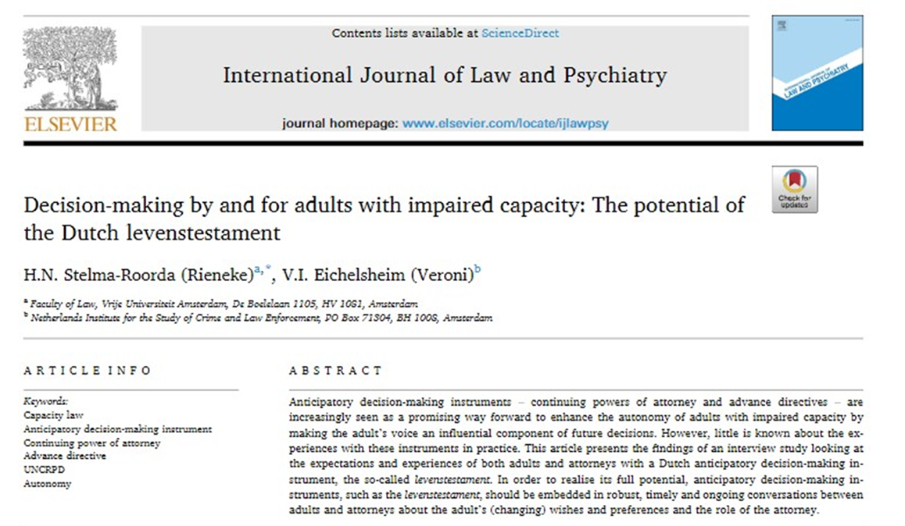
The Netherlands – Interview study with adults and family attorneys
Observations:
Information in the levenstestament about wishes, preferences and instructions is limited.
This information is not in all cases supplemented by conversations between the adult and the attorney.
The importance of regular and ongoing conversations - after all, wishes and preferences can change - is not understood by everyone
Over time with cognitive decline, having such conversations becomes even more difficult
The above creates the risk that the information as to the adult’s voice is limited. Although there is a lot the attorney can do, he knows little about what the adult wishes him to do.

Slide 10
The Netherlands – Interview study with professional attorneys
Together with Leon Verstappen (University of Groningen)
Semi-structured interviews with 16 professional attorneys
Coding and analysis phase currently taking place
Initial observations:
Clients are often adults with a limited social network
Involvement of a professional attorney during the drafting phase can potentially be very valuable
Several professional attorneys use an additional document – a so-called ‘life-file’ – besides the levenstestament
Active CPA
Entry into force
Drafting of a CPA

Slide 11
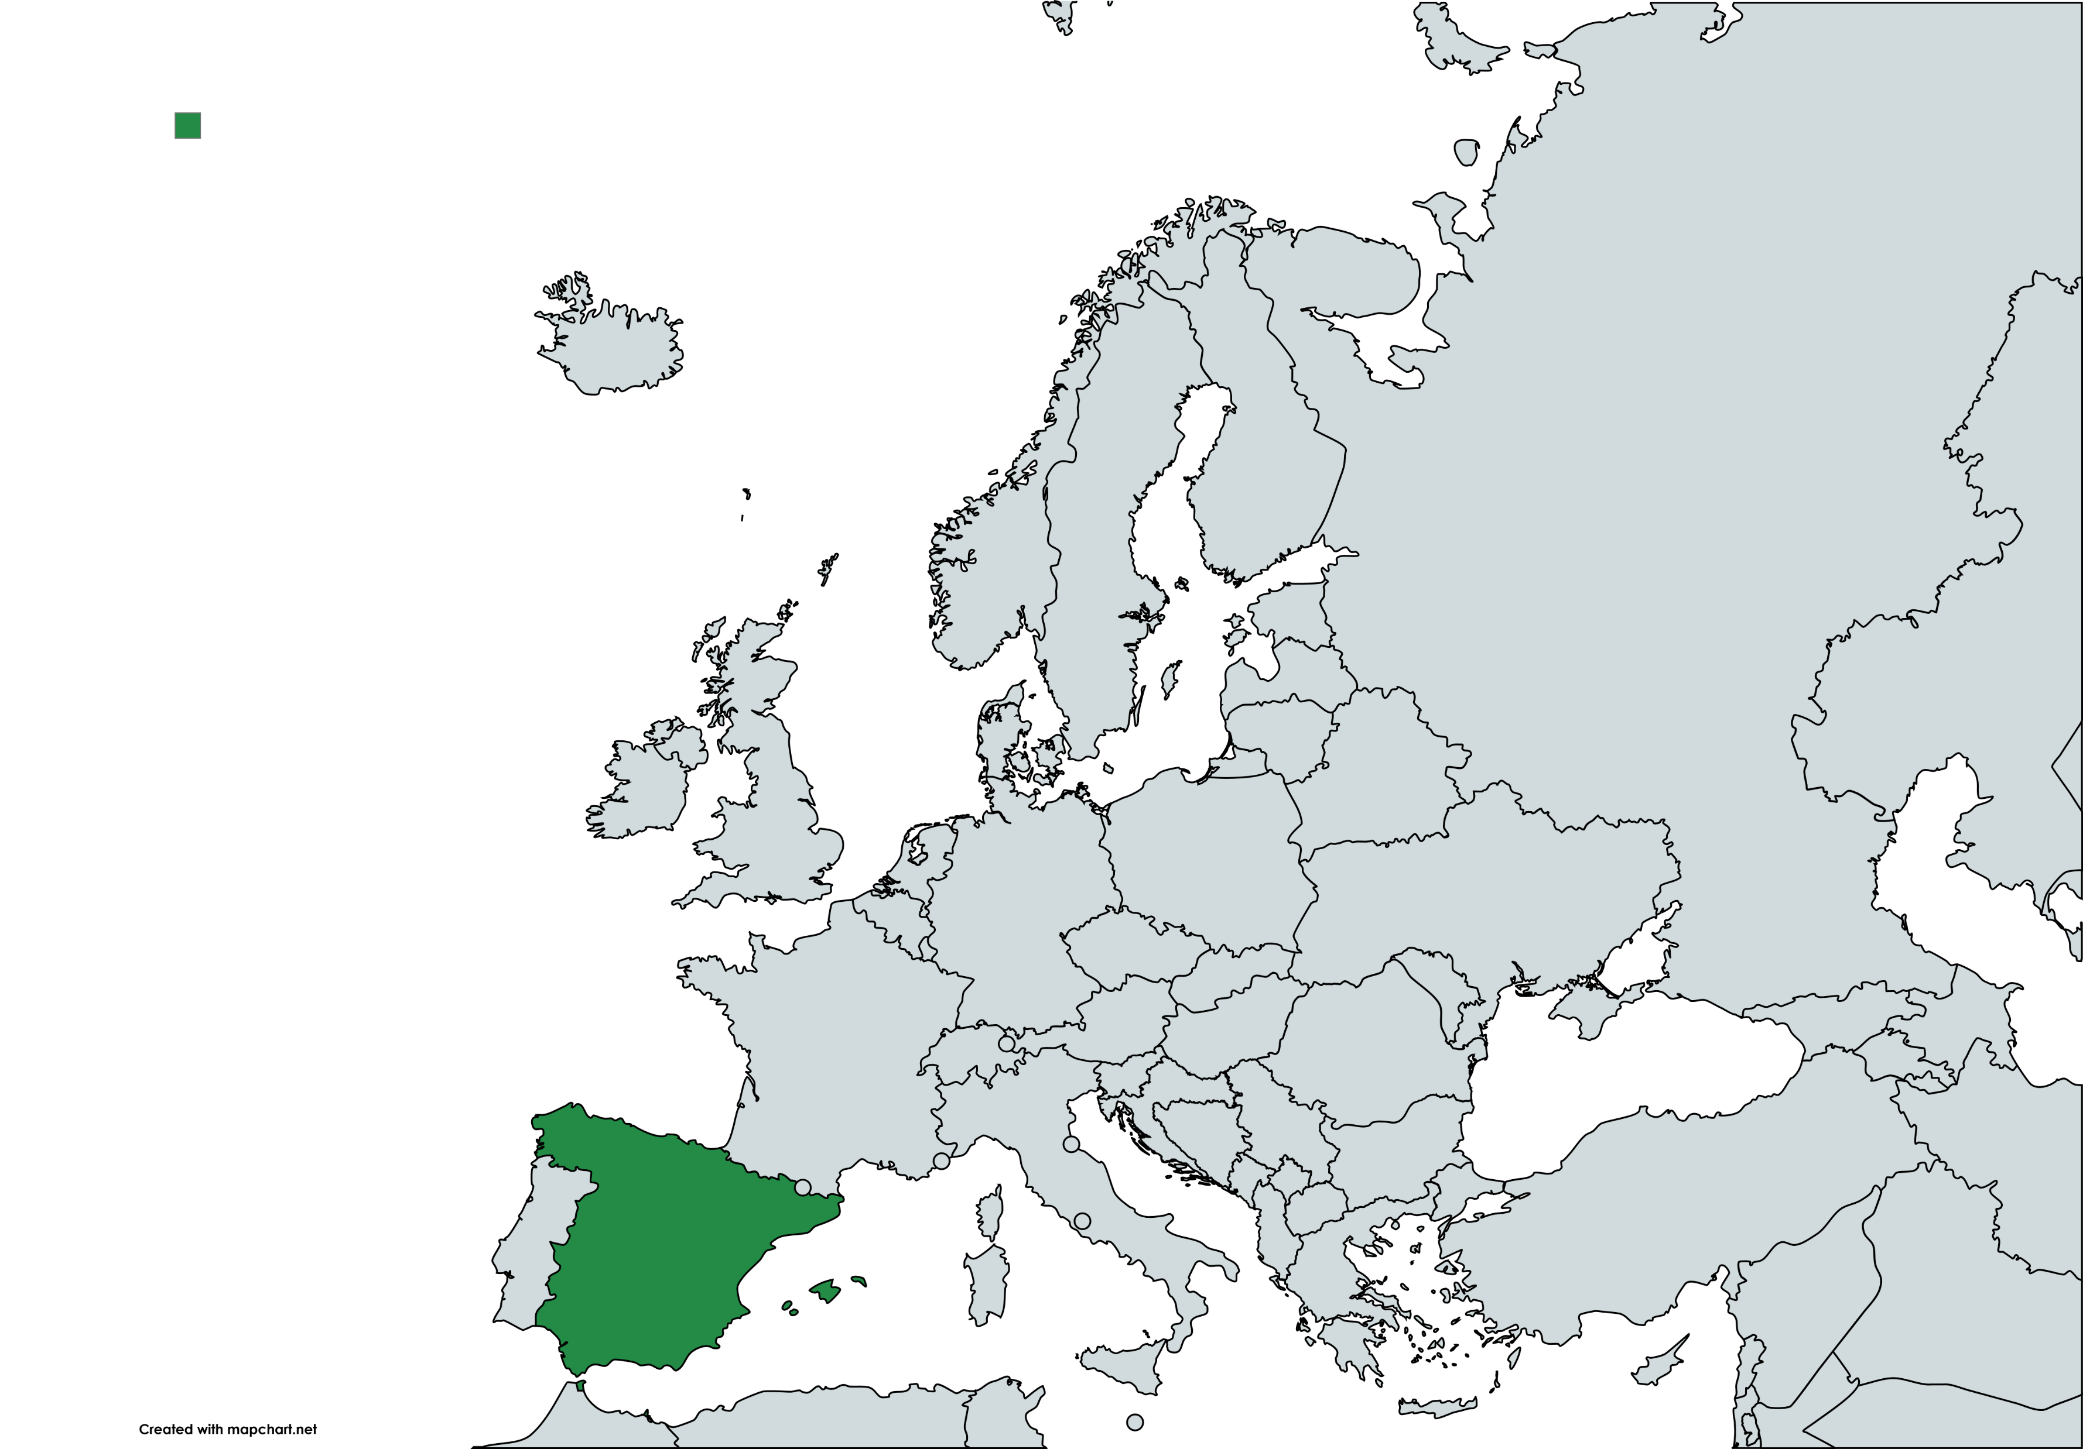
Spain
CPA are admitted in Spanish law since 2003 and known in doctrine as poder preventivo
In practice their use has grown exponentially

Slide 12
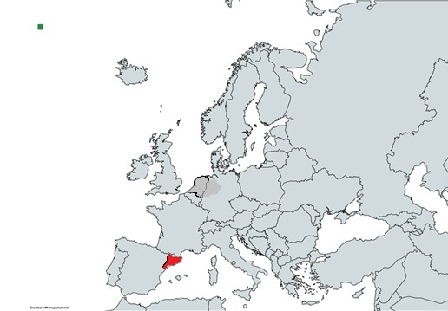
Spain (Catalonia)
CPAs are regulated in the Catalan Civil Code since 2011
Two types:
POWER OF ATTORNEY REMAINING IN FORCE UPON INCAPACITY
POWER OF ATTORNEY ENTERING INTO FORCE UPON INCAPACITY

Slide 13
Spain (Catalonia)
Available data (2023)
Legal acts (notarialised) |  | Registered acts Catalan Government
General Power of Attorney | 29012 | 26171
Continuing Power of Attorney | 10650

Slide 14
Spain (Catalonia)
Available data
Granters’ gender
Female | 7.168 | 57,60%
Male | 4.610 | 37,00%
No data | 666 | 5,40%
Total | 12.444 | 100%

Slide 15
Spain (Catalonia)
Available data
Granters’ age
0-20 | 21 | 0,20%
21-40 | 148 | 1,20%
41-60 | 889 | 7,10%
61-70 | 1.314 | 10,60%
71-80 | 2.764 | 22,20%
81-90 | 3.414 | 27,40%
91-100 | 879 | 7,10%
>100 | 4 | 0,00%
No data | 3.011 | 24,20%
Total | 12.444 | 100%

Slide 16
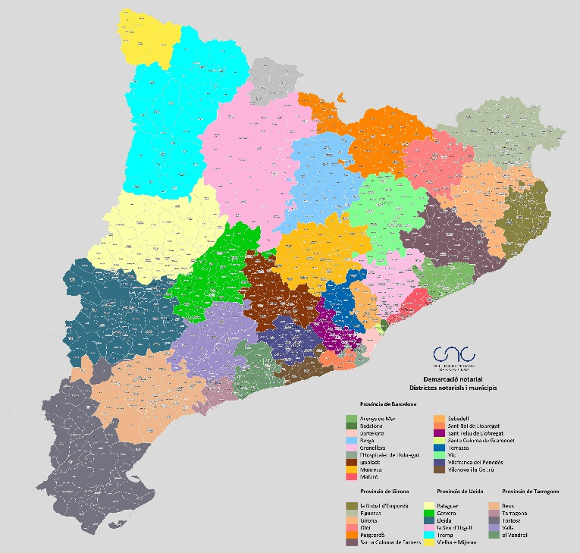
Spain (Catalonia)
Two exploratory research studies currently conducted:
Survey study looking at the experiences of notaries (2024)
Interview study with notaries (together with the University of Barcelona) (2025)
Survey study data
Anonymous online form via Microsoft Forms (39 questions, with sub-sections)
Sent in May 2024 to all notaries practicing at that time in Catalonia (n = 452)
Responses collected between May 30 and July 30, 2024
A total of 76 responses were collected: 26 in the Spanish version and 50 in the Catalan version (overall response rate: 16.7%)

Slide 17
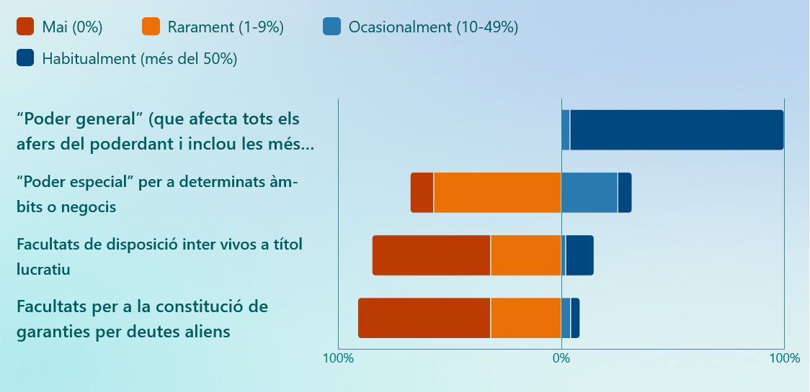
Spain (Catalonia)– Survey study
Who are appointed as attorneys?
Almost always the spouse/cohabitant and/or children
Extremely rarely other relatives, professional (lawyers, accountants) or NGOs providing support
Almost all CPAs are made to have immediate effect and to remain in force in a future period of incapacity
Most notaries indicated that more than 85% of the notarialised CPAs are general powers of attorney that include the so-called survivorship clause –remaining in force upon incapacity
(Pure) continuing power of attorneys are totally marginal (<2%)
Most of the respondents indicated that their clients use CPA to arrange financial affairs, but personal and welfare issues are not at all uncommon
Attorneys are granted the broadest powers legally available, but not generally for making donations or securing third parties’ obligations

Slide 18
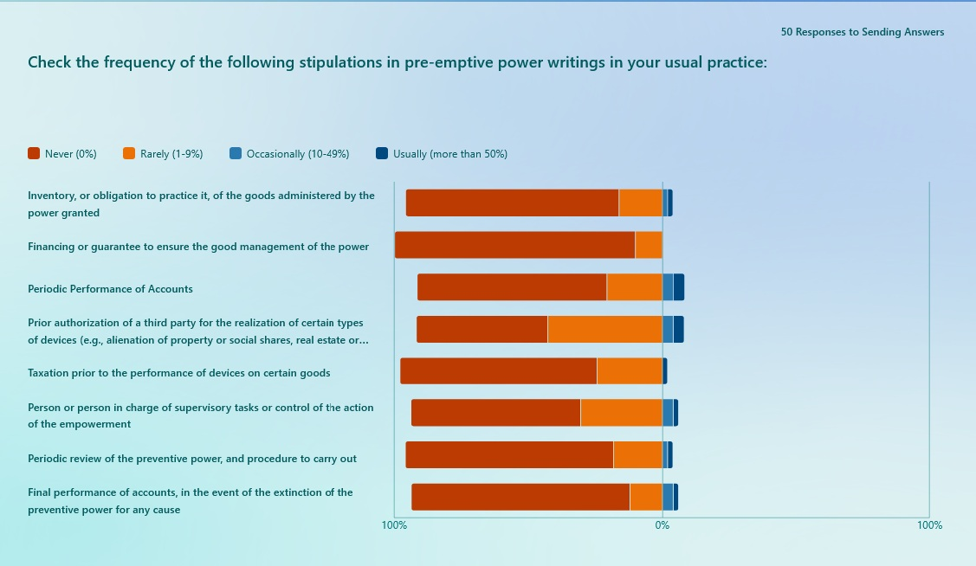
Spain (Catalonia)– Survey study
No reference to
Obligations arising from the representation, if the designation is accepted
Duties to maintain personal contact with the granter and periodically obtain their opinion and preferences on decisions to be made
Most notaries confirm that CPAs are made without any kind of safeguard, such as inventory of assets, periodic account delivery, authorisation of important legal acts by third parties or the judge, etc

Slide 19
Spain (Catalonia)– Survey study
No reference to
Obligations arising from the representation, if the designation is accepted
Duties to maintain personal contact with the granter and periodically obtain their opinion and preferences on decisions to be made
Most notaries confirm that CPAs are made without any kind of safeguard, such as inventory of assets, periodic account delivery, authorisation of important legal acts by third parties or the judge, etc
CPAs include instead very often individual clauses waiving up the application of certain statutory safeguards
Very frequent stipulations
Allowing selfcontracting | 76%
Waiving up safeguards in conflict of interest cases | 75%
Waiving up statutory requirements as to court permission to enter into most important legal acts | 64%

Slide 20
Spain (Catalonia)– Survey study
How do notaries perceive the need to include a form of supervision in CPAs?
‘Safeguards would be agreed only in the case of powers of attorney in favor of professionals or entities. Spouses and parents have trust spouses and children as they will proceed with their assets as if they were their own.’
‘once the power has been granted, what the adults want is peace of mind and not follow up on it periodically; if the CPA would involve this type of obligations they would say: look, leave it!’
‘Attorneys are so trusted by the granter that control or safeguard clauses are rarely incorporated. The adult wants to make their lives "easy" and that is why he does not usually put controls in place.’

Slide 21
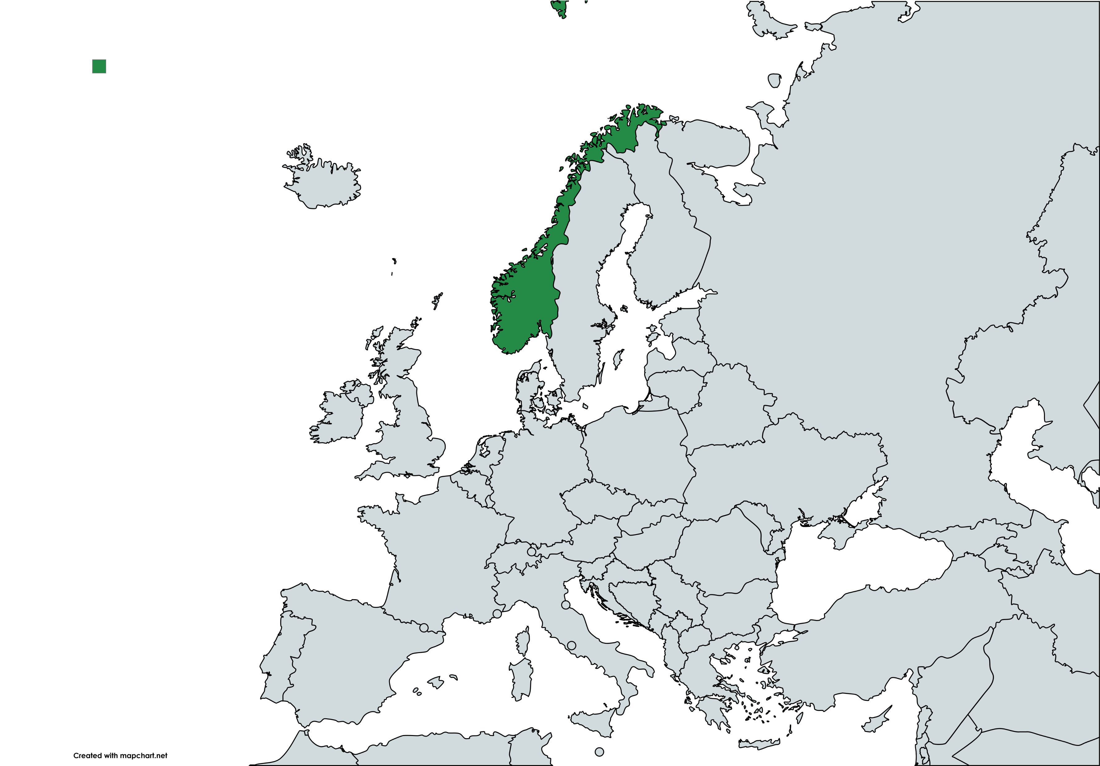
Norway
A comprehensive regulation of CPAs came into force in Norway in 2013 – still a young legal Instrument
Conducted research an investigations:
Kvisberg/Vea Lund has analyzed the use of all confirmed CPAs the first 5 years (2013 – 2018), 563 CPAs are in-depth analyzed.
Report from the Authority regarding the functioning of the Instrument (20.12.2023)
Analyzing of court cases and administrative decisions.

Slide 22
Norway
To register a CPA is voluntary, which means that we do not have solid statistics for all CPAs. To be registered the CPA must be:
- granted
- come into force – often following from age
- the Attorney must choose to register
The registered CPAs have nevertheless increased exponentially; doubled ten times in 5 years
AND the state-ordered measures have not increased in spite of such growth was expected due to an aging population
This growth make it crucial that the CPAs give the Granter the support he/she need.
Years | Registered CPAs
2019 | 434
2020 | 1 016
2021 | 1 596
2022 | 2 489
2023 | 3 616
2024 | 4 651

Slide 23
Norway – who is appointed as Attorney?
Who are the granters? More women (70 %) than men (30%) ;
Why? … perhaps because the female spouse was of better health and represented the male spouse informally – or before the Act came into force.
Who is appointed as Attorneys?
Who is Attorney? | Percentage
Granter’s child/children | 83 %
Granter’s spouse | 9 %
Granter’s niece and nephew | 2 %
Granter’s brother or sister | 1 %
A professional Attorney (lawyer etc.) | 1 %
Others | 3 %

Slide 24
Norway – CPAs as tool for distributing the Estate
According to law, an attorney can give gifts on behalf of the Granter when that is specified in the Power.
80 % of the CPAs specified the Attorneys ability to give gifts on behalf of the Granter
70 % of the CPAs regulated sale of the Granter’s family home and how the surplus from the sale should be divided among the Granter’s children
10 % of the CPAs regulated the interaction between the CPA and the Granter’s will

Slide 25
Thank you for your attention!
Understanding the practical application of CPAs: Insights from empirical research in three European countries
Katrine Kjærheim Fredwall
Jordi Ribot
Rieneke Stelma-Roorda

