Slide 1


Enabling true independence for concrete producers

Slide 2
Our Story

Slide 3
FURNO
Our Story
WE ARE A TEAM DEDICATED TO MAKING THE BIGGEST IMPACT POSSIBLE, NOT ONLY FOR THE PLANET, BUT ALSO FOR OUR CUSTOMERS
FURNO Content Confidential
Notes:
We are all here for impact

Slide 4
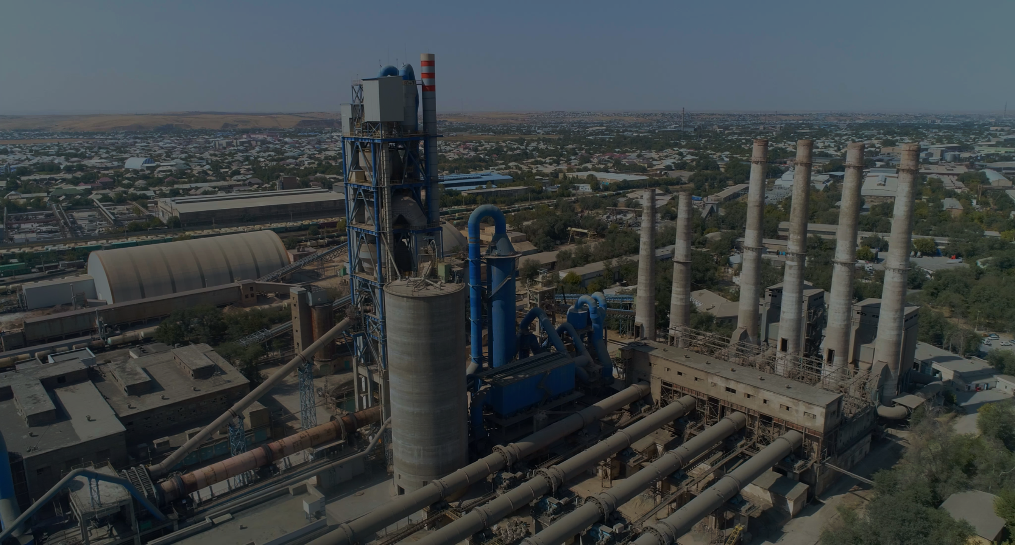
FURNO
Our Story
Large, Multi-National Producers Control the Global Cement Supply Chain
Costs, strict regulations, and lengthy construction processes constitute the barricade between local manufacturers and their path to independence and innovation
FURNO Content Confidential

Slide 5
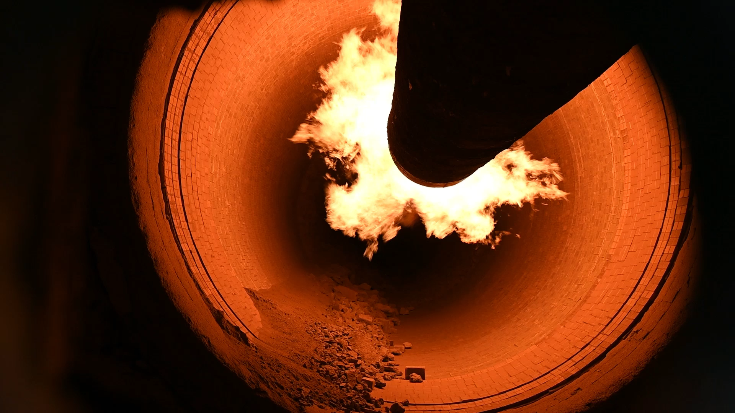
FURNO
Our Story
Current plants are optimized for speed but not efficiency
FURNO Content Confidential

Slide 6
The Solution
FURNO Content Confidential

Slide 7
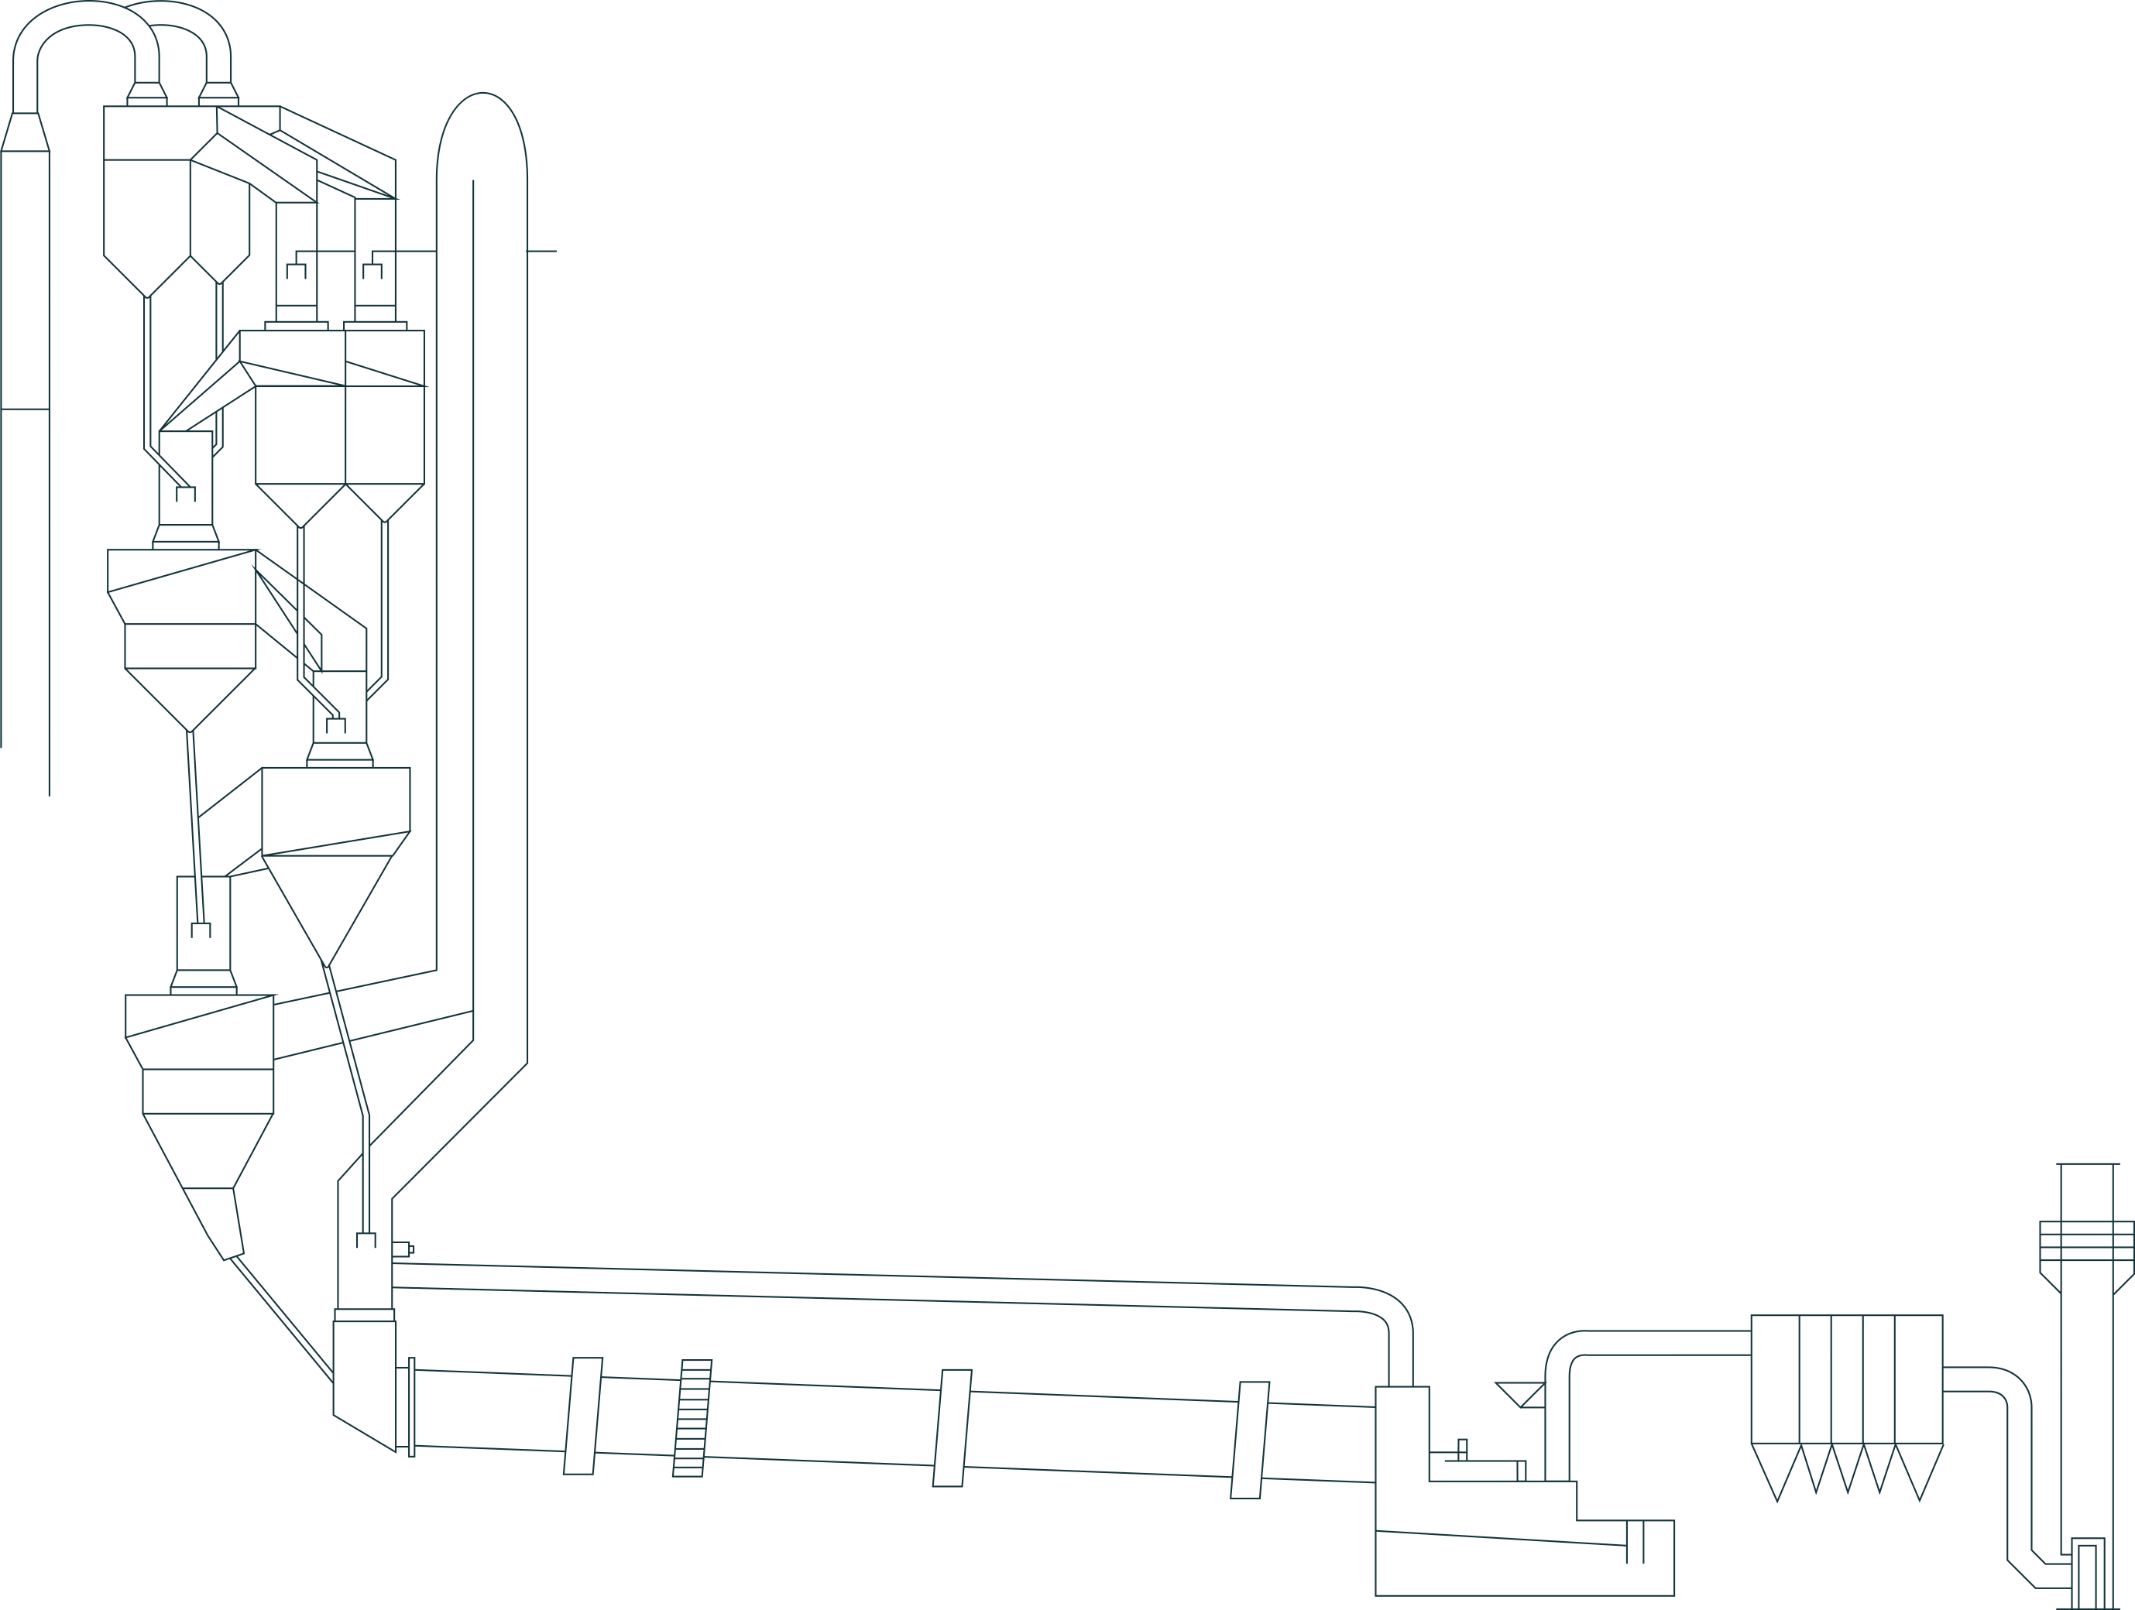
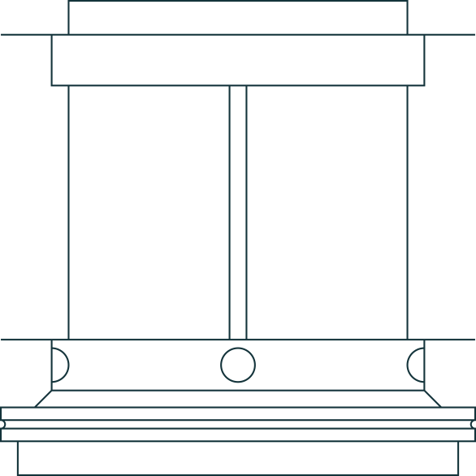
Furno Reactor is A novel compact single-step process that enables Automated, Modular, Emissions-, Energy-, and Cost-Reducing Plants
FURNO
The Solution
TRADITIONAL
FURNO
2m²/m³ material to gas contact
1800m²/m³ material to gas contact
rotary kiln
cross section demonstrating suboptimal material-to-gas contact
Furno kiln
cross section highlighting maximum material-to- gas contact
1000t/day
1000t/day
2m
2m
2m
20m
120M
>3.5
4
>5
ENERGY GJ/T
STAGES
GESTATION PERIOD (DAYS)
<2.2
1
<1
Energy (GJ/t)
Stage
Gestation Period (Years)
Material flow
Gas flow
FURNO Content Confidential

Slide 8
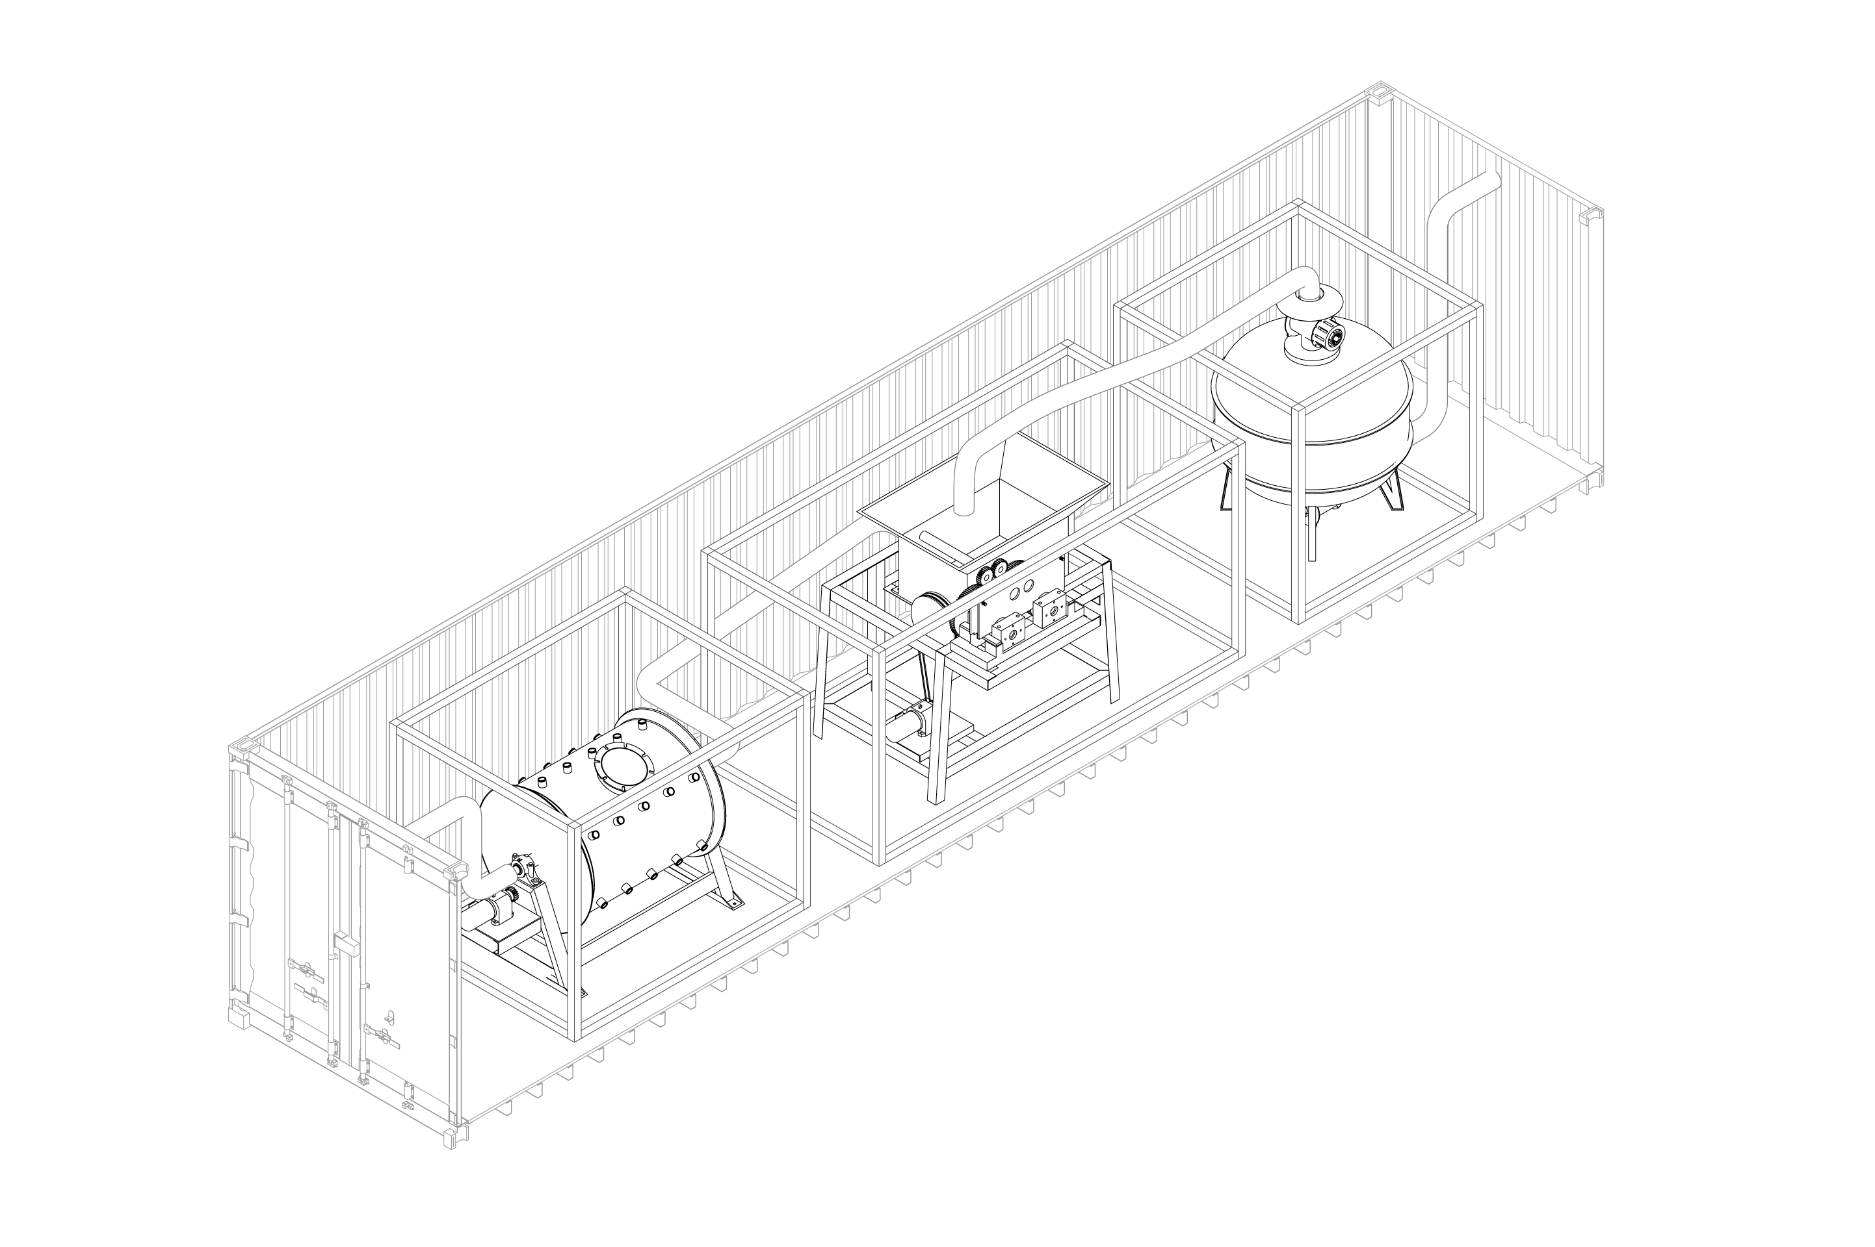
How Do We Do It?
The Furno Brick
FURNO
The Solution
We are developing units that are self-sufficient, modular facilities. This will allow us to:
Standardize design and fabrication
Dramatically reduce commissioning time and cost
Maintain predictable operation with thermal efficiencies of >90%
More easily comply with locally permitting
Reduce capital cost dramatically as compared to traditional plants
Lower barrier to entry for enabling alternative fuels such as hydrogen and renewable biogas
Integrate seamlessly into existing operations
Kiln
Briquetting Machine
Grinder
*Furno Concept
FURNO Content Confidential

Slide 9
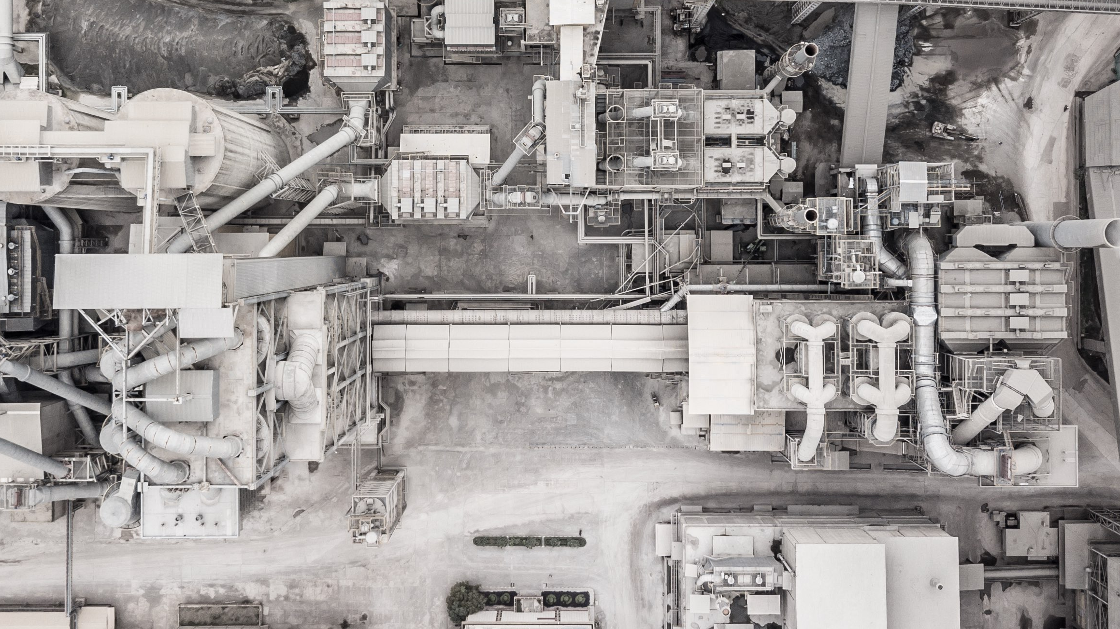




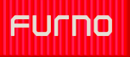
FURNO
The Solution

Slide 10
The Science
FURNO Content Confidential

Slide 11

Furno Is Not a Mini Version of a Standard Plant. It’s a Novel Approach to Combustion.
FURNO
The Science
Furno’s patented combustion technology leverages the following advantages:
Gaseous fuel is burned within the bed of material.
Enhanced heat transfer, >90% thermal efficiency.
Traditional
 |  | Traditional | Furno
Size | Packing Density | Low | High
 | Relative Kiln Diameter | Large | Small
 | Warm-Up / Cool-Down | Slow | Fast
Refractory | Requires Kiln Movement | Yes | No
 | Refractory Lifespan | <2 years | >5 years
Fuel / Control | Primary Fuel Source | Coal / Coke | NG / H2
 | Temperature Control | Slow | Instantaneous
 | Runaway Temperatures | Yes | No
Heat Transfer | Gas → Solid Heat Transfer | Poor | Excellent
Efficiency | Refractory Temperature Rating | 2000 C | 1750 C
 | Overall Efficiency | 62% | ~90%
Furno
FURNO Content Confidential

Slide 12
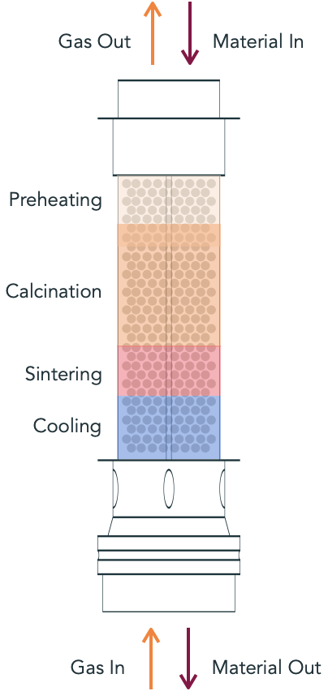
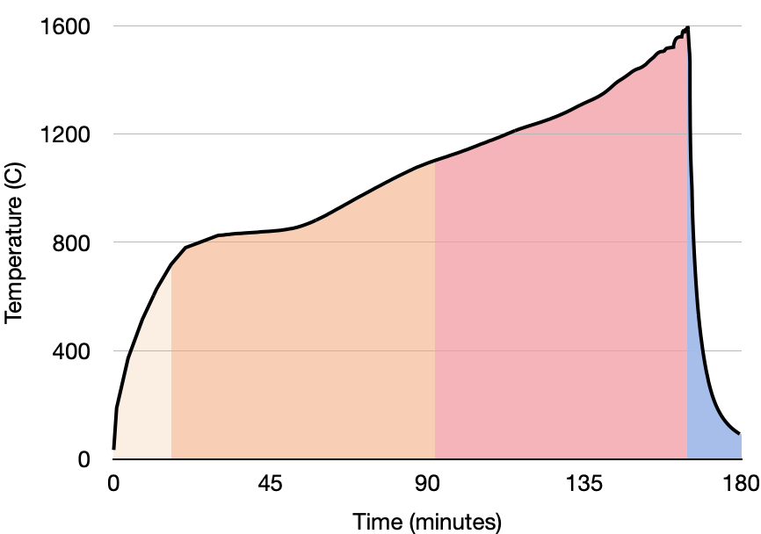
Furno’s Proprietary Combustion Technology Enables a ‘Four-in-One’ Reactor
FURNO
The Science
Gas Out
Gas In
Material In
Material Out
FURNO Content Confidential

Slide 13
FURNO
Recent
Breakthroughs
Furno Wins on Efficiency and Emissions
US average*
California*
India*
Furno’s expected
Global^{1,#}
Europe^{2,#}
Furno
# With CAPEx & OPEx intensive scrubbers
Emissions (ppm)
CO
NO_{x}
* CA-Cement-benchmarking-report-Rev-Final.pdf (climateworks.org)
¹ CO2 Capture Technologies for Cement Industry - ScienceDirect
FURNO Confidential
² Environmental Data of the German Cement Industry 2021 (vdz-online.de)

Slide 14
FURNO
Recent
Breakthroughs
Furno’s v0.1 Clinker Exceeds ASTM C150 Standards
Even when using sub-optimal (hard-to-burn) raw meal
Phase | Range Requirements | Furno clinker
C3S (Alite) Higher is better | 50 to 70% | 66%
C2S (Belite) | 10 to 25% | 10%
C3A Lower is better | < 10% | 3.6%
C4AF Lower is better | < 15% | 10.4%
MgO Lower is better | < 6% | 3.8%
More Alite = Stronger Concrete. V1 will be even better.
FURNO Confidential

Slide 15
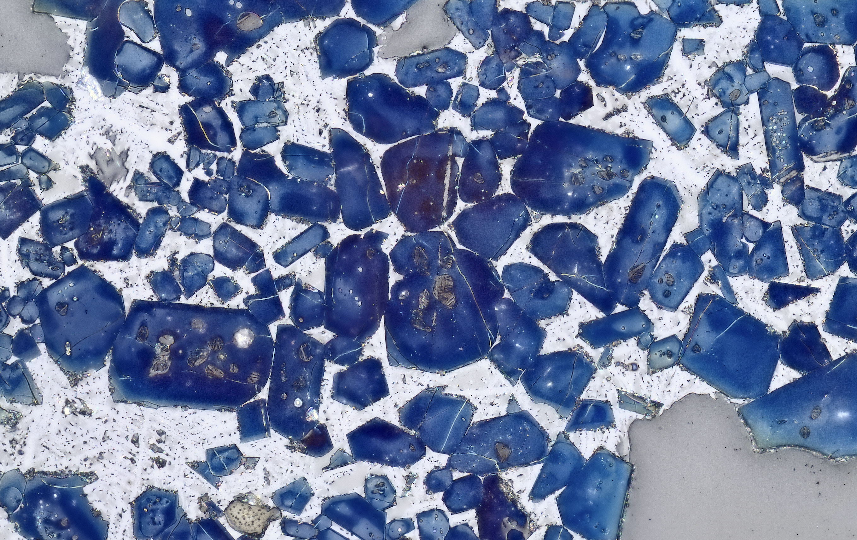
FURNO
Recent
Breakthroughs
Furno’s proprietary technology doesn’t just enable production of ASTM standard clinker.
It enables production of better than standard-quality clinker!
FURNO Confidential

Slide 16
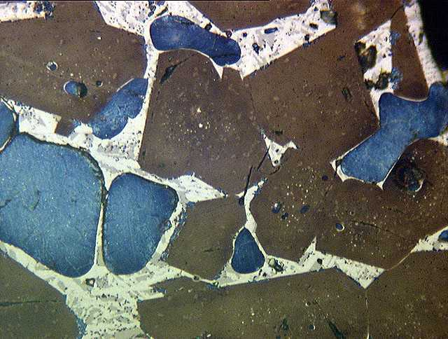
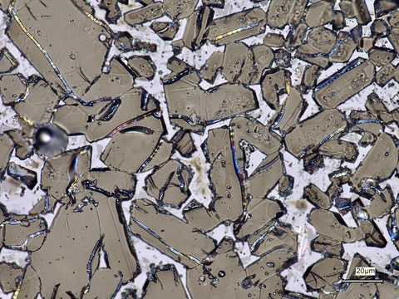


Fast cooling equals smaller grains.
Smaller grains equal greater strength.
FURNO
Recent
Breakthroughs
NIST RM 8488
Clinker
FURNO
Clinker
25 µm
FURNO Content Confidential
FURNO Confidential
16

Slide 17


FURNO
Recent
Breakthroughs
Furno’s High Quality Clinker = Savings for Customers
The higher the quality clinker, the lower volume needed to make concrete.
It’s like making juice from concentrate.
Furno’s clinker is so potent, less is needed to create
the same ASTM standard cement.
FURNO Confidential

Slide 18


FURNO
Recent
Breakthroughs
Furno’s High Quality Clinker = Savings for Customers
If Furno wants to sell the same cement volume, we simply dilute with inexpensive limestone and still meet ASTM spec.
FURNO Confidential

Slide 19


FURNO
Recent
Breakthroughs
Diluting with Limestone = Higher Revenues
When Furno sells standard volumes at standard specs, Furno reaps the cost savings.
1 ton traditional cement
1 ton Furno cement
clinker: 1 ton
CO2: 1 ton
limestone: 0
clinker: .9 tons
CO2: .55 tons
limestone: .1
FURNO Confidential

Slide 20
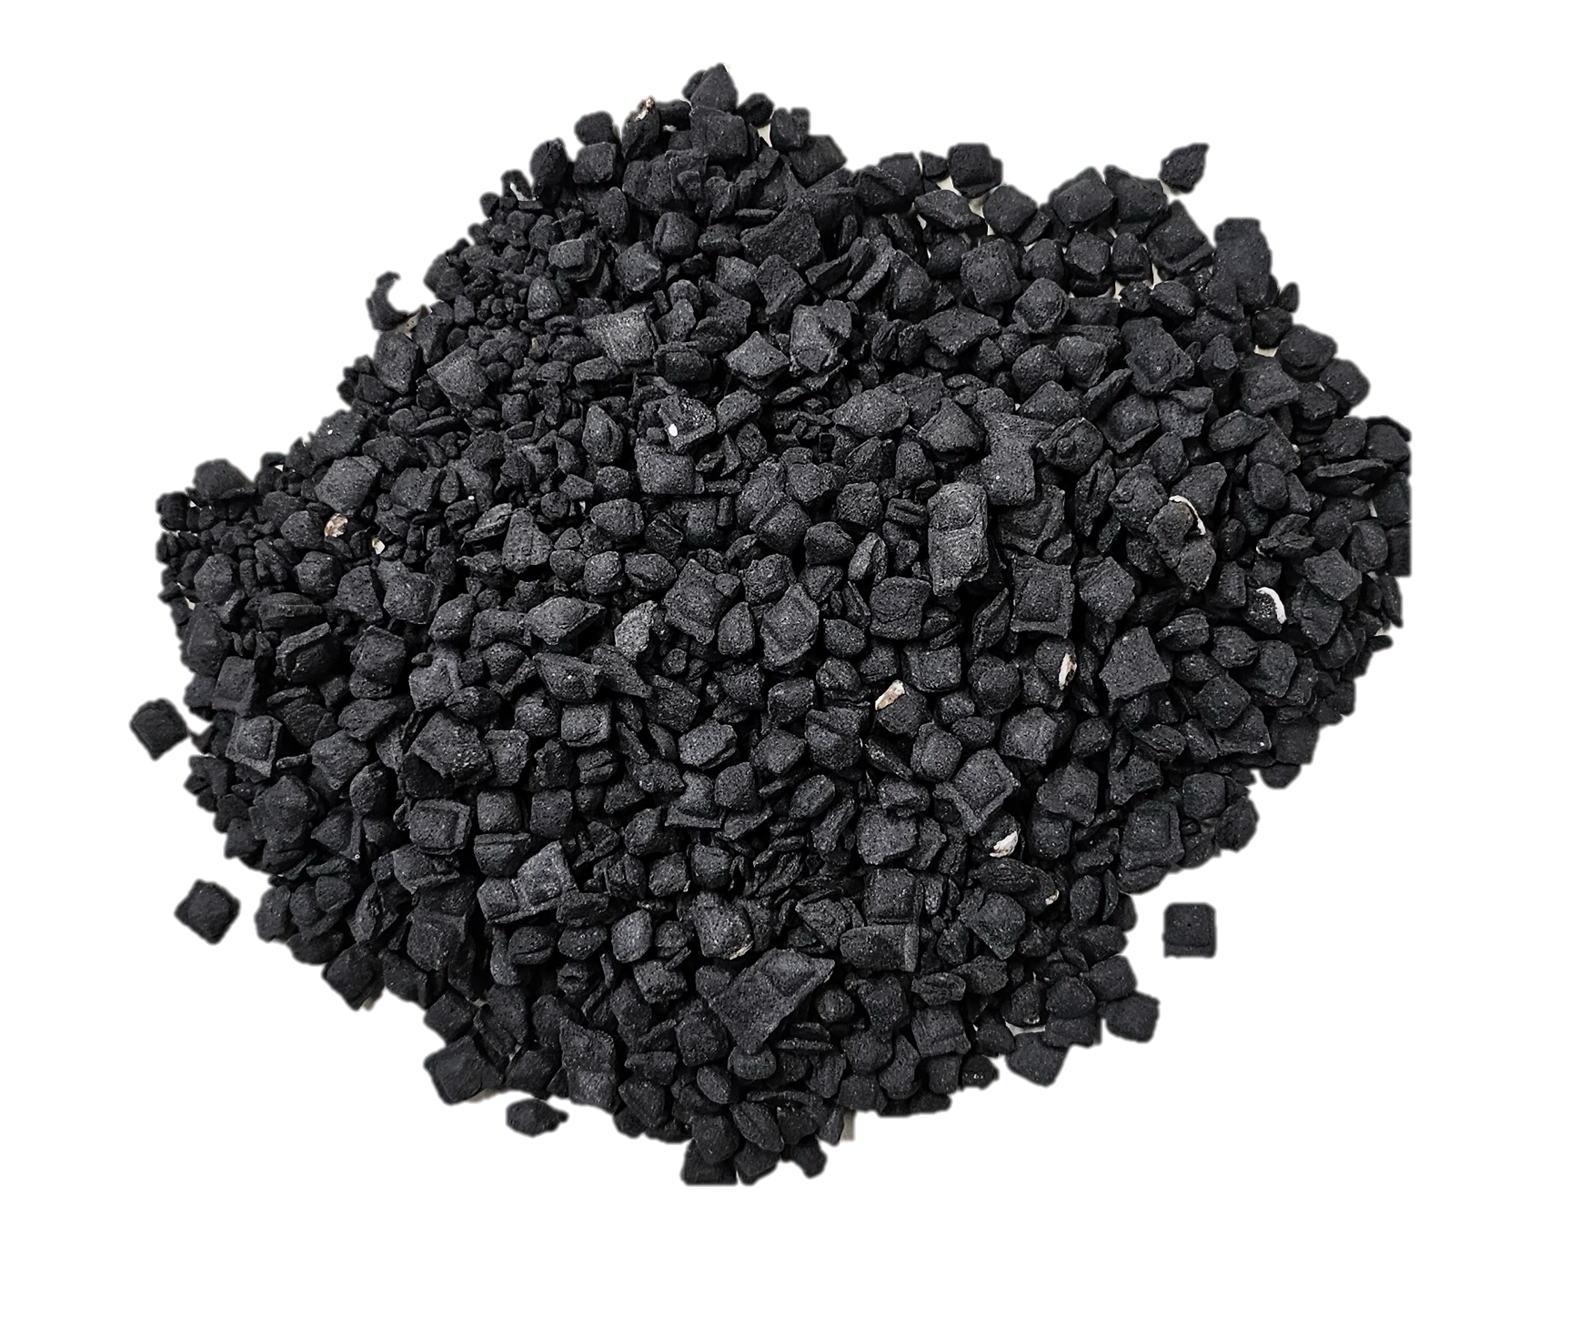
FURNO
Recent
Breakthroughs
Furno has sent initial samples to customers.
FURNO Confidential

Slide 21
Furno Units Feature ML-Driven, Instantaneous Quality Control
FURNO
The Science
Optimal Exposure Conditions
Traditional Route:
Material exiting the kiln is first cooled. Once ground and tested, process adjustments can finally be made.
Extremely slow, labor-intensive process resulting in material and time waste.
Furno’s Approach:
Development of proprietary reaction models which allow for instantaneous clinker quality assessment, not from end product hours later but rather from real-time temperatures inside the kiln
Zero material loss; mighty time gain
XRD performed on cooled sample
Temperature profile measured
Quantified Clinker Quality
Model predicted Extent of clinker formation
Traditional route
Furno’s Approach
FURNO Content Confidential

Slide 22
Furno Units Feature ML-Driven, Instantaneous Quality Control
FURNO
The Science
Furno instantaneously determines the quality of clinker, and we are spot on in our predictions. What does this look like?
Proprietary algorithms enable clinker quality assessment from temperature
We have demonstrated <3% deviation in prediction vs. actual measured values
FURNO Content Confidential

Slide 23
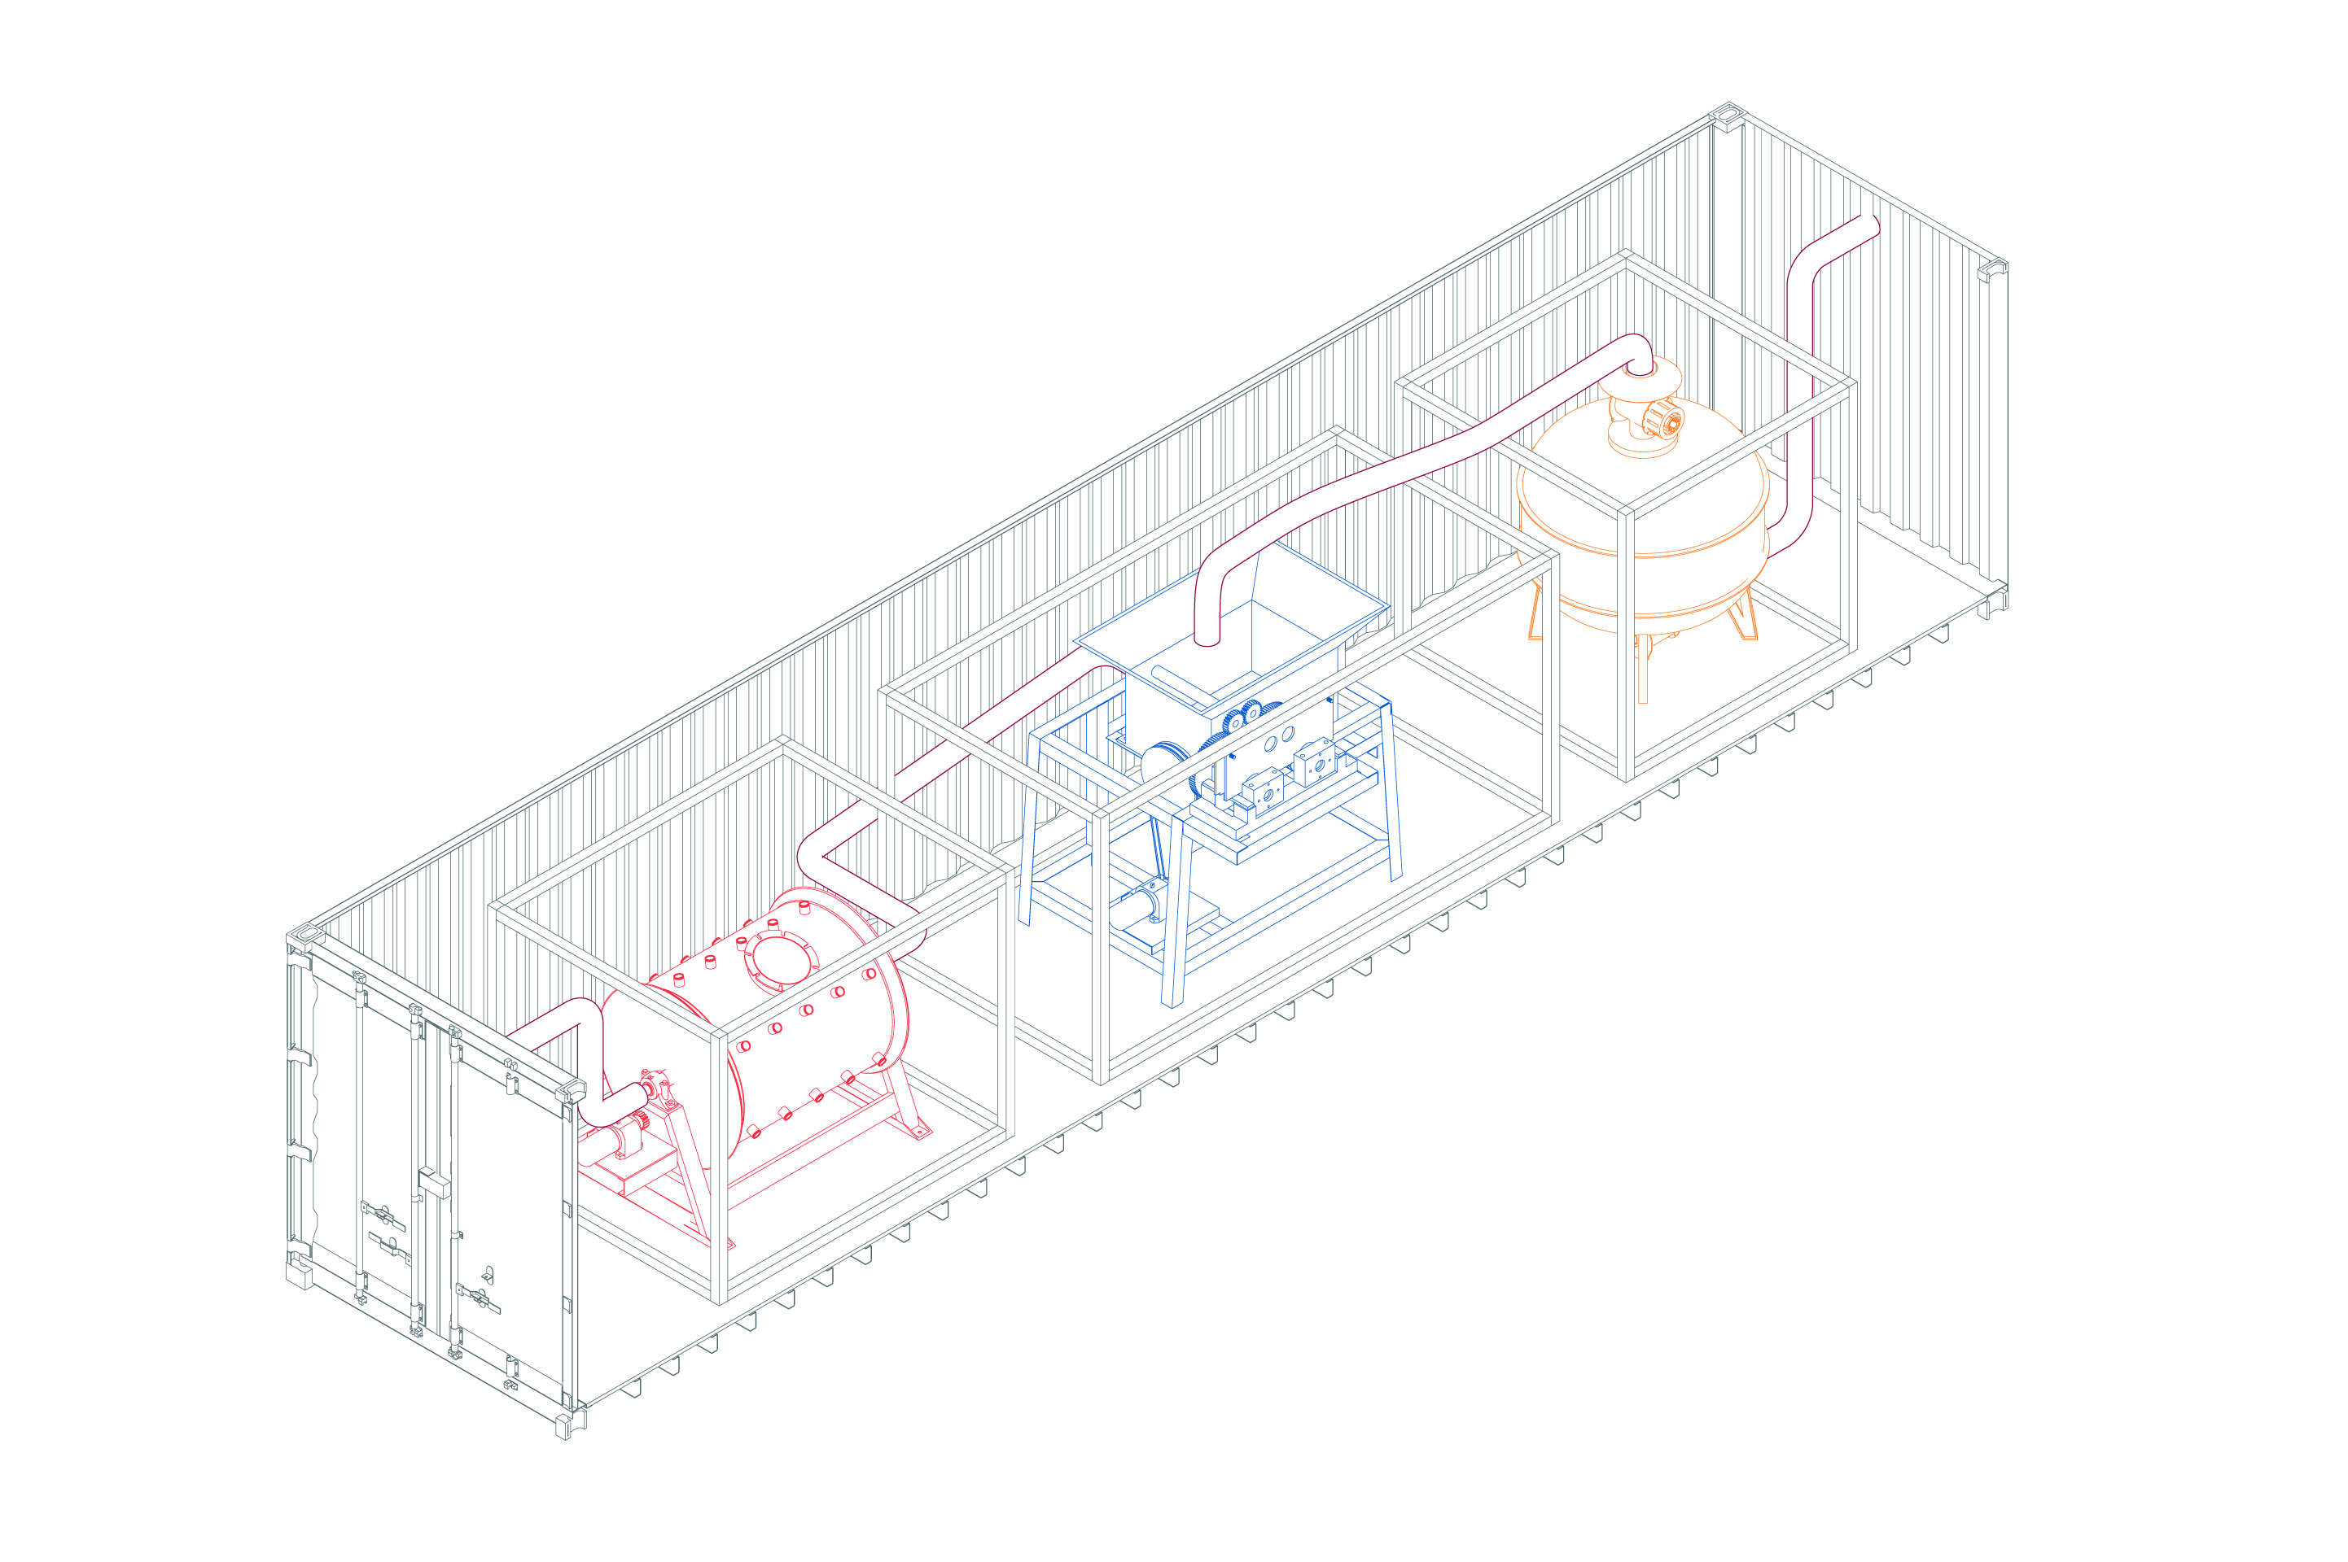
Furno’s Proprietary ML Operating System Enables Any Cement in Any Market
FURNO
The Science
Furno Brick Automated ML Operating System
OPC, I, II, III and V
Raw Materials
Alt. Materials
LC3
Recycled Concrete
Calcined Clays
Operating Controls
Operating Data
FURNO Content Confidential
Notes:
We make making cement easy for you. You put the right materials and fuels in in, we guarantee clinker comes out.

Slide 24


HQ
453 Ravendale Drive
Mountain View, CA
94043
650.732.7808
gurinder@furnomaterials.com

Slide 25





Backed by:

