Slide 1


The Mind of a Leader
Notes:
Let’s begin with a tale of two leaders.
The first leader was a Director of Rehab for a level 1 trauma center. She was “the leader”. She was “in charge”. Even from the interview she knew she was there to be a change agent.
She was told that this group practices like it was the last century. They weren’t up to date on best practices. In fact, they did as little as possible in their day.
She was told it was her job to turn these people around and if they didn’t want to be good therapists, well get rid of them. Her mindset was that she was there to fix these people. After all, she’s worked in the best trauma hospitals and she knew what good care was. She told them that they weren’t providing quality care and that they had to do better. She didn’t listen to their concerns because she knew best and she was going to show them whether they liked it or not. Of course, they showed up with their heads and hands / but not with their hearts. The team didn’t trust or respect her because they didn’t feel that she trusted or respected them. And if they loved acute care before, they didn’t love it now.
The second leader had the title of traveling therapist. Like many, you may have a perspective that contract staff aren’t really committed to the work that they were just in it for the money and the travel and since they are only there for 13 weeks, they just don’t care.
With no title except “the traveler”, she started her assignment at a long-term acute care facility. Getting to know the other team members, she began to use her background in cardiopulmonary care to change up some treatment plans. Then she talked with the physical therapists and the respiratory therapists about a program idea for vent weaning. And in those 13 weeks, together they created a new protocol for vent weaning trials that dramatically improved outcomes.
These two leaders / are very different. But they are both/ me.// Me with very different mindsets about leadership. Different intentions for my work. In the first story/ I had the title of leader and lost the team. In the second story/ I was the traveler who launched a new program in 13 weeks. ///
Leadership / is not a title; it is a mindset//. Leadership is not a title. Leadership is a mindset.

Slide 2
Humble Mind
Curious Mind
Beginner’s Mind
Pilot’s Mind
Grateful Mind
Willing Mind
Notes:
And so would begin the journey through the mind of a leader. As I share stories, the audience considers their mindset and intentions as a leader- regardless of title. While we can’t go through that entire keynote right now, I want you to experience one of the things that makes my keynotes unique.
To truly engage audiences, I do things a little differently from typical presentations. So much of what makes conferences truly worth it is the connection and collaboration that comes from engaging with others. So why limit that to the coffee breaks and lunch? What if we punctuate that engagement and interaction during the keynote.
How many of you are up for engaged and interacting today? By show of hands, how many of you are willing to truly, deeply engage and interact with your neighbors? I’ll tell you why that is appreciated. On multiple occasions you are think and talk with your neighbors. At a minimum to get the greatest value from our time together. and you may even discover more from yourself and from your neighbors. Raise your hands- Can I get agreement.
You are going to write down your answers so take out a pen and paper- it's okay, I'll wait.

Slide 3
What is a story that reminds you of why your work is meaningful and important?
Notes:
Take 2 minutes to think about a story that reminds you of why your work is meaningful and important? How does it serve you, your members, the world?
What are the lessons from the story?
What strengths can you appreciate?

Slide 4

2 minutes for personal reflection
Notes:
Image by OpenClipart-Vectors from Pixabay

Slide 5
2 minutes for personal reflection
8 minutes for small group conversation
Notes:
Image by OpenClipart-Vectors from Pixabay

Slide 6
2 minutes for personal reflection
8 minutes for small group conversation
8 minutes for large group sharing
Notes:
Image by OpenClipart-Vectors from Pixabay

Slide 7
Humble Mind
Curious Mind
Beginner’s Mind
Pilot’s Mind
Grateful Mind
Willing Mind
Notes:
For some audiences we want to inspire with the mind of a leader, other groups have the leadership mindset already so we focus on practical and tactical aspects of leadership. For example, in Delegation for Doers we start by having the audience explore their deeper reason/purpose for wanting to delegate. And I have to tell you, the reasons are extraordinary.
Then we bring in memorable connections like...

Slide 8

Notes:
The session description states that we are going to start with scrambled eggs. So here we go. First thing, pull out a pen and paper. Go ahead, I’ll wait.
What is your recipe for scrambled eggs.
Now how does this tie into delegation, well let’s start with the definition of delegation

Slide 9
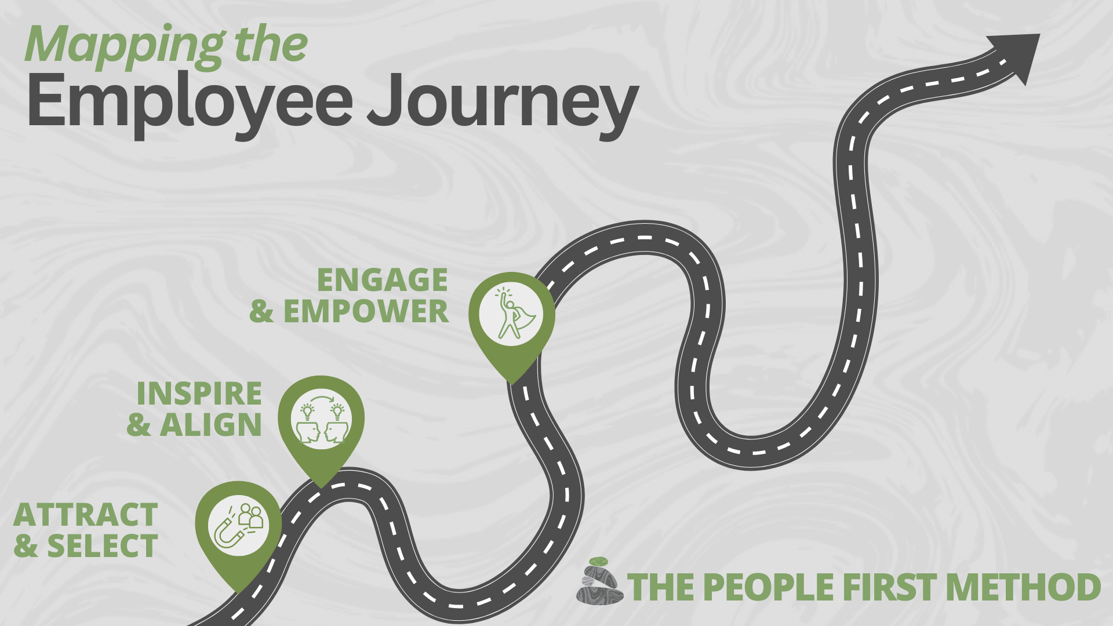
Notes:
For other audiences, we take them on the hero’s journey of an employee working at the ideal practice.

Slide 10

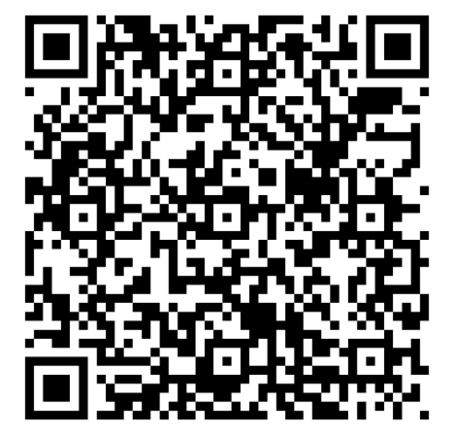
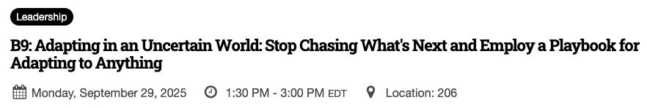
“This has been my favorite presentation so far”.
“I have to tell you that your presentations made the conference!”
“Loved every minute of this presentation!”
“One of the best speakers I have ever listened to. Very engaging and gave real live experiences”.
“The presentation of the conference!”
Notes:
Regardless of the keynote topic, the feedback from audiences is consistent. So if you’d like to connect and talk about your conference or if you are ready to book right now, use this QR code to fill out a few questions. And for everyone that does, I’ll provide 5 free copies of my book when I present at your conference.

Slide 11
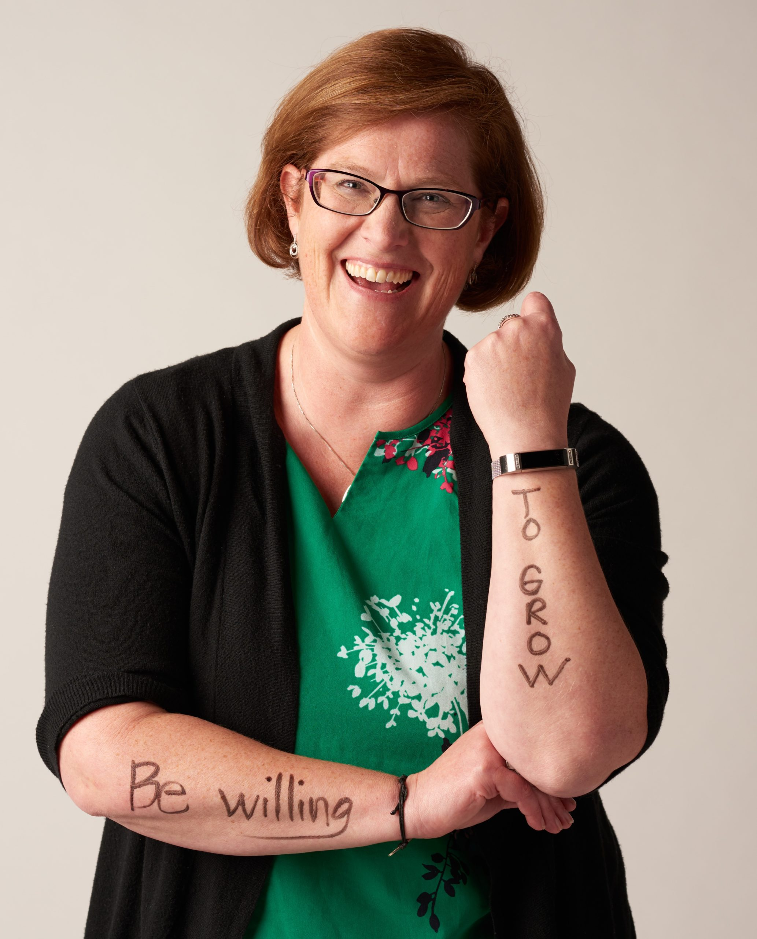



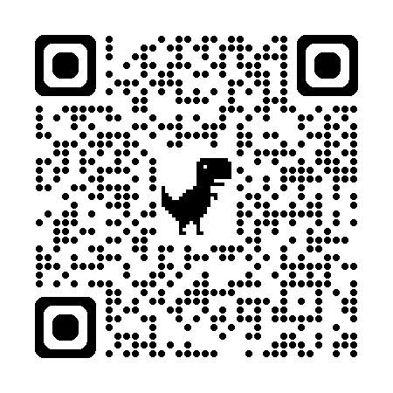
Keynotes:
Mind of a Leader
Delegation for Doers
Building Bench Strength
Mapping the Talent Journey
Workshops/Sessions:
Let’s talk
570-617-7836
www.amylafko.com
amy@cairncs.com
www.linkedin.com/in/amy-lafko

