Slide 2


UnBlocking Connection
How to Successfully Market MGMA State Chapters & Affiliates
September 27, 2025

Slide 3
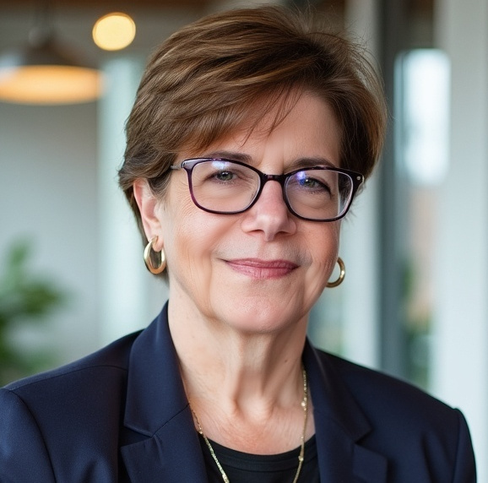
Roberta Rosenberg
Senior Director
Marketing General, Inc.

Slide 4

About Roberta
Roberta joined MGI as Senior Account Director in 2024. She’s a marketing and communications executive with 25+ years of leadership experience in trade associations, member and commercial organizations.
Roberta also teaches graduate marketing and nonprofit management at the University of Maryland Global Campus.
She holds an Executive MBA from the Quantic School of Business and Technology, an MS in Strategic Communication from Purdue University, and a BS in Broadcast/Film from UMGC.

Slide 5
Today You Will
Craft chapter- and affiliate- first value propositions (with examples)
Design a 20-minute, workflow-focused micro-learning (neutral)
Adopt a low-lift partnership cadence (liaison + micro-asks)
Measure meaningful results

Slide 6

Today’s Takeaway
Gain light‑lift tactics you can start this week … or today.

Slide 7
What’s Your Toughest Challenge as Affiliate or Chapter Leader?
Notes:
Seed Prompts:
STAT?
What nearly worked—but didn’t—and why?
What’s the biggest blocker to sending one welcome email?
If you automated just one step, which would move the needle?
Who’s a dream partner in your region you haven’t tapped?

Slide 8

Leader Challenges
Limited Time
You’re juggling a full‑time job with a volunteer role
Recruiting & Keeping Members
Cold outreach doesn’t land; new members don’t always see quick wins, and renewals slip without steady touchpoints.
Explaining Value Clearly
Prospects ask, “Why join now?”—you need simple, local, real‑world reasons that feel worth the dues.

Slide 9

3 Goals for Leaders
Acquisition
Engagement
Retention

Slide 10

How to Get to YES
Actionable education (Monday-ready; no promos in CE)
Low administrative lift (you provide logistics)
Measured value (registrations, CE hours, rating ≥4.5/5)

Slide 11
Audience Pain Points
Notes:
Let’s talk about member/customer pain points – what are they and how are you the aspirin to their headache?
[Ask someone in the audience to record the first 30 seconds of responses.]

Slide 12
Value Proposition & Strategic Messaging
Notes:
What can you say about your chapter or affiliate that no other organization can?
Does your audience agree?

Slide 13

Value Proposition Formula
We [org/product/service] help [target audience] solve [specific problem or need] by providing [unique benefit or solution].
Unlike [competitor/alternative], we provide [key differentiator].

Slide 14
MGMA Value Proposition Formula
MGMA State/Affiliate helps [ members/stakeholders] address [specific challenge or need] by providing [unique benefit or solution].
Unlike [other orgs or alternatives], we deliver [key differentiator] that makes membership essential and rewarding.

Slide 15

Pain Point – Denial Prevention
“We help medical practice leaders cut avoidable claim denials and improve first‑pass yield through state‑specific education, payer policy roundtables, and practical toolkits.
Unlike generic webinars or vendor promos, we deliver local payer know‑how, peer benchmarks, and hands‑on working sessions that convert knowledge into fewer write‑offs and faster reimbursement.”

Slide 16

Pain Point – Staffing & Access
“We help medical practice leaders stabilize staffing and expand timely patient access by equipping teams with role-based training, workflow toolkits, and peer benchmarks that optimize scheduling, triage, and care team deployment.
Unlike one‑size‑fits‑all scheduling tools, we deliver proven operational playbooks and state-specific guidance that reduce vacancies and churn, lower phone abandonment and no‑show rates, and more.”

Slide 17

Pain Point – Credentialing Cycle
“We help medical practice leaders start billing sooner by simplifying the credentialing & payer enrollment cycle.
Unlike generic webinars or vendor promos, we deliver local payer know‑how, practical templates, and real‑time status tactics—so you can accelerate onboarding and keep revenue on schedule.”

Slide 18
Content – and messaging - should speak directly to member needs, highlight measurable outcomes, and demonstrate tangible value.

Slide 19

Exercise: Crafting Your Value Proposition
MGMA State/Affiliate helps [ members/stakeholders] address [specific challenge or need] by providing [unique benefit or solution].
Unlike [other orgs or alternatives], we deliver [key differentiator] that makes membership essential and rewarding.
Notes:
Take 5 minutes to craft your chapter or affiliate “big picture” value proposition – 2 minutes solo and 2-3 minutes sharing

Slide 20
Do This, Not That - Outreach
Do: Lead with chapter mission & member outcomes
Do: Offer a single, simple CTA
Don’t: Spray‑and‑pray sponsorship emails
Don’t: Ask for member lists or heavy board lifts
Don’t wait for national to provide before you move.
Notes:
Author: KGCompton Subject: Sticky Note Date: 9/24/2025 2:20:42 PM
"Do"s on the right so you see them first maybe?
Also, suggest formatting the "Not"s in a similar manner as the "Do"s to make the slide easier to read and comprehend at a glance.
Author: mpeterson Subject: Sticky Note Date: 9/24/2025 2:58:43 PM
Agree. Also, should it be "Don't:" instead of "Not"?
Author: mpeterson Subject: Sticky Note Date: 9/24/2025 2:59:26 PM
Kelsey, did you mean move the "Do's" to the left?

Slide 21
Do This, Not That - Content
Do: 20-minute micro learnings on a workflow + checklists
Do: Neutral (promo-free) CE; optional hours
Don’t: Do promos in the CE slots
Don’t: Do broad, unfocused topics with no takeaways

Slide 22
Micro-Learning Format
& Delivery

Slide 23
Micro‑Learning Workflow
Title: [Topic Name] — Learn it → Apply it → Measure it
Promise (1 line): Attendees leave with 3 fixes + 1 checklist to improve results.
Keep it Simple and Promo-Free
8 min — Steps (3–5 steps)
4 min — Tools (3 fixes + 1 checklist
1 min — Why (pain +outcome)
7 min — Practice
Keep workflows targeted, specific, and tied to a
measurable outcome (e.g., time‑to‑first‑billable day,
first‑pass claim rate, no‑show rate, etc.).

Slide 24
Micro‑Learning Description Sample
Abstract & Asset Kit
Title
100-word abstract:
  Pain
  Workflow
  3 fixes
  Checklist
Messaging
Specific Benefit/Outcome in 20 Minutes
Outcomes:
  Map workflow
  Apply 3 fixes
  Track denials, touches, claims
Keep tone neutral, informative, and attendee-focused

Slide 25
Micro-Learning Workflow– Denial Prevention
Context/Pain Point:
Denial rate 8-12%
Goal:
Reduce touches and rework
Workflow:
Intake-> Eligibility-> Prior Auth-> Change Capture ->Claim
3 Fixes:
Pre-visit eligibility batch
Single-owner auth
48-hour claim edit queue
Checklist KPIs:
Denial %
Touches/claims
A/R days

Slide 26
3 Fixes + 1 Checklist Example
Fix #1: Pre‑Visit Eligibility Batch
Run day‑before eligibility + demographics checks to clear CO‑16 errors before DOS.
Fix #2: Single‑Owner Prior Auth
One accountable owner per auth with due dates; log status + payer reference ID.
Fix #3: 48‑Hour Claim Edit Queue
Scrub post‑charge and resolve edits within two business days to protect timely filing.
Checklist — QuickStart
WHO (owner/role) •
WHAT (steps & artifacts)
WHEN (SLA per step)
TOOLS (template/link)
METRIC
  Denial %
  Touches/claim
  A/R days)

Slide 27

Micro-Learning – Promo Messaging
Post:
Sept. 27: 3 Easy Fixes to Denial Prevention in 20 Minutes: Checklist
Stat:
Eligibility errors drive avoidable denials
Testimonial:
Cut rework by 20 minutes a day
Invite:
Click to Register: 20-Minute Micro-Learning + Checklist

Slide 28
Commit: Your 14-Day Learning Pilot
Pick
Day 1-2: Pick topic + finalize 3 fixes + checklist
Promote
Day 3-7: Promote (liaison micro-asks)
Deliver
Day 8-14: Deliver + measure (registrations, rating, opt-ins)

Slide 29
Partnership Model & Engagement Cadence

Slide 30

Identify A Chapter/Affiliate Liaison
Visible, engaged chapter/affiliate member
Has strong visibility and credibility with stakeholders
Naturally connects with peers and enjoys sharing resources
Is willing to make small, consistent outreach efforts on your behalf
Notes:
Keep it simple and repeatable. Liaisons get clarity and small asks.
Show how a four‑touch calendar keeps momentum without burnout.

Slide 31
Liason Playbook
30‑minute onboarding: goals, talking points, referral examples, and light activity menu.
Monthly Micro‑Ask Calendar:
  1 social post
  1 shareable stat
  1 testimonial
  1 invite
Toolkit: Canva templates, 2‑line referral email, onboarding call script.
Why This Works
Predictable, repeatable, and easy to delegate.
Builds awareness and trust through
multiple touchpoints.
Keeps your chapter top-of-mind without spamming inboxes.
They act as trusted voices, making recruitment and engagement feel personal—not promotional.
Notes:
Keep it simple and repeatable. Liaison get clarity and small asks.
Show how a four‑touch calendar keeps momentum without burnout.
Mini activity (60s): Write down your loudest, proudest member—what’s one thing they could do this month?

Slide 32
3 Onboarding & Engagement Moments that Matter

Slide 33

First 30 Days – Welcome Journey
3-Email Series - AUTOMATE
  Welcome
  Meet Your Community
  How to get value fast
Personal check-in via email or phone call
SAMPLE SUBJECT LINES:
Welcome! Here’s how to get the most from your membership
Your first 30 days: 3 quick wins to try now
Meet your MGMA community—start here

Slide 34

Mid-Year Pulse – Stay Close
3-Question Micro Survey
Two quick check-in calls or emails monthly
Share a small win/resource based on their response
SAMPLE SUBJECT LINES:
Celebrate your MGMA journey—before your renewal
Your MGMA story isn’t over—let’s keep building together

Slide 35

Anniversary Month – Celebrate Early
Spotlight + thank you before renewal notice
Remind of impact and value: Events attended, Connections made, Resources used
SAMPLE SUBJECT LINES:
Check-in: How’s MGMA working for you?
Your voice matters—2 questions, 2 minutes
What’s one thing we can do better for you?

Slide 36

3 Ways to Use AI
Draft Emails in Seconds
Prompt: “Write a friendly invite for a 20‑minute Coffee Chat. Include one clear CTA.”; Edit for tone and add your link.
Turn One Idea into Many Posts
Paste your event description and ask: “Create 3 LinkedIn posts and 2 tweets from this text.”
Repurpose for Articles or Newsletters
Prompt: “Expand this event recap into a 300‑word article for our chapter newsletter.”

Slide 37

Ready-to-Use Prompts
Event Invite (email – 120 words)
Write a friendly 120-word member email to a 20-minute “Coffee Chat” on Zoom hosted by our MGMA chapter.
Social Caption (LinkedIn – 2 lines + CTA)
Curious about MGMA? Join our 20-min Coffee Chat—one topic, one takeaway, zero pressure.
Testimonial Request – 2 sentences
Hi <First Name>—could you share 1–2 sentences about one practical win you’ve gotten from MGMA? We like to spotlight members like you in an upcoming post.

Slide 38
Measurement &
Next Steps

Slide 39

Opt-in Lead Capture
QR code
  Short Form: Name, Title/Role, Org, Privacy Consent
  Don’t ask for more info than you actually need
Privacy
  Follow-up with link to privacy policy.
  Verbiage to include no list sharing (buying, renting, etc.)
  No PHI
Deliver resources promptly

Slide 40

Measuring Success – Micro-Learning
What’s on your scorecard?
Registrations target
CE hours/attendee
Session rating
Opt-in leads
Additional event sign-ups

Slide 41

Measuring Success – Membership
Practical Membership Math
Response rate
Renewal rate
Cost to obtain a member
Average tenure
Lifetime value
Max acquisition cost
Steady state analysis

Slide 42
Resources

Slide 43
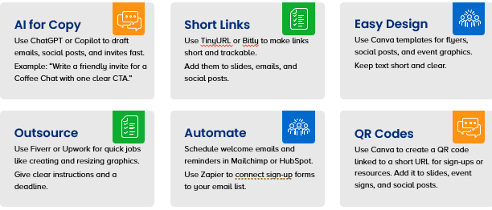
Light Lift Help

Slide 44

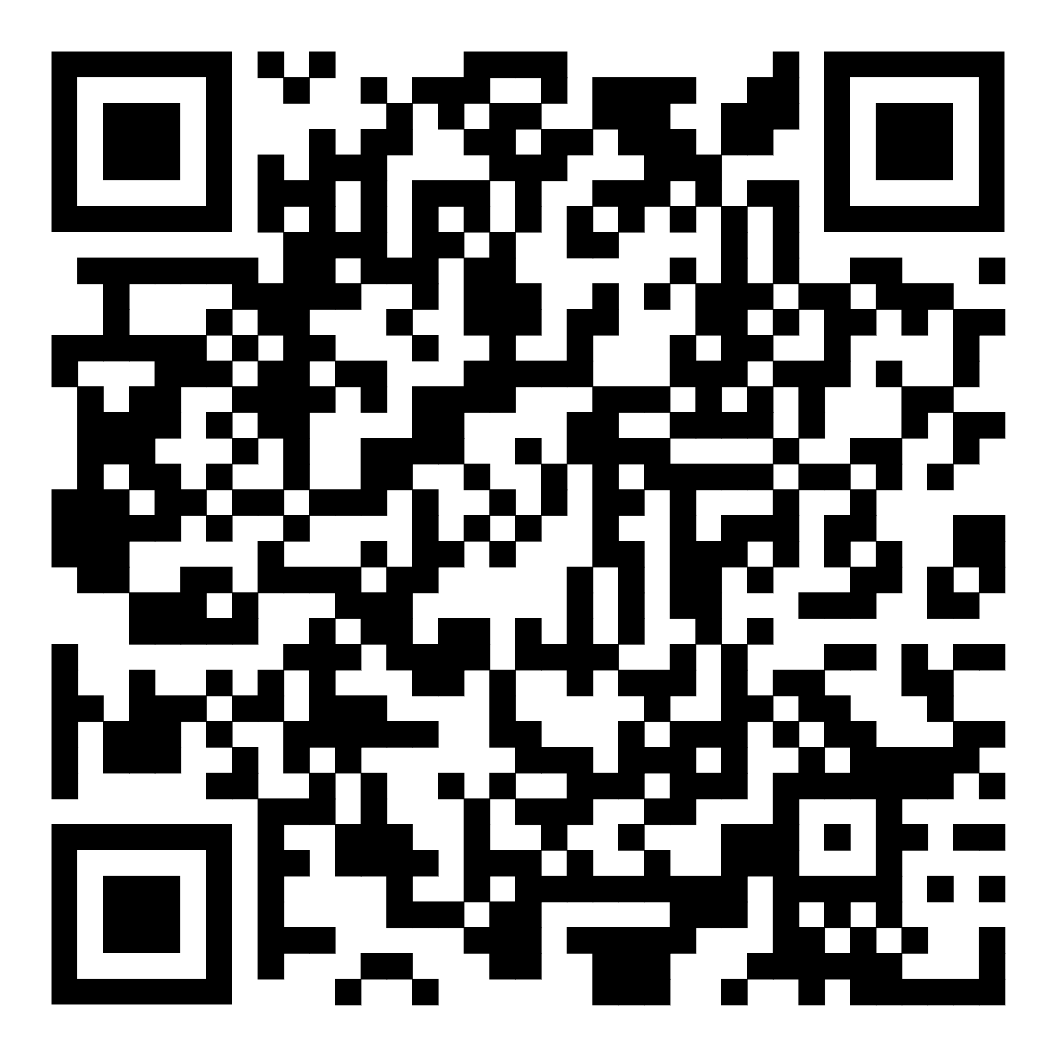
Using AI for Crafting Value Propositions
Transform how you connect with members with the power of AI.

Slide 45

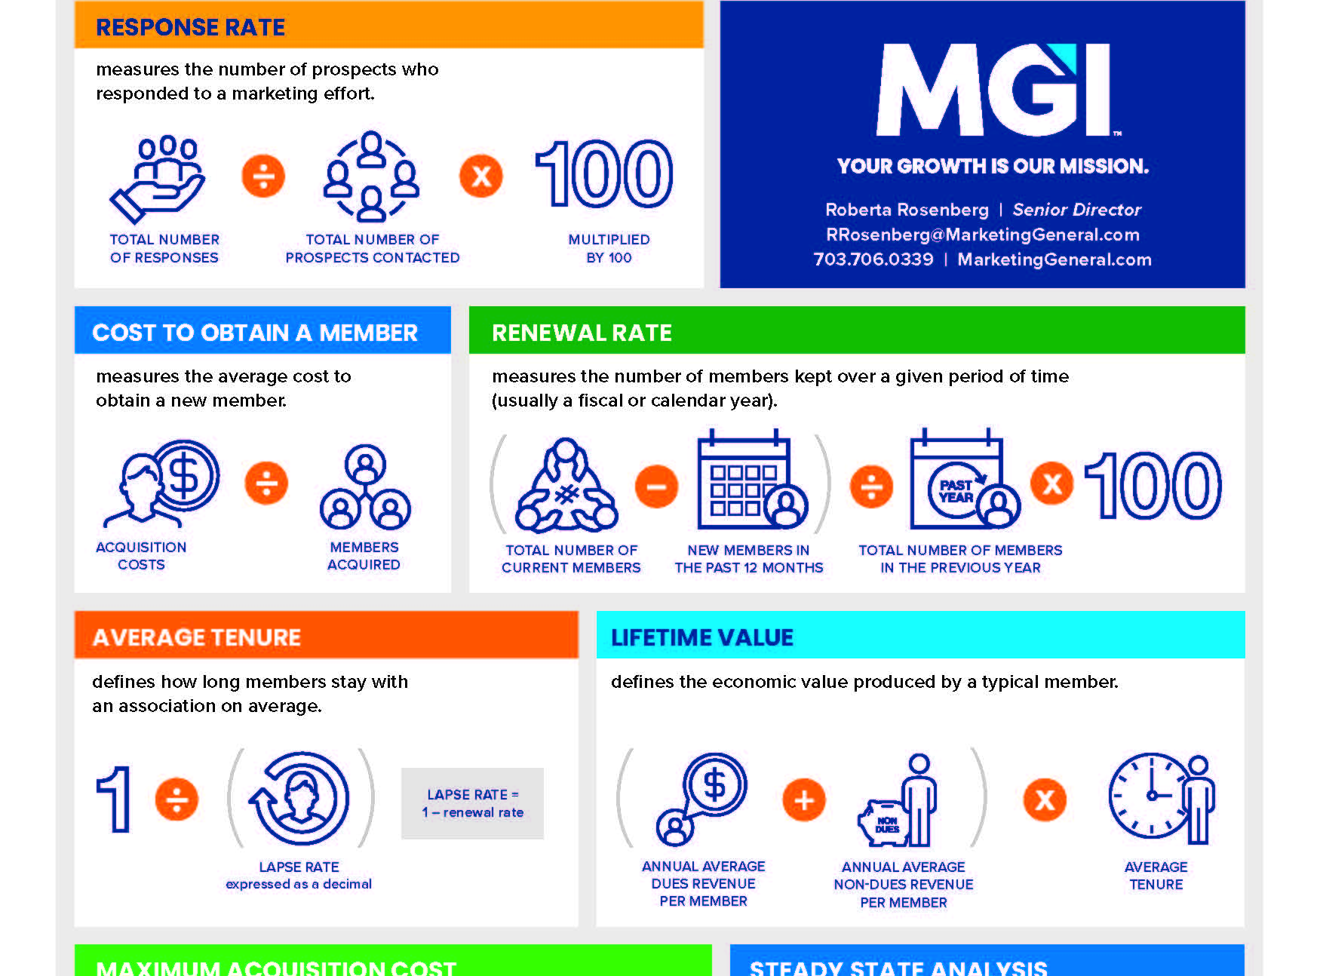
Key Membership Marketing Formulas

Slide 47


Thank You!

