Slide 1
National and State MGMA Data Collaboration to Elevate Member Value
September 2025

Slide 2
MGMA Data
State Participation
Data Benefits to Members
Q&A

Slide 3
MGMA Data
Since 1956, National MGMA has been collecting and reporting data on Cost and Compensation for medical practices.
2025 Participation Counts:
 | Groups | Individuals
Physician and APP Compensation | 8,040 | 220,141
Management and Staff Compensation | 4,317 | 198,700
Financials and Operations | 4,361 | ~

Slide 4
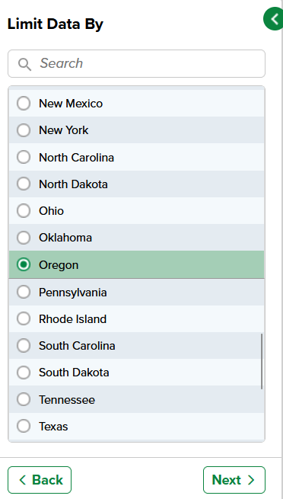
MGMA Data
State-specific benchmarks
MGMA Data can filter down to the state level on all compensation data sets.
Participants in the Management and Staff data collection will receive both national and state-level salary and bonus data for free.

Slide 5

MGMA DATA
Who’s Included
Physician-owned and hospital-owned groups
Separate academic medical center/teaching hospital cohort
Tenured physicians, providers new out of residency, and APPs
Medical Directors and On-Call physicians
Executives, administrators, managers, clinical and business support staff

Slide 6

data Participation
How and when users submit data
Data collection runs from January through February
Extensions granted into March for groups needing extra time
Streamlined upload of payroll, accounting and claims files
National MGMA maps to user files before first participation
Simple drag-and-drop files in future years

Slide 7

data Participation
Data analysis and survey assistance
Data Analysts work hand-in-hand with groups to clarify any data outliers
Information is analyzed, cleaned and de-identified before DataDive publication in the spring
National MGMA staff are available to answer questions and map files during collection and throughout the year

Slide 8
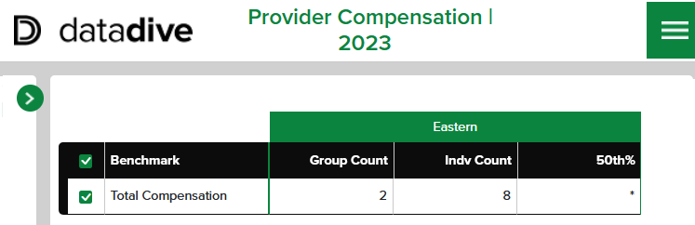
data Participation
Why do we need more groups?
National MGMA publishes a representation of the healthcare market in the US
There must be at least 3 groups and 10 individuals participating:
The more states that participate fully, the more data that is available for State Members to use
*

Slide 9

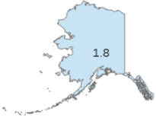
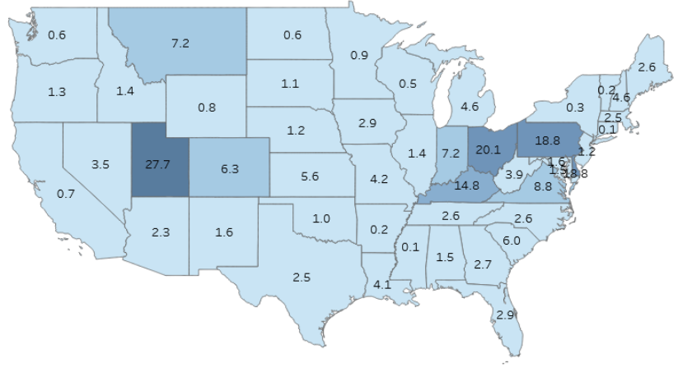

2025 Provider Compensation DataDive
Percentage of participating groups per state

Slide 10

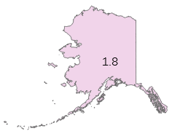
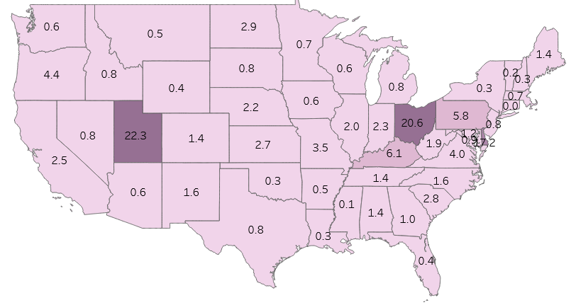
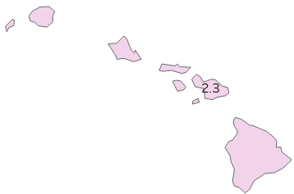
2025 Management and Staff DataDive
Percentage of participating groups per state

Slide 11

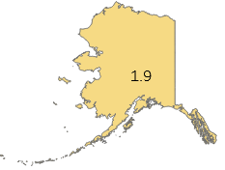
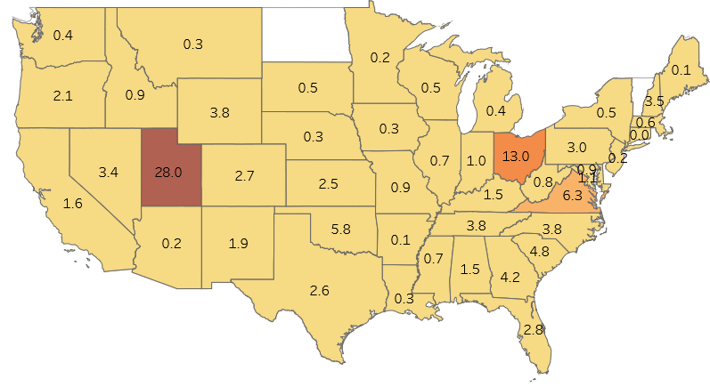

2025 Financials & Operations DataDive
Percentage of participating groups per state

Slide 12
Specialty participation percentage
States with opportunity: 0-5% participation out of entire market
Anesthesiology
Rhode Island
Florida
Arizona
Michigan
New Jersey
Virginia
Tennessee
New York
Texas
Georgia
Gastroenterology
Alaska
District of Columbia
Idaho
Wyoming
New Jersey
New York
Connecticut
Arizona
Maryland
Alabama
Radiology
Alabama
Alaska
Connecticut
Idaho
Maryland
Mississippi
Nevada
New Hampshire
New Mexico
Oklahoma

Slide 13
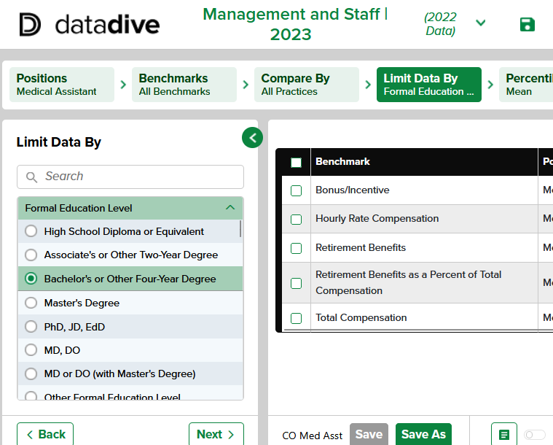
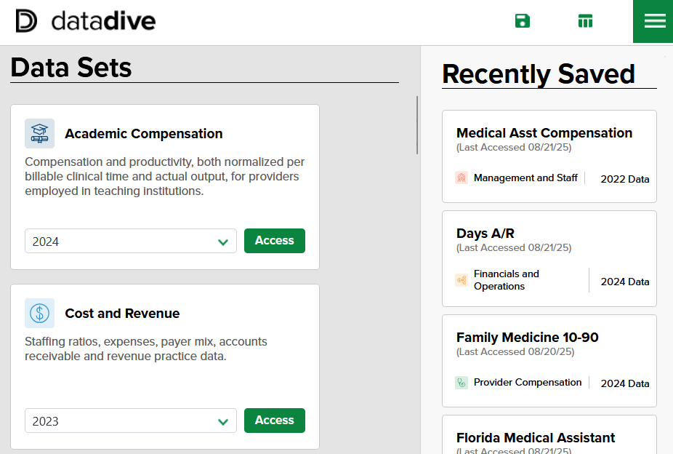
Data Participation Benefit
Upgraded DataDive platform

Slide 14
Why collaborate on participation?
MGMA Data is a powerful tool for your members.
Data collection can seem daunting, both to those who’ve participated long ago and those new to MGMA Data.
Your members will look to State MGMAs to show how simple the process is.
The more participation there is for your state, the better the reports are for your members.
When state participation goes up, State MGMAs will be the reason for the improved reporting.

Slide 15

How does Data help your members?
Review Staffing Ratios: how many support staff are needed
  Look at staff ratios per employed FTE physician, per 10,000 work RVUs produced, or 10,000 patients treated
Set Compensation Plans: physician and APP salary and wRVU levels for the market
  Observe data for providers based on their geographic location, group ownership, and metropolitan area
Compare Hourly Wages by State: review support staff rates to stay competitive
  Comprehensive data set with full-time, part time and partial-year employed staff

Slide 16

How does Data help your members?
Recruiting Newly Practicing Physicians: guaranteed compensation that doesn’t include tenured physicians
  Starting salary figures that are not inflated with productivity incentives
Physician Stipends: compare rates for medical directorships and on-call
  Variety of rate types including Annual, Daily, Hourly, Weekend and Holiday pay
Examine Leadership Benefits: assess compensation, retirement and bonus offered for executives and administrators by state

Slide 17
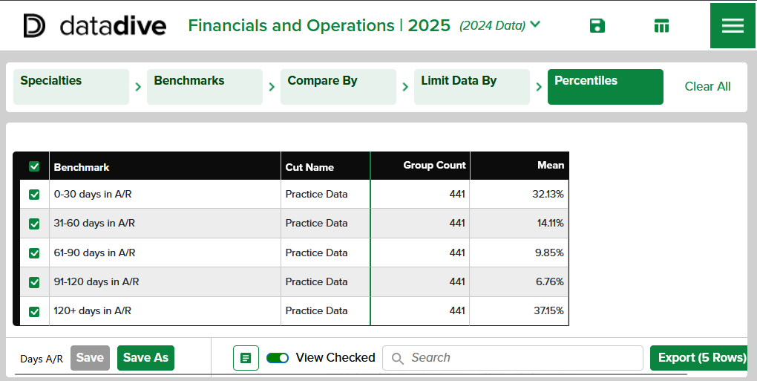
Data participation benefit
Your members get back what they put in, for free
Total Compensation
Work RVUs
Hourly Rate
Staffing Ratios
Expenses
Days in A/R
Payer Mix
Revenue
Coding Profile

Slide 18
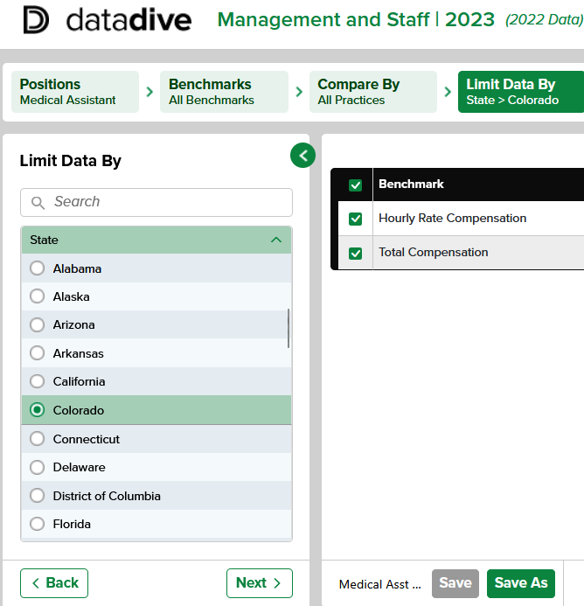
Data participation benefit
Narrow down to state
Management and Staff salary data customized by State
Discount on upgrade for State customizations in all other data sets
Advanced features include custom state groupings,
provider ranking reports and data tools

Slide 19

Getting the word out
National can help! We have compiled website graphics, newsletter banners and full participation copy

Slide 20
What else?
Help us help you
How else can MGMA support States to facilitate benchmarking and data collection in the upcoming year?

