Slide 1
From Vision to Action:
Bringing A Strategic Plan to Life
Stephen A. Dickens, JD, M.A.Ed., FACMPE
Vice President, Medical Practice Services • SVMIC
Notes:
This session provides a comprehensive overview of the process and best practices for implementing a strategic plan within your organization. Participants will gain insights into effective implementation techniques and understand how to overcome common challenges. The session will include real-world examples and practical advice to help leaders translate strategic goals into actionable steps that drive organizational success.

Slide 2
Objectives
Describe the steps involved in developing and implementing strategic plans
Identify and overcome implementation challenges
Break down strategic goals into specific, measurable, and actionable steps, enabling them to drive progress and achieve desired outcomes

Slide 3
Why Change?
Why?
Translation
Evolving markets or customers
Fix something broken
New opportunities
Make something better
Performance gaps
Achieve something great
Crisis
Change for the sake of change

Slide 4
Association Challenges
Recruiting & engaging volunteers
Financial constraints
Micromanagers
Serving/satisfying members
Staff vs. volunteers
Notes:
Volunteer effectiveness=managerial effectiveness
The lines can become blurred
Volunteers can become micromanagers – salad dressing
Staff may overstep bounds as well – powers not delegated to them – contract
There have to be checks & balances

Slide 5
Why We Fail
Change fatigue
Lack of input
Failure to plan
Ineffective
follow-up
Lack of
leadership
Lack of
communication

Slide 6
The Price of Failure
KODAK
Woolworth > Sears > Kmart
Blockbuster
Notes:
Many examples of companies that did not evolve or stay relevant – Xerox, Nokia
Churches, scouting, medical associations

Slide 7
Strategic Planning

Slide 8
It’s Just A Process
Define mission & values
Why does the group exist
How does the group interact
Understand key issues
Internal factors
External factors
Establish goals & objectives
Where does the group want to go
How do we get there
Implement & monitor strategies
Executing the plan
Keeping everyone on track
Notes:
Really not that complicated if you have the information to make decisions.

Slide 9
Governance
Yes
You can move forward with strategic planning
Do you have effective association governance?
Build a governance model first
No
OR
Do not waste your time
Notes:
Commitment and consistency come into play here.
It is why the right people and transitions are so important.

Slide 10
Does Anyone Ever Look At You Like This?
Notes:
This is why you need rules of engagement.

Slide 11
Governance Disorder Syndrome
Individuals or the group do not support decisions
Inability to make a timely decision
GDS
Inability to make a decision at all
Meetings are chaotic & ineffective
X
Latham, Will. Herding Cats
Notes:
Conflict management – 80% avoidance
Team development
Competing, collaborating, compromising, avoiding, accommodating
Forming, storming, norming, performing

Slide 12
Overcoming GDS
Group endeavor
Defines who you are & why you exist
Sets direction & helps to answer questions
Develop a vision statement
Size
Authority
Qualifications & election process
Voting-action
Develop an effective governance structure
How to make decisions
Expectations once a decision is made
Options if one does not like a decision
Agree to a decision-making process
Establish ground rules
Deal with inappropriate behaviors
When & how often
Make meetings work
Latham, Will. Herding Cats
Notes:
One bad president will destroy you and take years to overcome

Slide 13
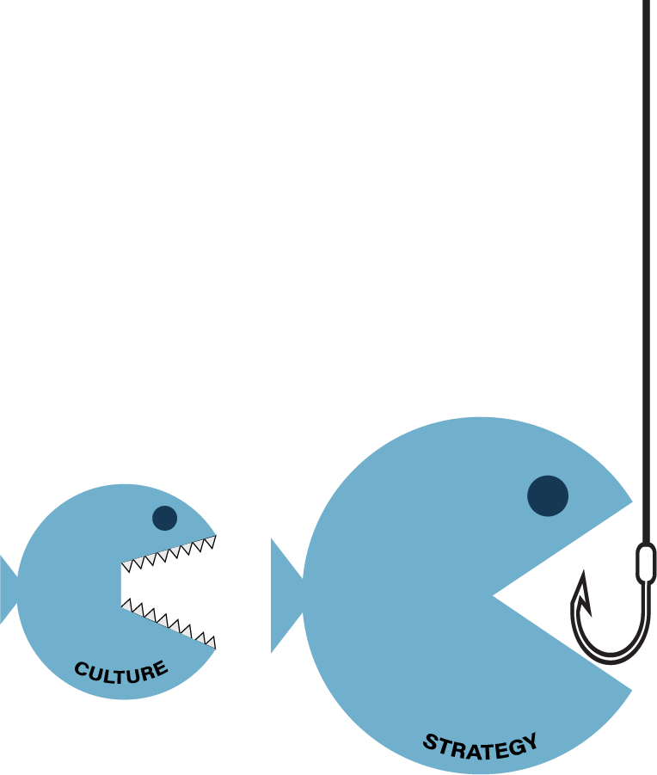
Organizational Culture
Mission, vision and core values influence strategic direction of the organization
Mission & vision statements provide:
Concise statement of group’s purpose and reason for being
Boundaries on planning
What it intends to do
Whom it intends to benefit
How it intends to function as an entity
Core values
Define behavior not operational practices
Establish consequences
Govern personal interactions
Do not change based on the environment
Collins & Porras - Built To Last
Notes:
Everything begins with culture
Culture is what we allow
Difference between mission/vision & hallucination is how many people see it
You need to be clear – there to provide members what they need in the moment

Slide 14
Retreat Planning & Logistics
Facilitator
Setting
Agenda
Preparation
Action plan
Results

Slide 15
Choosing A Facilitator
Understands the process
Understands associations
Understands the environment
Can ask hard questions
Can keep things moving
Can bring about decisions
Can facilitate follow-up if needed

Slide 16
Setting
Consider venue
Avoid practice offices especially during business hours
Formal, casual, getaway
Consider layout
Encourage conversation
Facilitate eye to eye contact
Consider tone
Day trip or overnight
Spouses or significant others
No alcohol during day

Slide 17
Agenda
Follow-up retreats
Establish the basics
Governance
Mission
Core values
Strategic issues
Environmental analysis
Internal assessment
Goals
Action plan
Review & affirm basics
Previous plan status
Identify what changed
Strategic issues
Goals
Action plan
Initial retreat

Slide 18
Preparation
Budget & dates
Secure venue
Schedule any outside activities
Facilitator
Study survey data
Prepare materials
Assemble resources
Prepare & test
Launch 4-6 weeks in advance
3-6 months
Survey
Meet with president/
exec
Agenda
Survey results
Financial or operational reports/ assessments
Board meeting materials
Flip charts
Markers
A/V
Determine tone & successful outcomes
Finalize agenda
Assign scribe
Define any follow-up activities
Decide who will attend
Focus groups
Notes:
Copy of my state survey provided as resource

Slide 19
Establish Ground Rules
Everyone has a unique perspective
Personal agendas must be set aside
Everyone has a voice
Improvement is a process
No one person has all the answers
The facilitator is in control to manage participation & attendees
All input is valuable but should be relevant
Establish a parking lot
Notes:
Gathering all the stakeholders around the table to analyze data and make decisions for the group is one of the most significant hurdles in the strategic planning process. It is essential all parties come with an open mind and speak it. The challenge is those who unintentionally, or intentionally, suck the air out of the room and dominate the conversation. Or, maybe you have a room full of people who would rather look at the wall or their shoes. Setting expectations and ground rules for behavior and participation is a must for the effective facilitator.

Slide 20
Establish A Plan
Establish accountability
Communication
Who will lead it
Who will participate/support it
Everyone knows the plan
Everyone knows the why
Everyone knows their role
Set goals
Identify metrics
Use the plan
What will be done
What is the benefit/purpose
Cost
Status updates
Completion
Stick to the plan
Follow-up & work the plan
Start a file for the next plan
Notes:
You have done the preparation, analyzed the situation and had the conversation looking to the future and direction of your organization. The work is not done though. If you leave the meeting without a plan, you have just wasted your time. What goes into an effective plan?

Slide 21
SWOT & SMART
Specific
Simple
Sensible
Significant
Time bound
Time based
Time/cost limited
Timely
Measurable
Meaningful
Motivating
STRENGTHS
WEAKNESSES
SWOT ANALYSIS
Relevant
Reasonable
Realistic & resources
Results based
THREATS
OPPORTUNITIES
Achievable
Agreed
Attainable
Notes:
Your job is to provide just in time information and resources.
This should guide your goals.
What can you give them of value they cannot get elsewhere?

Slide 22
Building A SMART Goal
Develop a student outreach program and membership category with 10 students at spring conference
04.30.25
Define student membership & dues structure
08.31.24
Identify universities with appropriate educational programs
09.30.24
Develop talking points & educational materials
09.30.24
Develop student focus content/social event for conference
12.31.24
Student recruitment/conference registration
02.28.25
Refer recommendations to By-laws Committee
Identify university program contacts
Initiate university contact
10.31.24
Allocate $2,500 to defray conference attendance costs
Attend student focused events
Ongoing

Slide 23
Action Plan Report
Goal | Goal Lead | Committee | Budget | Status Updates | Target Completion Date
Develop student outreach program 10 student attendees at spring conference | Billy Jo | Bobby Jo Betty Jo Joe | $2,500 | Committee met 08.08.24 – developed list of colleges for outreach, defined scholarship/membership criteria/pricing, referred to by-laws committee Committee met 09.05.24 – developed talking points, assigned outreach tasks | 01.25/04.25
Build spring conference agenda including local chapter leadership program 2 tracks - advanced & basic sessions | Suzy | Muffy Buffy Fluffy Buford | $500 | Committee met 09.25.24 – reviewed member survey, developed draft outline, contacting speakers, determining pricing | 01.25
Review & revise by-laws Add student membership category | Vlad | Igor Elvira | N/A | Committee met 09.15.24 – identified potential changes | 04.25
Develop organizational membership model | Eartha | Aretha Otis | N/A | Committee met 08.15.24 – outlined benefits & dues structure Committee met 09.19.24 – drafted marketing materials | 01.25
Notes:
The plan must live & be touched
Associations are clearinghouses for their members
You must give them something they cannot get elsewhere
This is a challenge given readily available information on the internet & evolving trends on how people connect

Slide 24
Eliminate Excuses
We cannot predict the future!
It is too expensive and time consuming!
Too many current problems: we do not need anything new!
I am not giving up my weekend!
It is just a waste of time dreamed up by consultants to make money!
Everyone is happy and it is going fine.

Slide 25
The Real Challenge…
Leading Change

Slide 26
Principles of Change Management
Assess
& adapt
Lead with
culture
Make your case
Monitor
Regroup
Redirect
Start at the top
Both rational & emotional
Lead &
demonstrate
Engage
Include every layer
What it means to me
Seek input
Embrace new thinking
Work outside the lines
Formal & informal solutions
Notes:
Think about it from their perspective
Get out of the gray zone – uncertainty is worse than change

Slide 27
Why Volunteers Resist Change
Personal perspectives
Input ignored
Lack of information
Lack of training
Loss of power
Personal agendas
Not my real job

Slide 28
Essential Elements
Shared vision
Communication
Notes:
Everyone is one board with the plan
Everyone understands the plan and is saying the same thing

Slide 29
Engaging Volunteers
Paint a real picture of the job
Provide information
Solicit input
Provide orientation
Celebrate successes
Identify future leaders
Be responsive
Regular meetings & touchpoints
Acknowledge contribution & service
Develop relationships
Listen actively

Slide 30
Developing Volunteers
SPECIFIC
What exactly does it look like for me to do my work well & be successful
Example
GROWTH
Show me what it has done for you and can do for me
Provide opportunities for growth
PRESENT
Walk the conference, go to sessions, ditch the cliques, let them see you are approachable
Notes:
Do not recycle the same ole people over and over
Be honest as you recruit
Let me see you having fun
Build relationships

Slide 31
The Elephant in the Room
It Is A Job
Job descriptions
Legalities
Time commitment
Professionalism
Transition
Elevator speech
Board responsibilities
Notes:
Some people just will not be the right fit – deal with it early

Slide 32
Fostering Relationships = Building Trust
Be proactive
Anticipate problems,
connect before they occur
Be positive
Negative interactions cloud the memory of positive ones
Be sincere
Mean what you say, say what you mean
Guard your
tone & language
Approachable, compassionate, inclusive
Connect
Engage, be present,
minimize distractions
Get to know them
Know something about who they are
Notes:
You can do your best to lead volunteers but unless you have a positive working relationship with them and they have trust in you, it is unlikely they will follow. Simple, everyday steps to build those relationships are essential, but they require a commitment and deliberateness. You must be consistent.

Slide 33
Develop Your Effectiveness
Set goals
Specific
Measurable
Attainable
Realistic
Timed
Delegate
Understand your preferences
Know your people
Be clear about purpose
Assess & reward
Maximize your value
Focus on things only you can do
Prioritize
Delegate everything else
Role clarity
Mission first
Enjoyment second
Learn to say no

Slide 34
Takeaways
Build a committed team
Identify the problem
Establish the goal
Follow-up regularly
Overcommunicate
Celebrate success
Recognize not everyone makes a good volunteer
Take it seriously & do your job
Remember it is not about you

Slide 35
Remember
Notes:
The only thing scarier than change is regret.
The goal is to leave it better than you found it.
Know when to move aside.

Slide 36
Stephen A. Dickens, JD, M.A.Ed., FACMPE Vice President, Medical Practice Services • SVMIC SteveD@svmic.com 615.377.1999

Slide 37
Resources & References
Aguirre, DeAnne; Alpern, Micah: “10 principles of leading change management”. https://www.strategy-business.com/article/00255. Accessed 09.02.24.
Collins, Jim; Porras, Jerry I.; Built To Last., 1994.
Katzenbach, Jon; von Post, Rutger; Thomas, James; “The Critical Few: Components of a Truly Effective Culture., https://www.strategy-business.com/article/00237. Accessed 09.02.24.
Kubler-Ross, Elisabeth, On Death and Dying, 1969.
Duncan, Noah. “How to apply the Kubler-Ross change curve in the workplace”. https://www.workpatterns.com/articles/change-curve. Accessed 09.02.24.
Latham, Will. “Herding Cats”, MGMA Connection, Volume 15, No. 3. May 2015.
Perkins, Tammy. “How to manage your team through change”. https://www.fastcompany.com/90234613/how-to-manage-your-team-through-change. Accessed 09.02.24.
Strategy & Katzenbach Center, https://www.strategyand.pwc.com/gx/en/insights/katzenbach-center.html. Accessed 09.02.24.
“The Top Six Leadership Challenges Around the World”, https://www.ccl.org/articles/leading-effectively-articles/top-6-leadership-challenges/. Accessed 09.02.24.
Weeks, Linton. Time for Associations to Trade in Their Past? https://www.npr.org/2011/05/25/136646070/time-for-associations-to-trade-in-their-past. Accessed 09.02.24.
Sample Strategic Planning Survey Template
Notes:
I did not cite all these, but they are applicable.

