Slide 2
Annual Education Planning
Maximizing Engagement; Delivering Member Value

Slide 3
Objectives
How do we align education to market demands?
Market Driven Education
Our members and prospective customers’ needs should shape how we frame our education offerings. Determining what the purpose is, who our targets are to receive the education and the methods we use to deliver are all considerations.
01
Education Planning
Once customer needs are recognized, the planning begins. Creating a fully developed roadmap for training helps with planning, monetization and marketing to solicit the right participants.
02
03
ACMPE BoK as a Content Framework
Using MGMA’s Body of Knowledge can be a useful organizing principle for your education offerings and to ensure alignment of continuing education to those subjects most relevant to members.

Slide 4
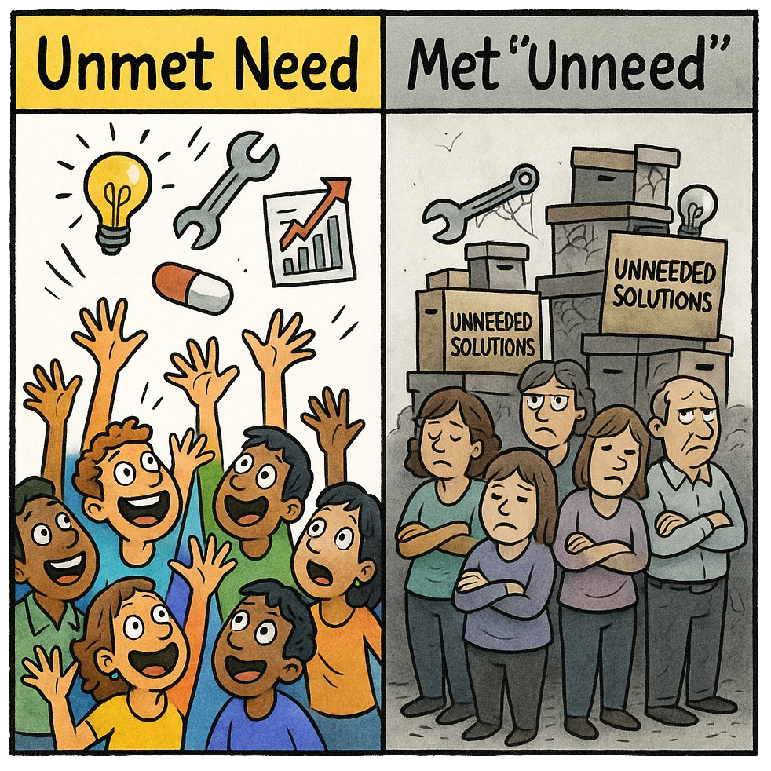
The Problems We Solve Are…
The Unmet Need vs. The Met Unneed
Are we meeting an actual need that customers have?
Every problem or unmet need is an opportunity.
Resources are limited
"We can do anything, but we can't do everything"
We need a method to inform what we are going to do and what we will not.
Notes:
Examples: you receive a letter from the biggest payer in the state about documentation changes for a set of heavily billed codes.
Your state Medicaid agency alters their coverage parameters tied to employment
Your city/region’s cost of living is high/low, so you’re group is experiencing continued wage inflation/ability to decrease.

Slide 5
The “Right” Approach
Training or Education
Skill or competency building
Didactic or Interactive
Single or Multi-Touch
What other approach considerations should we prioritize?
Notes:
Examples: you receive a letter from the biggest payer in the state about documentation changes for a set of heavily billed codes.
Your state Medicaid agency alters their coverage parameters tied to employment
Your city/region’s cost of living is high/low, so you’re group is experiencing continued wage inflation/ability to decrease.

Slide 6


Segments and Personas
MARKET SEGMENTS
CUSTOMER PERSONAS
Groups of customers sharing similar quantifiable characteristics.
Based on demographic/firmographic data
Answers "WHO are our customers?"
Focused on business metrics (revenue, growth)
Used for market sizing and targeting
Typically broad categories
Archetypal representations of users based on qualitative behaviors and needs.
Based on qualitative research and observed patterns
Answers "WHY and HOW users engage with solutions"
Focused on motivations, goals, and pain points
Used for product design and experience creation
Represents specific user types that may cross segments
Mid-size Medical Practices (11-50 physicians)
Annual revenue: $5-20M
Located in urban/suburban areas
Employs 50-200 clinitians
Serves 10,000+ patients annually
Ops Manager Maria oversees daily clinic operations
Primary goal: Maximize provider productivity
Key frustration: Manual scheduling inefficiencies
Seeks: Automated solutions that require minimal training
Decision driver: ROI through time savings
Market segments help identify WHERE to focus business resources, while personas help understand HOW to design solutions that meet specific user needs within those segments.
Identify valuable market segments (WHO) >
Research users within those segments >
Create personas representing behavioral patterns (WHY/HOW) >
Design solutions addressing persona needs >
Market solutions to segments using persona insights

Slide 7
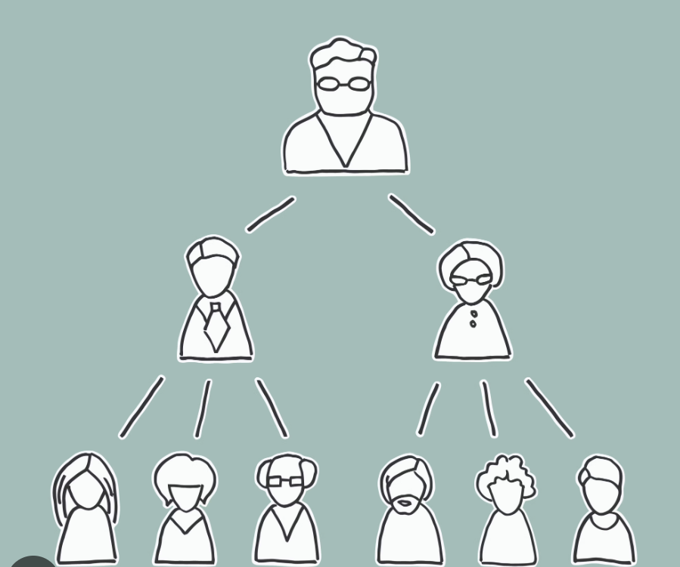
Potential Personas
We could enroll many audiences in our training and education. Who are the key targets?
Practice Administrators
Office Managers
Billing Staff
Front Desk Supervisors
Clinical Supervisors
What audiences do you specifically address well today? Which could use your attention?

Slide 8
Alternative Methods
Face to Face
eLearning
On-the-Job
Conference
Seminar
Workshop
Power Hours: Breakfast, Lunch or Happy Hour
Case Study Discussion
Webinar
Lunch n Learn
Online course
Short form video
Digital discussion forums
Q&A blogs
VR/AR Simulation
Mentoring
Coaching
Shadowing
Peer-to-Peer
Cross training
“How To’s”
Role Playing

Slide 9
Face to Face Events
1-2 Hours
Denial Management Workshop
Employment Law Seminar
4-8 Hours
Payor Day
8+ Hours
Multi-Topic Conference
2-4 Hours
Legislative Day
Job Fair
Role-Specific Event
Topic-Specific Event
Happy Hour Hot Topic
Morning Featured Speaker
Technology Demo

Slide 10
eLearning Examples
Webinar (or Series)
Create a three part webinar series on the application of new tech – new EMR workflow, patient engagement tool, website/social persona maintenance, AI agent phone tree.
Guided Online Classes
Micro- Learning Video Series
Making Online Courseware Yours
Use a free online course and host a guided discussion about the application of the material. Offer realism to the theory.
Digital Discussion Boards
Tik Tok / YouTube
Start a monthly short form self-recorded video series giving tips on the payer workarounds your team has discovered.
Webinars
Community Leadership
Digital Discussion Board
Each month, post a new topic and challenge every member to post a question or comment on the topic. Reward/recognize those that participate throughout.
Community Leadership/Partnership
Create a semi-annual email newsletter-like piece highlighting a medical group community partner and some members’ positive interaction with them
eLearning

Slide 11
On-The-Job Examples
Mentor
Coach
Ask a professional coach to give “free first coaching session” to first 10 members interested as part of a sponsorship
Connect mentors and mentees at a F2F event and continue the relationship on-the-job
Partner with willing tech provider to offer “trial” or simulated install to a number of members
Invite members to shadow a new service line taking a single specialty to a multispecialty group
Shadow
Sims

Slide 12
Monetizing Training & Education
Traditional sponsorship and exhibition packages
Cost per lead models with a base price
  Entry price of $1000 and another $100 per lead within 30 days after the event
Service provision “Exclusive Sponsorship”
  ABC Firm is the exclusive Accounting sponsor of State MGMA.
  Establish a handful of key sponsor verticals
  Could hinder growth of multiple providers in a vertical
Other creative monetization strategies you’ve seen to be successful?

Slide 13
Annual Calendar – 1st Half
January
February
March
April
May
June
Webinar
Discussion Forum
Regional Meet Up
Discussion Forum
Regional Meet Up
Gov Update
Discussion Forum
Webinar
Discussion Forum
F2F Day
Discussion Forum
Webinar
Discussion Forum

Slide 14
Annual Calendar
January
February
March
April
May
June
Webinar
Discussion Forum
F2F Day
Discussion Forum
Webinar
Discussion Forum
Webinar
Discussion Forum
Regional Meet Up
Discussion Forum
Regional Meet Up
Gov Update
Discussion Forum
December
November
October
September
August
July
F2F Day
Discussion Forum
Webinar
Discussion Forum
Webinar
Discussion Forum
Regional Meet Up
Discussion Forum
Regional Meet Up
Gov Update
Discussion Forum
Webinar
Discussion Forum

Slide 15
Example Training Plan
Front Desk Sup. | Webinar | Workshop | Seminar | Online Discussion | Conference | Coaching
Local Staffing Data | X | X |  |  | X
Payor Tips and Tricks |  |  | X | X | X
Role Stats & Expectations | X |  |  | X
Regulatory Operations |  | X |  |  | X | X
Community Network/ Resources |  |  | X |  | X

Slide 16
Exercise: Training Plan
Target Audience: Skill/Topic: | Format A | Format B | Format C | Format D | Format E

Slide 17
BoK Framework
Financial Management
Operations Management
HR Management
Body of Knowledge
Risk & Compliance
Organizational Governance
Transformational Healthcare Delivery
Notes:
As the certifying body of MGMA, ACMPE has been delivering professional development opportunities based on the Body of Knowledge for Medical Practice Management since 1956.
The MGMA-ACMPE Body of Knowledge for Medical Practice Management
An outline of the competencies and knowledge that define the foundation of the profession
Foundation for the ACMPE Certificates, Board Certification, and Fellowship
Valuable resource for professional development and practice improvement
Provide content for relevant and up-to-date publications, education programs and resources

Slide 18
Local Content Depth
IT
Operations
Finance
HR
Establish a bi-annual local user group where members using specific EMRs gather to discuss best practices – with or without the vendors present
Create a “shark tank” where local billing companies differentiate themselves, live
Local market analysis presentation with differentiation planning/ coaching
Partner agency review – state & community resource access
Corporate real estate perspectives from brokers and practices
Discuss local payer policy challenges in the digital community
Recruit a regional payer rep to speak at a live event
Recruit a local audit firm to sponsor a webinar on medical group audit best practices
Legislative update summarizing impactful regulation/laws tied to staff management
Webinar on local compensation data & trend analysis
In person benefit fair (like a job fair) for groups to shop many solutions at once

Slide 19
ACMPE State Resources - Implementation and Ideas
Education
Conference Sessions Study Groups
Study Groups BoK Deep Dives
Fireside Chat with a Member Case Study
Certified “Celebrity”
Promotion Support
Forum Rep Update/Report
Newsletter
Study Tips
Certified/Fellow Member Spotlight
Forum Rep Support Materials
Email Templates
Presentation Examples
Digital Brochures/Materials
Conference Ribbons & Buttons
Flashcard Giveaways

Slide 20
ACMPE Update
Body of Knowledge evaluation and update occurring in 2025-2026
New and expanded areas of focus, reflecting our changing industries’ evolution and expertise
Following the launch, revised materials and testing will be built and launched
More information coming in the spring of 2026

