Slide 2
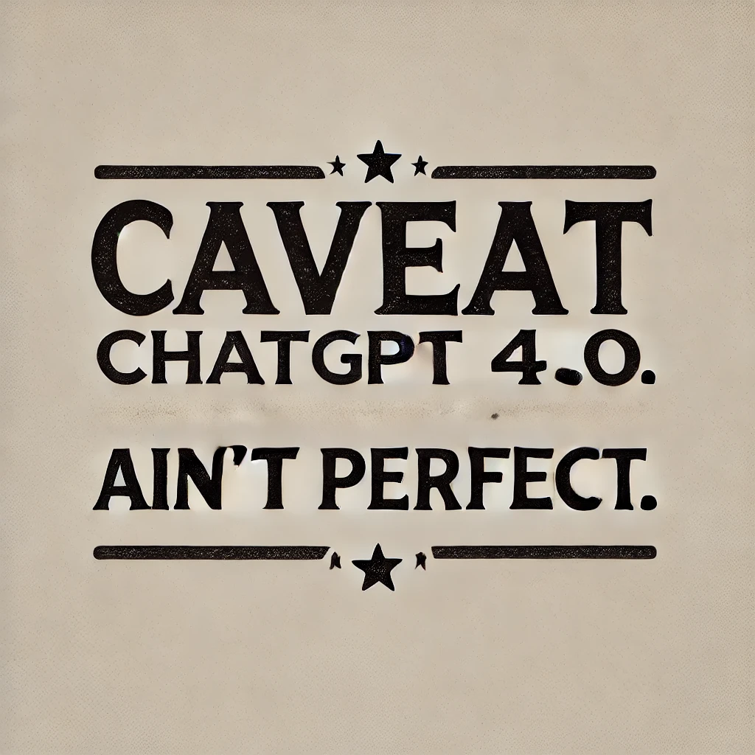

Slide 12
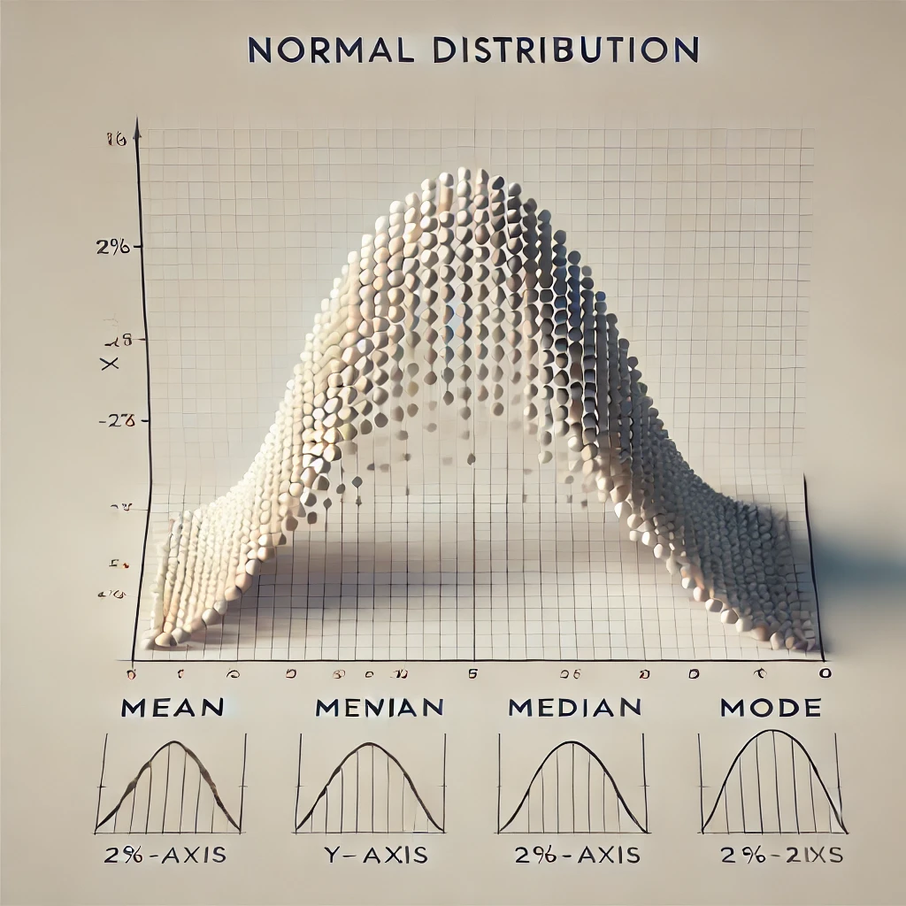

Slide 16
Congruence with Mission
Orientation
Open communication
Networking
Professional development
Recognition
Alignment with personal values
Inclusivity
Collaboration
Adaptability
Commitment to Social Issues

Slide 17
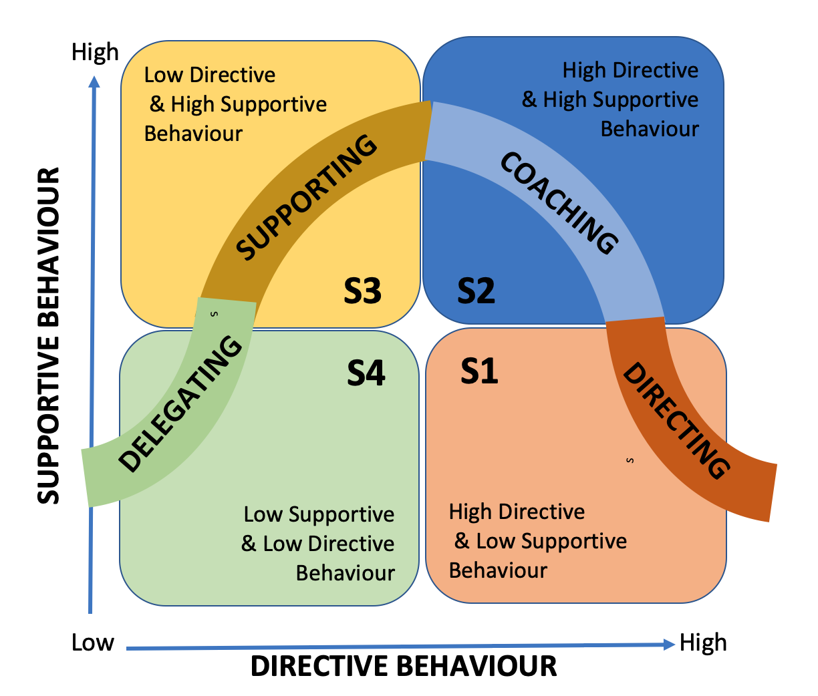

Slide 18
