Slide 1


Savvy Saving Seniors®: Steps to Avoid Scams
Welcome
Organization/Event Name
Date

Slide 2



Discussion Starter
    Quiz
    Take the quiz in your handbook to test your knowledge.
    How prepared are you to recognize and stand against scams?

Slide 3


Today’s Objectives
1. Discover how much you know about modern AI-enhanced scams
2. Understand why you’re at risk of financial exploitation
3. Recognize the usual suspects and common scams
4. Gain the tools to safely respond to attempted scams
5. Know how to report scams and financial crimes 6. Feel confident in protecting yourself and loved ones from scams

Slide 4

Scams and You
Fraud: A broad legal term that encompasses dishonest activities for financial or personal gain
Scam: A type of fraud that involves tricking someone into giving up money or personal information
1 in 6 people in the U.S., or 17% of the population,
is age 65+.
In 2023, more than 101,000 adults age 60+ reported being victims of financial scams.
The resulting losses topped $3.4 billion.
The average monetary loss per victim of elder fraud in 2023 totaled $33,915.

Slide 5

Why You’re at Risk
Greed-motivated scammers
Concerns about retirement money running out
Isolation as a risk factor
Rapidly evolving AI technology
Perpetrators can include strangers, family members, caregivers

Slide 6

The Likely Perpetrators
Strangers preying on older adults who may be isolated, lonely, confused, or in need of cash or attention
Family members to whom the older adult wants to stay connected
Caregivers (family and other) who use fear or guilt to take advantage of an older adult

Slide 7
The Dirty Dozen:
Top 12 Scams Targeting Older Adults
    ​Call Center and Tech Support Scams
    Personal Data Breach Scams
    ​Confidence Scams
    ​Nonpayment/Nondelivery Scams
    ​Investment Scams
    ​Extortion Scams
    ​Government Impersonation Scams
    ​Credit Card and Check Scams
    ​Business Email Compromise Scams
    ​Identity Theft Scams
    ​Advance Fee Scams
    ​Windfall Scams

Slide 8
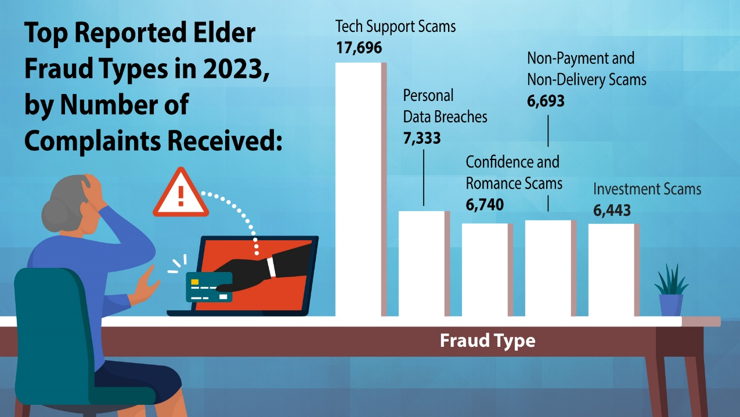
Source: FBI Internet Crime Complaint Center, https://www.fbi.gov/news/stories/elder-fraud-in-focus

Slide 9
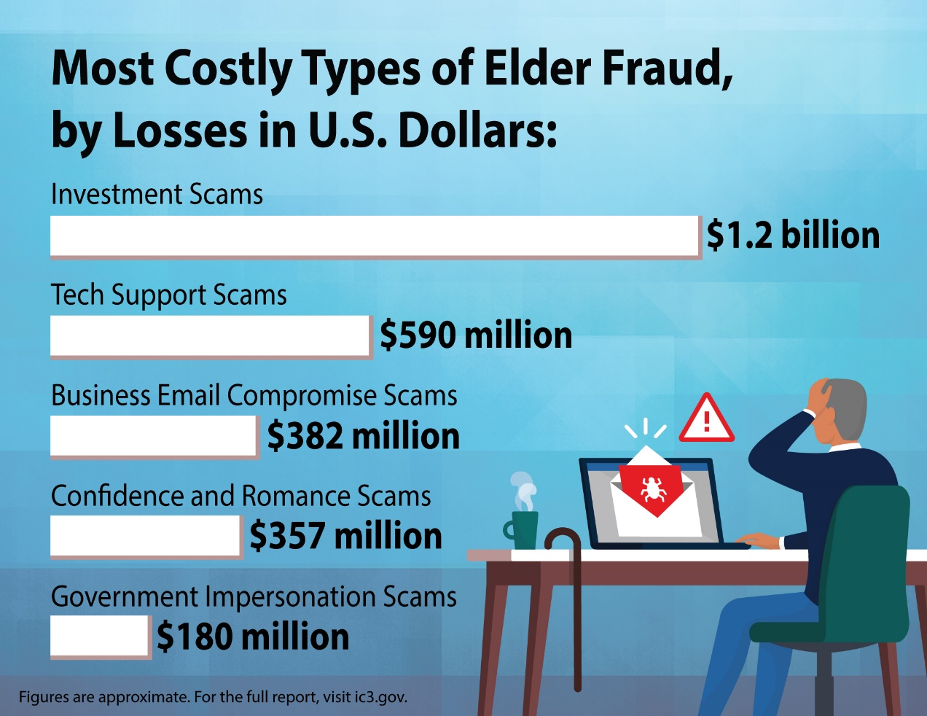
Source: FBI Internet Crime Complaint Center, https://www.fbi.gov/news/stories/elder-fraud-in-focus

Slide 10

1. Call Center
and Tech
Support Scams
The Scam
Fake tech support calls, emails, or pop-ups say they will fix a computer issue, perform needed updates, or download helpful antivirus software
The Reality
Scammers want access to your computer and the personal and financial information on it
Phantom Hacker Scam
Starts as tech support but progresses to fake banking officials and government imposters
AI Spotlight
AI can bypass spam filters, gather information on you, and make communications and scammers appear credible

Slide 11

2. Personal Data Breach Scams
The Scam
Messages claim your personal information was compromised in a data breach and pressure you to act quickly to secure your account(s)
The Reality
Scammers are phishing to obtain your personal and financial information
AI Spotlight
AI can create highly personalized emails that are built to fool spam filters—and you

Slide 12

3. Confidence Scams
The Scam
Scammers start by building trust before introducing the financial swindle.
The Reality
Examples include romance scams, grandparent scams, home repair/contractor scams, and spousal death/funeral scams
AI Spotlight
Voice cloning, manipulated deepfake videos, convincing scripts, and impeccably faked documents make these scams harder to spot

Slide 13

4. Nonpayment/
Nondelivery Scams
The Scam
Individuals are tricked into a one-sided transaction where the good or service is provided but never paid for or the good or service is paid for but never received
The Reality
These offers are too good to be true offers, include pressure to buy quickly, and involve unusual payment methods
AI Spotlight
AI can be used to produce sham online stores or product listings

Slide 14

5. Investment Scams
The Scam
These often begin with a confidence scam to build your trust, and they feature complex investment opportunities, presented as little to no risk with guaranteed high returns
The Reality
These include advance fee scams, Ponzi schemes, pyramid schemes, market manipulation fraud, real estate investing, and trust-based investing such as cryptocurrency investment
AI Spotlight
Deepfake videos, voice cloning, and AI-generated content across many mediums and platforms can deceive investors

Slide 15

6. Extortion
Scams
The Scam
Scammers use blackmail threats of releasing intimate, illegal, or embarrassing materials if you don’t pay
The Reality
These scams can include ”sextortion” or government impersonators threatening legal consequences
AI Spotlight
AI-generated materials lend credibility to impersonations and fake evidence

Slide 16

7. Government Impersonation Scams
The Scam
The scammer impersonates a government official—often claiming to be with the IRS, Social Security Administration, or Medicare—and presents fake claims, makes demands of payment for personal information, or threatens legal consequence or loss of benefits
The Reality
Government officials do not call, email, message on social media, show up at your home, or make threats for payment
AI Spotlight
AI can be used to forge official documents and identification, as well as spoof phone numbers to boost credibility

Slide 17

8. Credit Card and Check Scams
The Scam
Scammers use phishing tactics to gain access to personal identification information and credit card or account numbers, then max out the credit card accounts or use personal information to open new accounts or lines of credit
The Reality
It’s critical to protect your personal information, review your transaction history, and monitor your credit score
AI Spotlight
AI can speed up phishing techniques and add voice cloning and deepfakes to make these scams more prevalent

Slide 18

9. Business Email Compromise Scams
The Scam
Scammers impersonate known vendors or partners using fake invoices or fraudulent payment links
The Reality
Malware on company computers to access professional, financial, and employee data
AI Spotlight
AI is used in emails, text messages, business communication apps, cloned voice calls, and even deepfake Zoom calls

Slide 19

10. Identity Theft Scams
The Scam
Using robocalls and phishing, scammers use your personal identification information to access your accounts and open new accounts in your name
The Reality
Signing up with the National Do Not Call Registry can help
AI Spotlight
AI powers data mining, creates highly specific personalized phishing campaigns, and voice cloning

Slide 20

11. Advance Fee Scams
The Scam
This is a game of give to get—they required you to pay upfront before you can get something of value in return
The Reality
Examples include rental scams, loan and employment scams, and lottery scams
AI Spotlight
AI also can scrape data on job boards and LinkedIn profiles to create realistic employment opportunities and precisely target job seekers

Slide 21

12. Windfall Scams
The Scam
Foreign crime organizations or others claim you won a lottery, sweepstakes, or received an unexpected inheritance, often requiring you to pay upfront fees to claim the money
The Reality
You can’t win if you didn’t play!
AI Spotlight
AI can be used to impersonate lottery officials and lawyers

Slide 22

Case Study: A Closer Look at Common Scams
Maggie, a 72-year-old widow, met James through an online dating site for older adults. He quickly charmed her with attention, affection, grand gestures, and promises for the future. It was a whirlwind romance, and she scarcely had time any longer to visit her kids, attend her church group, or go on her daily walk with her neighbors.
Within a few short months, their relationship grew more serious, and James convinced Maggie to invest a large sum in a lucrative opportunity he claimed was guaranteed to secure her—and their—financial future. Feeling pressured, she was about to send money when she hesitated.
In retaliation, James threatened to expose intimate messages and images, obtained through manipulated online conversations, unless Maggie complied. Fearing disgrace, she relented and wire transferred the money to James. Maggie was left heartbroken, scared, in dire financial straits, and feeling very alone to process what happened to her.
Let’s examine this case...

Slide 23
Case Study: A Closer Look at Common Scams
Type(s) of Scams
Warning Signs
Prevention
Can you identify what type (or types) of scams took place in this scenario?
What were some of the red flags you noticed as this scenario progressed?
Do you think there is anything Maggie could have done differently?

Slide 24

Tips to Avoid Scams

Slide 25

Tips to Avoid Call Center
and Tech Support Scams
Tip 1
Tip 3
Do not engage with unsolicited offers for tech support, ignoring links, pop-ups, text messages, calls, and other attempts.
Never send money, cryptocurrency, gift cards, or other payments to unsolicited tech support.
Tip 2
Tip 4
Do not download software from an unknown person and never allow an unknown person to have remote access or control of your computer.
Sign up for the Do Not Call Registry.

Slide 26
Tips to Avoid Personal Data Breach Scams
Tip 1
Tip 3
Do not click on pop-ups, links, or attachments warning of a data breach.
Do not engage with text or email messages or phone calls alerting you to a data breach. Instead, contact the named company directly using a confirmed phone number or website.
Tip 2
Tip 4
Look for red flags, such as poor grammar or spelling, prompts to confirm personal information, and pressure to act quickly.
Use strong passwords and enable multifactor authentication to protect your information from real data breaches.

Slide 27

Tips to Avoid Confidence Scams
Tip 1
Tip 3
Don’t mix dating and dollars. Set strong boundaries between your finances and romantic partners.
Always get information in writing and take your time to consider the situation and research parties involved.
Tip 2
Tip 4
Create a secret family password to outsmart scammers using voice cloning.
Don’t concede to high-pressure sales tactics or personal manipulation.

Slide 28
Tips to Avoid Nonpayment/Nondelivery Scams
Tip 1
Tip 3
Don’t provide personal or payment information on unfamiliar or unverified websites.
Take time to research websites or individual sellers before moving forward with a purchase.
Tip 2
Tip 4
Opt for secure payment methods like credit cards that offer buyer protection.
Check the quantity and content of the customer ratings and reviews.

Slide 29
Tips to Avoid Investment Schemes
Tip 1
Tip 3
Be wary of investment opportunities claiming no risk, quick profits, or guaranteed returns.
Do your homework to verify the credibility of investment opportunities and the people promoting them from multiple reputable sources.
Tip 2
Tip 4
Ignore unsolicited offers asking you to invest money.
Consult with a registered investment professional before making any decisions. Visit Investor.gov to confirm the status of any investor’s legally required registration.

Slide 30

Tips to Avoid Extortion Scams
Tip 1
Tip 3
Reconsider sharing identification information as well as overly personal stories on online public platforms like social media, as they could be used against you by extortionists.
Keep in mind that a real government official or law enforcement officer will not threaten you for money.
Tip 2
Tip 4
Strongly rethink posting, emailing, texting, or sharing intimate photos or videos, which can be used in sextortion scams.
Don’t panic—block and report. Blackmailers bank on scaring you into compliance. Don’t respond, don’t try to negotiate your way out of it, and don’t pay.

Slide 31
Tips to Avoid Government Impersonation Scams
Tip 1
Tip 3
Government agencies will never call, email, text, show up unannounced, or message you on social media to ask for money or personal identification information.
Know that the government will never ask you to pay via money wire, gift cards, cryptocurrency, or other unusual payment methods.
Tip 2
Tip 4
Government agencies will never threaten you with arrest or loss of benefits as a consequence for not making a payment you have not confirmed.
Don’t rely on your caller ID because scammers can spoof, or fake, a government agency’s name and/or real phone number when they call.

Slide 32

Tips to Avoid Credit Card and Check Scams
Tip 1
Tip 3
Don’t respond to anything in an unsolicited email, text message, or phone call asking you to update or verify account information. Call the bank or company via a verified number to ask if the request is legitimate.
Protect your account logins with strong passwords and enable two-factor authentication for your account logins.
Tip 2
Tip 4
Use direct deposit for benefits checks to prevent physical checks from being stolen.
Ensure you are set up to receive fraud alerts from your bank and credit card company.

Slide 33
Tips to Avoid Business Email
Compromise Scams
Tip 1
Tip 3
Scrutinize invoices and requests for payment to confirm exact email addresses, websites, and details for known contacts.
For payment or purchase requests that are new or unusual, verify their validity in person or by calling a confirmed number yourself.
Tip 2
Tip 4
Use strong passwords and set up two-factor or multifactor authentication on any business-related account login that allows it. Don’t open attachments from unknown senders.
Pause on any payment or purchase request that comes with pressure to act quickly.

Slide 34

Tips to Avoid Identity Theft Scams
Tip 1
Tip 3
Be cautious and protective of your personal information wherever it is being used or written down and never share it online or over the phone based on unsolicited requests.
Avoid connecting your phone or computer to the internet using unsecured public WiFi networks, as it leaves your device vulnerable to access by cybercriminals.
Tip 2
Tip 4
Collect your mail regularly to lessen the chance of it—along with your personal identification or account information—being stolen, and shred documents with personal or account information before throwing away.
Avoid connecting your phone or computer to the internet using unsecured public WiFi networks, as it leaves your device vulnerable to access by cybercriminals.

Slide 35
Tips to Avoid Advance Fee Scams
Tip 1
Tip 3
Never pay upfront fees for anything, especially for employment applications or training, loan processing, or to claim a prize.
Judge all requests for unusual payment methods as red flags. These include wire transfers, gift cards, and money orders—all of which are difficult to track or recover.
Tip 2
Tip 4
Take caution with companies that are difficult to locate, lack a physical address, or are not easily verifiable from multiple trusted sources.
If you must pay an upfront fee that you believe to be legitimate, use a secure payment method and then monitor your accounts closely.

Slide 36
Tips to Avoid Windfall Scams
Tip 1
Tip 3
Remember: You can’t win if you did not play. Do not believe claims you won a lottery or sweepstakes you never entered yourself.
Never pay an upfront fee to claim a prize or inheritance. Legitimate lotteries and sweepstakes take taxes and fees out of prize money before your payout.
Tip 2
Tip 4
U.S. citizens can’t play and win foreign lotteries. It is illegal, so hang up on anyone calling about the Jamaican lottery or any others you have not played.
Do not share your personal or financial information with anyone claiming to need it to confirm an inheritance.

Slide 37

Protect the People You Care About: Know the Signs

Slide 38

Know the Signs
Stay alert for signs that someone you care about may be experiencing a financial-related scam or other problem. Here are some signs to take notice of:
Unusual recent changes in personal accounts, including atypical withdrawals, new individual(s) added, or sudden use of a debit or credit card
A person suddenly seeming confused, unkempt, or fearful
A caregiver not allowing others access to the older adult
Piled up sweepstake mailings, magazine subscriptions, or “free gifts,” indicating their name has been added to a list

Slide 39

Reporting Scams
National Elder Fraud Hotline: 833-FRAUD-11 (833-372-8311)
FBI’s IC3: ic3.gov
Federal Trade Commission: ReportFraud.ftc.gov
Adult Protective Services: napsa-Now.org/Help-in-Your-Area
Medicare: 800-MEDICARE

Slide 40
Other Smart Steps You Can Take
Step 1
Step 3
Contact all your banks and credit card companies immediately.
Put out a fraud alert to all three credit reporting agencies (Experian, Equifax, and TransUnion) and consider a credit freeze.
Step 2
Step 4
Cancel any debit or credit cards linked to the stolen account. Reset personal identification (PIN) numbers and passwords.
File a report with the police. The police may not be able to do much themselves, but you may need a police report to clear up the problem.

Slide 41

Questions and Answers
Scams happen every day!
The best way to defend yourself is to be knowledgeable on the tactics that scammers use and learn how to recognize them. Do you have any questions regarding the material presented here today?

Slide 42

Thank You!

