Slide 1
Take charge of your health with [PROGRAM NAME]

Slide 2
Agenda
Basics, background, benefits
Keys to success
Are [PROGRAM NAME] workshops for you?
Join a workshop

Slide 3
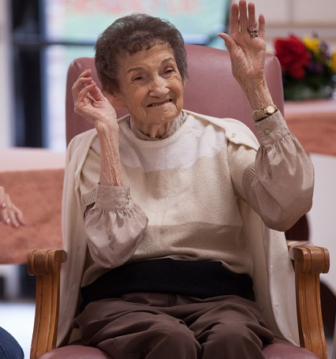
[PROGRAM NAME] Workshops: The Basics
Free workshop
2 ½-hour sessions, held each week for six weeks
Each session is led by 2 trained volunteer leaders with health conditions themselves
Set your own goals and make a step-by-step plan to improve your health—and your life

Slide 4
[PROGRAM NAME] Workshops: The Basics
Workshops include information on:
Exercise and nutrition
Medication usage
Stress management
Talking with your doctor or health professional
Dealing with emotions and depression
Opportunities for discussion and problem solving
Mutually supportive setting

Slide 5
Background
Developed in the early 1990s by the Stanford Center for Research in Patient Education, based on a successful arthritis self-management program.
A credible, “evidence-based” program with broad experience and demonstrated results in a variety of settings, populations, and chronic conditions.
Now used internationally in 29 countries, all 50 U.S. states, the District of Columbia, and Puerto Rico.
Over 300,000 people have participated in the program across the U.S.

Slide 6
[PROGRAM NAME] Workshops: The Benefits
Get practical tips that can you use right away.
Get support from people like you who are living with ongoing health conditions
Learn relaxation and other strategies to deal with pain, fatigue, and frustration
Discover how healthy eating can improve your condition
Create an exercise program that works for you
Understand new treatment choices
Explore how to talk with your doctor and family about your health

Slide 7
[PROGRAM NAME] Workshops: The Benefits
Research has found that people who complete [PROGRAM NAME]:
Feel healthier and have a better quality of life after completing the program
Report fewer sick days or days in depression
Have increased ability to manage symptoms like fatigue, pain, shortness of breath, stress, and sleep problems
Increase the number of days they are physically active
Improve communication with doctors
Increase ability to properly take medications
Improve confidence filling out medical forms

Slide 8
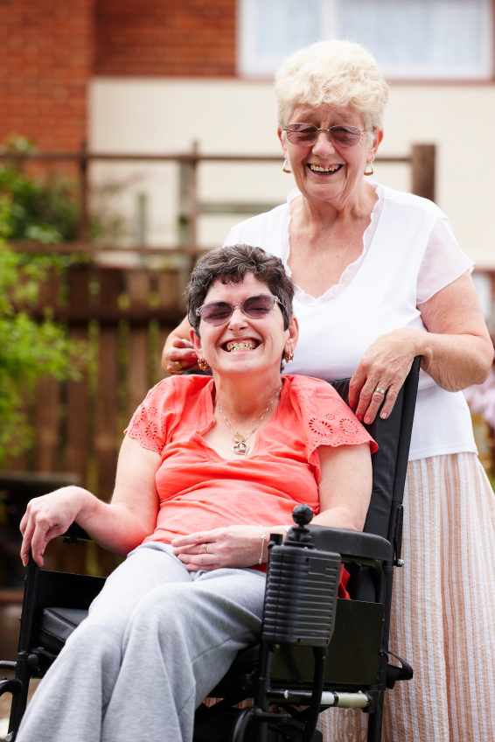
Keys to success
The format addresses specific problems and goals for people with ongoing health problems. It is not a drop-in support group.
Participants choose their own goals and track their own progress toward success.
Trained peer leaders offer guidance and support, but participants find practical solutions individually and together.

Slide 9
[PROGRAM NAME] workshop may be for you, if you…
Are living with any ongoing health condition, such as:
Arthritis
Diabetes
Asthma
High blood pressure
Heart disease
Cancer
Chronic pain
Anxiety
Depression
And others
Feel limited in your day to day activities
Feel tired or frustrated
Are looking for better ways to manage your symptoms

Slide 10
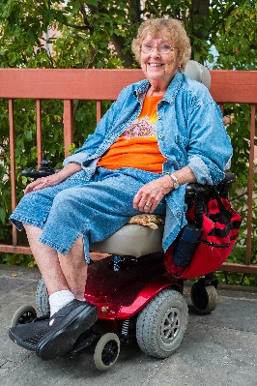
Make a step-by-step plan to improve your health—and your life.
[Add your own quotes and/or use these & remove this line]
“The class helped me manage my diabetes better, and my A1C is within normal limits now.” — John in Virginia
“I have learned there are people like me, not living life to the fullest because of a chronic condition, and that we can move forward.” – Caroline in Washington
“After taking the workshop, I have since lost 25 pounds. I began exercising and eating healthier. After losing the weight along with proper nutrition and exercise, I have been able to get off my blood pressure medicine and my blood pressure now runs about 130/70. I feel great and have a lot more energy.” —Sam in Virginia

Slide 11
Sign up today— and take charge of your health!
To join a [PROGRAM NAME] workshop, please call:
XXX-XXX-XXXX
Our next class is available on:
{add date and time}
at
{add place of workshop}

