Slide 1
Duke University Press
Digital Products for Libraries 2026
Humanities, Social Sciences, and Mathematics
March 2026

Slide 2

About Duke University Press
Humanities, social sciences,
and mathematics publisher
A division of Duke University
in Durham, North Carolina, USA
Strong reputation for leading-edge scholarly publishing

Slide 3

Publishing Strengths
Ground-breaking scholarship that defines and redefines disciplines
Strong interdisciplinary and international focus
Foregrounding traditionally underrepresented and new scholarly voices
Cultivating emerging fields and
new subject areas

Slide 4

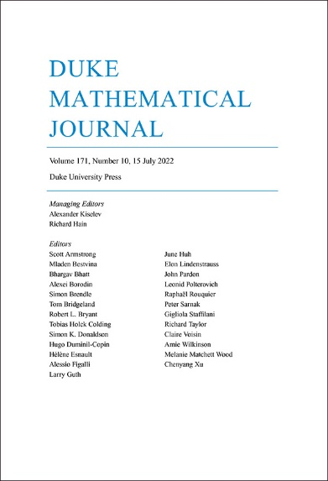
2026 Journals Citation Report
61 titles in SCOPUS
52 titles in the MLA International Bibliography
49 titles in the Web of Science
33 titles in the Arts and Humanities Citation Index
14 titles in the Social Sciences Citation Index
10 titles in the Emerging Sources Citation Index
4 titles in the Science Citation Index Expanded
4 titles in Zentralblatt MATH
0.9 Impact Factor (2024)
3.0 Impact Factor (2024)

Slide 5

Humanities and Social Sciences
Anthropology
Art
African and African Diaspora Studies
Asian Studies
Cultural Studies
Environmental Humanities
Ethnography
Film and Television Studies
Gender and Sexuality
History
International Studies
Latin American Studies
LGBTQIA+ Studies
Literary Studies
Media Criticism and Theory
Music and Sound Studies
Native and Indigenous Studies
Political Science
Postcolonial Studies
Psychology
Public Policy
Race and Ethnicity
Religious Studies
Social Theory
Sociology
Transgender Studies

Slide 6
Product Overview
e-Duke Journals 60 journals in the 2026 collection
Journal Archival Products Back content for all current journals and archival content of Black Sacred Music, Tikkun, and American Literary Scholarship
e-Duke Books Approximately 120 new titles in the 2026 collection, term access to over 3,300 backlist titles in pre-2008 archive and annual backlist collections 2008-2025
e-Book Subject Collections
                African American, African, and Black Diaspora Studies
      Anthropology
      Art and Art History
      Asian Studies
      Environmental Humanities
      Pick-and-Choose e-Books
      Direct to Open (D2O)
Gender Studies
      LGBTQIA+ Studies
      Transgender Studies
      Latin American Studies
Music and Sound Studies
Native and Indigenous Studies (new in 2026)
Religious Studies

Slide 7


e-Journals Products

Slide 8


e-Duke Journals Collection
60 titles with strengths in
  Criticism and theory
  Cultural studies
  History
  Literary studies
  Politics and sociology
  Asian Studies
New Additions
Federal Sentencing Reporter
New Political Science

Slide 9

e-Duke Journals Collection Features
Perpetual access to current content
Term access to all back issues during
the year of purchase
No digital rights management (DRM)
Unlimited multiuser access
COUNTER-compliant usage statistics
No ongoing maintenance fees

Slide 10
Flagship Journals
American Literature
Comparative Literature
GLQ: A Journal of Lesbian and
Gay Studies
Hispanic American Historical Review
History of Political Economy
Journal of Asian Studies
Journal of Health Politics, Policy and Law
The Philosophical Review
Public Culture
Small Axe: A Caribbean Journal of Criticism
TSQ: Transgender Studies Quarterly

Slide 11


Supporting Emerging Scholarship in New Fields
Environmental Humanities
History of the Present
Journal of Middle East Women’s Studies
liquid blackness
positions: asia critique
Public Culture
QTR: Trans and Queer Studies in Religion
TSQ: Transgender Studies Quarterly

Slide 12



Archival Journal Products
American Literary Scholarship
2000-2022
During its years of publication, American Literary Scholarship featured bibliographic essays arranged by writer and time period, from pre-1800 to 2020, and acted as a “systematic evaluative guide to published studies of American literature” (ALA Booklist).
Black Sacred Music
Complete archive from 1987 to 1995
Black secular music, the early days of rap, soul, jazz, civil rights songs, religious music of Africa and the African diaspora, spirituals, gospel music, music of the black church
Tikkun
Content from 2000–2018 as a complete collection or by year
Analysis and commentary that strives to bridge the cultural divide between religious and secular progressives from a Jewish perspective

Slide 13


e-Books Products

Slide 14



e-Duke Books Collection
Over 3,300 titles through 2025
Annual collection model
  Perpetual access to new titles published during purchase year (approximately 120 titles)
  Term access to entire backlist
  (during purchase year)
  Annual collections 2008-2025 available for outright purchase
Notes:
up from 120+ front-list titles each year before 2021

Slide 15


e-Duke Books Archive
Over 1,200 titles published before 2008
Perpetual access model
  Outright purchase with perpetual access
  Current e-Duke Books collection customers receive only term access to these titles with no post-cancellation access

Slide 16

Direct to Open (D2O)
D2O is the MIT Press’s innovative framework for new release monographs that creates a collaborative, library-supported open access model. Duke University Press is proud to partner with the MIT Press to:
Bring open access to 20 new Duke University Press scholarly monographs annually via recurring participation fees.
Provide participating libraries with term access to 250 backlist/archival titles which will otherwise remain gated. Participating libraries will receive access even if the model is not successful.
Cover partial direct costs for the publication of high-quality works that are also available for print purchase.

Slide 17

E-Book Subject Collections
Our e-Book Subject Collections allow you to purchase all of the available e-books in the subject areas for which Duke University Press is best known.
Purchase Full Collections
Purchase includes perpetual access to all e-books in the chosen collection.
Top-ups
Existing subject collection customers have the option to “top up” their subject collection by purchasing the year’s new batch of relevant titles. 2026 top-ups contain all relevant titles published in 2026.

Slide 18
e-Book Subject Collections
African American, African, and Black Diaspora Studies (636 titles)
Anthropology (804 titles)
Art and Art History (316 titles)
Asian Studies (492 titles)
Environmental Humanities (133 titles)
Gender Studies (899 titles)
  LGBTQIA+ Studies(298 titles)
  Transgender Studies (31 titles)
Latin American Studies (750 titles)
Music and Sound Studies (221 titles)
Native and Indigenous Studies (130 titles) - New in 2026
Religious Studies (183 titles)

Slide 19

Pick-and-Choose e-Books
Title by title purchase of e-books
Across title list of e-books in the humanities and social sciences
Volume discounts start at 25 books
Allows curation of e-book collections
Same platform and features as
e-book collections products
Outright purchase with perpetual access

Slide 20

e-Book Features
No digital rights management (DRM)
Unlimited multiuser access
Tiered discounting
COUNTER-compliant usage statistics
Users can print, read online, or download PDFs by chapter
No ongoing maintenance fees
Free MARC records, created by catalogers at Duke University Libraries

Slide 21


Open Access Content
Open Access Journals:
  Black Sacred Music
  Critical Times: Interventions in Global Critical Theory
  Environmental Humanities
  Hispanic American Historical Review archival content (1918-1999)
  liquid blackness: journal of aesthetics and black studies
  QTR: A Journal of Trans and Queer Studies in Religion
  Sungkyun Journal of East Asian Studies
  Trans Asia Photography
Open Access Book Partnerships
  Duke University Open Archive
  Direct to Open (D2O)
  The California Digital Library (CDL)
  Open Access Pilot

Slide 22

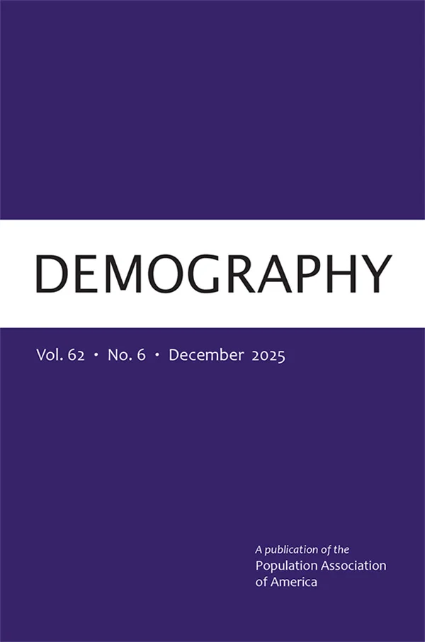
Demography: A Subscribe to Open Journal
Subscribe to Open access model started in 2024
Flagship journal of the Population Association of America
The most-cited journal in population studies
Global geographic focus with highest quality original research
Paid subscribers receive immediate and perpetual access. If the funding threshold is met, the volume becomes fully open access.

Slide 23


Applied Mathematics
Commutative Algebra
Formal Logic
Functional Analysis
General Mathematics
Integral Equations
Mathematical Analysis
Mathematical Physics
Statistics and Probability
Mathematics

Slide 24


Product Overview
Duke Mathematical Journal One of the world’s top ten mathematics journals (Based upon 2024 Journal Impact Factor)
DMJ100 An archive of the first 100 volumes of Duke Mathematical Journal, 4,830 articles published from 1935 to 1999
Euclid Prime collection A collection of 29 high-impact, peer-reviewed journals in theoretical and applied mathematics and statistics hosted by Project Euclid

Slide 25
Euclid Prime
29 titles in 2026
Journals published by small societies and university departments
Highly international; in addition to seven US-based titles, the collection includes titles from Africa, Asia, and Europe
Hosted on the Project Euclid platform
Subjects
  Algebraic Geometry
  Associative Rings and Algebras
  Commutative Algebra
  Differential Geometry
  Integral Equations
  Mathematical Logic
  Number Theory
  Operator Theory
  Ordinary Differential Equations
  Partial Differential Equations
  Probability
  Real Functions
  Statistics

Slide 26

Euclid Prime Facts
Leading journals (with 2024 impact factor):
  Rocky Mountain Journal of Mathematics (0.7)
  Notre Dame Journal of Formal Logic (0.5)
  Kodai Mathematical Journal (0.5)
  Illinois Journal of Mathematics (0.7)
  Tokyo Journal of Mathematics (0.3)
Annual subscription

Slide 27
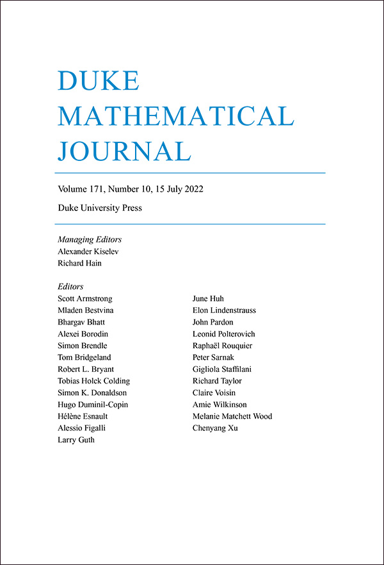
Duke Mathematical Journal and DMJ100
Duke Mathematical Journal
  Duke Mathematical Journal has a five-year impact factor of 2.9 (2024)
  Annual subscription
DMJ 100
  An archive of the first 100 volumes of Duke Mathematical Journal(1935–1999)
  One-time purchase

Slide 28




Project Euclid Platform Features
Platform designed specifically for math and
well-integrated with mathematical tools
A nonprofit, university-based online hosting
platform managed by Duke University Press
Migration to upgraded platform in early 2021, developed by SPIE
Over 80% of content on Project Euclid is open access

Slide 29






A collaboration between nonprofit scholarly journal publishers and societies managed by Duke University Press
Electronic hosting and print fulfillment* of over 200 journals from 10 publishers
Single-title subscriptions and collection sales
Cornell University Press*
Texas Tech University Press*
West Virginia University Press*
University of North Carolina Press*
*Print subscription fulfillment only

Slide 30





The Scholarly Publishing Collective - Electronic Platform
Five scholarly publishers
Over 140 journals
Over 86,500 articles
Decades of content
Scholarlypublishingcollective.org

Slide 31
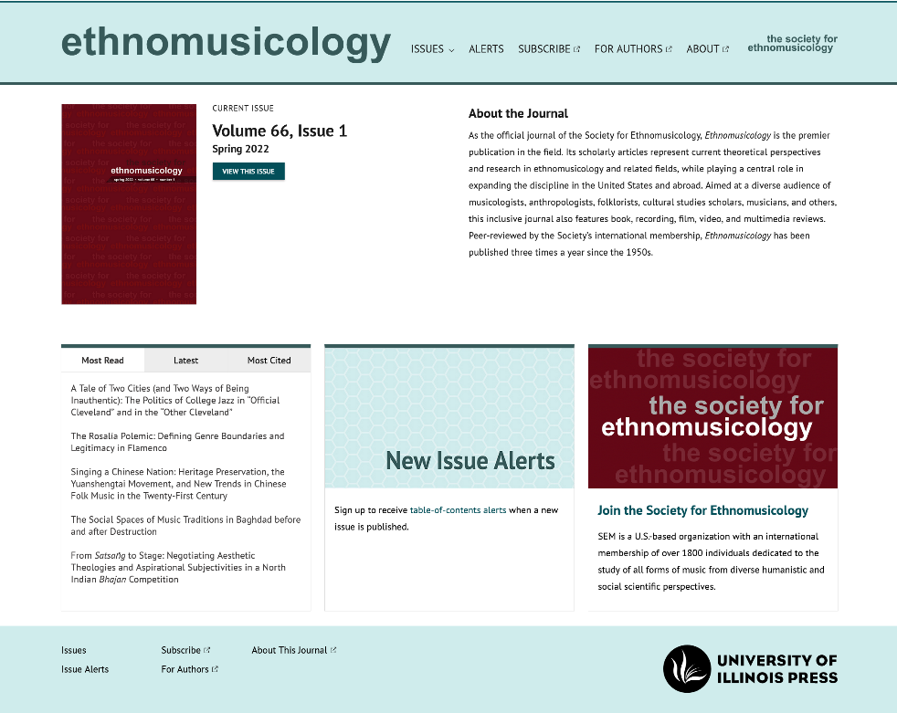
The Scholarly Publishing Collective - Electronic Platform
Features of the platform and collections
COUNTER-compliant usage statistics
No ongoing maintenance fees
DRM-free access and printing
Unlimited multiuser access
Citation links to Crossref, PubMed, and Google Scholar
Platform user experience that meets or exceeds the World Wide Web Consortium Web Content Accessibility Guidelines version 2.1, Level AA Conformance
Robustly indexed in major discovery services, including Crossref, OCLC, EBSCO, and the ProQuest family of products

Slide 32


Penn State Journals Collection
The 2026 collection provides online access to scholarship from 80 journals published by Penn State University Press, a leading publisher of humanities and social sciences journals, and archival content from six additional journals. This collection aims to broaden the reach of scholarship produced by small scholarly organizations and societies, covering literature, religious studies, education, theater, and more.

Slide 33


Illinois Journals Collection
The 2026 collection provides online access to scholarship from 40 journals published by the University of Illinois Press, a leading publisher of humanities and social sciences journals, and archival content from two additional journals. This collection offers a longstanding list of established titles in a wide range of disciplines, including philosophy and religion, ethnic and regional European studies, American studies, and music and visual culture, as well as the publications of several state historical societies.

Slide 34
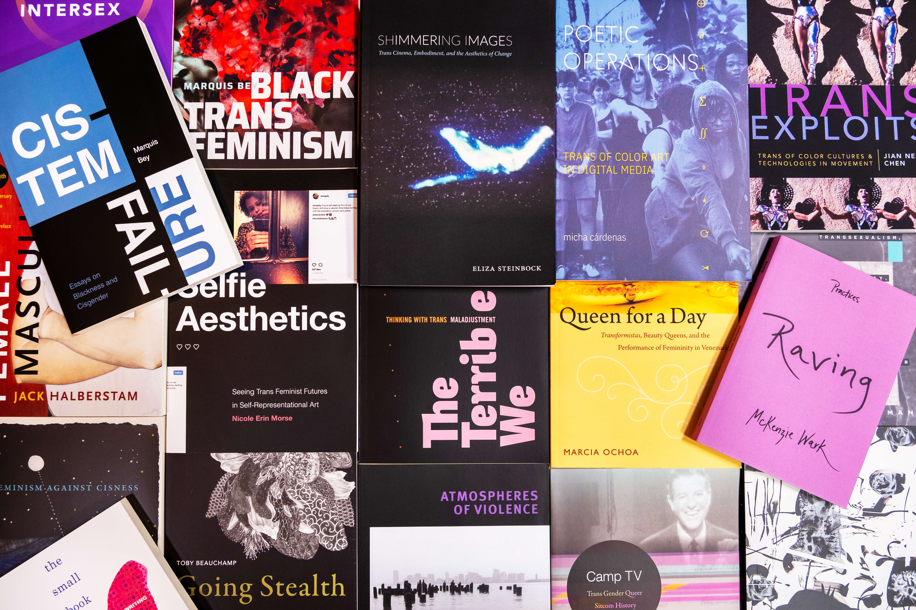
More Resources from DUP

Slide 35
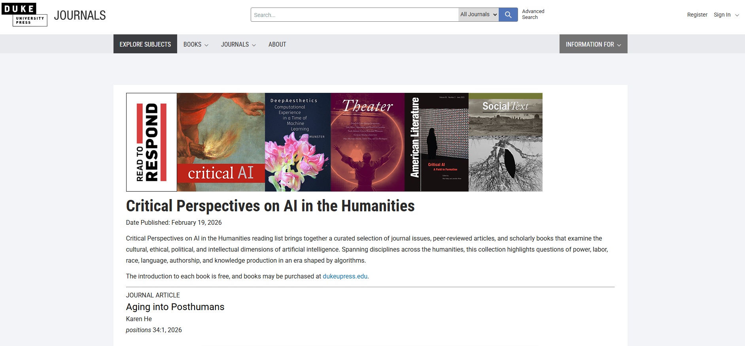
Reading Lists
Staff-curated syllabi featuring book chapters and journal content covering today’s most critical topics
  Racial Justice
  Environmentalism and Climate Change
  Navigating the Threat of Pandemic
  Global Immigration
  Police Violence
  and more
Including open access content and/or some content made temporarily free to read

Slide 36


Thank you!
For further details, please contact:
dup_libraryrelations@duke.edu

