Slide 1
Duke University Press Digital Products for Libraries 2025
Humanities, Social Sciences, and Mathematics
July 2024

Slide 2

About Duke University Press
Humanities, social sciences, and mathematics publisher
A division of Duke University in Durham, North Carolina, USA
Strong reputation for leading-edge scholarly publishing

Slide 3

Publishing Strengths
Ground-breaking scholarship that defines and redefines disciplines
Strong interdisciplinary and international focus
Foregrounding traditionally underrepresented and new scholarly voices
Cultivating emerging fields and new subject areas

Slide 4

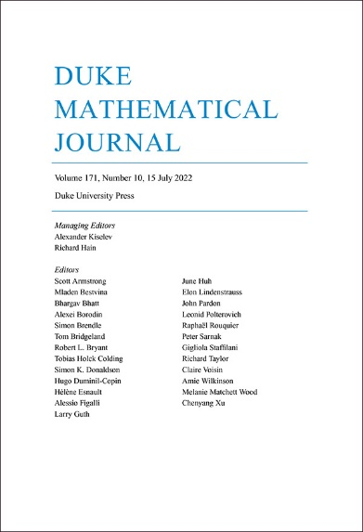
2024 Journals Citation Report
61 titles in SCOPUS
48 titles in the MLA International Bibliography
50 titles in the Web of Science
33 titles in the Arts and Humanities Citation Index
15 titles in the Social Sciences Citation Index
14 titles in the Emerging Sources Citation Index
5 titles in the Science Citation Index Expanded
4 titles in Zentralblatt MATH
1.442 Impact Factor (2021)
2.377 Impact Factor (2021)

Slide 5

Humanities and Social Sciences
Anthropology
Art
African and African Diaspora Studies
Asian Studies
Cultural Studies
Environmental Humanities
Ethnography
Film and Television Studies
Gender and Sexuality
History
International Studies
Latin American Studies
LGBTQIA+ Studies Literary Studies
Media Criticism and Theory
Music and Sound Studies
Political Science
Postcolonial Studies
Psychology
Public Policy
Race and Ethnicity
Religious Studies
Social Theory
Sociology
Transgender Studies

Slide 6
Product Overview
e-Duke Journals Scholarly Collection 59 journals in 2025
Journal Archival Content Back content for all current journals and archival content of Black Sacred Music, Tikkun, and American Literary Scholarship
e-Duke Books Scholarly Collection At least 150 new titles in 2025, term access to over 3,300 backlist titles in pre-2008 archive and annual backlist collections 2008-2024
e-Book Subject Collections
African American, African, and Black Diaspora Studies
Anthropology
Art and Art History
Asian Studies
Environmental Humanities (new in 2024)
Pick-and-Choose e-Books
Gender Studies
LGBTQIA+ Studies (new in 2024)
Transgender Studies (new in 2024)
Latin American Studies
Music and Sound Studies
Religious Studies

Slide 7


e-Journals Products

Slide 8

e-Duke Journals Scholarly Collection
59 titles with strengths in
Criticism and theory
Cultural studies
History
Literary studies
Politics and sociology
Asian Studies
New in 2025
Federal Sentencing Reporter and New Political Science

Slide 9

e-Duke Journals Scholarly Collection Features
Perpetual access to current content
Term access to all back issues during the year of purchase
No digital rights management (DRM)
Unlimited multiuser access
COUNTER-compliant usage statistics
No ongoing maintenance fees

Slide 10


Flagship Journals
American Literature
GLQ: A Journal of Lesbian and Gay Studies
Hispanic American Historical Review
History of Political Economy
Journal of Asian Studies
Modern Language Quarterly
Philosophical Review

Slide 11


Supporting Emerging Scholarship in New Fields
Environmental Humanities
History of the Present
Journal of Middle East Women’s Studies
liquid blackness
positions: asia critique
Public Culture
QTR: Trans and Queer Studies in Religion
TSQ: Transgender Studies Quarterly

Slide 12



Archival Journal Products
American Literary Scholarship
2000-2022
During its years of publication, American Literary Scholarship featured bibliographic essays arranged by writer and time period, from pre-1800 to 2020, and acted as a “systematic evaluative guide to published studies of American literature” (ALA Booklist).
Black Sacred Music
Complete archive from 1987 to 1995
Black secular music, the early days of rap, soul, jazz, civil rights songs, religious music of Africa and the African diaspora, spirituals, gospel music, music of the black church
Tikkun
Content from 2000–2018 as a complete collection or by year
Analysis and commentary that strives to bridge the cultural divide between religious and secular progressives from a Jewish perspective

Slide 13


e-Books Products

Slide 14



e-Duke Books Scholarly Collection
Over 3,300 titles through 2024
Annual collection model
Perpetual access to new titles published during purchase year (150+ titles*)
Term access to entire backlist (during purchase year)
Annual collections 2008-2024 available for outright purchase
Notes:
up from 120+ front-list titles each year before 2021

Slide 15


e-Duke Books Archive
Over 1,200 titles published before 2008
Perpetual access model
Outright purchase with perpetual access
Current e-Duke Books Collection customers receive only term access to these titles with no post-cancellation access

Slide 16

E-Book Subject Collections
Our e-book Subject Collections allow you to purchase all the available e-books in the subject areas Duke University Press is best known for.
Purchase Full Collections Purchase includes perpetual access to all e-books in the chosen collection. 2025 collections include all relevant titles published through the end of 2024.
Top-ups Existing subject collection customers have the option to “top up” their subject collection by purchasing the year’s new batch of relevant titles. 2024 top-ups contain all relevant titles published in 2024.

Slide 17
e-Book Subject Collections
African American, African, and Black Diaspora Studies (560+ titles)
Anthropology (750+ titles)
Art and Art History (260+ titles)
Asian Studies (450+ titles)
Environmental Humanities (123 titles) New in 2024
Gender Studies (800+ titles)
LGBTQIA+ (263 titles) New in 2024
Transgender (23 titles) New in 2024
Latin American Studies (700+ titles)
Music and Sound Studies (200+ titles)
Religious Studies (160+ titles)

Slide 18

Pick-and-Choose e-Books
Title by title purchase of e-books
Across title list of e-books in the humanities and social sciences
Volume discounts start at 25 books
Allows curation of e-book collections
Same platform and features as e-book collections products
Outright purchase with perpetual access

Slide 19

e-Book Features
No digital rights management (DRM)
Unlimited multiuser access
Tiered discounting
COUNTER-compliant usage statistics
Users can print, read online, or download PDFs by chapter
No ongoing maintenance fees
Free MARC records, created by catalogers at Duke University Libraries

Slide 20


Open Access Content
Seven fully open access journals:
Carlyle Letters Online
Critical Times
Environmental Humanities
liquid blackness
QTR: A Journal of Trans and Queer Studies in Religion
Sungkyun Journal of East Asian Studies
Trans Asia Photography
Select book titles included in the open e-book initiatives
Tome
Knowledge Unlatched
Duke University Open Book Archive
OAPEN platform

Slide 21


Demography: A Subscribe to Open Journal
Subscribe to Open access model started in 2024
Flagship journal of the Population Association of America
The most-cited journal in population studies
Global geographic focus with highest quality original research
Paid subscribers receive immediate and perpetual access. If the funding threshold is met, the volume becomes fully open access

Slide 22


Applied Mathematics
Commutative Algebra
Formal Logic
Functional Analysis
General Mathematics
Integral Equations
Mathematical Analysis
Mathematical Physics
Statistics and Probability
Mathematics

Slide 23


Product Overview
Duke Mathematical Journal One of the world’s top ten mathematics journals
DMJ100 An archive of the first 100 volumes of DMJ, 4,830 articles published from 1935 to 1999
Euclid Prime collection 31 peer-reviewed journals in 2024 from a variety of publishers

Slide 24
Euclid Prime
31 titles in 2025
Journals published by small societies and university departments
International journals based in Japan, Egypt, Senegal, United States, Spain, Belgium
Hosted on the Project Euclid platform
Subjects
Applied Mathematics
Commutative Algebra
Formal Logic
Functional Analysis
General Mathematics
Integral Equations
Mathematical Analysis
Mathematical Physics
Probability

Slide 25

Euclid Prime Facts
Unique titles
not available in any other aggregations
Leading journals (with 2023 impact factor):
Rocky Mountain Journal of Mathematics (0.7)
Notre Dame Journal of Formal Logic (0.6)
Publicacions Matemàtiques (0.8)
Kodai Mathematical Journal (0.4)
Tokyo Journal of Mathematics (0.4)
Annual subscription

Slide 26
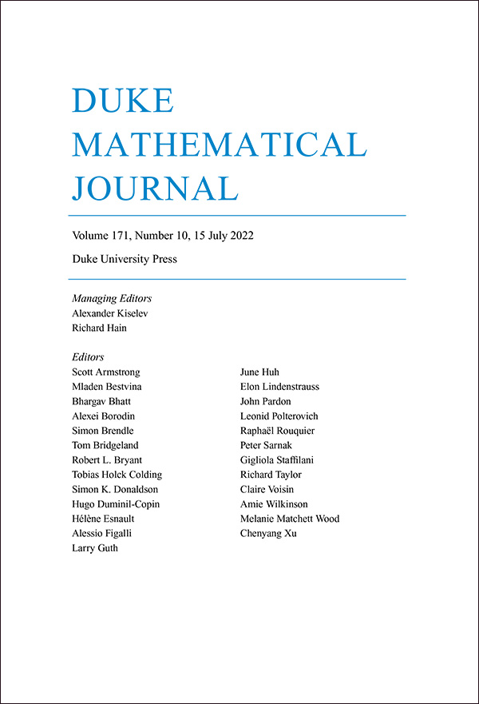
Duke Mathematical Journal and DMJ100
Duke Mathematical Journal
DMJ has a five-year impact factor of 2.8 (2022)
Annual subscription
DMJ 100
An archive of the first 100 volumes of DMJ (1935–1999)
One-time purchase

Slide 27




Project Euclid Platform Features
Platform designed specifically for math and well-integrated with mathematical tools
A nonprofit, university-based online hosting platform managed by Duke University Press
Migration to upgraded platform in early 2021, developed by SPIE
Over 80% of content on Project Euclid is open access

Slide 28





A collaboration between nonprofit scholarly journal publishers and societies managed by Duke University Press
Electronic hosting and print fulfillment* of over 200 journals from 10 publishers
Single-title subscriptions and collection sales
The Journal of Mental Health Counseling, will be hosted on the Collective platform beginning in 2025.
Cornell University Press*
Texas Tech University Press*
West Virginia University Press*
University of North Carolina Press*
*Print subscription fulfillment only

Slide 29






The Scholarly Publishing Collective - Electronic Platform
Four scholarly publishers
Over 158 journals
Over 70,000 articles
Decades of content
Scholarlypublishingcollective.org
New for 2024
American Mental Health Counselors Association

Slide 30
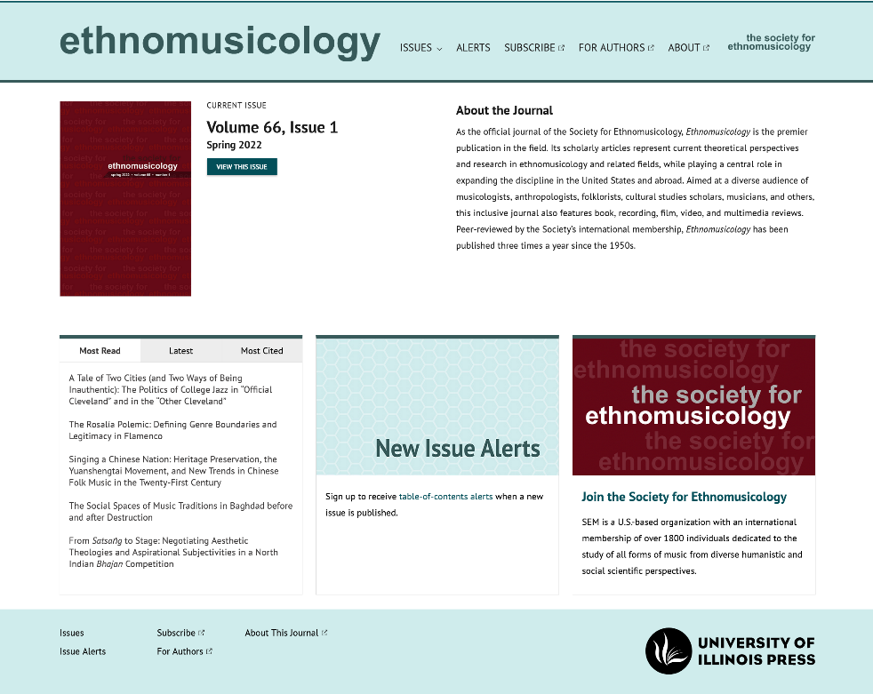
The Scholarly Publishing Collective - Electronic Platform
Features of the platform and collections
COUNTER-compliant usage statistics
no ongoing maintenance fees
DRM-free access and printing
Unlimited multiuser access
Citation links to Crossref, PubMed, and Google Scholar
Platform user experience that meets or exceeds the World Wide Web Consortium Web Content Accessibility Guidelines version 2.0, Level AA Conformance
Robustly indexed in major discovery services, including Crossref, OCLC, EBSCO, and the ProQuest family of products

Slide 31


Penn State Journals Collection
The 2025 Collection provides online access to scholarship from 81 journals published by Penn State University Press, a leading publisher of humanities and social sciences journals. This collection aims to broaden the reach of scholarship produced by small scholarly organizations and societies, covering literature, religious studies, education, theater, and more.

Slide 32


Illinois Journals Collection
The 2025 Collection provides online access to scholarship from 39 journals published by the University of Illinois Press, a leading publisher of humanities and social sciences journals. This collection offers a longstanding list of established titles in a wide range of disciplines, including philosophy and religion, ethnic and regional European studies, American studies, and music and visual culture, as well as the publications of several state historical societies.

Slide 33
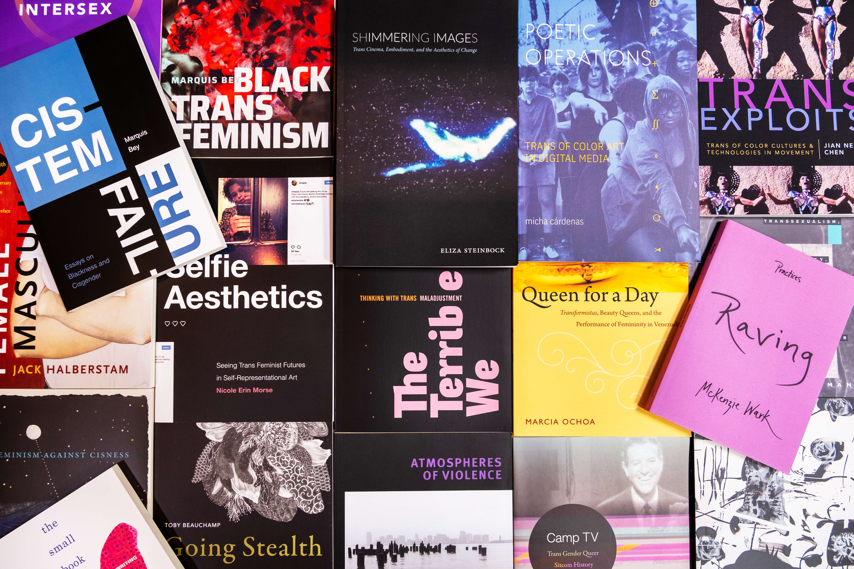
More Resources from DUP

Slide 34
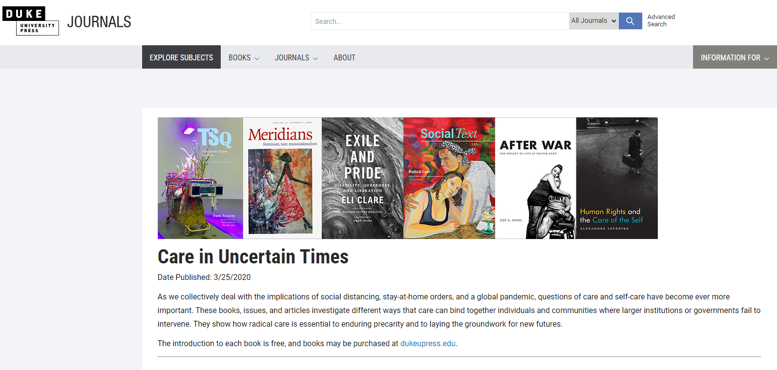
Reading Lists
Staff-curated syllabi featuring book chapters and journal content covering today’s most critical topics
Racial Justice
Environmentalism and Climate Change
Navigating the Threat of Pandemic
Global Immigration
Police Violence
and more
Including open access content and/or some content made temporarily free to read

Slide 35


Thank you!
For further details, please contact:
Dup_libraryrelations@duke.edu

