Slide 1
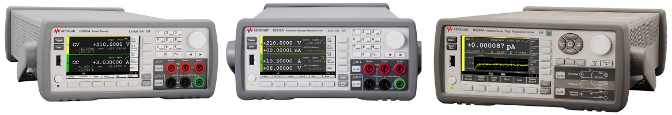
Application Examples for B2900 Precision Instrument Family
Keysight Technologies
Notes:
Hello, everyone.
The Keysight B2900 precision benchtop instrument family provides best-in-class source and measurement performance along with other powerful capabilities.
It covers broad applications from research and education to industrial development, production test, and automated manufacturing.
The family currently consists of precision source/measure units (SMUs), precision low-noise power sources, and femto/picoammeters and electrometers/high-resistance meters. These units work equally well as standalone or system components.
Today, I’d like to share with you some application examples for the B2900 precision instrument family.

Slide 2
B2900A Precision Source/Measure Unit

Slide 3
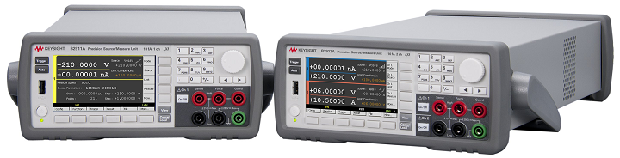
B2900A Precision Source/Measure Units
Part of Keysight’s B2900 Precision Instrument Family
Quickly debug and accurately characterize a wide range of devices at a low price!
210 V / 3 A DC / 10.5 A pulsed
6 ½ digits, 10 fA/100 nV minimum resolution
User friendly GUI operation; display IV curves directly on the instrument
Notes:
The Keysight B2900 precision benchtop instrument family includes several different source and measurement solutions. The B2900A series of precision source/measure unit (SMU) is one group of instruments.
The B2900A series of SMUs can source voltage with wide coverage up to +/- 210 V and current up to +/- 3 A (DC) or +/- 10.5 A (pulsed), although it obviously cannot source both maximum output voltage and maximum current at the same time. The range should be wide enough to cover all of your test requirements for a variety of devices.
The SMUs can source and measure current with 10 fA resolution and voltage with 100 nV resolution. That helps you make a precise characterization of devices and materials.
The B2900A series of SMU has an interactive graphical user interface (GUI) on its 4.3’’ color LCD display. Both voltage and current on all channels can be displayed numerically and simultaneously.
The B2900A series of SMU solves many common issues associated with conventional SMUs and helps you quickly test, debug and accurately characterize a wide range of devices at a low price.

Slide 4
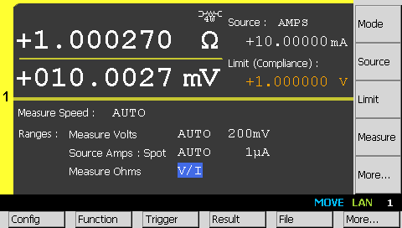
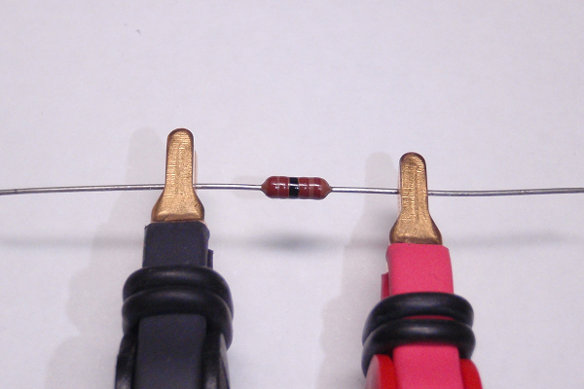
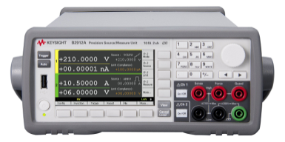
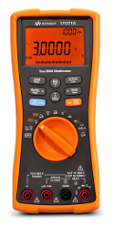
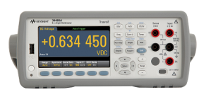
Wide Range Resistance Measurement Solution
Measure a wide range of resistance from sub-Ω to GΩ accurately
Make a wide range of resistance measurements
Coverage of currents from 10 fA to 3 A (DC)/10.5 A (pulsed) and voltages from 100 nV to 210 V
enables a wide range of resistance measurements from sub-Ω to GΩ
Ensure the accuracy with a variety of functions
4-wire connection eliminates cable resistance effects in low resistance measurements
Resistance compensation function minimizes thermal EMF errors
Pulsed operation mode prevents device self-heating from distorting the measurement results
Guard function prevents current from leaking into the cable and the surrounding measurement path in high resistance measurements
Improve measurements with flexible test condition
Both current and voltage output modes are available
Manual measurement mode provides optional test current settings or voltage settings to suppress self-heating caused by power dissipation
B2900A Series of SMU
Digital Multi Meter
10 µΩ
10 mΩ
10 Ω
10 kΩ
10 MΩ
10 GΩ
10 TΩ
10 PΩ
http://literature.cdn.keysight.com/litweb/pdf/5990-6633EN.pdf
http://literature.cdn.keysight.com/litweb/pdf/5992-1212EN.pdf
Notes:
A resistance measurement is a fundamental way to characterize materials, electronic devices, and circuits. While digital multimeters (DMMs) are commonly used to make resistance measurements, (and Keysight sells a bunch of DMMs in different form factors), the B2900A series of SMU, is the best solution to measure a wide range of resistance from sub-Ω to GΩ accurately.
Why? Because the B2900A series of SMU can make a wide range of resistance measurements. The B2900A covers currents from 10 fA to 3 A (DC)/10.5 A (pulsed) and voltages from 100 nV to 210 V, which makes it possible to make a wide range of resistance measurements from sub-Ω to GΩ, as compared with DMMs.
The B2900A also provides a variety of functions to ensure the measurement accuracy.
A basic 2-wire connection is the most common configuration used for resistance measurements. However, for very low resistance measurements where the residual lead resistance is comparable to the DUT resistance, a 2-wire measurement will produce erroneous results. A 4-wire connection configuration (remote sensing) can be used to eliminate this error. The B2900A series of SMU supports both of 2-wire and 4-wire connections. Since the voltage drop across the DUT is small when measuring low resistances, the effects of the offset and EMF voltages are not negligible. However, when the resistance compensation function of the B2900A is enabled, the instrument will automatically make a 2-point measurement and calculate the true value of the resistance. Pulsed operation mode prevents device self-heating caused by power dissipation from distorting the measurement results. Leakage currents in the cables and test fixturing can cause significant measurement errors, especially when measuring large resistances where the measurement current is small. A built-in guard function maintains the guard terminal at same voltage potential as the high force line, which prevents current from leaking into the cable and the surrounding measurement path.
Finally the B2900A series offers flexible test conditions. It supports voltage and current output modes. Its manual measurement mode provides optional current or voltage settings to suppress self-heating caused by power dissipation. You can use arbitrary test currents up to 3 A and voltages up to 200 V.
Those make the B2900A Series of SMU the best solution to measure a wide range of resistance from sub-Ω to GΩ accurately. I’ve listed application notes on this slide for more detail.

Slide 5
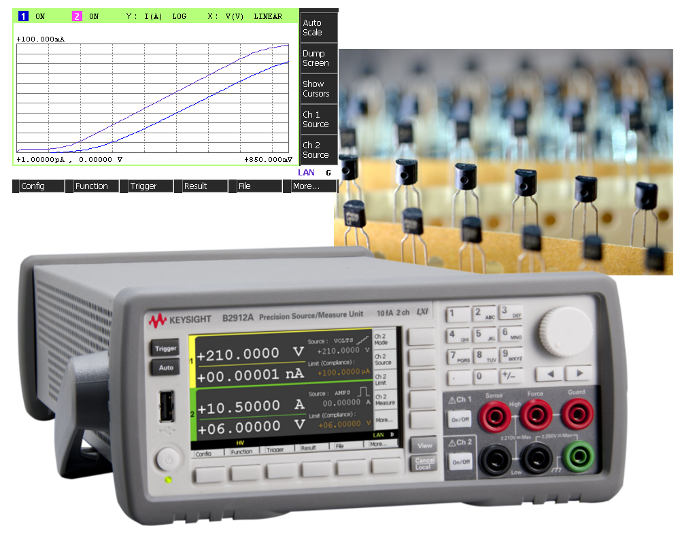
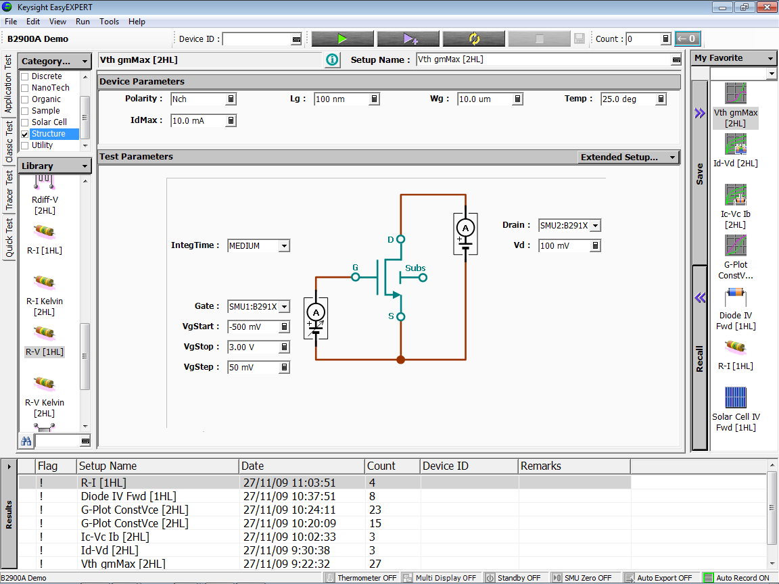
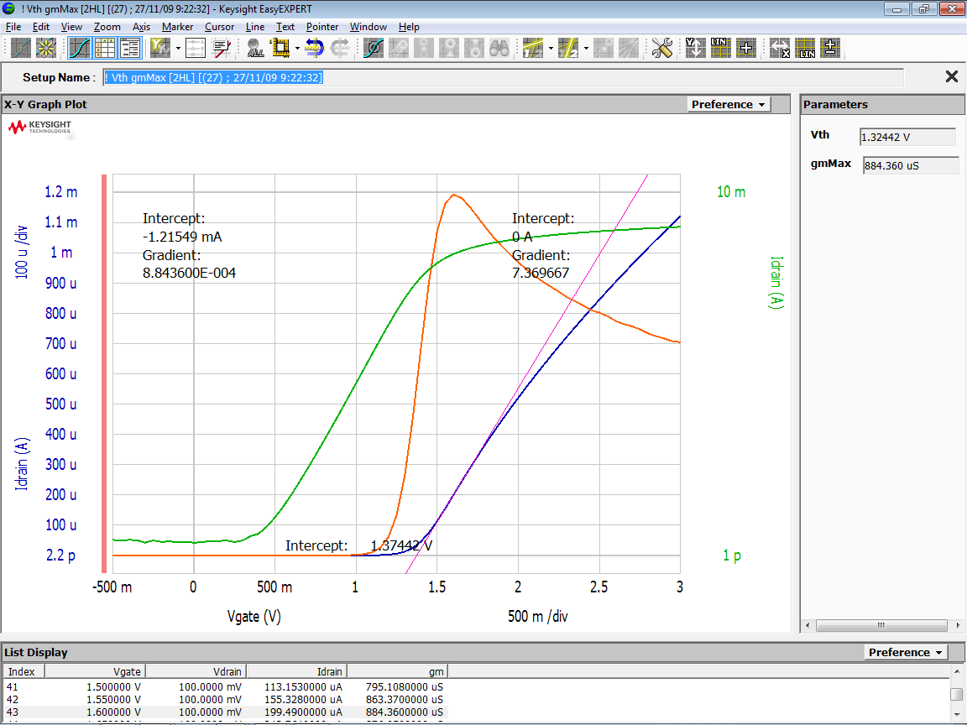
Current-Voltage Characterization of Transistors
Simplify multi-channel I-V measurement tasks and improve characterization efficiency
Characterize a variety of transistors precisely
Integrated I-V source & measurement capabilities eliminate the needs for the complicated instrumentation and wiring
6 ½ digit source & measurement resolution helps you make a precise characterization
Range of up to ±210 V and ±3 A (DC) / ±10.5 A (pulsed) provides wider coverage for testing a variety of transistors
Perform multi-channel sweep measurements easily
Built-in sweep function supports all of the standard sweep parameters
Channels in 2 Ch models can work with each other synchronously, which makes them suitable to get 3 terminal transistor characteristics
such as Id-Vd, Id-Vg, Ic-Vc curves
Improve productivity for test, debug and characterization
Intuitive GUI makes it easy to set up, make, and display sweep measurements quickly
EasyEXPERT group+ software is available for detailed characterization and analysis of transistors
Application notes:
http://literature.cdn.keysight.com/litweb/pdf/5990-6995EN.pdf
http://literature.cdn.keysight.com/litweb/pdf/5990-6587EN.pdf
Notes:
The IV or current-voltage characterization of transistors generally requires applying different voltages and currents with the constant or the sweep condition to the gate and the drain terminals, respectively. The B2900A series of SMU simplifies multi-channel current-voltage measurement tasks and improve characterization efficiency.
How? To start, the B2900A series of SMU has the capability to characterize a variety of transistors precisely. An SMU combines a current source, a voltage source, a current meter and a voltage meter along with the capability to switch easily between these various functions into a single instrument. This means it can evaluate the current-voltage characteristics of devices across all four measurement quadrants without complicated wiring and additional equipment. Its 6.5 digit source & measurement resolution makes it possible to achieve 10 fA or 100 nV minimum resolution, which helps with precise characterization. The B2900A covers voltages up to 210 V and currents up to 3 A (DC)/10.5 A (pulsed), which enables it to provide wider coverage for testing a variety of transistors.
Secondly, the B2900A series of SMU easily performs multi-channel sweep measurements. It has a built-in sweep function which supports all of the standard sweep parameters such as, the start value, stop value, and number of steps, etc. You don’t need to create each step by setting constant source voltage or current one by one. In the two channel models, the channels are synchronized to get three terminal transistor characteristics such as Id-Vd, Id-Vg, Ic-Vc curves.
Finally, the B2900A series of SMU helps you improve productivity for test, debug and characterization. It has the intuitive graphical user interface, which makes it easy to quickly set up, make, and display sweep measurements. It also comes with a range of software control options. One option, the EasyEXPERT group+ software, provides a powerful solution for detailed characterization and analysis of transistors. It has been widely used in the industry and has become the standard, with the semiconductor parameter analyzer.
Again, please refer to the application notes shown in this slide for more detail.

Slide 6
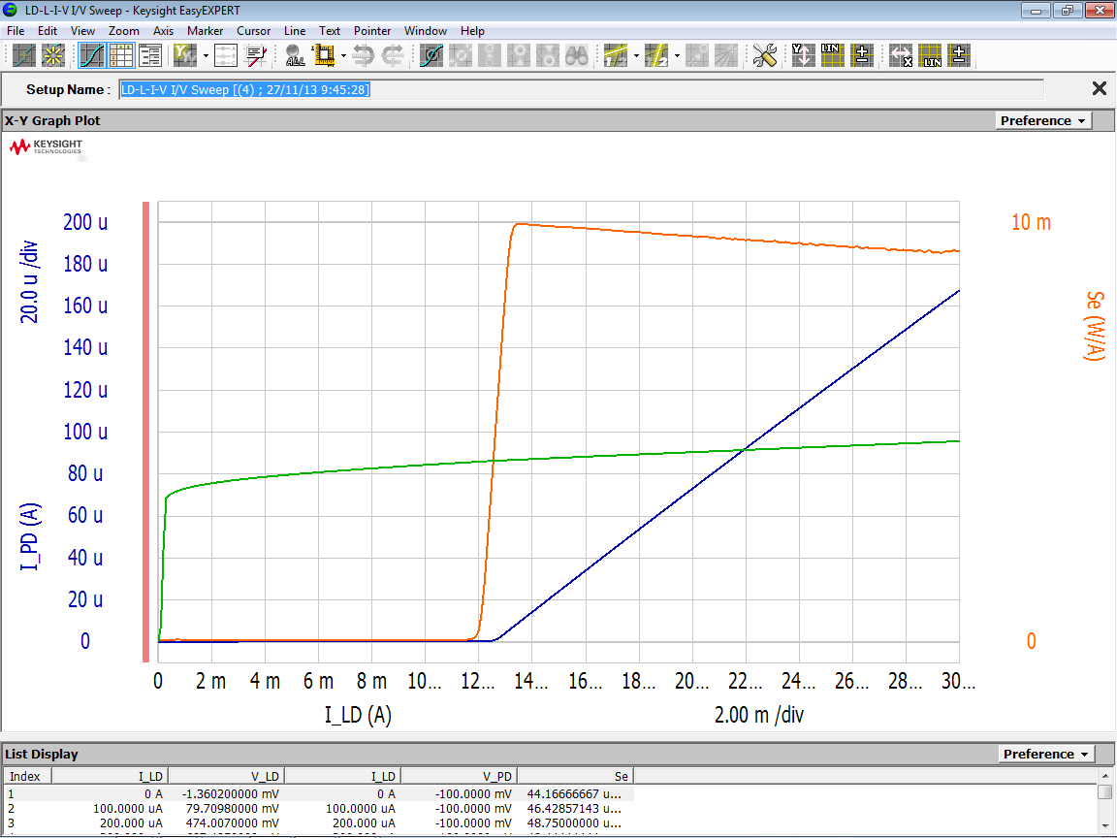
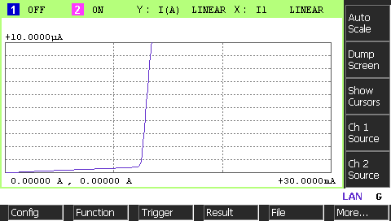
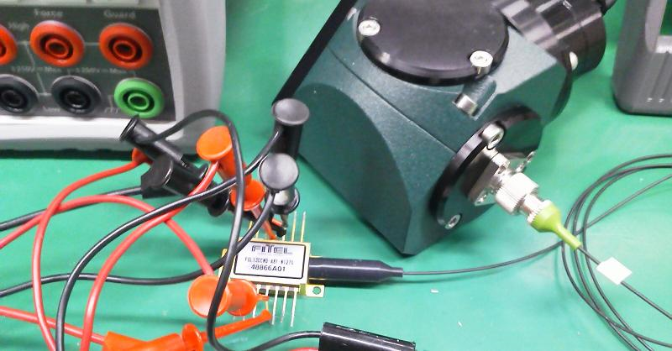
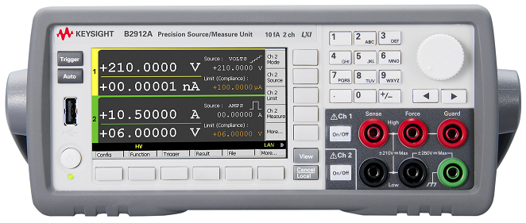
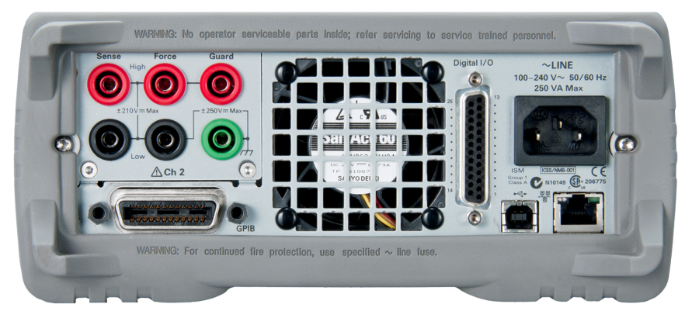
Fast Light-Current-Voltage Testing of Laser Diodes
Improve L-I-V test speed by fast & noiseless measurement
Improve throughput in production test
The B2900A of SMU series possesses the fastest sweep measurement speed of any SMU in its class
6 ½ digit high resolution & low noise floor help you get accurate & stable test result with shorter measurement time, and prevent the self-heating effect from affecting the characteristics
Perform multi-channel sweep measurements easily
Built-in sweep function supports all of the standard sweep parameters
Channels in 2 Ch models can work with each other synchronously
Improve productivity for test, debug and characterization
Intuitive GUI makes it easy to set up,make, and display sweep measurements quickly
Multiple software control options improve productivity for test, debug and characterization
Application note:
http://literature.cdn.keysight.com/litweb/pdf/5990-7115EN.pdf
High Force
High Force
Low Force
LD
PD
Low Force
Ch1
B2902A or B2912A
Ch2
Notes:
The light-current-voltage (L-I-V) sweep test is a fundamental measurement to determine the operating characteristics of a laser diode (LD). In the L-I-V test, current applied to the laser diode is swept, and the intensity of the emitted light is measured using a photo detector. So from electrical point of view, you need to measure the photo detector current with sweeping the laser diode drive current. Keysight’s B2900A series of SMU improves the L-I-V test speed with a fast & quiet measurement.
First, the B2900A series of SMU improves throughput of the L-I-V test in production test. It possesses the fastest sweep measurement speed of any SMU in its class.
Its 6.5 digit high resolution and low noise floor also help you get accurate and stable test results with shorter measurement time. Since the L-I-V test requires measurement of more than 1,000 points per sweep to evaluate linearity, sweep speed, resolution and noise are the key factors to improve the throughput. It is also important to make the measurement time as short as possible to prevent self-heating from affecting the measurement results.
Secondly, the B2900A series of SMU makes it easy to perform multi-channel sweep measurements. As mentioned before, the B2900A has a built-in sweep function which supports all of the standard sweep parameters so you don’t need to create each step one by one. Also, you have the option of synchronized channels for L-I-V.
Also as mentioned before, the B2900A series of SMU helps you improve productivity with its intuitive graphical user interface, range of software control options. Please refer to the application note shown in this slide for more detail.

Slide 7
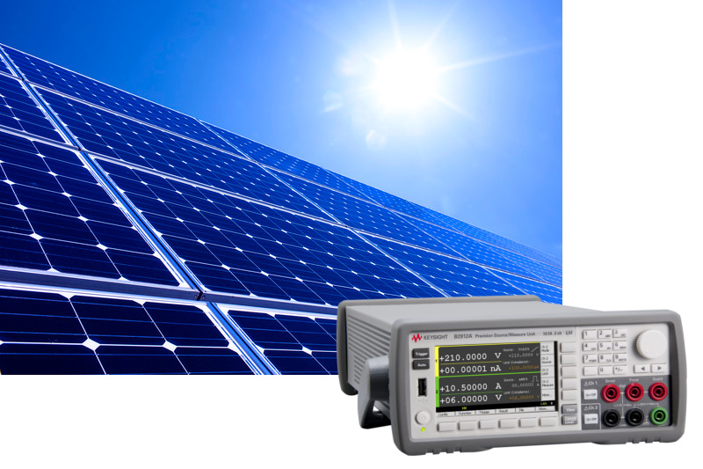
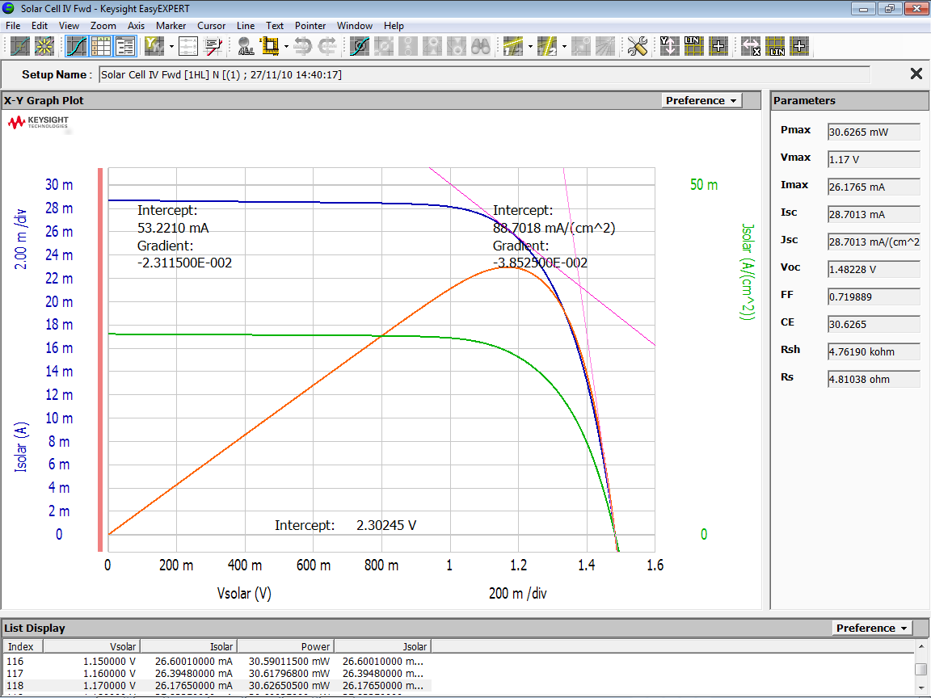
Photovoltaic Cell Current-Voltage Characterization
Simplify the characterization tasks and improve their accuracy & efficiency
Better measurement performance with less measurement error
Integrated I-V source & measurement capabilities eliminate the needs for the complicated instrumentation and wiring
6 ½ digit source & measurement resolution helps you make a precise characterization
Characterize the details in the region of interest easily
Built-in list sweep capability allows you to specify widely-spaced steps in regions where the device characteristics are stable, and closely-spaced steps in regions of special interest such as the maximum power point
Improve productivity for test, debug and characterization
Intuitive GUI makes it easy to set up, make, and display sweep measurements quickly
EasyEXPERT group+ software is available for detailed characterization and analysis of photovoltaic cells
Application note:
http://literature.cdn.keysight.com/litweb/pdf/5990-6660EN.pdf
V₁
V₂
V₃
V₄
V₅
V₆
V₈
V₁₀
V₇
V₉
V₁₂
V₁₄
V₁₁
V₁₃
Source Values
Notes:
There are on-going efforts to develop photovoltaic solar cells that operate more efficiently and at a lower cost. Keysight’s B2900A series of SMU simplifies the current-voltage characterization of photovoltaic cells to improve efficiency while also improving accuracy.
First of all, the B2900A series of SMU provides better measurement performance with less measurement error. As mentioned before, an SMU combines multiple capabilities into a single instrument which enables it to more efficiently evaluate the current-voltage characteristics of devices across all four measurement quadrants. And it offers 6.5 digit source & measurement resolution for 10 fA or 100 nV minimum resolution, which helps you make a precise characterization.
Secondly, the B2900A helps you characterize the details in the region of interest easily.
Its built-in list sweep capability allows you to specify widely-spaced steps in regions where the device characteristics are stable, and closely-spaced steps in regions of special interest such as the maximum power point.
Again, the B2900A helps you improve productivity with its intuitive graphical user interface, and range of software control options. EasyEXPERT group+ software offers a powerful solution for detailed characterization and analysis of photovoltaic cells. It supports efficient and repeatable characterization across the entire characterization process from measurement setup and execution to analysis and data management.
Please refer to the application note shown in this slide for more detail.

Slide 8
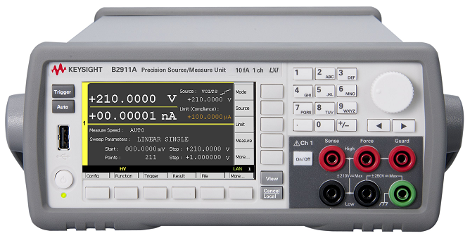
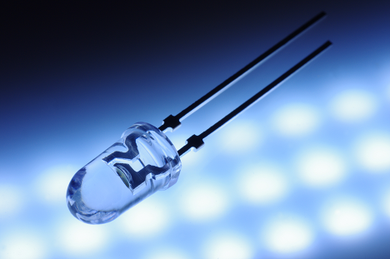
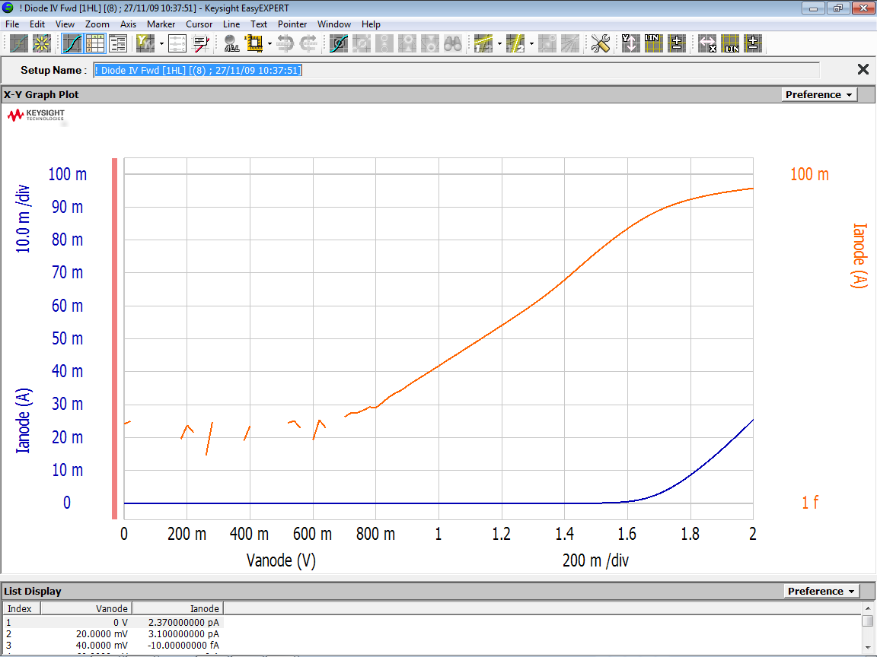
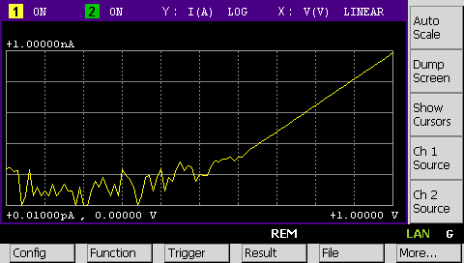
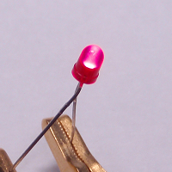
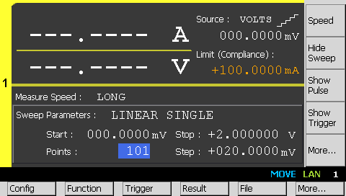
Current-Voltage Characterization of Diodes
Simplify difficult I-V measurement tasks and improve characterization efficiency
Characterize a variety of diodes precisely
Integrated I-V source & measurement capabilities eliminate the needs for the complicated instrumentation and wiring
6 ½ digit source & measurement resolution helps you make a precise characterization
Range of up to ±210 V and ±3 A (DC) / ±10.5 A (pulsed) provides wider coverage for testing a variety of diodes
Improve productivity for test, debug and characterization
Built-in sweep capability makes it easy to get diode characteristics
Intuitive GUI makes it easy to set up, make, and display sweep measurements quickly
Multiple software control options improve productivity for test, debug and characterization
Application notes:
http://literature.cdn.keysight.com/litweb/pdf/5990-6659EN.pdf
http://literature.cdn.keysight.com/litweb/pdf/5990-6571EN.pdf
Notes:
LEDs are energy efficient and durable. And they are now widely used in a variety of applications such as lighting, display panels, etc. This has spawned research into new types of LEDs with even higher energy efficiencies and properties tailored for specific applications. Keysight’s B2900A series of SMU simplifies complex current-voltage measurement tasks and improves characterization efficiency.
First, the B2900A series of SMU has the capability to characterize a variety of diodes precisely. As mentioned before, it efficiently measures the current-voltage characteristics of devices across all four measurement quadrants at 6.5 digit source & measurement resolution and 10 fA or 100 nV minimum resolution, for precise characterization. The B2900A covers voltages up to 210 V and currents up to 3 A (DC)/10.5 A (pulsed), which enables it to provide wider coverage for testing a variety of diodes.
The built-in sweep function helps you efficiently create sweeps and a range of software control options, helps you choose the solution that best fits your particular requirement and improve productivity for test, debug, and characterization.
Please refer to the application notes shown in this slide for more detail.

Slide 9
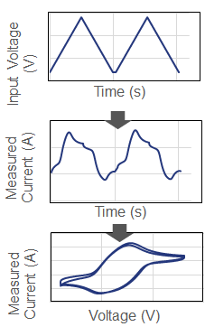
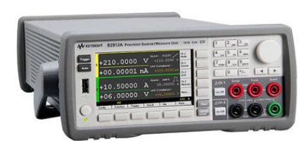

Electrochemistry 3-Electrode Measurement
Well suited for electrochemical measurements with integrated I-V source & measurement capabilities
Measure electrochemical currents precisely
6 ½ high measurement resolution helps you make a precise electrochemical current measurement
10 fA minimum measurement resolution allows even small electrode systems with low electrochemical currents to be accurately measured
Built-in sweep capability makes it easy to output required voltage waveform
Accurate timing control capability with 10 μs resolution ensures the source and measurement timing strictly and accurately
Improve productivity for test, debug and characterization
Intuitive GUI makes it easy to set up, make, and display electrochemical measurements quickly
Multiple software control options make it easy to control the entire process from measurement setup and execution to analysis and data management
Application note:
http://literature.cdn.keysight.com/litweb/pdf/5992-2154EN.pdf
Anodic
High Sense
High Force
Guard
Chassis Ground
Low Force
GPIB or USB
(optional)
Keysight Quick IV measurement software
(optional)
Low Sense
PC (optional)
Cathodic
RE
CE
WE
Solution
Notes:
The field of electrochemistry, a combination of electrical and chemical energy, is attracting investment in energy-focused research areas such as batteries, capacitors, energy storage devices, photovoltaics, corrosion, hydrogen cells, electrochemical sensors etc. A common measurement technique in electrochemistry is cyclic voltammetry (C-V) which studies the redox and transport properties in an electrolyte solution. Keysight’s B2900A series is well suited for electrochemical measurements with integrated current-voltage (I-V) source & measurement capabilities.
First, the B2900A series of SMU has the capability to measure electrochemical currents precisely. In addition to the benefits described before, its 6.5 digit source & measurement resolution and 10 fA minimum measurement resolution, enables even small electrode system with low electrochemical currents to be accurately measured.
The B2900A series of SMU has built-in sweep capability which makes it easy to output required voltage waveform. Its accurate timing control capability with 10 μs resolution ensures the source and measurement timing strictly and accurately.
Please refer to the application note shown in this slide for more detail.

Slide 10
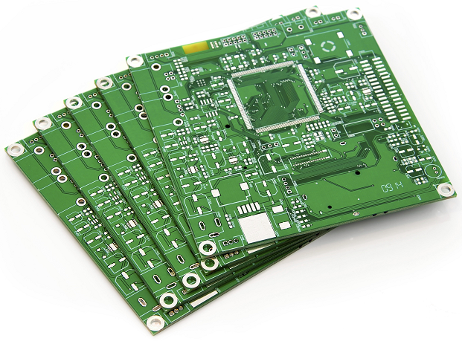
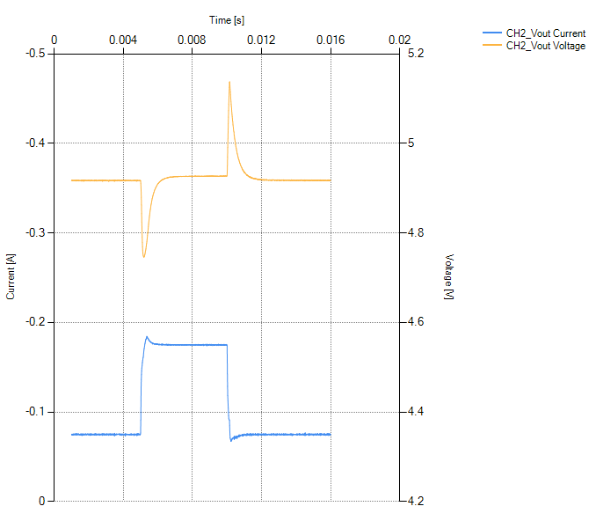
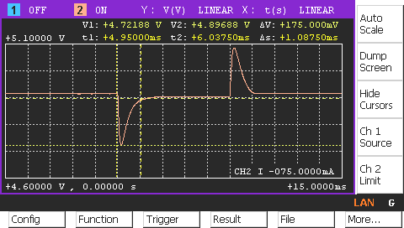
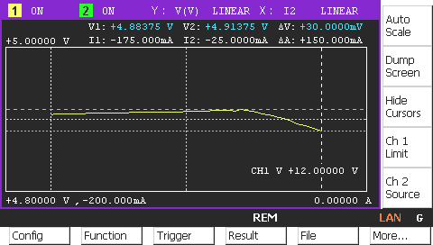
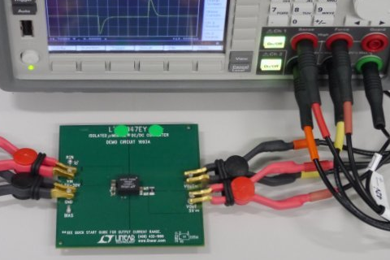
Bench-top Evaluation of ICs and Electronic Components
Improve benchtop DC measurement efficiency for IC & electronic component evaluation
Better measurement performance with less measurement error
Integrated I-V source & measurement capabilities eliminate the needs for the complicated instrumentation and wiring
6 ½ digit source & measurement resolution helps you make a precise evaluation
4-wire connection eliminates cable resistance effects
Improve productivity for test, debug and evaluation
Built-in sweep function supports all of the standard sweep parameters
Channels in 2 Ch models can work with each other synchronously, which makes them suitable to make two port measurements such as load regulation, load transient response, etc.
Intuitive GUI makes it easy to set up, make, and display sweep measurements quickly
Multiple software control options improve productivity for test, debug and evaluation
Application notes:
http://literature.cdn.keysight.com/litweb/pdf/5991-3119EN.pdf
http://literature.cdn.keysight.com/litweb/pdf/5991-0307EN.pdf
Notes:
Traditionally, evaluating ICs and electronic components required multiple instruments such as a digital multimeter, a power supply, and an electronic load. This meant that you would need to change the wiring for each measurement parameter. Keysight’s B2900A series of SMU improves bench-top DC measurement efficiency for IC and electronic component evaluation.
In addition to the other benefits mentioned before, the B2900A supports 4-wire connection which eliminates cable resistance effects for measurements using high current. Also, the channels in the two channel models can work with each other synchronously, to make two port measurements such as load regulation, load transient response, etc.
Please refer to the application briefs shown in this slide for more detail.

Slide 11
B2960A 6.5 Digit Low Noise Power Source

Slide 12
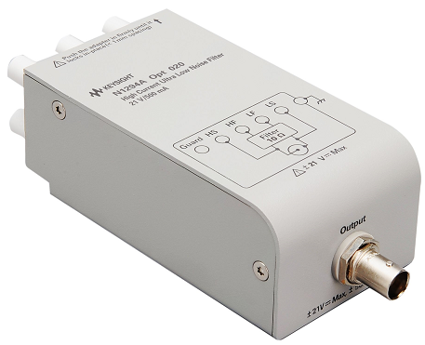
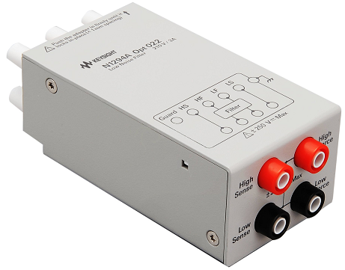
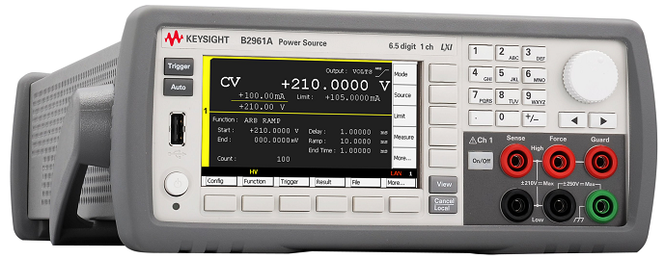
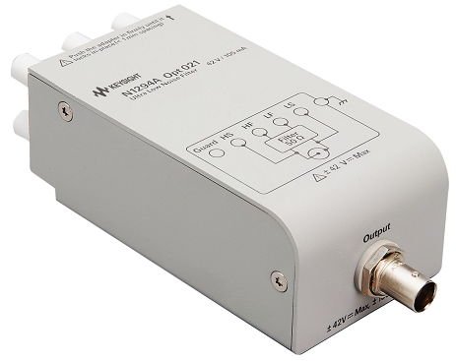
B2960A 6.5-Digit Low-Noise Power Source
Part of Keysight’s B2900 Precision Instrument Family
A revolutionary power supply for precision low-noise voltage/current sourcing
Precision : 6.5-digit, 10 fA/100 nV sourcing resolution
Wide range : 210 V / 3 A DC / 10.5 A pulsed output
Ultra low noise : 10 μVrms, 1 nVrms/ √ Hz@10kHz
Innovative sourcing functions: ARB, viewer
Notes:
The Keysight B2960A 6.5-digit low-noise power source is another member of the B2900 family.
The B2960A series can precisely source voltage with wide coverage up to +/- 210 V and current up to +/- 3 A (DC) or +/- 10.5 A (pulsed) with 6.5-digit resolution, although the units cannot source both maximum output voltage and maximum current at the same time. This is wide enough to cover the requirements for testing a variety of devices.
The noise performance of conventional power supplies is about 100 μVrms or 1 mVrms even if they are linear power supplies. The B2960A Series surpasses that to as low as 10 μVrms with optional filters. That’s 10 to 100 times better than conventional power supplies. We offer a choice of three external filters, so that you can select the one that best meets your needs.
In addition, the B2960A series has a precise and wide-range arbitrary waveform generation function and a time-domain voltage/current waveform viewer. Conventional power supplies don’t usually come with extra source functions.
The Keysight B2960A series can solve issues with conventional power supplies and help you test a variety of devices at modest prices. The following slides give some application examples where the B2960A provides specific benefits.

Slide 13
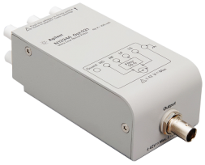

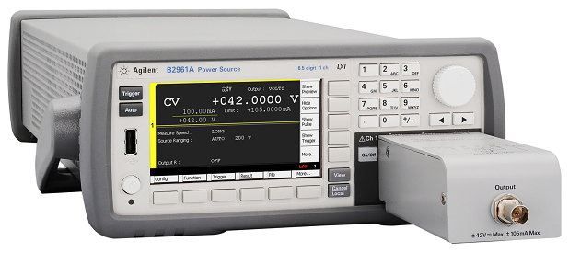
Voltage Controlled Oscillator Characterization
Uncover the true characteristics with external filter options
Minimize voltage noise with external filters
Both of HC-ULNF & ULNF achieve 10 μVrms (10 Hz – 20 MHz), 1 nVrms/√Hz at 10 kHz
(A noise density between 1 nVrms/√Hz to 10 nVrms/√Hz at 10 kHz is desirable for optimal VCO characterization)
Expand maximum current output
HC-ULNF allows the B2960A to source voltage up to 21 V and current up to 500 mA
ULNF allows the B2960A to source voltage up to 42 V and current up to 105 mA
Improve flexibility as a standalone low noise power supply
Bench-top form factor makes it easy to use it for additional ports of the VCO devices, to share among the multiple test systems, and to combine it with the other instruments such as spectrum analyzers, frequency counters, etc.
Carrier frequency : 791 MHz
V power (Vs)
Ch 2
VCO
Output
signal
B2962A
Ch 1
V tune (Vc)
Signal Source Analyzer,
Spectrum Analyzer,
Frequency Counter, etc.
Application note:
http://literature.cdn.keysight.com/litweb/pdf/5991-1616EN.pdf
Notes:
An output signal frequency of voltage controlled oscillator (VCO) is controlled by the DC voltage at its tuning port. VCOs are extremely sensitive to DC source noise, so a low-noise DC source is crucial for accurate VCO characterization. Keysight’s B2960A low-noise power source with external filter options can reveal true characteristics of voltage controlled oscillators.
With the B2960A, it is possible to minimize its voltage noise using the dedicated external filters. We offer two ultra-low noise filters. One is a high-current ultra-low noise filter, and the other is an ultra-low noise filter. Both of them make it possible to achieve 10 μVrms in the frequency range of 10 Hz to 20 MHz, and 1 nVrms/√Hz at 10 kHz. Generally, a noise density between 1 nVrms/√Hz to 10 nVrms/√Hz at 10 kHz is desirable for optimal VCO characterization.
Secondly, the B2960A series with its external filters can expand maximum current output. A DC control voltage source output built into Keysight’s E5052B signal source analyzer is commonly used for the characterization. However, its output current is limited to 20 mA. The B2960A’s high-current, ultra-low noise filter allows it to source voltage up to 21 V and current up to 500 mA. The ultra-low noise filter allows the B2960A series to source voltage up to 42 V and current up to 105 mA.
Finally, the B2960A series helps you to improve measurement flexibility as it is a standalone low noise power supply. It’s bench-top form factor makes it easy to use it for additional ports of the VCO devices, to share among the multiple test systems, and to combine it with the other instruments such as spectrum analyzers, frequency counters, etc.
Please refer to the application briefs shown in this slide for more detail.

Slide 14

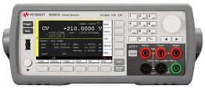
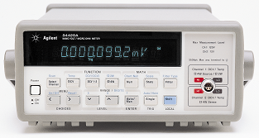
Low Resistance Measurement Solution with nV Meter
Accurately measure range of low resistance values to sub-mΩ
Expand nV meter’s resistance measurement capability
Coverage of test currents up to 3 A (DC) enables a wide range of low resistance measurements down to sub-mΩ
Improve measurements with flexible test current
The measurement voltage can be kept as large as possible to ensure the accuracy
Test current can be optimized to suppress device self-heating or device damage caused by power dissipation during testing
It is possible to generate alternating polarity test currents to minimize the effects of thermal EMF errors
I
I_{Src}
t
-I_{Src}
V
V₁
Application notes:
V_{EMF}
V₂
t
http://literature.cdn.keysight.com/litweb/pdf/5991-1421EN.pdf
http://literature.cdn.keysight.com/litweb/pdf/5991-1854EN.pdf
Measurement
N1294A-031
GPIO – BNC Trigger Adapter
Test using alternating
polarity test currents
Coaxial Cable
DIO 9
Triggering
To Trigger In
1 µΩ
Isrc
Vmeas
Notes:
As I mentioned before, resistance measurements are one of the most commonly performed tests to characterize electrical device properties. Very small resistance measurements require a very precise, low-level current source to prevent device self-heating or device damage during testing. Keysight’s B2960A series combined with a nano-volt meter is the best solution to measure a wide range of low resistance down to sub-mohm accurately.
First, the B2960A series can expand the nano-volt meter’s resistance measurement capability. Generally, the test current of the nano-volt meter is fixed and the range of the resistance measurements is limited. However, the B2960A series’ wide coverage of test currents up to 3 A (DC) enables a wide range of low resistance measurements down to sub-mohm.
Secondly, the B2960A series helps you to improve measurements by using flexible test current to keep the measurement voltage as large as possible to ensure the measurement accuracy. At the same time, the test current can be optimized to suppress device self-heating or device damage caused by power dissipation during testing. It is also possible to generate alternating polarity test currents to minimize the effects of thermal electromotive force errors.
Please refer to the application notes shown on this slide for more detail.

Slide 15
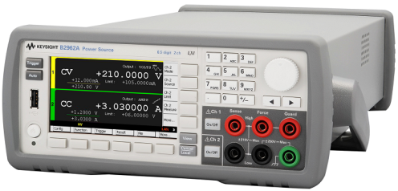
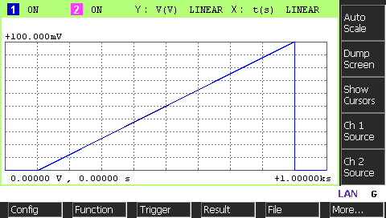


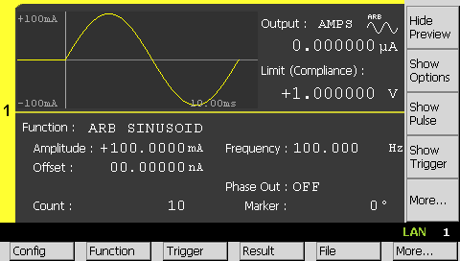

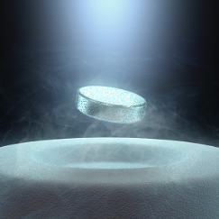
Physics, Chemistry & Biotechnology Evaluation
Stable current/voltage sources aid evaluation of materials
Resolution to nA & µV
Both DC & Dynamic (1mHz~10kHz) outputs
Highly stable and precise outputs ensure that you can detect all tiny signal variations emanating from materials under test
Very stable and clean current / voltage output, with ranges of nA~10A, μV~210V
Capability to source Sinusoid, Pulse, Ramp waveforms at DC/1mHz~10kHz/100us~1Day ^{*1)}
Maintain stable output even if the state of the sample changes
Ability to monitor output accurately at high speed with 0.02 % accuracy and 10 μs resolution eliminates the need for an additional ammeter or voltmeter
Applications
Material Science
Electrochemical
Chemical Material
Organic Material/Device
Bio sensing
*1) The maximum period for Sinusoid, ramp waveforms are limited to 1,000 s
Notes:
A variety of new materials are being developed and studied in the area of physics, chemistry and biotechnology. The physical properties of these materials must be evaluated electrically with highly stable and precise current or voltage outputs. Keysight’s B2960A series provides highly stable current/voltage sources, ideal for evaluating the physical properties of materials and many types of samples.
Highly stable and precise outputs of the B2960A series ensure that you can detect all tiny signal variations emanating from materials under test. First, it can output very stable and clean current and voltage with ranges of nA to 10 A, and μV to 210 V.
Second, the B2960A series has the capability to source not only DC signals, but also sinusoid, pulse, ramp waveforms in the frequency range of 1 mHz to 10 kHz.
Third, it can maintain a stable output even if the state of the sample changes.
Finally, the B2960A series has the ability to monitor its output accurately at high speed with 0.02 % accuracy and 10 μsec resolution, which eliminates the need for an additional ammeter or voltmeter to ensure the actual output.
Those features make the B2960A series ideal for evaluating the physical properties of materials and many types of samples in the applications such as material science, electrochemical, chemical material, organic material/device, and bio sensing.

Slide 16
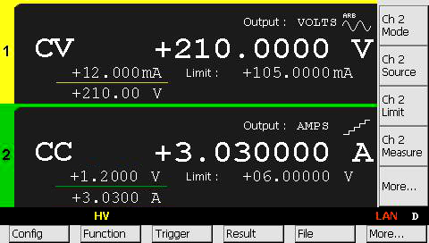
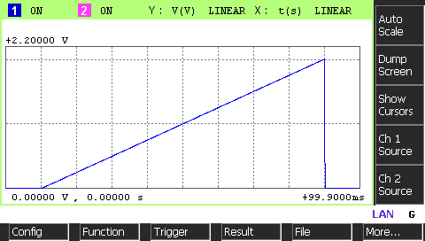
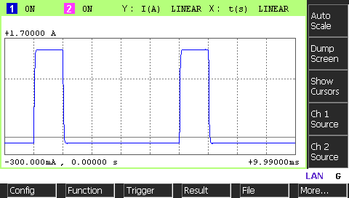

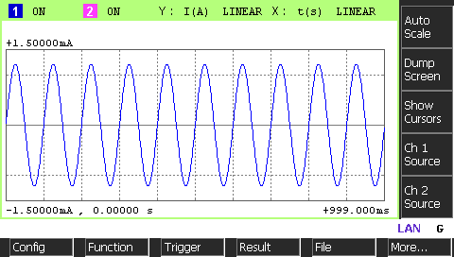
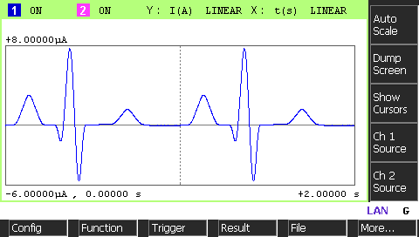
Electronic Circuit Final Verification, Validation & Debug
The B2960A series is High Speed Current/Voltage Source with 0.02 % basic accuracy & waveform monitor function
Voltage Source Mode
6.5 digit source resolution
Convenient FG/PG^{*1)} function provides highest accuracy and stability available (basic accuracy 0.02 %, 1 mHz -10 kHz)
Current Source Mode
Excellent Linearity
Variable
Duty Cycle
Highly Stable Output
Simulated glitch
Enhance validation accuracy
Higher accuracy, higher stability and much lower noise than conventional
power supplies greatly improve measurement results
Arbitrary waveform generation (AWG) function enables you to emulate signal variations to the circuit as it switches on and off
Eliminate the need to create custom circuits for validation
Low noise performance removes the need for an external filter circuit
No stabilizing circuit is required
No need to develop a circuit to source constant current
Improve test efficiency
Voltage source’s ability to monitor current eliminates need for additional meter
No digital multimeter necessary since it can monitor its own output
Source can be connected to the circuit output and operate as an electronic load
Various Output Modes
*1) FG: Function Generator
PG: Pulse Generator
Notes:
Final verification, validation and debug of an electronic circuits requires a voltage source or current source. Keysight’s B2960A series simplifies electronic circuit final verification, validation, and debug with its high speed current/voltage source. The B2960A provides a convenient, highly accurate and stable waveform generation function with 0.02 % basic accuracy in the frequency range of 1 mHz to 10 kHz. There are three major benefits to use the B2960A series as a voltage source or current source.
First, the B2960A series enhances validation accuracy.
It offers higher accuracy, higher stability and much lower noise than conventional power supplies to significantly improve measurement results. The arbitrary waveform generation function helps you emulate signal variations to the circuit as it switches on and off.
Secondly, the B2960A can eliminate the need to create custom circuits for validation.
The B2960A series’ low noise performance removes the need for an external filter circuit and any stabilizing circuit. In addition, it is not necessary to develop a circuit to source constant current because current source mode is one of its basic functions.
Thirdly, the B2960A helps you improve test efficiency. Since the B2960A monitors current or voltage, it eliminates need for an additional meter. In addition, it can monitor its own output, eliminating the need for a DMM. The B2960A can also be connected to the circuit output and operate as an electronic load.
The B2960A series simplifies electronic circuit final verification, validation, and debug and gives you those benefits.

Slide 17
B2980A Femto/Picoammeter & Electrometer

Slide 18
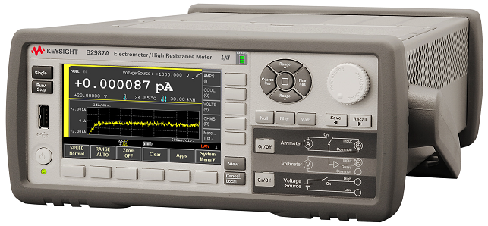
Keysight B2980A Femto/Picoammeter & Electrometer
Part of Keysight’s B2900 Precision Instrument Family
The world’s only graphical picoammeter/electrometer that can confidently measure down to 0.01 fA and up to 10 PΩ at modest prices!
Best-in-class accurate 0.01 fA & 10 PΩ measurement capabilities
Interactive 4.3” front-panel GUI allows graphical viewing, debug, and characterization
Battery-operated models for line-noise-free measurements
Optional Test Setup Integrity Checker function for noise source isolation
Notes:
Another group of instruments under the Keysight B2900 precision benchtop instrument family is the Keysight B2980A series femto/picoammeters and electrometer/high resistance meters.
The B2980A femto/picoammeter and electrometer offers best-in-class current ranges from 2 pA to 20 mA. Its internal voltage source can output voltage up to 1,000 V. This ensures accurate 0.01 fA and 10 Peta-ohm measurement capabilities. It also has an interactive graphical user interface (GUI) on its 4.3’’ color LCD display that allows quantities to be displayed not only numerically but also graphically. This helps with quick benchtop testing, debug, and characterization.
Battery-operated models are available to help you eliminate AC power-line noise as a source of measurement error. And a “Test Setup Integrity Checker” software option is available to help ensure that cables are working correctly.
The Keysight B2980A series can solve issues with sensitive measurements and help you confidently measure down to 0.01 fA and up to 10 Peta-ohm at a low price.

Slide 19
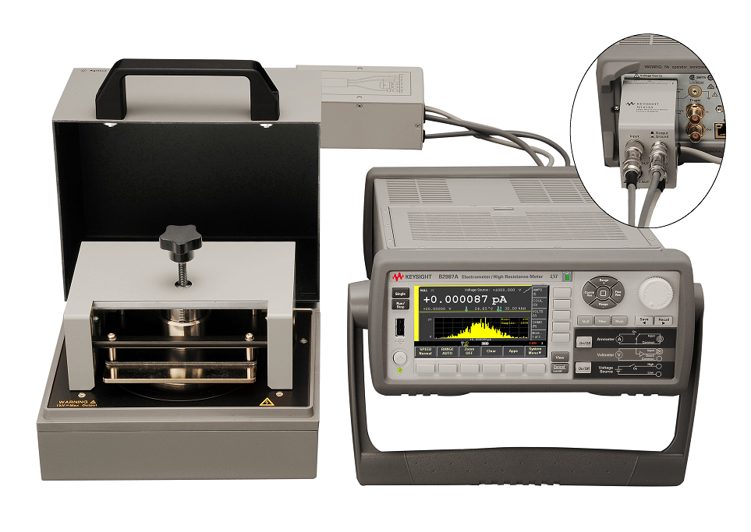
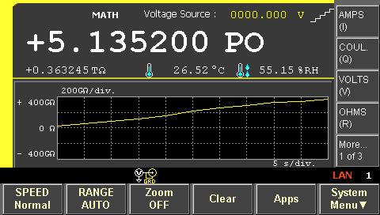

Surface/Volume Resistivity Measurements
Simply surface and volume resistivity characterization of insulating materials
Make a high resistance measurement accurately
Unmatched current measurement resolution of 10 aA (0.01 fA) and a built-in 1000 V voltage source allow you to measure resistances of up to 10 PΩ
Guard function prevents current from leaking into the cable and the surrounding measurement path
Maximize measurement confidence with a variety of functions
Humidity and temperature affecting resistivity measurements can be recorded along with resistance measurement data
Timer-based triggering capability helps you specify exactly what time to make a measurement after applying stimulus (electrification)
A trend graph of the resistivity versus test time can be plotted on its display to view resistivity changes up until the point at which the final resistivity value is recorded
Application note:
http://literature.cdn.keysight.com/litweb/pdf/5992-0124EN.pdf
Notes:
Surface resistivity and volume resistivity measure the resisting power of a specified material or property against the flow of an electric current. Keysight’s B2980A series simplifies the surface and volume resistivity characterization of insulating materials.
The B2980A can make a very accurate high resistance measurement. Its unmatched current measurement resolution of 10 atto-amps and a built-in 1,000 V voltage source allows you to measure resistances of up to 10 peta-Ohm. Its guard function prevents current from leaking into the cable and the surrounding measurement path. Current leakage in cables and test fixtures can cause significant measurement errors, especially when measuring large resistances (more than 1 GΩ) where the measurement current is small (less than a nanoamp). In this case, a guarding technique is required to make an accurate measurement.
Some other features offered for resistivity tests include the B2980A’s ability to record humidity and temperature affecting resistivity measurements along with resistance measurement data. It has a timer-based triggering capability to help you specify exactly what time to make a measurement after applying stimulus. The resistivity of insulating materials typically does not converge to a stable value quickly, which means that any resistivity specification has to state at what time the resistivity measurement should take place. In addition, a trend graph of the resistivity versus time can be plotted on its display to view resistivity changes up until the point at which the final resistivity value is recorded.
Those enable the B2980A series to simplify the surface and volume resistivity characterization of insulating materials.
Please refer to the application note shown in this slide for more detail.

Slide 20
Summary

Slide 21



Keysight B2900 Precision Instrument Family
The B2900 family provides best-in-class sourcing, measurement, and other powerful capabilities
Precision Source
B2960A Low-Noise Power Source
Ultra-low noise source (10 μVrms, 1 nVrms/√Hz@10kHz)
Unmatched source resolution (6.5 digit, 100 nV/10 fA)
Precision ARB capability (1 mHz ~ 10 kHz)
Time-domain waveform viewer
Precision Source/Measure
B2900A Precision Source/Measure Unit
Wide application coverage (from 100 nV/10 fA to 210 V/ 3 A DC & 10.5 A pulsed)
Best-in-class source & measure resolution (6.5 digit, 100 nV/10 fA)
Fast current-voltage (I-V) sweep measurement capability
Graphical I-V curves view
Precision Measure
B2980A Femto/Picoammeter & Electrometers
Best-in-class current measurement performance
(2 pA range and 0.01 fA resolution)
Integrated 1,000-V source supports resistance measurements up to 10 PΩ
Battery operation models for line-free noise measurements
Graphical time domain and histogram views
Notes:
To summarize, the Keysight B2900 precision benchtop instrument family provides best-in-class source and measurement performance along with other powerful capabilities. It addresses a broad range of applications from research and education to industrial development, production test, and automated manufacturing. The family consists of precision source/measure units (SMUs), precision low-noise power sources, and femto/picoammeters and electrometers/high-resistance meters.
These units work equally well as standalone or system components.
The B2900A precision source/measure unit (SMU) helps you quickly debug and accurately characterize a wide range of devices, better than conventional SMUs, at a low price. It can be used for a variety of applications such as resistance measurements of materials, characterization of the transistors, photovoltaic cells, diodes, L-I-V tests for laser diodes, electrochemistry 3-electrode measurements, and bench-top evaluation of ICs and electronic components.
The Keysight B2960A 6.5-digit low-noise power source helps you test a variety of devices better than conventional power supplies, at a low price. It can be used for voltage controlled oscillator characterizations, low resistance measurements, Physics, Chemistry & Biotechnology evaluations, and electronic circuit final verifications, validations & debugs.
The Keysight B2980A femto/picoammeter and electrometer/high resistance meter can solve issues with sensitive measurements and help you confidently measure down to 0.01 fA and up to 10 Peta-ohm at modest prices. It can be used for sensitive measurements such as volume and surface resistivity measurements.

Slide 22

Thank You
Keysight B2900 Precision Instrument Family — at last you have a solution!
Notes:
Thank you for giving us time to introduce the application examples using Keysight B2900 precision instrument family.
At last you have a solution!

Slide 23

Question & Answer Session
Notes:
So now I will open up the question and answer session.

Slide 24
Thank you for your kind attention

