Slide 1
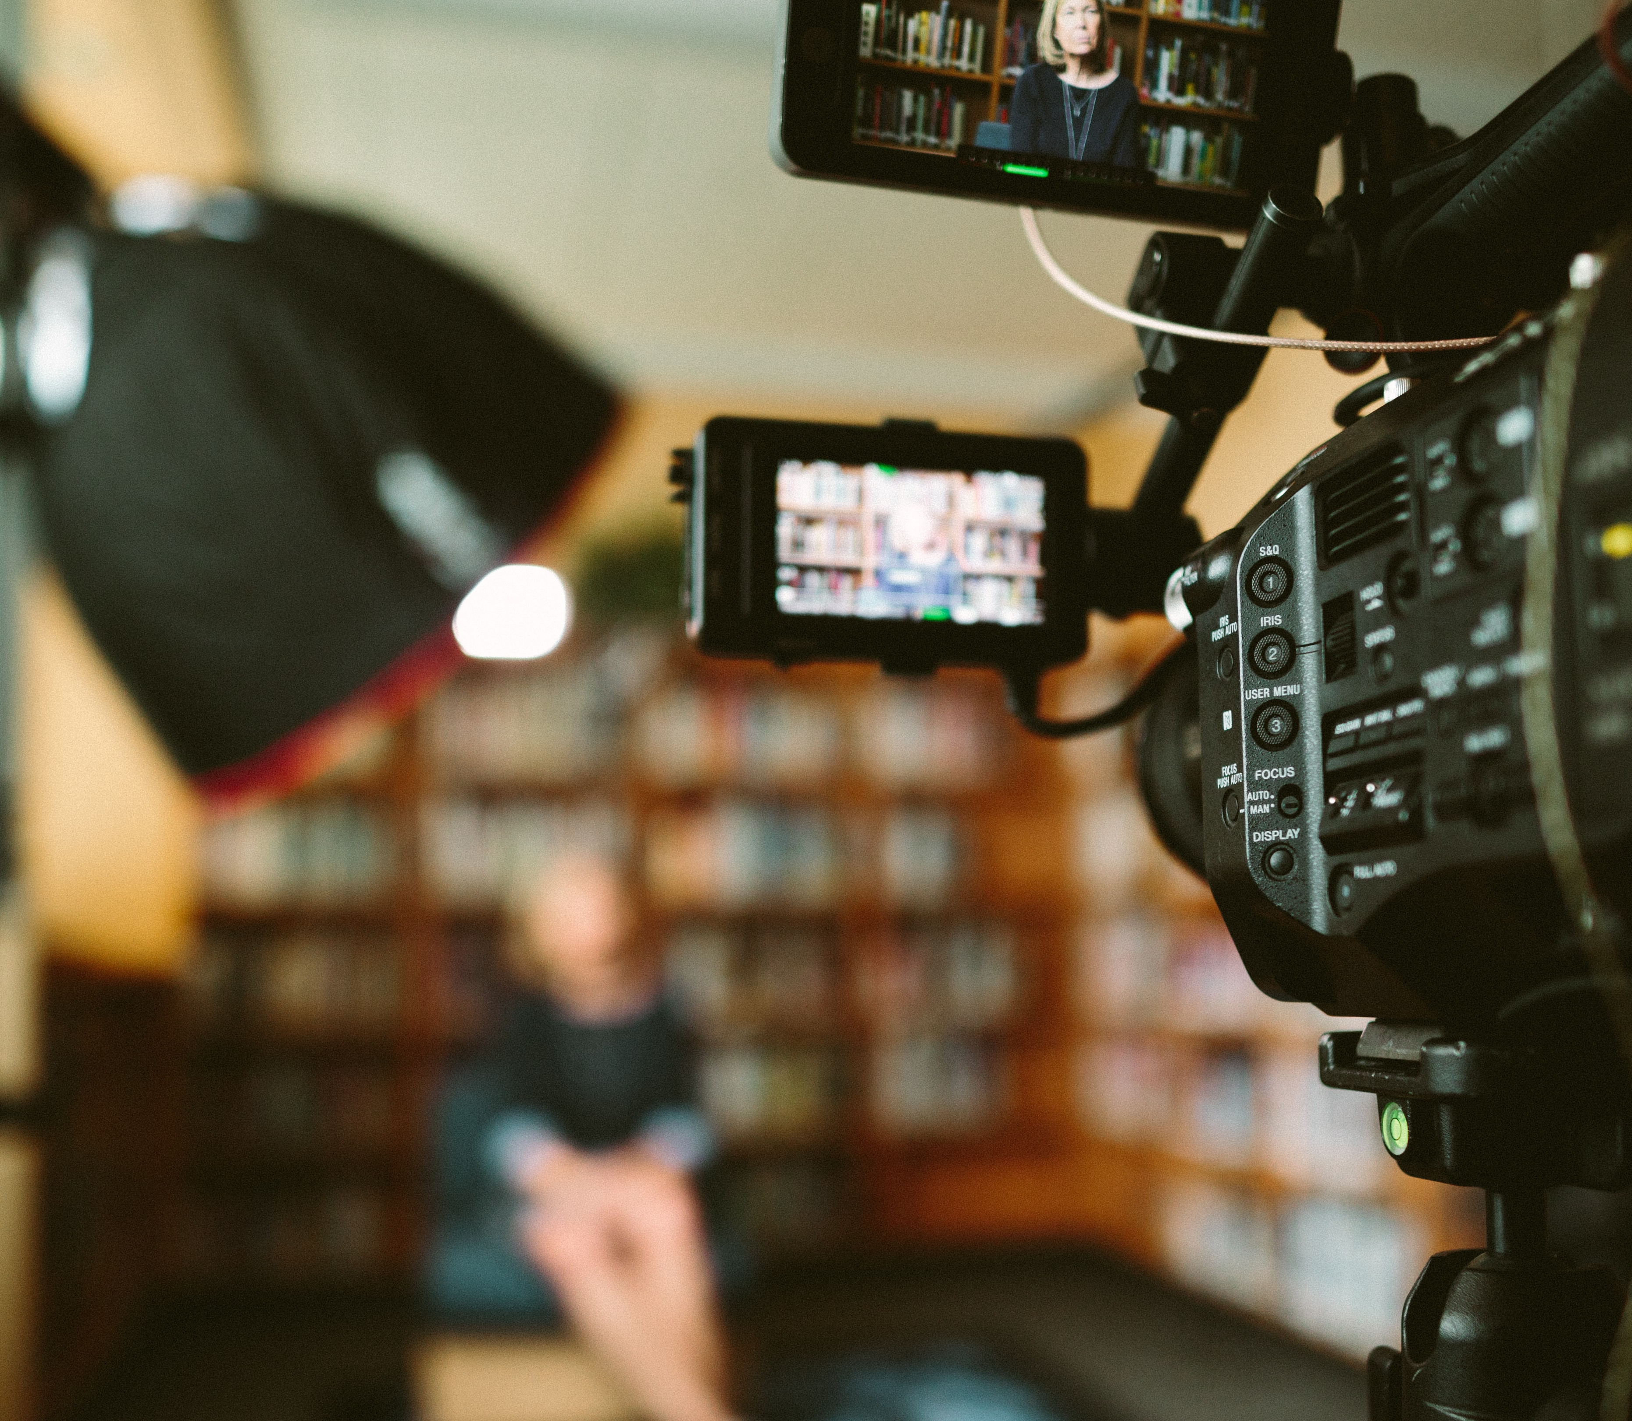
Faculty of social sciences
RSO Workshop: utilizing media attention for scientific impact
By Ciska Schippers,
Communications and Press Officer for FSS

Slide 2
Planning
Introduction
The communications team
Media training
Social Safety event
Media attention: what are journalists looking for
What can I do to help
Think about your core message
Q&A on media attention
If we have time: practice your core message and interviewing in groups

Slide 3
Introduction
Who am I?
Background in journalism
My work at VU Amsterdam
Internal communication (faculty newsletter, online articles on prizes, grants and appointments, etc.)
External communication (such as writing press releases, contact with journalists, but also creating content for the research and programme pages)

Slide 4
My colleagues
Team FSS
Communications Advisor - Esther Wijnen
Advises, informs and supports the faculty and programmes on all types of communication issues.
Web Editor - Renzo Storm
Responsible for the FSS website and programme pages.
Events Coordinator – Julia Hermann
Organises various (online) recruitment events.
Student assistant
Central Press Team
Two spokespeople, two central press officers

Slide 5
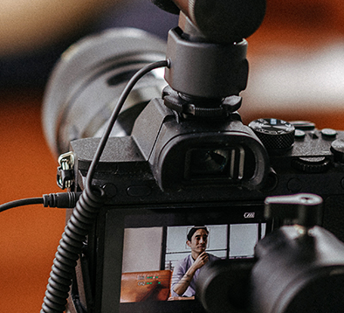
Media training
The Press Office organises weekly media training, on Thursday morning. In person, so much more interactive and elaborate than this meeting today.
For more information, click here.
For now only in Dutch, but English media training will be organised in the future. If you would like to sign up, send an email to pers@vu.nl

Slide 6
Event coming up: C&M comes to FSS
If you have any questions regarding the ways communication is relevant to social safety, or the organisation and vision of the Communications & Marketing department, I would like to point to an event coming up in Thursday, 10 March 2022, from 16:00 until 17:15.
The Director of C&M will explain how the C&M services are organized and what the vision for the coming years is. He would like to present this and simultaneously hear from the faculty on ideas to work better with C&M.
There will also be discussion on how particular new forms of communication can threaten the social safety of academics.

Slide 7
Media attention for research

Slide 8
Media
Two ways that we are in touch with journalists
Journalists come to us looking for experts
We proactively reach out to media with interesting research results, publications, etc.
Why should you talk to journalists?
Impact / valorisation
Putting yourself on the map as an expert
Sharing knowledge

Slide 9
What are journalists looking for?
Information related to current events. Is the topic of your research relevant to current societal debates?
They want a clear core message, something that you can explain to a large audience AND in a headline. Is it something the reader can and will tell friends about? Think about the audience!
Choose the type of media most likely to care about this topic
But also: timing is important. Media want to be the first, so reach out before publication is live
Results can be different: there can be a lot of media attention, sometimes it’s only a press release on VU.nl. But even small results can lead to media requests in the future.

Slide 10
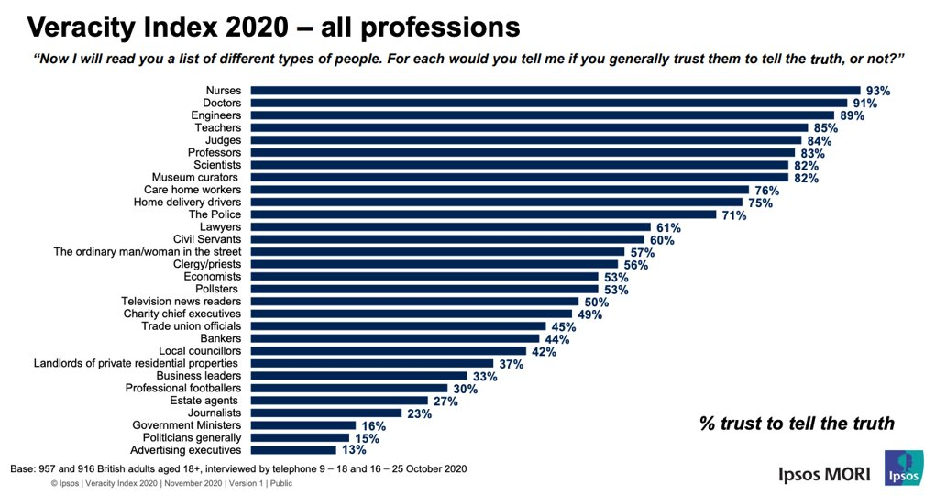
Why do journalists want to talk to you?

Slide 11
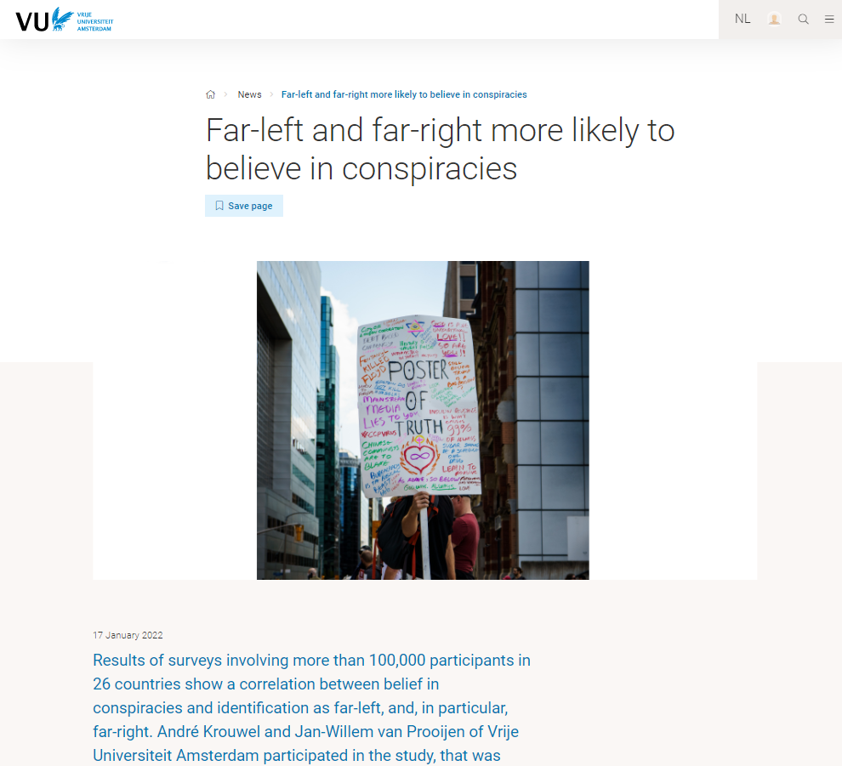
How do we reach press
Send out press releases to specific journalists
Press releases are also published on our own website
Bi-weekly newsletter to journalists

Slide 12
So when do you reach out to me?
If you are rounding up a research project, or have a publication coming up (preferably before the publication is live, journalists are looking to be the first!) We can put together a press release together
If you have own media contacts: it’s always better to reach out to them directly. But we can look at your press release / core message together. Also keep me in the loop in case other media reach out to me
If you have a media appearance coming up and would like to practice your core message / any advice
When you’re an expert on something that’s being talked about

Slide 13
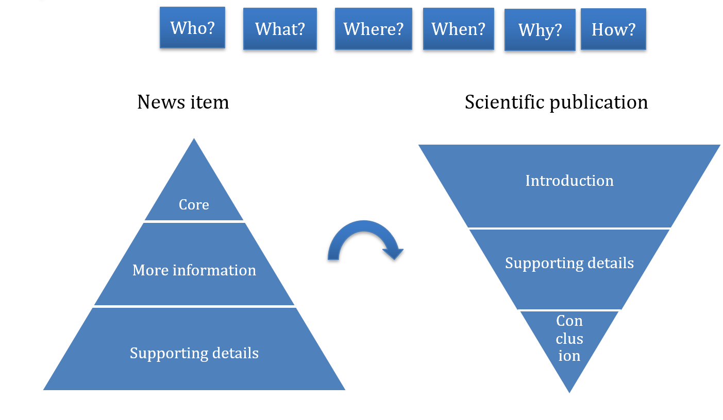
Getting your core message right

Slide 14
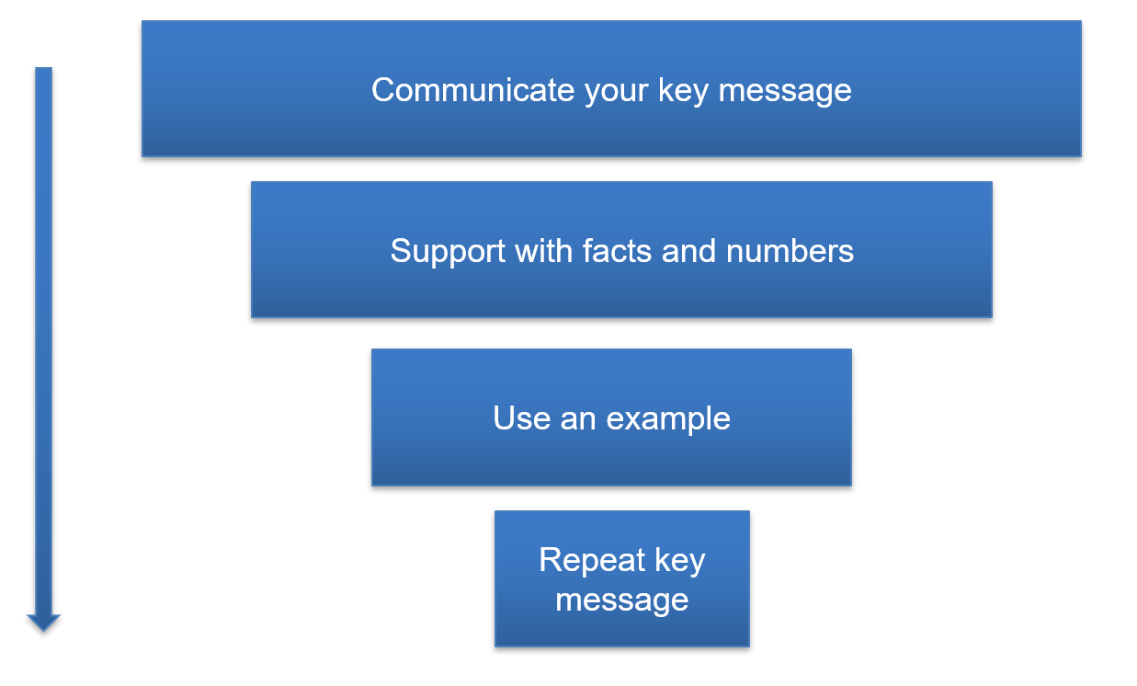
What to do during an interview

Slide 15
Any questions so far?

Slide 16
Practicing your core message
We will divide you in groups
Take a couple of minutes to draft a core message on research you are working on at the moment, or something you’re knowledgeable about. Keep it as simple as possible!
Interview each other. Try to ask the W-questions. Why is this research important? What can we do with the outcome? Don’t be afraid to interrupt each other if they are not getting to the point

Slide 17
Contact me
If you would like to gather media attention or have any other questions related to press and/or communications, reach out to me: c.schippers@vu.nl or 06 18869648
Apply for media training by sending an email to pers@vu.nl. Let them know whether you speak English or Dutch.

