Slide 1
TTT Advocacy Academy
Refugee Academy (R.A.)– Vrije Universiteit Amsterdam
Elena Ponzoni, Mohammed Badran, Domenica Ghidei

Slide 2
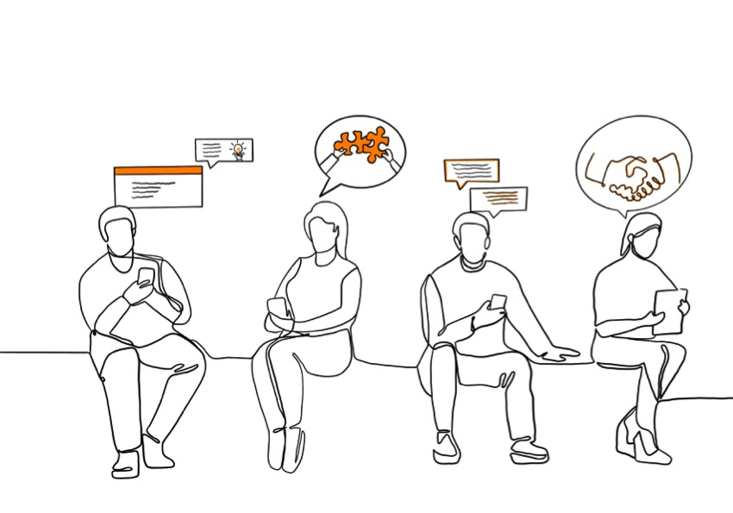
Starting points and
Assumptions
Policy is often detached from the experiences, whishes and perspectives of refugees
Experiences of refugee advocates are source of reflection for policy makers (reflecting on one’s position and actions)
Polivocality: How to create space for a variety of pespectives?

Slide 3
Structure of the advocacy academy
1 full day (offline)
  Morning: Discussing notions of ‘polivocal policymaking’ – lecture Halleh Ghorashi
Afternoon: Working in groups
  Mapping participatory spaces
  Diving into concrete cases
One come back session (online) after 3 weeks
Sharing and reflecting on the basis of the assingment and looking back on key notions

Slide 4
Basic issues
Understanding the field and context
  What is the status of refugee participation in policy in your context? What is happening now, what is the history behind it?
  What are the current spaces (platforms/consultations, committees etc.) where refugees can voice their perspectives? What are the challenges with these spaces?
  Who are the key players (NGOs, academics, etc) in on the policy levels? Often the people who have a seat at the table.
  What is the status of the debate over ‘meaningful refugee participation’?

Slide 5
Basic issues
2. Be aware of your positioning
  Discuss in groups: What are the advantages and disadvantages when NGO’s, Refugee-Led Organisations, or Academy provide this masterclass? Discuss with each other

Slide 6
Basic issues
3. Considerations for recruiting – What are the (strategic) considerations that you made when deciding for recruiting?
Per country /group. With flipcharts. Take 10 minutes to draw your own strategy; reflect on what worked and what didn’t, ideas to do next time, and then presentations and discussion?

Slide 7
Conditions for learning
Ryan en Markova (2006)
In the comfort zone, someone feels comfortable without anxiety or discomfort. There are no new challenges or reflections to start a learning process
The other extreme is the panic zone, a space that is overwhelming and far from comfortable. In this zone, people experience stress and anxiety. Learning is impossible because people are forced to expend all their energy on coping with stress and panic.
In between is the stretch zone. In this space, things can be unknown and can become uncomfortable, but there is room for a learning process.

Slide 8
Set the stage
4. Understanding the discursive field
Prepare the introduction: what are considerations?
Making a case: Start from personal/professional experience and/or share theoretical assumptions
Theoretical elements (see handout):
  Deep democracy
  Politics of presence and politics of ideas

Slide 9
Holding space
Holding space is something that requires to be very sensitive to how people feel and how they are occupying the space (in this case: Their presence in the masterclass)
Non-verbal language and signals.
Can you ‘hold’ the space in such a way people feel “safe enough to be brave”?
“Brave”: Daring to speak up when you have a personal history of not being heard
Daring to look at your positioning and assumptions throught the eyes of another
You can ask participants what they need to feel good in the space

Slide 10
Typical questions
You don’t need to have a definitive answer to these questions, but it helps to think about them beforehand.
Examples:
How can we know which organizations to engage with? Where can we find the right people? Where do we find refugee-led organizations?
We can't engage with everyone. How do you choose who to involve?
It's better to have one organization than multiple organizations. It's more efficient.
How do we deal with tensions and competing attitudes within refugee communities?

Slide 11
Typical questions
Are these advocates representative enough? Objective enough?
We should not consult only refugees but also the host community.
We make policies for all refugees not for a specific group. We can't talk with one group only.

Slide 12
Typical questions
I myself am convinced of the importance of the refugee perspective but how can I convince people above me in the organization?
→ Can you think of more questions??

Slide 13
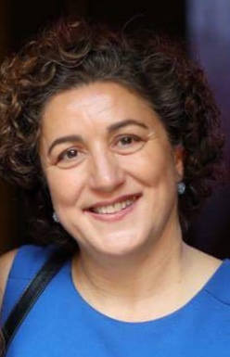
Lecture: Polyvocal policymaking
By Halleh Ghorashi
Professor of Diversity and Integration – Sociology
Vrije Universiteit Amstedam

Slide 14
Participatory governance
Inclusion of different perspectives to create ‘polivocality’ in policymaking
Deep democracy within deliberative structures: Making space for unusual and even disruptive voices in the process of decision making /policy making.

Slide 15
Different forms of power
Visible power – power of domination
Invisible power - discourses that reproduce certain taken for granted ways of thinking and acting

Slide 16
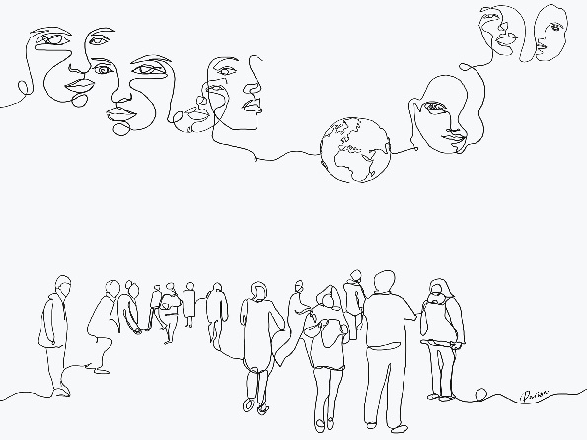
In-between instead of against
  In-between the lines
  In-between individuals
  In-between spaces

Slide 17
In-between instead of against
  In-between the lines
  “In a space that we cannot capture in rules and regulations, something extraordinary happens: something meaningful: a moment of consideration for the specific aspect of some one’s life situation; a moment of possible governmental and legal creativity ” (Hirsch Ballin)

Slide 18
In-between instead of against
  ‘In-between individuals’ having specific forms of consciousness
Practical consciousness (embedded enough to know how the new structure works)
Reflective consciousness (constant mirroring between the past and the present)
Relational consciousness (one’s narratives is situated within the general patterns of their network with other refugees/soulmates)

Slide 19
In-between instead of against
  ‘In-between spaces’ (or ‘interspaces’)
Slowing down – create space for multiplicity
Epoché (temporary suspension of one’s own judgement)
Alterity (approaching the other from the position of the other) –Emmanuel Levinas

Slide 20
Capacity building for all actors
Capacity building for people in decisionmaking
Capacity building for refugee advocates
Capacity sharing

Slide 21
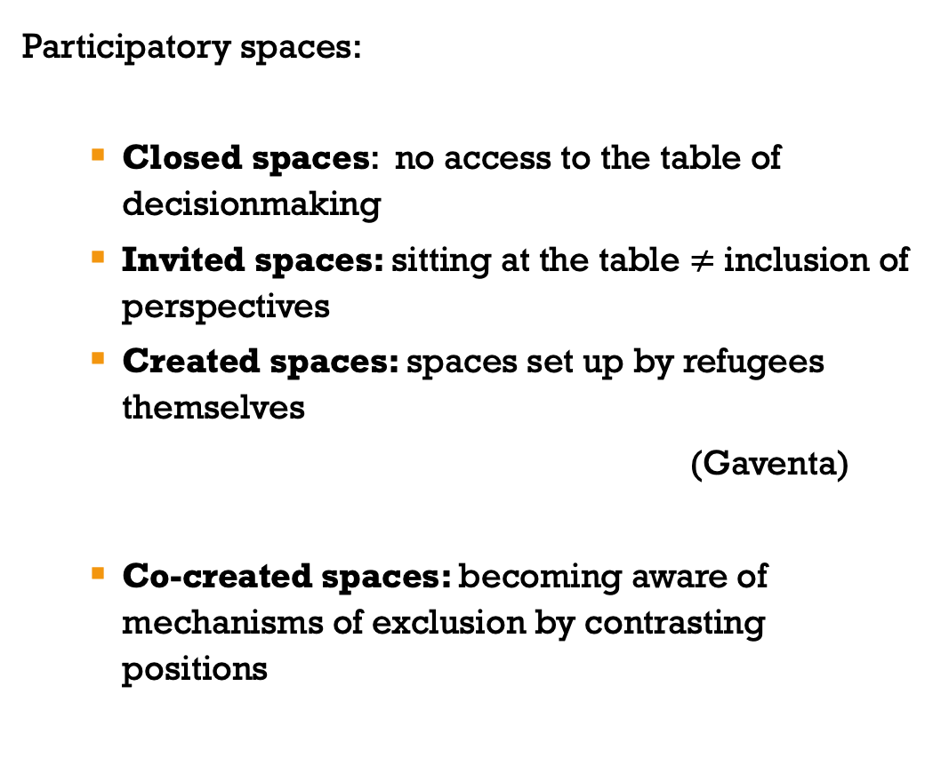
Participatory spaces
Participatory spaces:
  Closed spaces: no access to the table of decisionmaking
  Invited spaces: sitting at the table $≠$ inclusion of perspectives
  Created spaces: spaces set up by refugees themselves
  (Gaventa)
  Co-created spaces: becoming aware of mechanisms of exclusion by contrasting positions

Slide 22
Walking exercise
What did you hear in the lecture that is relevant for you/your work? Why is it relevant and how do you reflect on it?
Share an experience which you see as a good example of bringing refugee/migrant’s perspectives to policymaking and one example where that did not go so well.

Slide 23
Participatory spaces
What we mean with ‘Spaces’: Context and situations for decision making and consultation.
Location/structure or is it the opportunity you have?
But also: “Opportunities, moments and channels where citizens can act to potentially affect policies, discourses, decisions and relationships that affect their lives and interests” (Gaventa)

Slide 24
Participatory spaces
Participatory spaces:
  Closed spaces: no access to the table of decisionmaking
  Invited spaces: sitting at the table $≠$ inclusion of perspectives
  Created spaces: spaces set up by refugees themselves
  (Gaventa)
  Co-created spaces: becoming aware of mechanisms of exclusion by contrasting positions

Slide 25
Thank you!

