Slide 1

School of Business
and economics
  Research Ethics Guidelines for Master Students at SBE
  SBE Ethics Review Board
    Date: September 2025

Slide 2
Background
  In 2018, two important ethics documents were issued:
    The Code of Ethics for Research in the Social and Behavioral Sciences involving human participants.​
    The Netherlands Code of Conduct for Research Integrity.
  Both instruments call for the ethical handling of human subjects in research. Human participants should be handled in an honest, transparent, scrupulous, independent and responsible manner.​
  These principles also apply to research conducted by SBE students.

Slide 3
SBE Ethics Review Board
The SBE Ethics Review Board (ERB) consists of a Chairman, 5 board members and a secretary. The chairman and board members are all SBE affiliated professors.​
The ERB:​
    ensures that research (including student theses) at SBE that uses data on human subjects is in line with institutional, national and international ethics regulations and legal requirements.​
    reviews research proposals and issues statements declaring that the proposals are in line with the guidelines for research involving human subjects.​
    promotes ethical research practices at SBE.

Slide 4
Ethics Procedure for students
All students are required to complete the online ethics self-check prior to the start of their thesis research.
The online ethics self-check is available here: https://vuamsterdam.eu.qualtrics.com/jfe/form/SV_6nf3iZrOy2CUt8y
  Students that do not complete the self-check will not be able to obtain the full grade for their thesis.

Slide 5
Ethics Procedure for students
  Upon completion of the online self-check, the ERB will issue statements that either report that the students' research proposals:
      comply with the SBE ethics guidelines.
      do not involve data on human subjects.
      have already been reviewed for ethics issues.
      do not comply with the SBE ethics guidelines. In these cases, students have to revise their research designs or (in exceptional cases) request their supervisors to apply for a full ethics review.

Slide 6
Ethics issues and advice
Students should consider the following issues prior to the submission of an ethics application:
Ethics issue | Guidance
Use of personal special data (e.g. religion, ethnicity) and sensitive data (e.g. grades, finances) | Anonymization or pseudonymization and secure storage of data are necessary. If identifiable data is required for thesis, supervisor should contact ERB.
Use of deception or withholding of information about the research project | Transparency and sharing of complete and correct information is essential. Revise study design in case of deception or withholding of information.
Involuntary participation in research | All participation should be voluntary. Revise study if this is the case.
Lack of active informed consent to participate in the study | Active informed consent should always be provided. Revise study if informed consent is not possible.

Slide 7
Ethics issues and advice
Whenever possible, students are advised to deal with their ethics issues by revising their study designs. For example, variables on ethnicity can be omitted if not necessary for the research question.
Ethics issue | Guidance
Risks, harm or negative consequences due to participation in the research | No risks should be imposed on subjects from participation. Revise study in such cases.
Subjects are exposed to distressing stimuli | Subjects should not be exposed to distressing stimuli. Revise study in such cases.
Age and mental capability of subjects | Subjects should be adults and mentally capable. Supervisors should contact ERB if the data from minors or vulnerable groups are required for research.

Slide 8
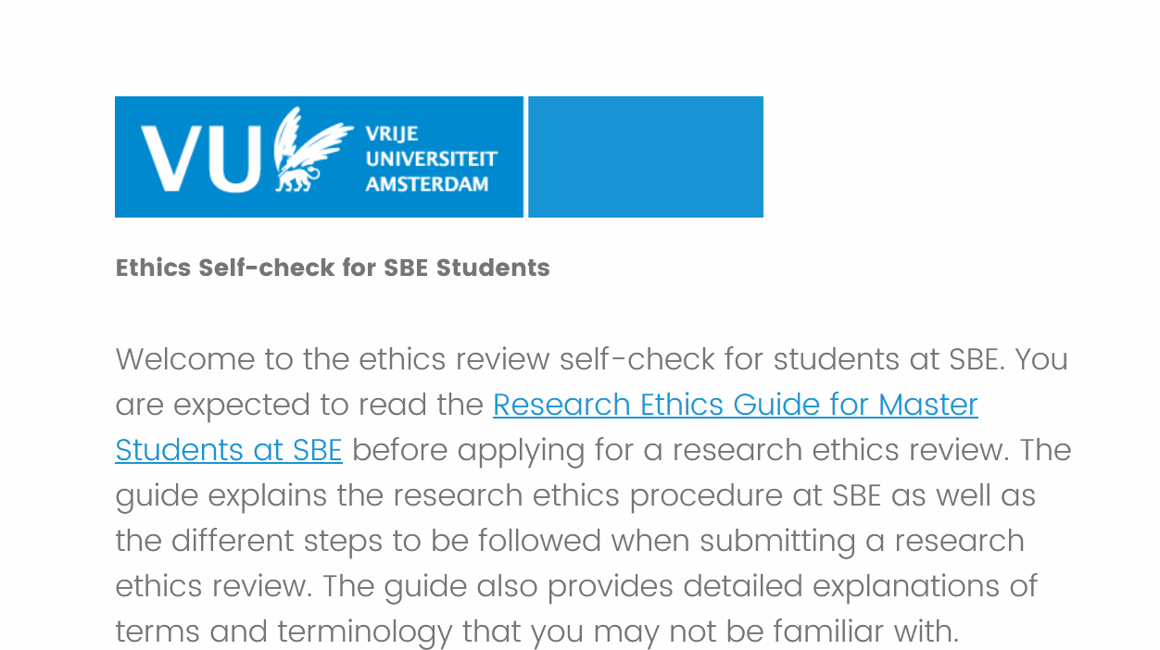
Self-check questions
https://vuamsterdam.eu.qualtrics.com/jfe/form/SV_6nf3iZrOy2CUt8y

Slide 9
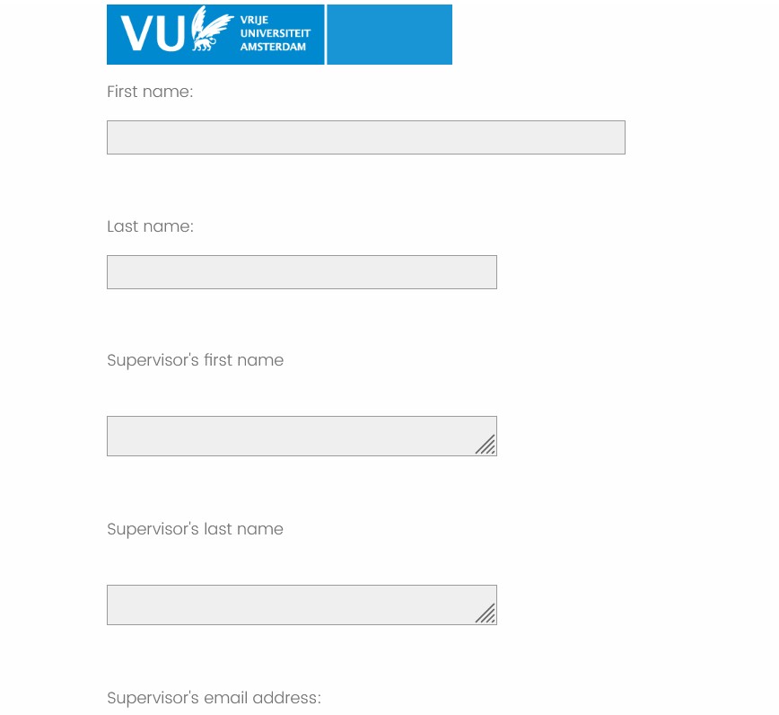
Self-check questions
Names and email addresses should be typed correctly to ensure that confirmation emails are sent out.

Slide 10
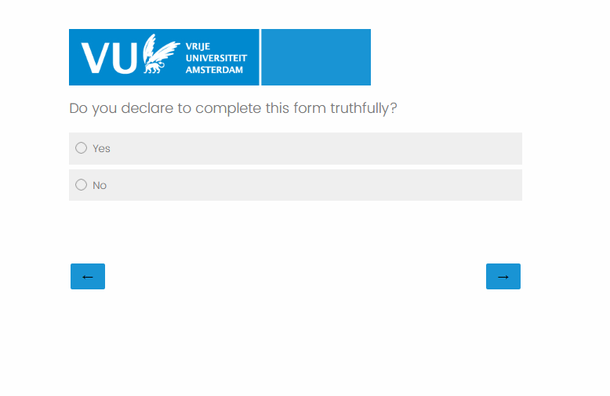
Self-check questions
The form can only be submitted if answered truthfully. Students can still make minor changes to their research after the self-check. e.g. changing research methodology or the way particular variables or questions are analyzed.
However, students will be required to submit a new application via the online self-check, for fundamental changes to the research design such as changes in the data used or main research questions.

Slide 11
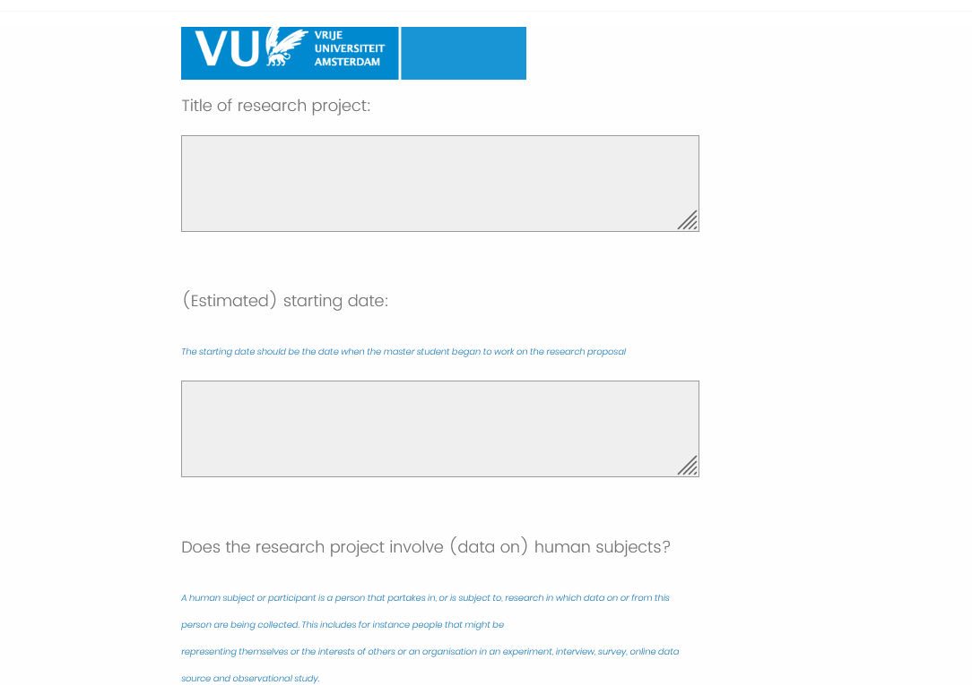
Self-check questions
The self-check should be completed before the data collection phase of the thesis.
The starting date should be the date you begin working on the proposal.
A human subject or participant is a person that participates in research in which data on or from this person are being collected. Data can be collected at the individual, group, community or organisation level.
Aggregated data on human subjects such as population figures are not considered as data on human subjects.

Slide 12
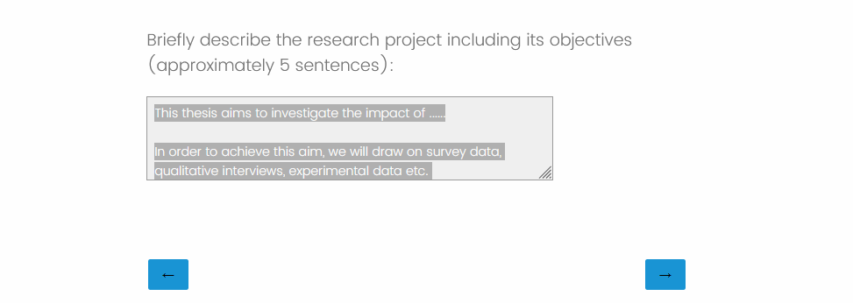
Self-check questions
The thesis description should be as detailed as possible, see the example given in the form field.

Slide 13
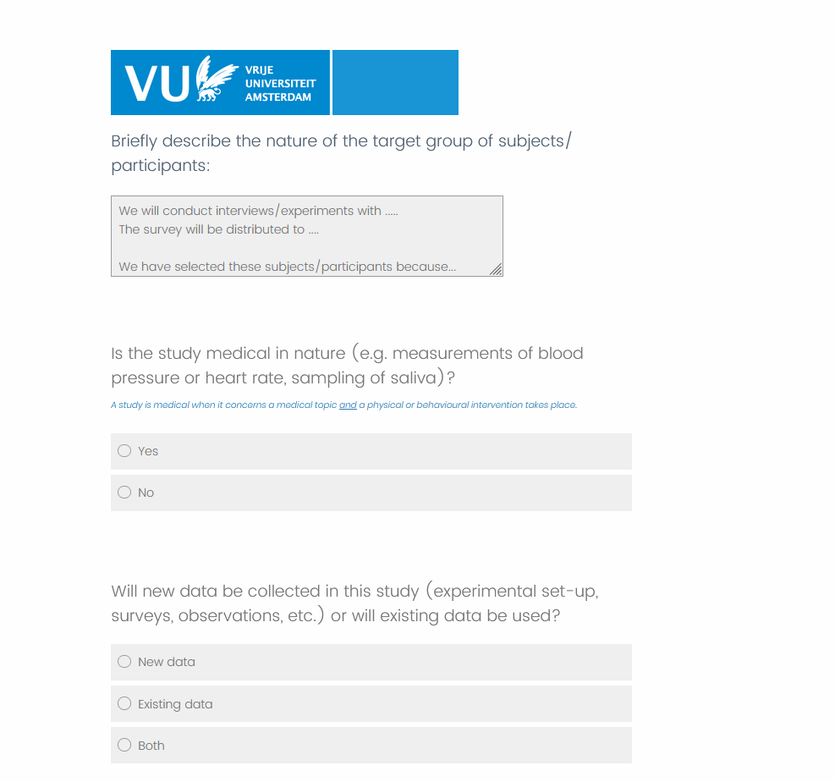
Self-check questions
Medical studies cannot be reviewed by the ERB and should be submitted to the Medical Research Ethics Commitee
Please note that the ethics implications for new and existing data are different. Explanations for both new and existing data are provided in the next slides

Slide 14
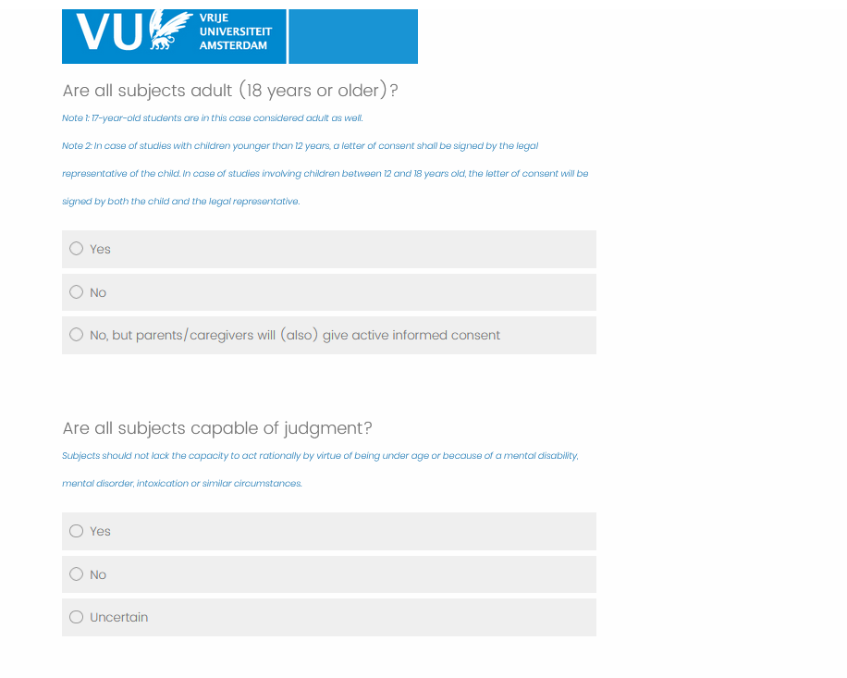
Self-check questions
For children younger than 12 years, written informed consent is required from their legal representatives or parents.
Children that are 12 years and older, should sign the letter of consent together with their legal representatives.
All subjects should be mentally competent and capable of judgement, students should revise their designs if this is not the case.

Slide 15
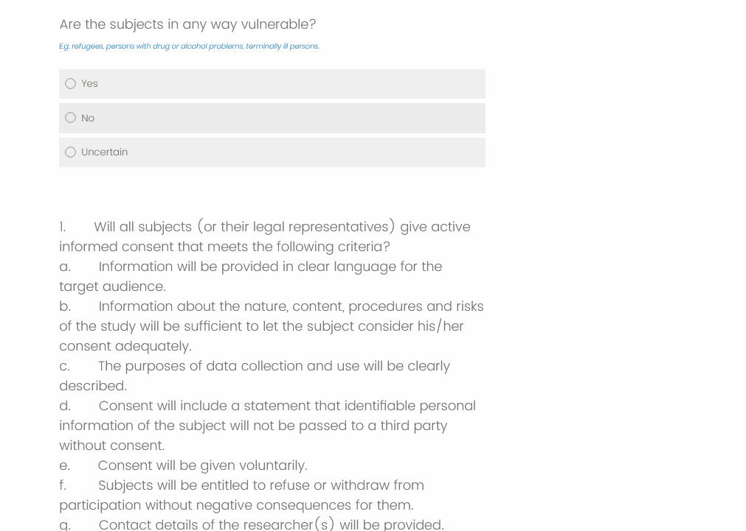
Self-check questions
Vulnerable subjects are those who are in a position of dependence (whether psychological, social, economic, political, or otherwise), easily stigmatised, discriminated against, prosecuted, or met with violence.
Examples of vulnerable populations include refugees, homeless people, terminally ill people, people engaged in substance abuse or ethnic minorities that are discriminated against.
Research designs should be revised whenever possible, if identifiable vulnerable subjects are involved.

Slide 16
Self-check questions
Voluntary and active informed consent (i.e. the subject performs an action to confirm their participation and evidence of this action had been well documented) is required for all studies.
If the research project occurs in a group or organization, consent should be obtained from the head of the group or organization.
Research in public spaces is permitted if individual privacy is not violated.
Please see the informed consent checklist on the last slide

Slide 17
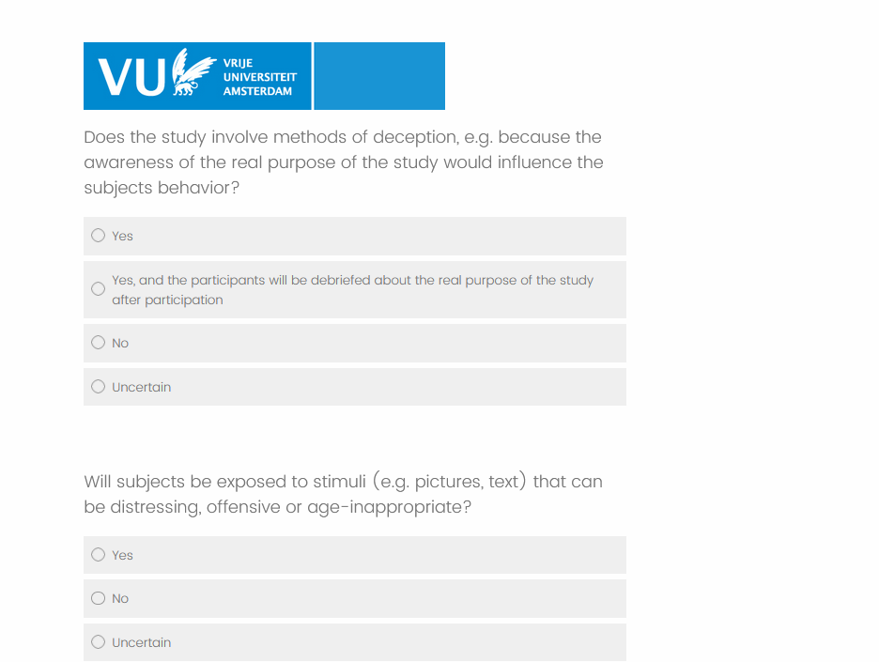
Self-check questions
Research should always be conducted in a transparent manner where the research aims, goals and methodology are clearly explained to subjects.
In exceptional cases, information is withheld from subjects because subjects knowledge of the research questions may bias the research outcome. In these cases, subjects should be provided information after their participation but not later than the end of data collection. Subjects should also be offered the right to withdraw their data.
Deception in any form (e.g. not providing true information about the researchers identity or research questions) should not be employed.

Slide 18
Self-check questions
Subjects should not be exposed to stimuli that can be distressing such as pictures and text.
Participation in the study should not pose any risk, harm or negative consequences on the subjects.
In case this is necessary for the research and the research design cannot be adjusted, the master students and their supervisor need to contact the RERB.

Slide 19
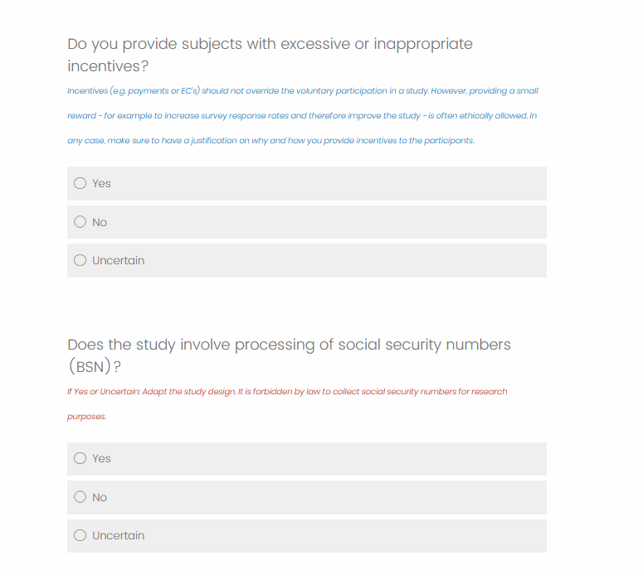
Self-check questions
Compensation or incentives aimed at increasing participation can be given to subjects.
However, compensation or incentives should not be set so high that they override the voluntary participation in the study. The amount offered should also not result in inflation beyond normal levels.
The nature of these incentives and their potential risks, obligations should be clearly communicated with subjects.
It is forbidden by law to collect social security numbers or BSNs for research purposes.

Slide 20
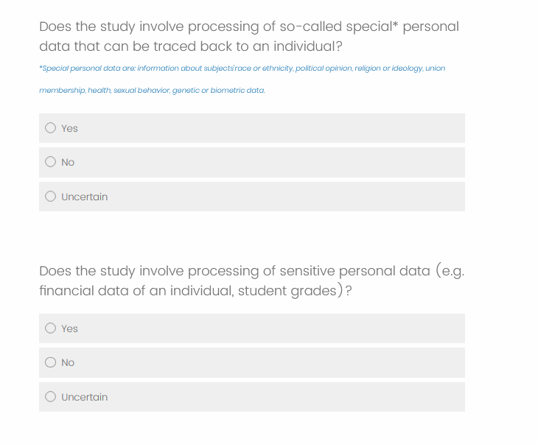
Self-check questions
Strict rules apply for the collection of special categories of personal data and sensitive personal data due to the European General Data Protection Regulation (GDPR), if such data is necessary for the master thesis, master students and their supervisors are requested to submit a full ethics review.​
​
Special categories of personal data include religious and philosophical beliefs, trade union membership, biometric data, genetic data, data on sexual orientation or sex life, racial or ethnic origin, health data and political stands.
Examples of sensitive personal data include financial data and student grades.

Slide 21
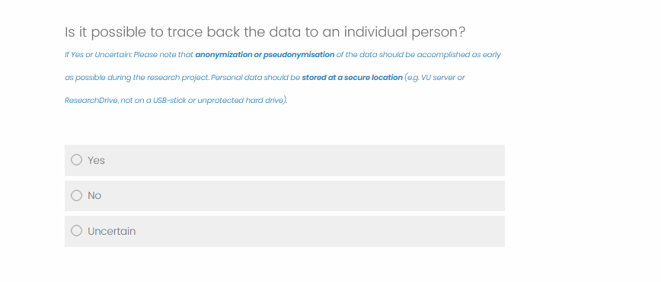
Self-check questions
Unless consent has been given, it should not be possible to identify subjects from the data.
Anonymization or pseudonymization should be accomplished immediately after data collection.
Secure storage should also be used for personal data. . Questions on anonymization and data storage should be addressed to rdm.sbe@vu.nl

Slide 22
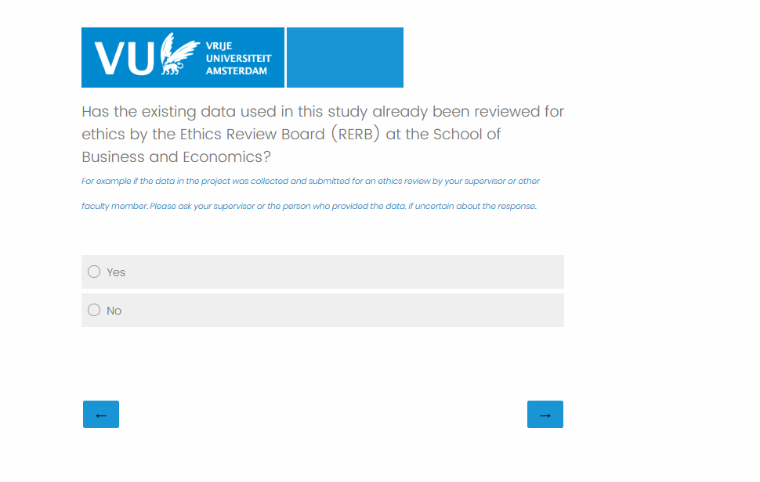
Self-check questions
If the data used in the study has already undergone an ethics review by the SBE RERB, the survey will end after this question and a report stating that an ethics review has already been conducted will be issued. Supervisors will be notified via email.
In case of uncertainty, students are requested to verify whether a review has been undertaken with their supervisors.

Slide 23
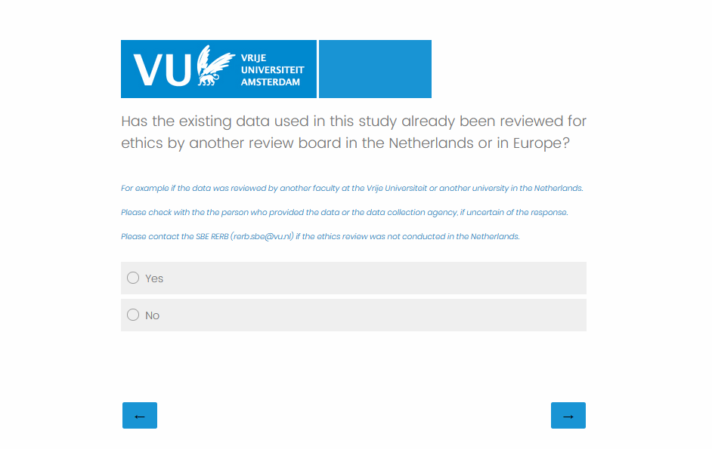
Self-check questions
If the data used in the study has already undergone an ethics review in the Netherlands or in Europe, the survey will end after this question and a report stating that an ethics review has already been conducted will be issued. Supervisors will be notified via email.
The SBE RERB can be contacted in case of uncertainty
(student.ethics.review.sbe@vu.nl).

Slide 24
Informed consent checklist
  Study participants should receive an information sheet that clearly describes:
    the nature and purpose of the research.
    the benefits and risks of participating in the study.
    the procedures to decline participation and withdrawal from the study at anytime without negative consequences.
    whether any personal information about the participant will be collected, processed and how and for what purpose; the right of the participant to request access to and rectification or erasure of personal data.
    usage of the data during research, safeguarding personal information, maintaining confidentiality and de-identifying (anonymising) data, controlled access to data, especially in relation to data archiving and reuse, ways of dissemination, data archiving and possible publishing.
    retention period for the research data, or if that is not possible, criteria used to determine that period.
    contact details of the student, their supervisor.

Slide 25
School of Business
and economics
Research Ethics Guidelines for Master Students at SBE
(student.ethics.review.sbe@vu.nl)

