Slide 1

Positive action
January 2025
April Robertson and Marguerite Adam

Slide 2

Today
What causes occupational segregation?
What is positive action?
What we could do now?
Notes:
​

Slide 3
MA starts by sex and occupational group 2023/24
Notes:
This data is taken from the MA Q4 23/24 Statistics report
Key Points:
This table shows that gender segregation by occupational grouping is prevalent within MA and aligns with existing segregation in FA frameworks (male representation is higher in construction and engineering; female representation is higher in health and childcare).
Questions to consider:
Are there things we can do diversify frameworks?

Slide 4

Why don’t women choose engineering?
There are multiple entrenched barriers:
Perceptions of STEM careers and subjects
Inconsistent promotion of STEM in schools
Few employers are proactive in attracting and retaining women
Notes:
The under-representation of women and girls in STEM careers in Scotland is well documented, as are the multiple and entrenched barriers which combine to perpetuate the horizontal* and vertical* segregation of the labour market, and the gender pay gap*. This situation is detrimental to women, the Scottish economy and society

Slide 5
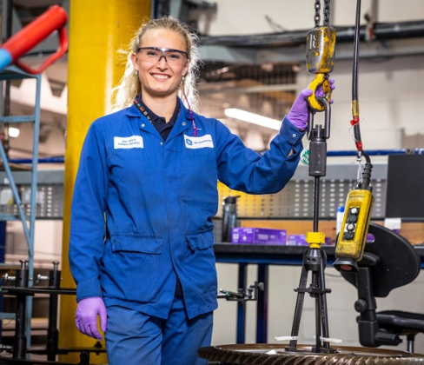
“…there is a real need to ensure that STEM education being provided in schools is rooted in the real world, and of direct relevance not only for their future career choices, but accurately represents STEM-related enterprises and other sectors of the economy as well as its importance in terms of the transition to net zero and learning for sustainability. More and better information regarding STEM jobs is also required.”
Apprentice Aircraft engineer Viktoryia Parkhamovich
Notes:
From Structural barriers to STEM engagement 5.4 p36
With employers offering pupils experiential learning opportunities, chance to visit and promoting inclusive workplace culture.

Slide 6
What is lawful positive action?
Section 159 of the Equality Act 2010 permits proportionate positive action in recruitment and promotion where the employer reasonably thinks:
Persons who share a protected characteristic suffer a disadvantage connected to the characteristic; or
Participation in an activity by persons who share a protected characteristic is disproportionately low.
The employer can take any action, which is a proportionate means of achieving the aim of:
overcoming or minimise the disadvantage identified;
Enabling or encouraging persons who share the protected characteristic to participate in the activity.
Notes:
The information is from solicitors: Anderson Strathern.

Slide 7
Implementing lawful positive action?
Collate evidence; Monitoring; Evaluate
Draw up an action plan:
  Set out evidence
  Specific outcomes you wish to achieve
  Identify possible action to achieve outcomes
  Assessment of proportionality
  Set out steps decide to take
  Set out measurable indicators of progress towards aims
  Explain how will consult
  Specify time period for programme
  Set out period for review

Slide 8

What employers could do now
Offer, taster days, tours, work experience, videos of roles, paid internships, sponsorship
Train female engineers to do talks, support activity in school, mentor etc..
Review recruitment practices and workplace culture
Ensure all staff support this approach
Notes:
Ensure colleagues understand the need to diversify workforce. Could this be a development opportunity to mentor or to line manage a trainee?
Review processes- inclusive recruitment panels; question the need for specific qualifications or are these appropriate interview questions?
Do we need to have staff training to ensure new staff are welcomed and we have inclusive workplaces : polices, practice, office banter

Slide 9

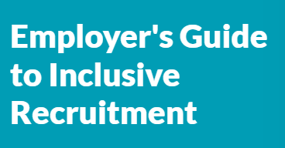
Promoting inclusive recruitment
The Gender Commission evidence review : “Positive Action is rarely used in apprenticeship recruitment because employers lack awareness and/or the confidence to implement effective positive-action measures.”
Employer's Guide to Inclusive Recruitment
Positive action guide

Slide 10

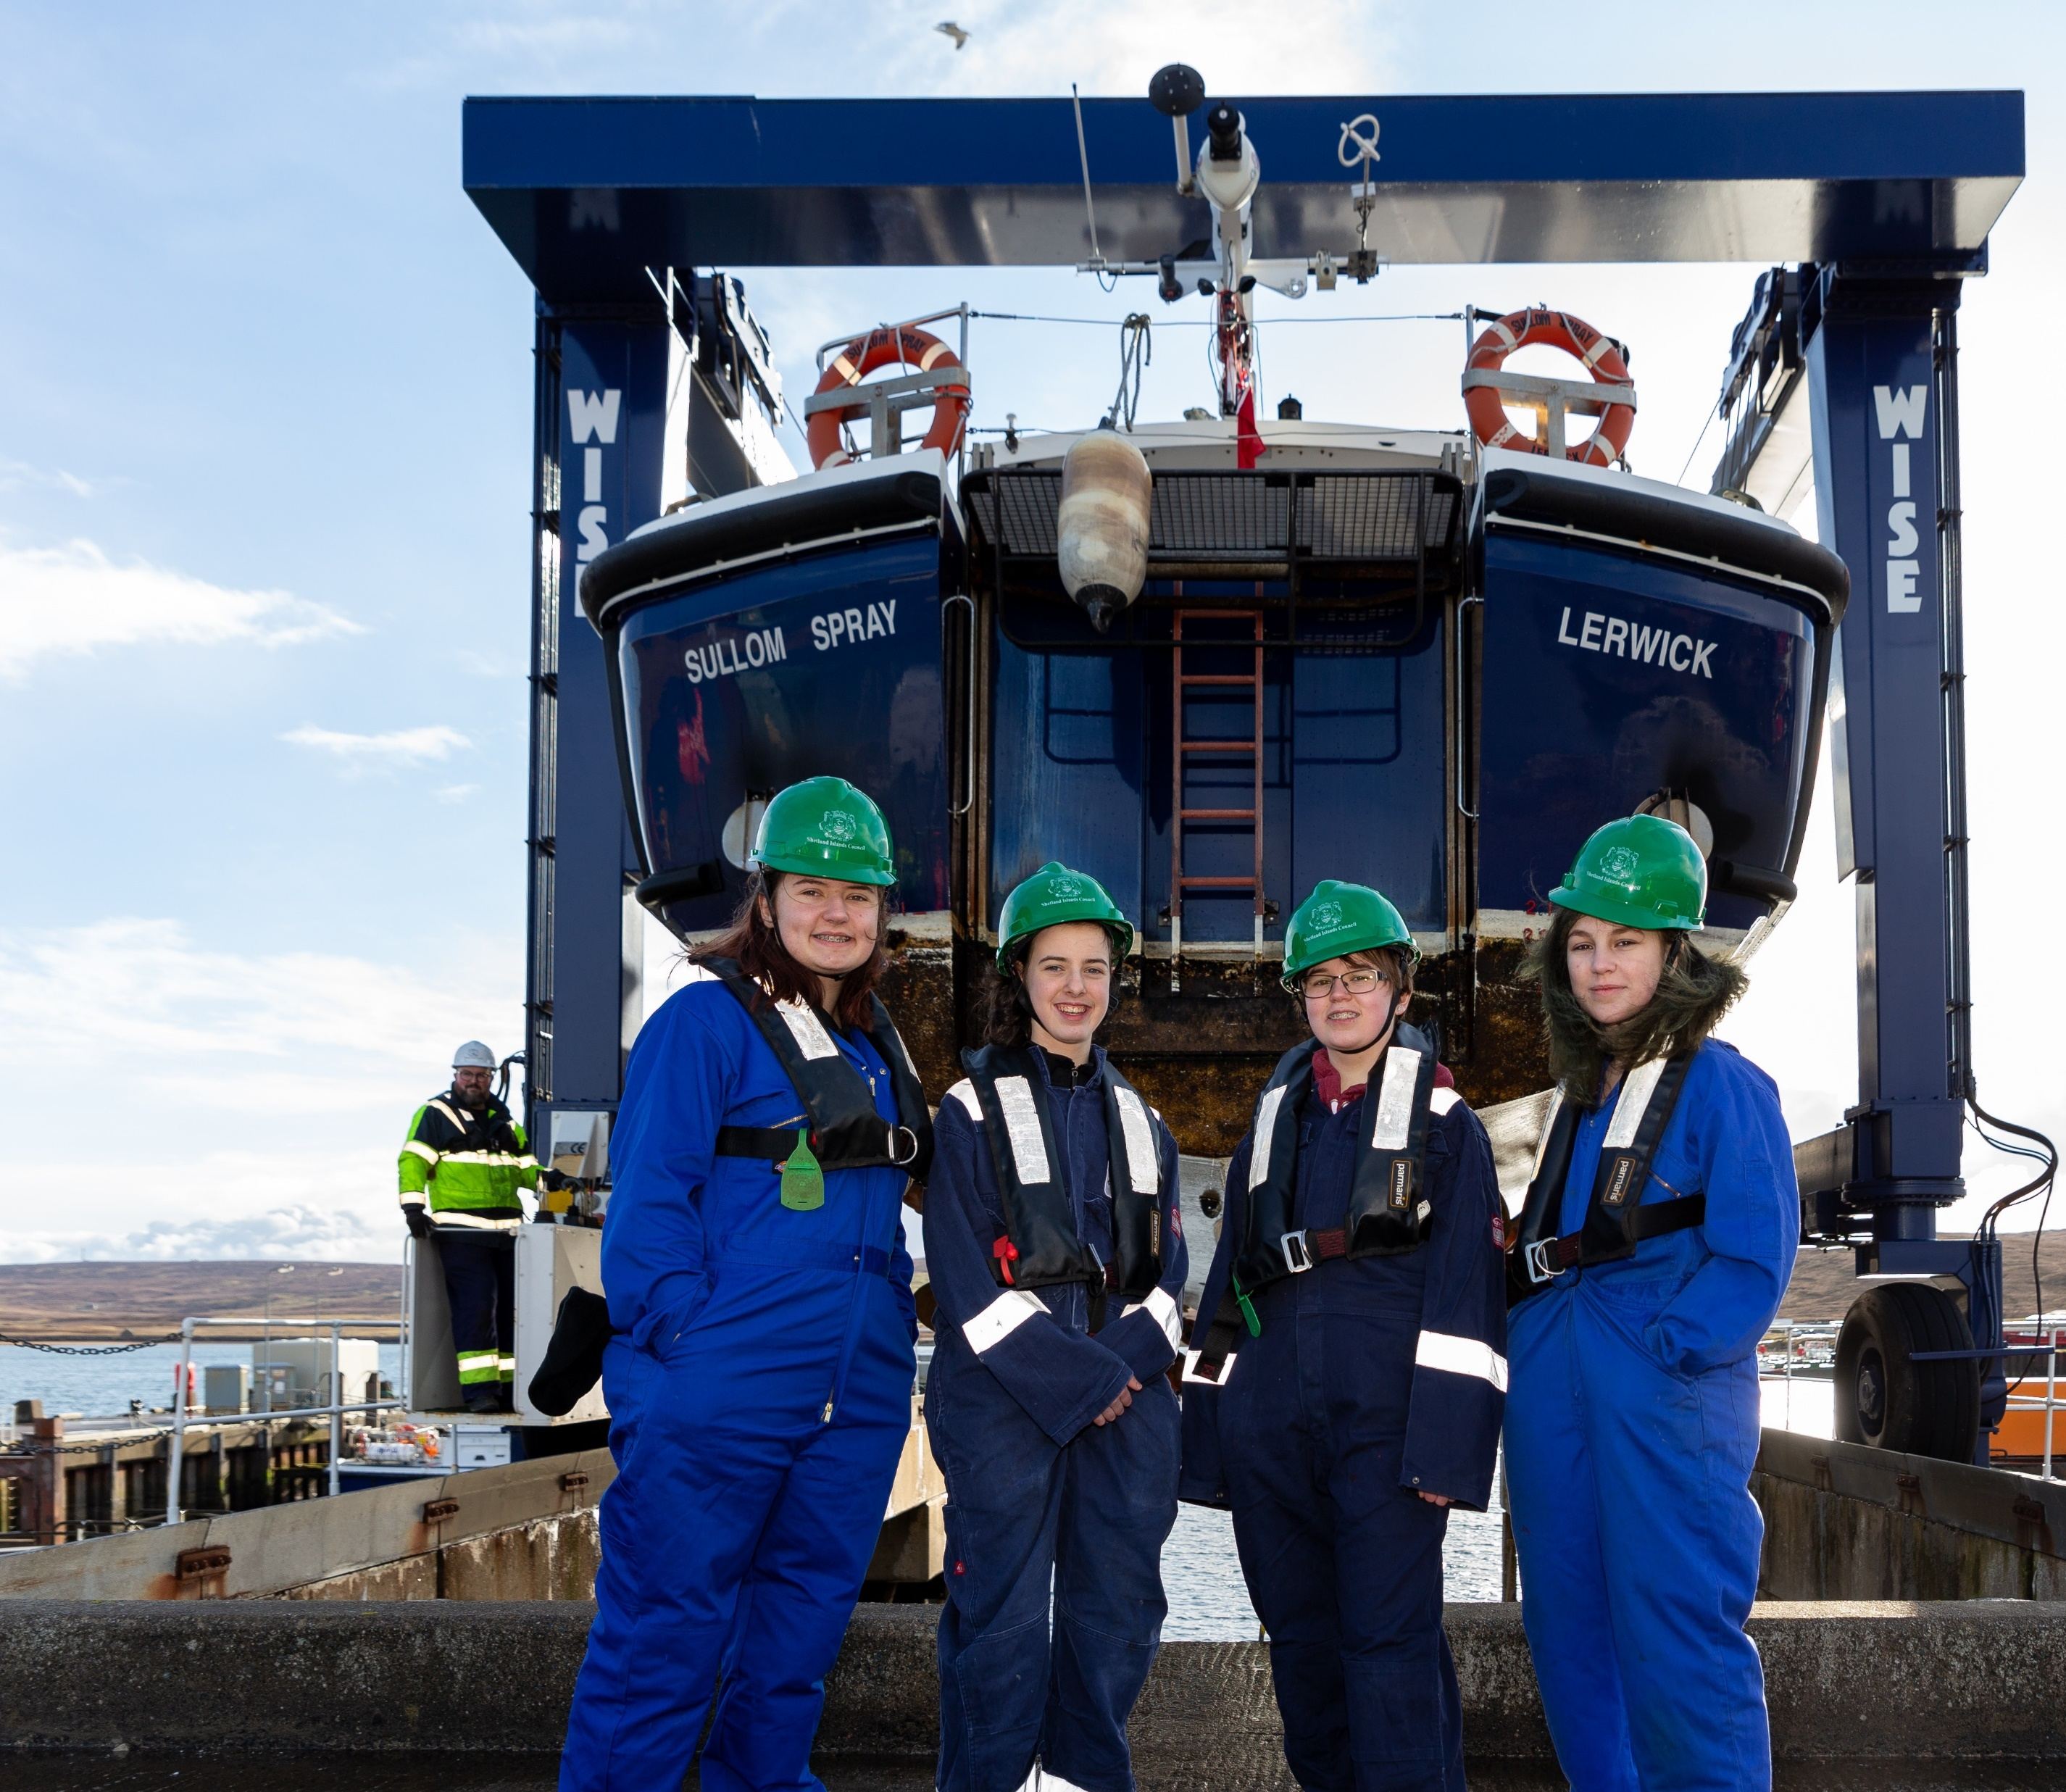
Day of work experience in sex atypical roles
Notes:
Been running in Shetland since 2019, initially with Shetland Council employers and now including private sector employers too. Pupils are S3 and above.
How to get involved… marketplace

Slide 11
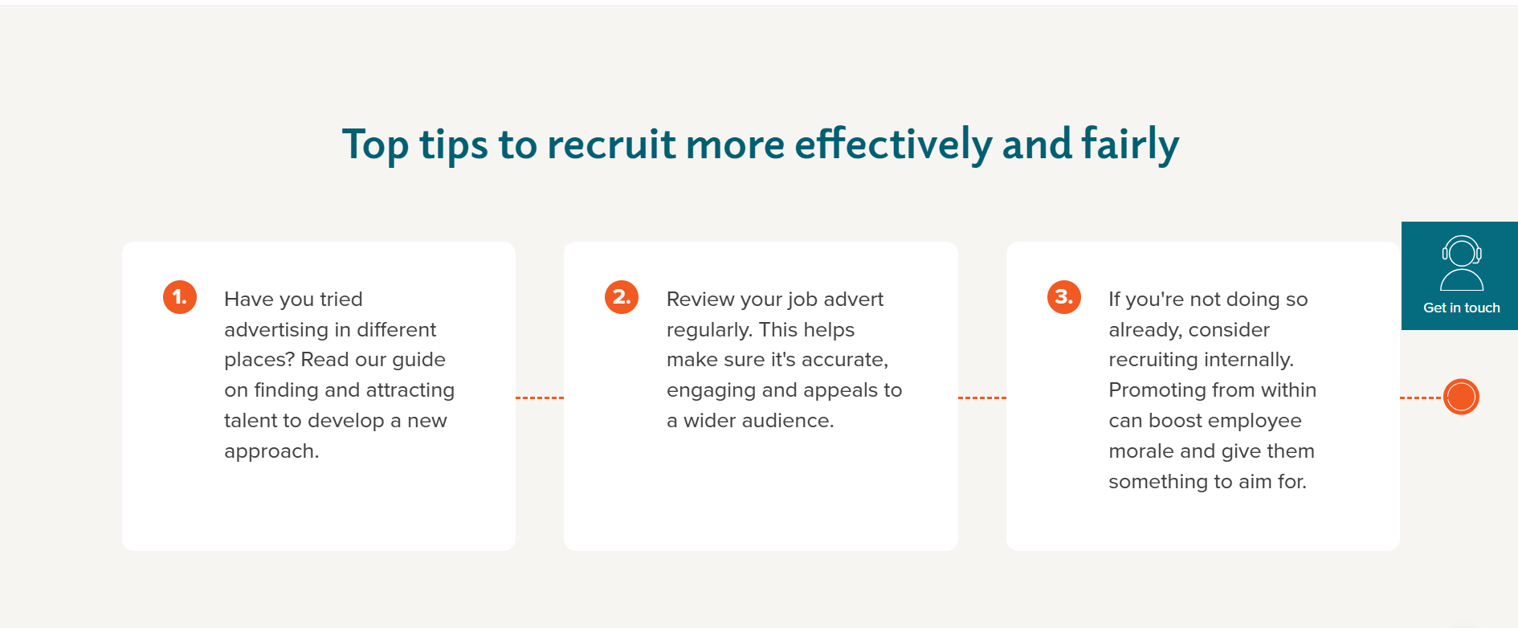
Resources
Employer Inclusive recruitment guides
Notes:
Check out the guide or just dive straight into the section you want to read about.
Step 1: How to find and attract talent
Step 2: Job description and advert
Step 3: Shortlist and interview
Step 4: Welcoming your employees
The Think business think equality tool includes practical suggestions for business organisations, public agencies and industry groups to assist SMEs, and to help them engage in the opportunities available to support this important topic. This includes a test to assess how your employment practice measures up when it comes to gender equality, information to download and short videos.

Slide 12
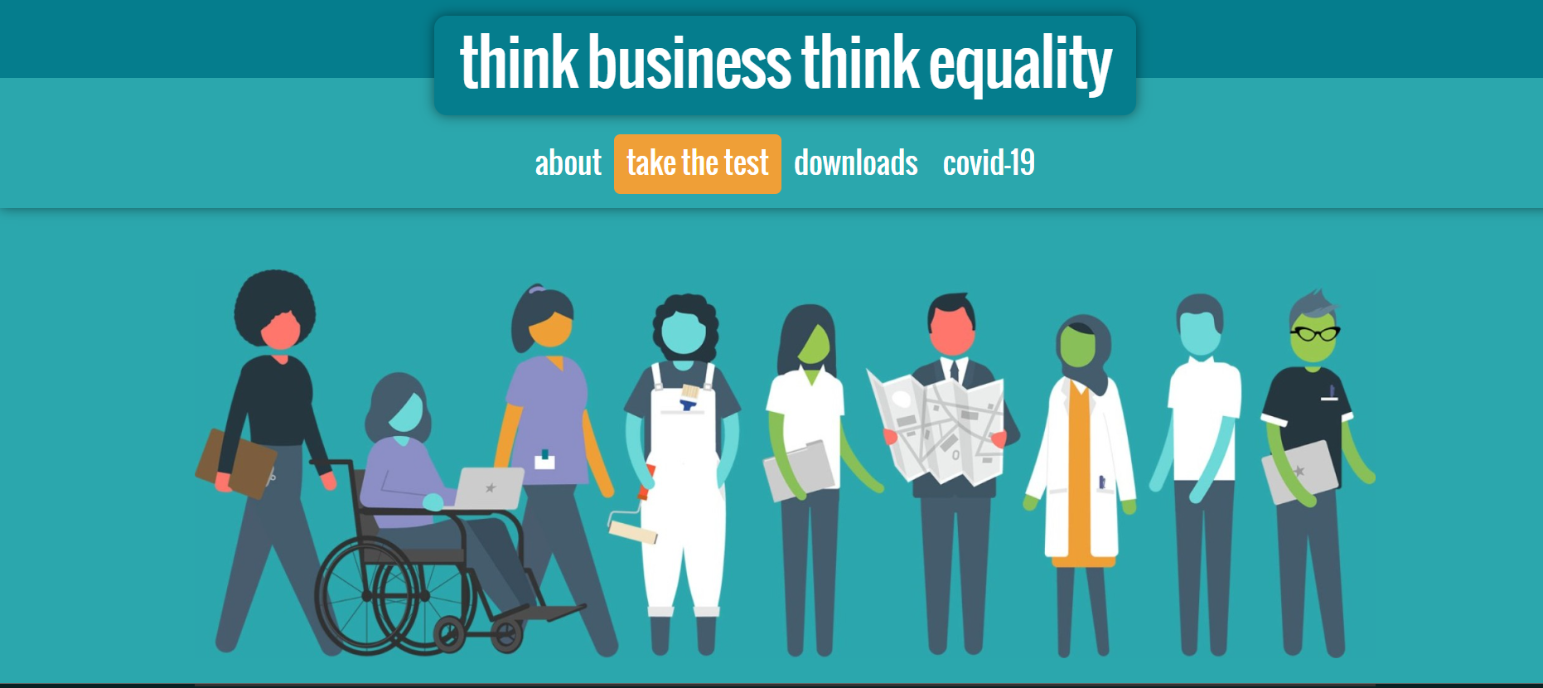
Recommendation One- Inclusive Workplace
Think Business, Think Equality
Notes:
Think Business, Think Equality self-assessment tool, developed by Close the Gap. The tool includes practical suggestions to assist SMEs, and to help them engage in the opportunities available to support this important topic. This includes a test to assess how your employment practice measures up when it comes to gender equality, information to download and short videos.

Slide 13
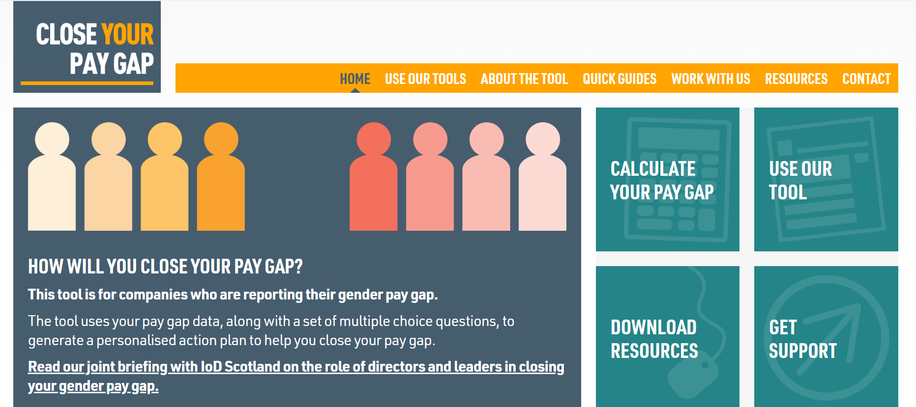
Tool for larger employers & public bodies
The Close Your Pay Gap tool uses gender pay gap data, along with answers to a short set of questions, to determine the key factors behind an organisations pay gap.
Notes:
Although the Think Business Think Equality Toolkit can be utilised by any employer. There is another tool, developed by Close The Gap that should be promoted to large employers and public sector bodies. The tool uses gender pay gap data, along with answers to a short set of questions, to determine the key factors behind an organisations pay gap.The tool will produce a personalised report and action plan.

Slide 14
Thank You
Contact Details:
April.Robertson@sds.co.uk Marguerite.adam@sds.co.uk
Diversity@SDS.co.uk

