Slide 1




The Education Landscape
A Guide for Employers

Slide 2


Introduction
A skilled workforce is at the heart of every business.
As a business leader you get enquiries to work with local schools, colleges and universities – and you’ll probably have some questions given the education and skills landscape can be complex to understand. There are many different ways to get involved – but which are the best fit for your business, and how will they help connect you to your future workforce, or boost productivity by upskilling your current team?
That’s why Gatsby helped create this resource – the Education Landscape: A Guide for Employers.
It describes options for working with schools, colleges and universities, young people* and older learners, and the benefits of doing so for your business. You can also find out how technical education is changing to better meet your skills needs – including apprenticeships, T Levels and Higher Technical Qualifications.**
*The term young person is used to include students at schools, colleges and universities up to age 24.
**The document describes the education landscape in England, however Enginuity has included career pathway maps for Scotland and Wales on pages 11-12.

Slide 3
The benefits for business
Develop your current team
Getting your employees involved in education engagement activities can be rewarding and inspiring. It contributes to your team’s professional development, helping to build communication, leadership and management skills, and can strengthen their loyalty to your company. Linking up with your local college or university can also open the door for technical training to upskill your existing staff.
Build new partnerships
Connecting with schools, colleges and universities offers a strong value exchange. The institutions gain broader insight into your industry needs, and you can get involved in shaping the skills being taught in your local area, whilst benefitting from building your existing knowledge and expertise, for example, in developments in technology. This collaboration also demonstrates the wider contribution your business makes to the community.
Connect locally
Working with your local education institutions can contribute to your organisation’s social responsibility and reputation. Your real-world input brings the curriculum to life and gives learning a concrete focus. It’s also a great opportunity to inspire, inform and help young people - which is good for them, the community, and you.
Discover new talent
Fresh perspectives
Being involved with schools, colleges and universities is an opportunity to identify potential employees who are a good fit with your organisation. In the medium-term this can reduce expensive and time-consuming recruitment activity and support your planning for the future.
Students on an industry placement will quickly acquire new knowledge and skills and make a real contribution to your team as they do so. They can also bring awareness of emerging trends and new ideas to your business.

Slide 4


Ways to get involved
Supporting students
Providing workplace experiences
Much of your future workforce is currently in education. Sharing your knowledge, experience and advice will inspire and inform their career choices – helping them to develop the confidence to move into a role that is right for them – and to be the right employee for you. Opportunities include giving a class careers talk or providing one-to-one mentoring for a student on a longer-term basis.
Nothing beats hands-on experience for gaining an insight into working life, and your business can also benefit in a number of ways. Opening your doors to young people is an opportunity to raise awareness and understanding of your organisation and industry, and help students transition into the workplace. And in the longer-term you could have a future employee. Activities include hosting short workplace visits or longer industry placement opportunities for older students.
Outreach efforts not only help you connect with and encourage young people to enter engineering but also have long-term benefits for the industry as a whole. By actively engaging with the younger generation, companies can contribute to the development of a skilled and diverse engineering workforce, fostering innovation, and driving advancements in the field.
For more information about the different activities, commitment required and the benefits, take a look at this brilliant resource, The Education Landscape: Index
We at Enginuity also provide our own free resources, including those which support companies with outreach in local schools and surrounding communities, which can be found on our website: enspire.enginuity.org
Our latest product, Enspire City is an interactive map with zones in Automotive, Space, Aerospace and Vertical Farming, built for children aged 8-14 years to explore these sectors and the careers within them.
Providing expert guidance
Support high-quality teaching
Work-based learning
Nobody knows your business like you do. Sharing your knowledge and expertise with government, and with the education institutions around you, will help to influence what is taught so that it is relevant to your business. You could work with a college to design a course relevant to your business or be a school or college governor. Or you might contribute to the expert employer panels that shape technical education nationally or locally.
Your input into classes will ensure that teachers can share up to date knowledge and gives you the opportunity to shape the skills being taught around your business needs. You could help design a course or support a student project, give teachers the opportunity to find out about current industry practice by hosting a site visit, teach a masterclass yourself, or even donate some equipment or workshop time for students.
Helping an individual learn whilst they work in your business is a great way to develop a motivated, skilled, and qualified employee. For example, apprenticeships offer real job experience whilst a person studies for a formal qualification. You can adapt these training programmes to meet the needs of your organisation and fill gaps within your workforce skillset. Managing students also offers professional development for existing employees.

Slide 5
Education - What is changing?
Apprentices are employed and learn through on and off-the-job training. An apprentice develops the knowledge, skills and behaviours set out in the employer designed standard for their occupation. They are assessed against this standard so you can be sure an apprentice can really do the job. Most of the apprentice’s training is on-the-job working with a mentor, and additional off-the-job training is provided by a training organisation. Depending on the occupation an apprenticeship can take between one and six years to complete.
In England at age 16, young people have a range of options for the next step towards their career. The academic path, with GCSEs, A Levels and undergraduate courses, is well-understood. But not everyone is familiar with our technical education system, and this has not always met the needs of employers. Government has been working with employers to change technical education – to benefit industry, and help individuals gain good jobs.
T Levels are new two-year courses that launched in September 2020. They will be the main college-based technical option for students at age 16, sitting alongside apprenticeships and A Levels. T Levels offer students a mixture of classroom learning and ‘on-the-job’ experience during an industry placement of around 45 days. The content of T Levels has been developed with employers, using the occupational standards as their reference. Alongside their technical knowledge, T Level students also build maths, English and digital skills. So, you can be sure that these new qualifications meet the needs of industry and prepare students for work, further training or study. T Levels in 23 different subject areas are being introduced by September 2023.
Employers are at the heart of our new system for technical education. Groups of employers are setting the standards for different occupations. Each occupational standard describes what a person needs to know and be able to do for a particular role. These standards are grouped into fifteen technical education routes – from agriculture, to catering, to health & science. The Institute for Apprenticeships and Technical Education works with panels of employer experts to make sure that the standards stay up to date.
Higher Technical Qualifications are specialised training for adults, at higher levels 4 and 5 (A Levels and T Levels are at level 3). Employer expert panels will decide which qualifications meet the employer designed occupational standards. Only level 4 and 5 qualifications that do this will be approved by the Institute as a Higher Technical Qualification. These qualifications will be awarded a quality mark so you can be sure they will develop the knowledge and skills needed by employers.

Slide 6

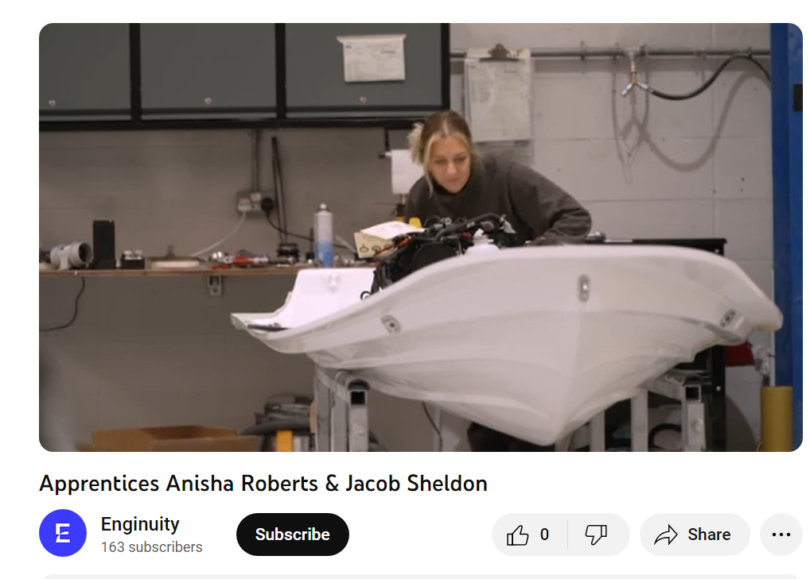
Case Studies
Anisha Roberts, Apprentice at Williams Jet Tenders
‘I love learning new things every single day. I’ve had so many opportunities here I never could have imagined. It’s great. I love coming to work every day.
There’s always a smiling face, some one to ask, some one to help me.’
Jacob Sheldon, Thermal Paint Engineer at Rolls-Royce
‘I’ve been going into schools, talking to young students about STEM subjects and what career they could go into... I went into my old seondary schools to talk to students and parents about apprenticeships.
The work I’ve done over the past four years, I’m really proud of it. It’s been challenging, difficult and trying at times but in the end the work has paid off and the recognition goes a long way.’
CLICK HERE TO WATCH THE VIDEO

Slide 7
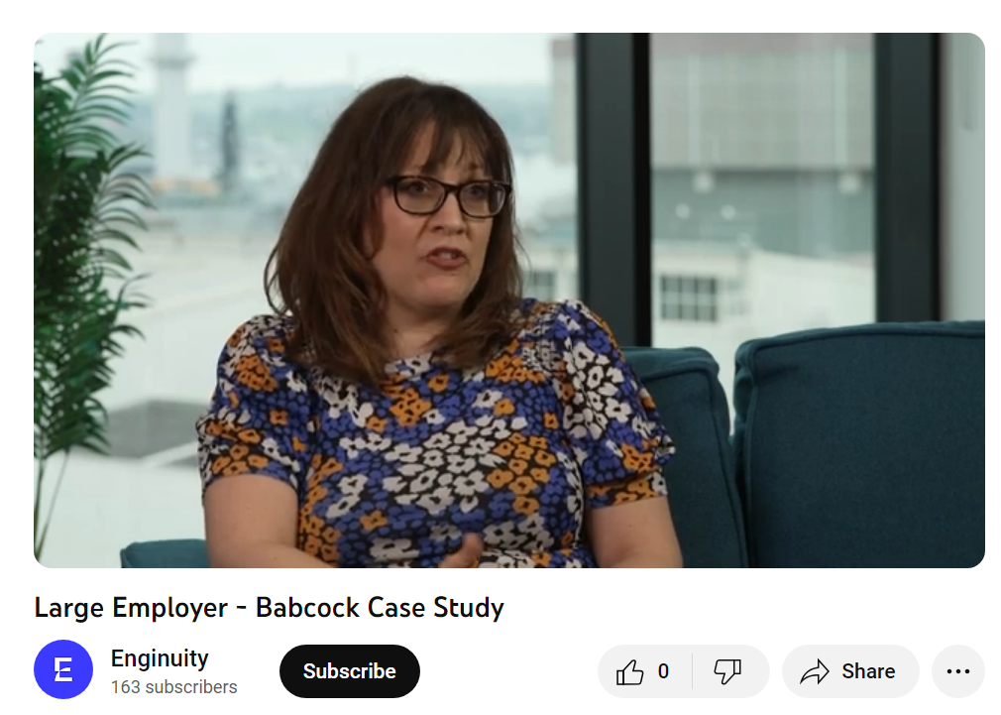
Case studies
Hannah Rose, Regional Early Careers Advisor at Babcock International
‘We attract people by going into local schools to do career talks and fairs. We also have an early careers group/campaign which focuses on our Apprentices. They take part so they can tell their stories and what it means to them.’
Gareth Kenwood, Apprentice Early Careers Advisor at Babcock International
‘The Apprenticeship scheme is really important for Babcock on multiple levels... we need an increasing level of skills and different types of skills in order to meet the needs of our customers... We need to keep up with new technologies and ways of working.
We absolutely see Apprenticeships as the future for what we do.’
CLICK HERE TO WATCH THE VIDEO

Slide 8
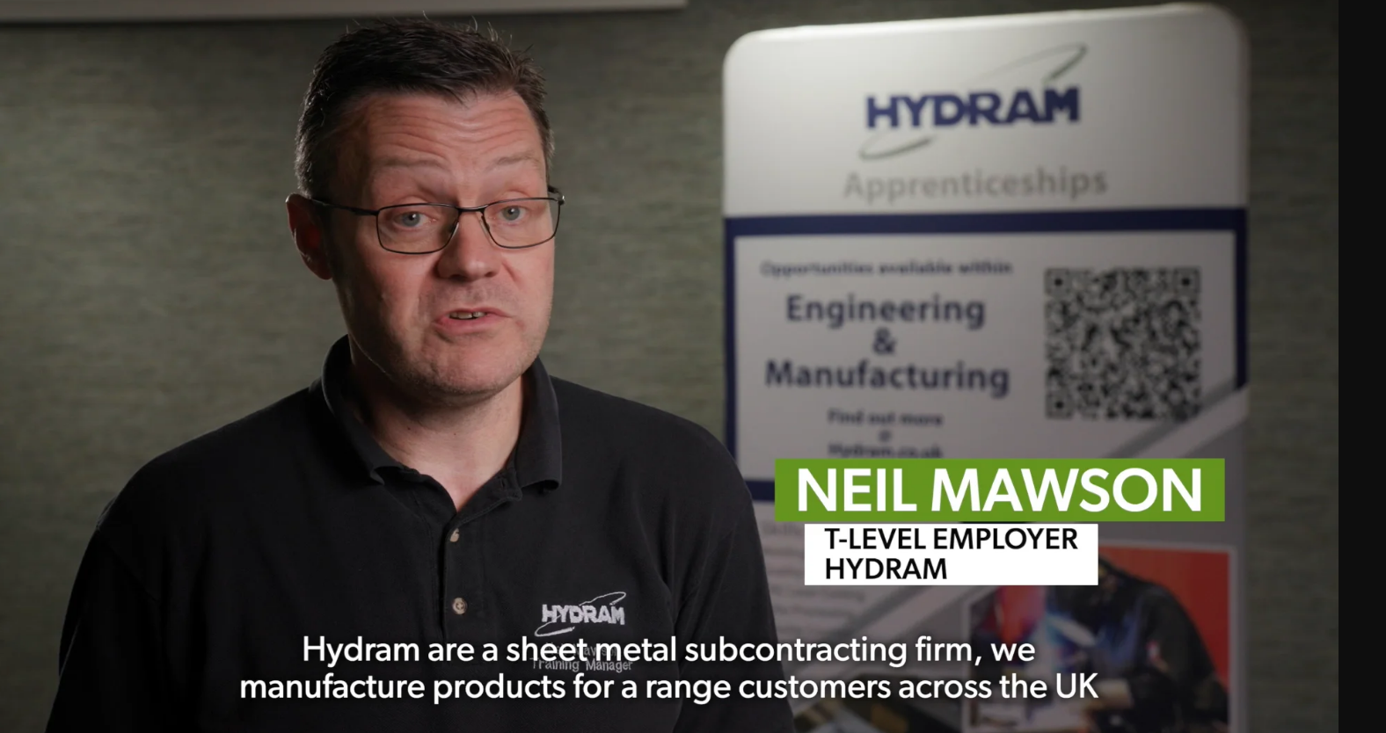
Case studies
Here’s an additional case study on T-Levels, kindly provided by Gatsby and Hydram.
Neil Mawson, T-Level Employer at Hydram
‘Having the T-Level placements on site for a period of time is valuable for us and them. They already know how the equipment works... they’ve been able to gain that experience in a practical manner...
From an employer perspective, T Levels are an important qualification. It acts as a stepping stone between college and employment, provides valuable work skills and it provides the young person incredible insight to work ethic and the world of work.’
CLICK HERE TO WATCH THE VIDEO

Slide 9
AGE
PHASE OF EDUCATION
WHERE
DESCRIPTION
5-7
KS1
7-11
KS2
Primary schools generally have students aged 4 to 11 years, with infant and junior classes. Government has set out a national curriculum for all subjects across Key Stages One to Four, and there are national tests and teacher assessments for students at the end of both Key Stage One and Two.
Primary Education
  Primary Schools
11-14
KS3
14-16
KS4
Secondary Education
Secondary education starts at age 11 and continues until age 16. Students are usually studying GCSE courses, and/or other courses as appropriate (e.g. a technical qualification). Some regions also have middle schools, and a small number of students attend specialist secondary school settings.
  Secondary Schools
16-18
KS5
  Colleges
  School Sixth-Forms
  Training Companies
  Employers
  Charities
Further Education
At this stage young people may undertake a full-time course at college or school sixth-form, such as A Levels or a T Level, or start an apprenticeship or traineeship. They can also combine work or volunteering with part-time study or training. Education or training is compulsory until the age of 18 in England.
18+
Further Education for Adults
Higher Education
  Colleges
  Universities
  Institutes of Technology
  Training Companies
  Employers
Higher education (HE) is education and training at a standard beyond A Levels and T Levels. HE programmes are offered by universities or colleges and vary in size and type. HE can include: Higher Technical Qualifications (including Higher Nationals and foundation degrees), undergraduate degrees, higher apprenticeships and postgraduate courses. Many adults also continue to improve their skills by studying Further Education (FE) courses – from basic skills to technical courses.
Education system at a glance
England and Wales
There are plenty of reasons why businesses should get involved at all stages of the education system. The starting point is understanding the landscape
Notes:
England/Wales, remove if utilising slide deck in Scotland

Slide 10
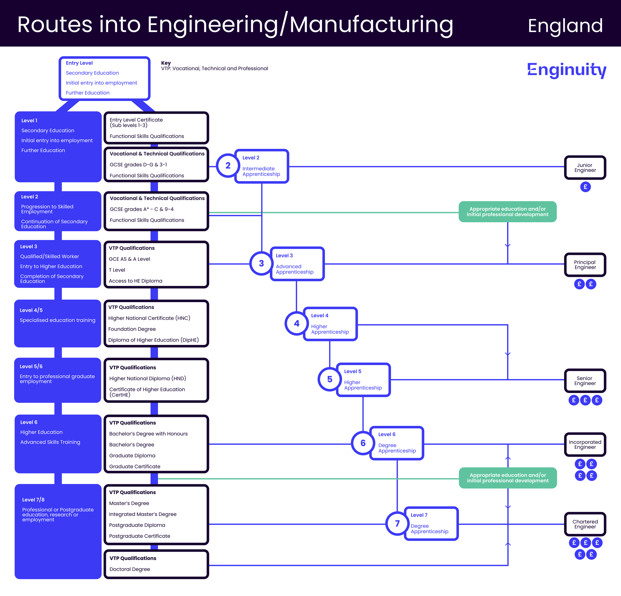
Routes into engineering
England
Notes:
Remove this slide if you are based in Wales or Scotland

Slide 11
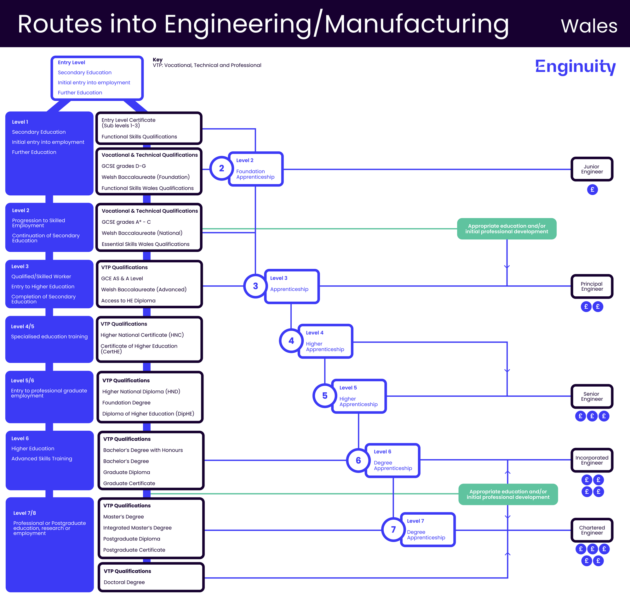
Routes into engineering
Wales
Notes:
Remove this slide if you are based in England or Scotland

Slide 12
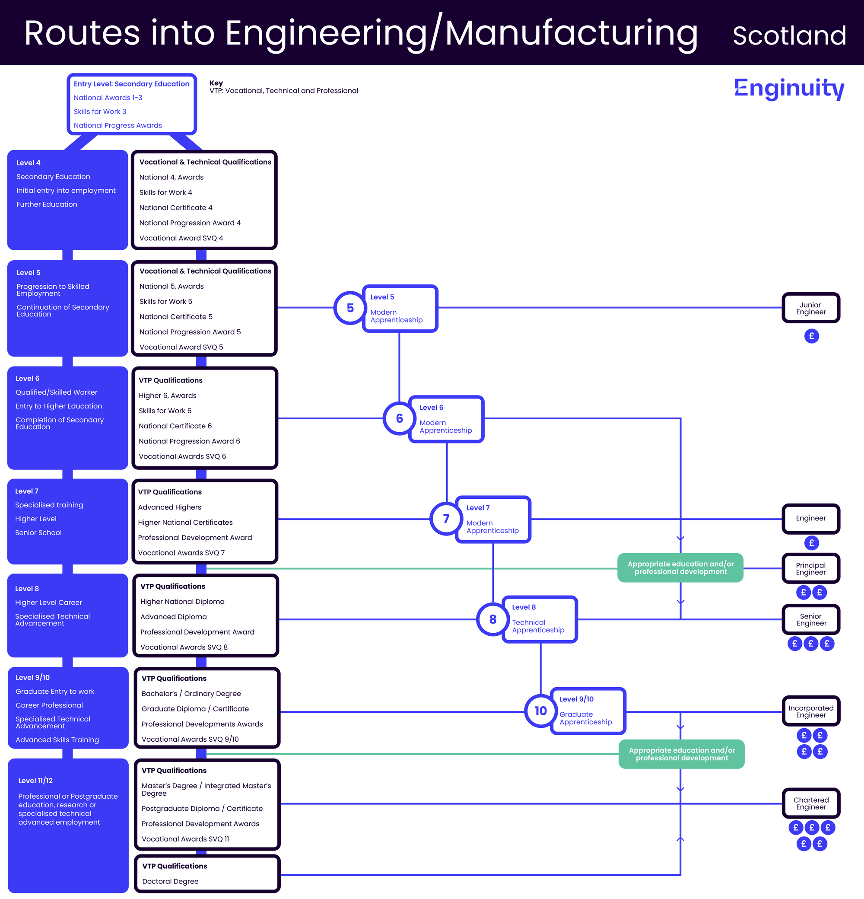
Routes into engineering
Scotland
Notes:
Remove this slide if you are based in England/Wales

Slide 13

Further resources
Enginuity
Our main site: https://enginuity.org
Enspire Site: https://enspire.enginuity.org
Education Landscape
https://educationlandscape.org.uk/
Thank you to Education Landscape for the text contained within slides 2-5 and 8 of this presentation

