Slide 1
Hello, and welcome to today’s webinar!
If you are seeing this screen, you are in the right place, connected with the host, and the host can see you in the Participant list.
After you are connected to the PowerPoint and phone, please:
Put your phone on Mute – if you do not see a mute button on your phone, press *6
Please do NOT put us on Hold ☺
Enter questions in the Chat box
If you see yourself in a video view, press the “X” in the upper right hand corner to close the camera

Slide 2
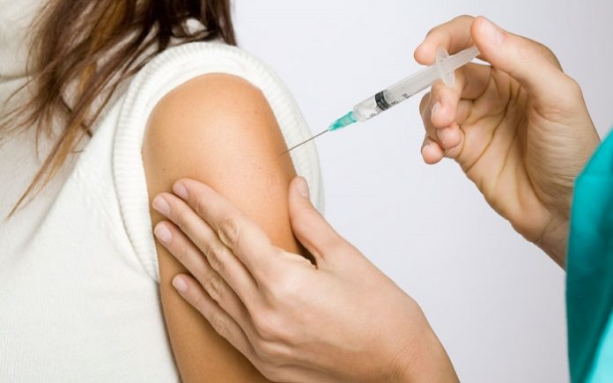
CriticalVAX – Medical Countermeasure Full-Scale Exercise/Real Event 2020-2021 (BPR-5/CRI-6)
Office of Health Emergency Preparedness
Division of Epidemiology
Grants Administration Unit

Slide 3
LHDs Conducting MCM POD/POAs

Slide 4
Agenda
Rationale for MCM POD/POA
Review Objectives
Objectives distributed to preparedness regional reps to send to LHDs
EXPLAN and AAR/IP Template posted on HCS
On Health Commerce System:
My Content → Documents by Group → LHD → Preparedness → Exercises
Details of exercise/real event
Grants Discussion

Slide 5
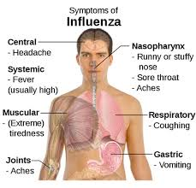
Choice of POD/POAs to Conduct
Seasonal Influenza
OR
COVID-19

Slide 6
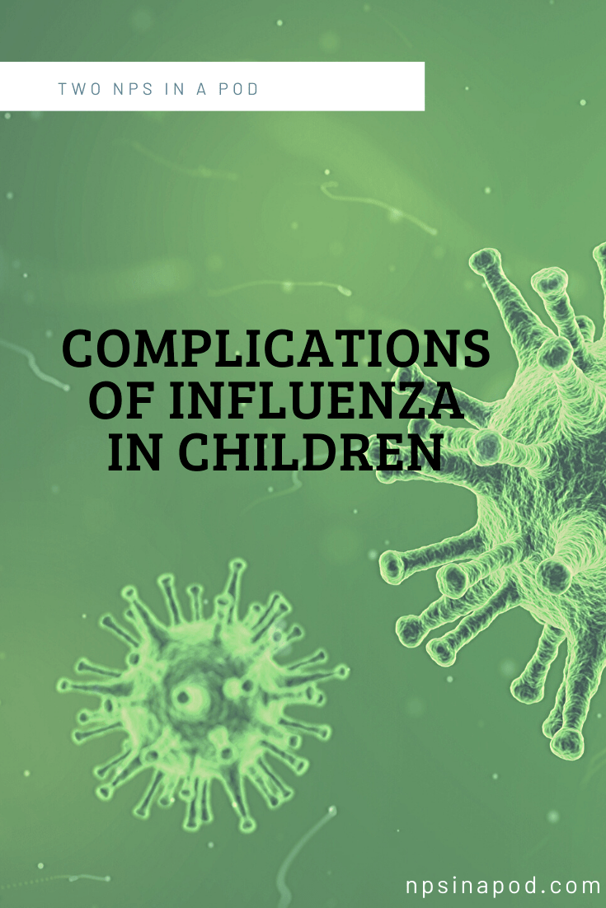
Rationale for Seasonal Influenza
Routine immunization
Prevents disease in individuals, families, and communities
Prevents illnesses that lead to unnecessary medical visits and hospitalizations, further straining the healthcare system

Slide 7
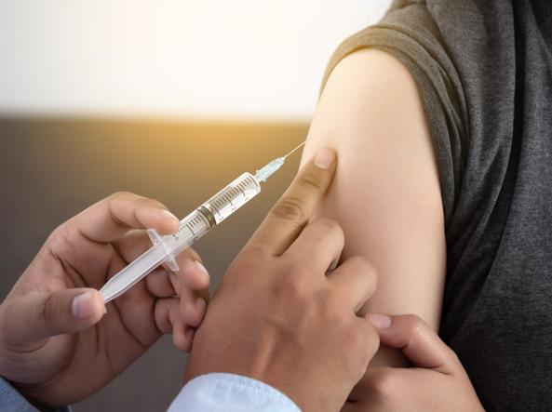
Getting a flu vaccine is
the most important thing you can do to protect yourself, loved ones, and the community, including reducing the risk of serious outcomes that can lead to hospitalization and death.

Slide 8
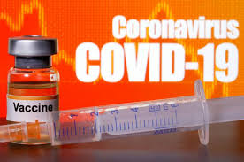
Rationale for COVID-19
Interrupt the transmission of SARS-CoV-2
Best hope to end the pandemic
Provide long-term protection for those
vaccinated
Protect older individuals
Those >50 at higher risk of severe infection
Return to a level of pre-pandemic “normalcy”

Slide 9
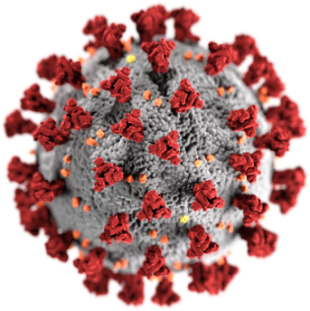
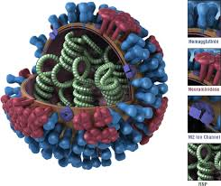
Assumptions for 2020-2021 Seasonal Influenza Season
Expect SARS CoV-2 to continue to circulate
Once COVID-19 vaccine is available
May require 2 doses due to no pre-existing
immunity

Slide 10
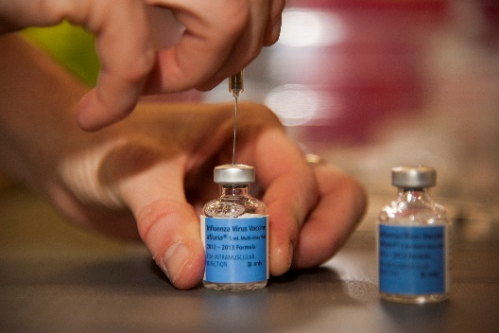
Assumptions for 2020-2021 Seasonal Influenza Season
Maximize available vaccine supply
Expect >190M influenza doses for U.S. Market
Enhanced education and communication
Align with COVID-19 messaging
Messaging for high-risk individuals

Slide 11
Potential Barriers

Slide 12
Potential Barriers for Seasonal Influenza
Fewer worksite vaccination clinics available
People might not feel safe in a clinic or pharmacy setting
In-person clinic visits could be cancelled or moved to telehealth

Slide 13
Potential Barriers for Seasonal Influenza
Concerns about safety of COVID-19 vaccine could translate to more questions about safety of flu vaccine
COVID-19-related unemployment might impact ability to afford flu vaccination

Slide 14
Potential Barriers for Seasonal Influenza
Working parents have limited free time to focus on staying up to date on vaccinations due to work/home schooling/child care responsibilities
People may equate social distancing/masks with no need for a flu vaccine

Slide 15
Potential Barriers for COVID-19
Vaccine hesitancy
Distrust of the safety of a new vaccine
Distrust of the efficacy of a new vaccine
Equating flu vaccine with protection from COVID-19
Vaccine allocation strategy when initial supply is limited

Slide 16
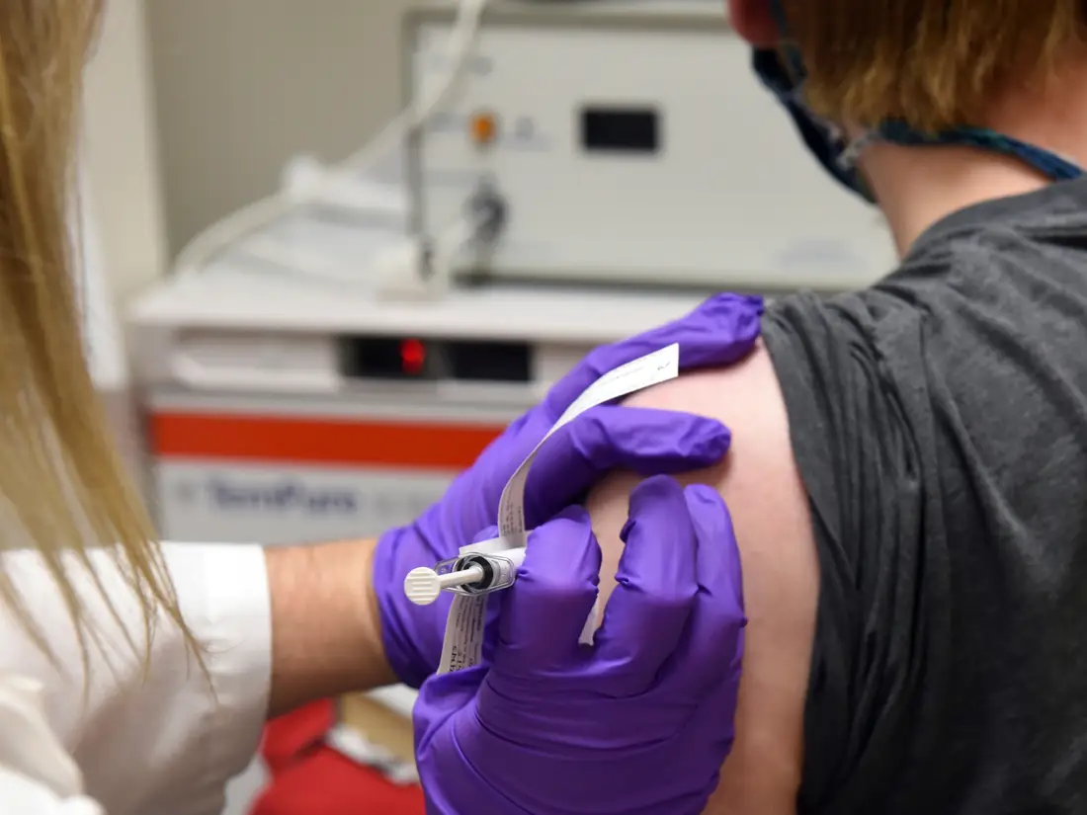
Potential Barriers for COVID-19
False sense of security
Won’t get infected
Even if infected,
symptoms not problematic
enough to seek vaccine
Misinformation about the vaccine
Fear of adverse events
2 dose regimen

Slide 17
Activities for Success

Slide 18
Activities Critical to Successful Influenza Vaccination Season
Coordinated messages on importance
of flu vaccine and vaccine clinic sites
Protocols to ensure patients can be safely vaccinated
Creative approaches to address access/disparity issues and common misperceptions about flu vaccination

Slide 19
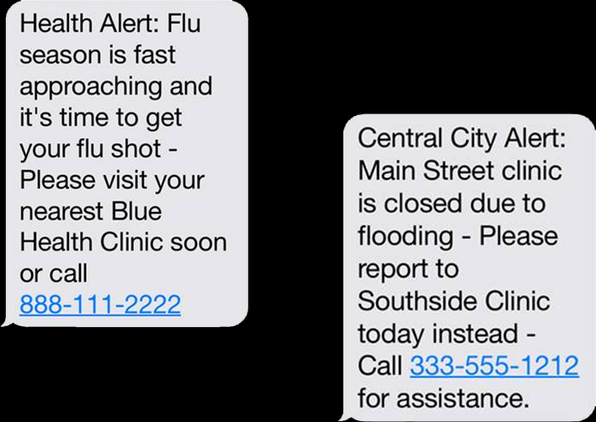
Activities Critical to Successful Influenza Vaccination Season
Information on Medicaid, VFC insurance subsidies, or payment options for those without insurance
Continue vaccination efforts for the duration of flu season

Slide 20
Activities Critical to Successful COVID-19 Vaccination
Set public expectations of what the vaccine can achieve
Not going to prevent all infection, but going to prevent disease
Lower the level of circulating virus
Provide accurate, timely, vetted public education materials

Slide 21
Activities Critical to Successful COVID-19 Vaccination
Continue mitigation strategies (masks, social distancing, hand washing) until critical mass is vaccinated
Continue to test, trace, isolate, and treat
Continue quarantine of travelers from areas with widespread transmission/infections

Slide 22
MCM Full-Scale Objectives

Slide 23
MCM Full-Scale Objectives
Objective 1: Notify and confirm availability of the pre-identified Point of Dispensing /Point of Administration (POD/POA) site within one hour of the decision to activate the site.
Objective 2: Develop a schedule to cover the first two (2) operational periods at least 24 hours prior to the start of POD/POA operations.
Objective 3: Notify and confirm availability of personnel identified to fill roles for the first operational period at least 24 hours prior to the start of POD/POA operations.

Slide 24
MCM Full-Scale Objectives
Objective 4: Ensure that all identified POD/POA staff for first operational period report to the POD/POA within 30 minutes of identified reporting time.
Objective 5: Manage delivery and recovery of the MCM and ancillary supplies to the POD/POA site using the Medical Emergency Response Inventory Tracking System (MERITS) or another inventory system used by the county.
Objective 6: Set up POD/POA (materiel, layout, supplies, stations for staff) within six (6) hours prior to POD/POA operations.
Objective 7: Inform public of dispensing/administration operations, including locations, time period of availability, and method of
delivery at least 48 hours prior to start of POD/POA operations.

Slide 25
MCM Full-Scale Objectives
Objective 8: Activate the Countermeasure Data Management System (CDMS) or other online electronic pre-registration (e.g., eHealth Scheduling) at least 48 hours before POD/POA operations start to allow recipients to register per planned operational periods to support social distancing within the POD/POA.
Objective 9: Ensure that individuals with access and functional needs are provided additional support as requested.
Objective 10: Provide Just-in-Time Training (JITT) to POD/POA staff and volunteers within 24 hours before the start of POD/POA Operations.
Objective 11: Sustain MCM administration operations for three (3) hours and determine hourly throughput based on the throughput for
the specific POD/POA plan for that site.

Slide 26
MCM Full-Scale Objectives
Objective 12: Demonstrate maintaining Cold Chain storage of the MCM in accordance with package instructions and the “Vaccine Storage and Handling Toolkit” (January 2020) throughout entire POD operations.
Objective 13: Simulate/administer MCM to affected population for a three (3) hour dispensing period, and ensure outcomes are recorded in CDMS. (Target: #5 in Health Electronic Response Data System (HERDS) Security Survey for the POD/POA site being exercised).
Objective 14: Provide 100% of recipients with instructions on the procedure for reporting adverse events and medical follow-up immediately after vaccine is administered.

Slide 27
Details and Considerations

Slide 28
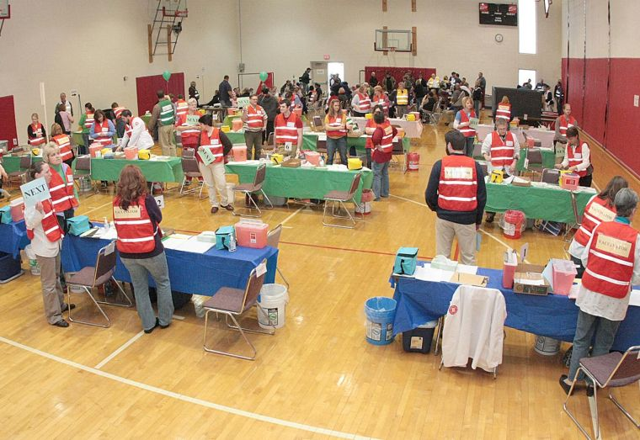
Details for Seasonal Influenza POD/POA
Open POD/POA at a Point of Dispensing/Point of Administration
General Population
Acceptable to use a more focused group, e.g.
Homeless
County employees
Adults over 18
Etc.

Slide 29
Details for COVID-19 POD/POA
Open POD/POA at a Point of Dispensing/Point of Administration
Prioritization will depend on guidance from CDC
May include:
Critical Infrastructure
Nursing homes
Healthcare workers
Individuals at higher risk

Slide 30
Details for Seasonal Influenza POD/POA
Timeframe – 3 hours (without set-up and demobilization)
E.g.:
POD
Demob
Set up

Slide 31
Details for Seasonal Influenza POD/POA
Use of Countermeasure Data Management System (CDMS)
Vaccination, staffing and traffic flow planning
Public registration before Operation
On-site kiosk registration for walk-in vaccine recipients during POD hours
Easy, accurate real-time point-of-care documentation of vaccine or countermeasure administration
Vaccine administration reporting to NYSIIS

Slide 32
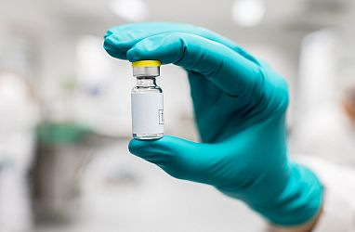
Details for COVID-19 POD/POA
POD/POA timing and details currently unknown
Contingencies include:
- Timing of release of vaccine
- Quantity of vaccine released
- Number of doses required for efficacy
- Prioritization scheme for limited vaccine
Vaccine storage requirements
Administration reporting requirements
Guidance from CDC/other Federal partners
These will all effect POD/POA and CDMS planning

Slide 33
Considerations for Seasonal Influenza AND COVID-19 POD/POAs

Slide 34
Considerations
During the POD/POA, ensure physical distancing and enhanced infection control measures are in place and implemented
CDC/EPA Guidance (https://www.cdc.gov/coronavirus/2019-ncov/community/pdf/Reopening_America_Guidance.pdf)
Cleanse and disinfect vaccination stations at a minimum every hour, between shifts and if station areas become visibly soiled
Ensure all patients and accompanying attendants wear a cloth face covering or face mask that
covers the nose and mouth

Slide 35
Considerations
CDC/EPA Guidance (https://www.cdc.gov/coronavirus/2019-ncov/community/pdf/Reopening_America_Guidance.pdf)
Ensure staff is wearing appropriate PPE.
Ensure supplies such as tissues, hand sanitizer, and wastebaskets are readily accessible throughout the clinic.
If gloves are worn by those administering vaccine, they should be changed, and hand hygiene should be performed between patients.

Slide 36
Considerations
CDC/EPA Guidance (https://www.cdc.gov/coronavirus/2019-ncov/community/pdf/Reopening_America_Guidance.pdf)
Make sure there are signs, barriers, and floor markers throughout the clinic to instruct patients to maintain a 6-foot distance from others, and promote use of hand hygiene, respiratory hygiene, and cough etiquette

Slide 37
Patricia.anders@health.ny.gov
Matthew.wiley@health.ny.gov
David.Casey@health.ny.gov
J’nelle.oxford@health.ny.gov
Marie.Desrosiers@health.ny.gov

