Slide 1

Ex-lege measures FL-EUR conference
Wendy Schrama and Femke de Kievit

Slide 2
Our definition of ex-lege measures
Ex lege representation: an adult protection measure providing legal authority to other persons to act ex lege (by operation of law) on behalf of the adult, requiring neither a decision by a competent authority nor a voluntary measure by the adult.

Slide 3
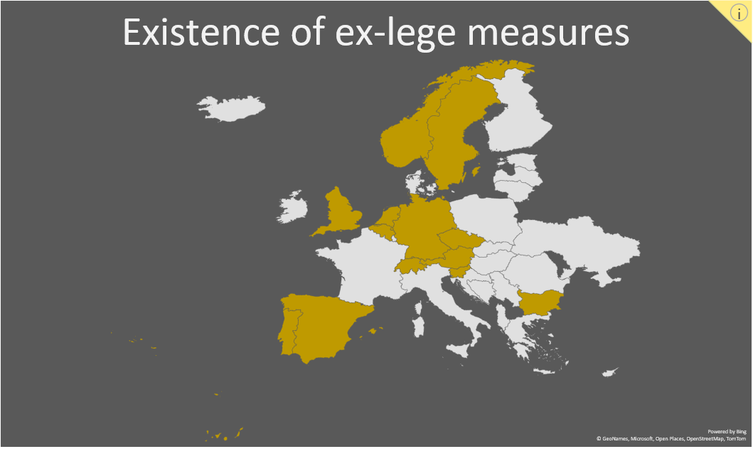
Evidence

Slide 4
Legal ground
Quite some variety, such as ‘mental illness’, ‘mental incapacity’, ‘is not capable of making decisions autonomously’, ‘unconsciousness or illness’, ‘mental and physical impairments’, ‘disability, illness, mental disorder, frailty or similar conditions’
Often ‘the condition’ must result in the inability to take the (specific) legal decisions

Slide 5
Medical evidence required? Registration required?
Yes (in practice) | 3
No | 8
Other/depends | 2
Yes | 2
No | 10
Optional | 1

Slide 6
Who can act as ex-lege representative?
Spouse | Germany, Switzerland
Partner and relatives, prescribed order | Belgium, Bulgaria, Norway, Slovenia, Sweden
Partner and relatives, no order | Austria, Czech Republic?, Netherlands
Also other persons | England&Wales, Spain

Slide 7
Extent of the representation
Care and medical matters | Belgium, England & Wales, Germany, Netherlands, Slovenia, Spain, Switzerland
‘Every day matters’ | Czech Republic, Norway, Spain, Sweden, Switzerland
Broad (financial, administrative, health, court proceedings) | Austria, Bulgaria

Slide 8
Safeguards and supervision
Annual report to the court, information duty | Austria, Spain
Guardianship authority may discharge representative | Bulgaria, Switzerland
No specific supervision | Czech Republic, Portugal, Sweden
Health professional may decide otherwise | Belgium, Netherlands, Slovenia
Other specific safeguards | England & Wales, Germany
Provisions on how representative must act | Belgium, England & Wales, Germany

Slide 9
Questions to reflect on
How does ex-lege representation work in everyday life?
How do legal systems deal with the potential legal unpredictability and third parties?
Given the rising number of informal relationships, systems which only provide for ex-lege representation for formal relationships do not fulfill the ratio of ex-lege representation
Given the demographic changes, will there be a bigger role for the broader social network?
What are the human rights norms for ex-lege measures?

Slide 10
Questions to reflect on
A combination of a broad scope (everyday financial and administrative matters and care and medical issues) with a broad scope of representatives could cover the need for protection and support for many vulnerable adults
Yet, we still know little about abuse, conflicts and third party positions

