Slide 1

Ex lege representation
Comparative insights, models for legislation and preliminary best practices
Prof. Wendy Schrama & dr. Femke de Kievit
FL-EUR conference 2nd May 2025

Slide 2
Contents
What is ex lege representation?
Models for legislative choices
Best practice: Austrian system (by dr. Ingeborg Mottl)
Best practices based on the comparative analysis
Final remarks

Slide 3
What is ex lege representation?
Our definition: an adult protection measure providing legal authority to other persons to act ex lege (by operation of law) on behalf of the adult, requiring neither a decision by a competent authority nor a voluntary measure by the adult.

Slide 4
What is ex lege representation?
Statutory measures
Ex lege representation
Informal representation
Voluntary measures

Slide 5
What is ex lege representation?
Best of both worlds?
Statutory measures
Ex lege representation
Informal representation
Voluntary measures
Protection via various safeguards (supervision e.g.)
Pragmatic (fast, inexpensive, versatile)

Slide 6
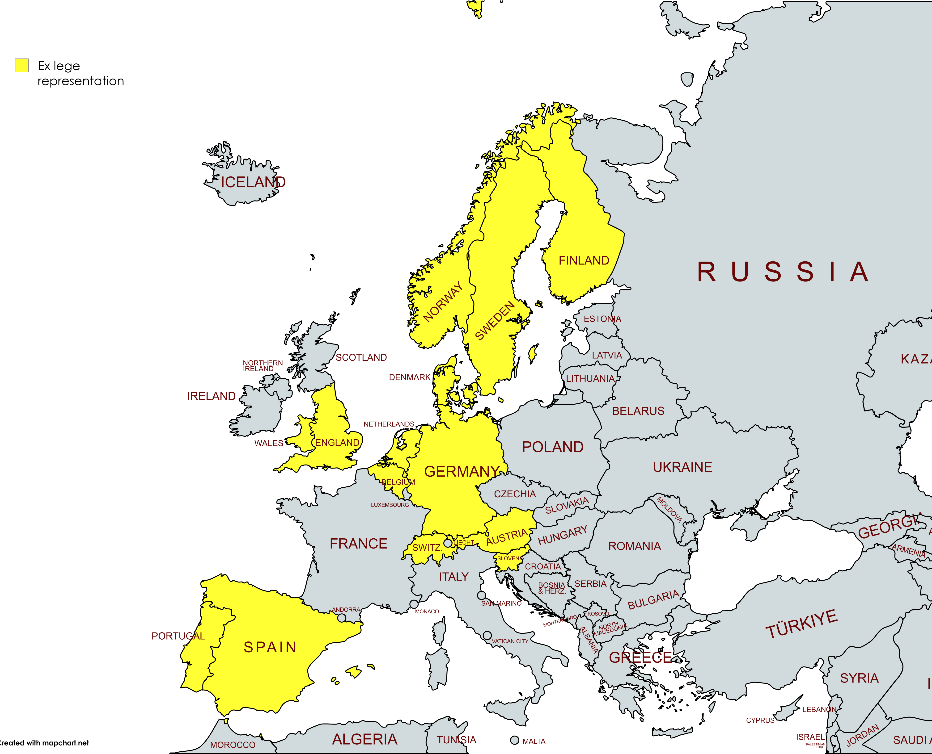
Prevalence of ex lege legislation in Europe
Only ex lege for vulnerable adults
Countries where ex lege is only reported in marital law are excluded
Some qualification issues

Slide 7
Models for legislation: introduction
Comparative insights: wide variety in ex lege provisions on all aspects. No country is the same.
Relevant topics:
  Who can act ex lege?
  What can they do ex lege?
  When can they act ex lege?
  Are there any safeguards protecting adults from undue influences, abuse or conflicts of interest?

Slide 8

Models for legislation: introduction
There are many different choices that exist to regulate ex lege, based on the comparative study;
Choices can be evaluated on how they strike the balance between pragmatism (fast, cheap, versatile and feasible representation) and adequate protection against risks such as abuse, undue influence and conflicts of interest.

Slide 9
Models for legislation: What?
Patiënt rights (informed consent e.g.)
All daily life matters (also financial)
All legal acts
Application for social security benefits
Protection
Pragmatic

Slide 10
Models for legislation: when
Common factor: a form of incapacity meaning that there is a problem which leads to an inability to make decisions;
Operationalization of incapacity is very different per country;
Additional legal grounds beyond the incapacity criterium:
  Risk of harm
  No objection
  Registration a constutive factor

Slide 11
Models for legislation: When
Incapacity + additional requirements such as risk of harm
Mental and physical impairments
Broad incapacity concept (whatever the cause) including old age and frailty
Only mental impairments
Only temporary incapacity
Protection
Pragmatic

Slide 12
Models for legislation: who
Only spouses or (de facto) partners
+ brothers, sisters
+ non-family members such as health care workers or closely connected person
+ (grand)children and (grand)parents
+ nieces, nephews, uncles and aunts
Protection
Pragmatic

Slide 13
Models for legislation: Safeguards
Procedural:
  Medical proof (as constutive factor);
  Registration (as constutive factor);
  Time constricted → ending after three years.
Rights of adult:
  Objection to ex lege (also after it takes effect);
  Excluding persons beforehand.

Slide 14
Models for legislation: Safeguards
Material:
  Forbidden acts (selling house, refusing treatments, contracting with yourself, buying cars, gifting, euthanasia and sterilization);
  Financial means need to be kept apart.
Supervision:
  by courts or authorities (+ obligation to keep the books);
  other third parties such as doctors (derogate from decisions made);
  family members can intervene.

Slide 15
Austrian system by dr. Ingeborg Mottl

Slide 16
Best practice: target group
Ex lege: regulating what in practice de facto already happens within families;
Default form of representation → opting out via a voluntary measure or need for statutory measures in certain situations:
  Family conflict
  Abuse, conflict of interest or undue influence
  Wealthy individuals or own business

Slide 17
Reflection: preliminary best practices
What: broad scope including daily financial matters;
  makes ex lege versatile and future proof;
  Regulating forbidden acts as a best practice
    Selling homes (only with court approval)
    Contracting with yourself
    Gifting (court approval
    More?

Slide 18
Reflection: preliminary best practices
Who: family members (up until the second degree) or closely connected persons;
  Restricting to family is not future proof;
  Assumption that abuse only happens outside the family is not correct;
  A close friend is a better option than a distant cousin.

Slide 19
Reflection: preliminary best practices
When: incapacity meaning being unable to make decisions + additional factors such as risk of harm?
  One of the most pressing question: where do we draw the line and who decides whether the adult crossed that line?;
  Medical situations less problematic because of the involvement of a doctor;
  How does financial ex lege works in practice?

Slide 20
Reflection: things to consider for the future
  How many representatives? And with a hierarchy?
  Who decides when ex lege representation is needed/ takes effect?
  Is it an active right? Or a defensive more passive right?

Slide 21

Discussion

