Slide 1


LA COUNTY OFFICE OF CHILD, YOUTH, AND FAMILY WELL-BEING
Strategic Plan
STRATEGIC PLAN 2025-2030
WELLBEING.LACOUNTY.GOV

Slide 2
Introduction
Ten years ago, the Los Angeles County Office of Child, Youth, and Family Well-Being (OCFW) was created in response to a bold vision: that no child should fall through the cracks of a fragmented system. Today, as we chart our course for the next five years, that vision endures — but the world around us has changed. Families face new challenges, and systems must evolve in kind. This strategic plan reimagines OCFW as a dynamic, cross-systems catalyst focused on child and family wellbeing — one that continues to bridge silos, align partners, and center community wisdom to create upstream, equity-driven solutions for children, families, and communities.
Today, the OCFW is stepping into a reimagined future—one where its role as a strategic hub for advancing LA County’s child and family wellbeing outcomes is clear, focused, and transformative.
Rather than delivering services directly, OCFW convenes, aligns, and catalyzes action across systems to drive upstream, equity-centered solutions that benefit every child and family — not only those already involved in County systems.
Guided by a targeted universalism approach, OCFW implements strategies that lift outcomes for all children, youth, and families in Los Angeles County, with focused interventions for those most impacted by inequity, including those involved in the child welfare system. This means moving beyond crisis response to strengthen prevention, align policies, and build shared responsibility across departments, community partners, and philanthropy.
This plan is both a renewal and a reorientation. It reflects what we have learned over the past decade, incorporates findings from deep listening and data analysis, and anchors us in a forward-looking agenda that repositions OCFW to lead in a time that demands clarity, courage, and collaboration.
This plan clarifies what OCFW is best positioned to lead in order to stay focused, nimble, and impactful. In doing so, it reaffirms OCFW’s purpose: to make the County’s systems work better together before harm occurs, so every child and family can thrive.
WELLBEING.LACOUNTY.GOV
STRATEGIC PLAN 2025-2030

Slide 3

Mission
To lead a broad partnership that implements meaningful solutions to improve the lives of children and families.
WELLBEING.LACOUNTY.GOV
STRATEGIC PLAN 2025-2030

Slide 4

The Office of Child, Youth, and Family Well-Being serves as Los Angeles County’s strategic hub for advancing child and family wellbeing outcomes — aligning systems, supporting upstream prevention, and centering those most impacted to build a more coordinated and compassionate ecosystem.
We envision a future where every child grows up safe, supported, and thriving, and where all families —regardless of their starting point — have what they need to flourish long before crisis occurs.
Vision

Slide 5

STRATEGIC PLAN 2025-2030
LA COUNTY OFFICE OF CHILD, YOUTH, AND FAMILY WELL-BEING
The Office of Child, Youth, and Family Well-Being (OCFW) is Los Angeles County’s strategic hub for advancing child and family wellbeing policies.
We align systems, support upstream prevention, and advance policy and systems change to benefit all LA County children, families, and communities.
Who we are
The Office of Child, Youth, and Family Well-Being reimagined

Slide 6
STRATEGIC PLAN 2025-2030
LA COUNTY OFFICE OF CHILD, YOUTH, AND FAMILY WELL-BEING
Core Values
SHARED RESPONSIBILITY
TRANSPARENCY + INTEGRITY
EQUITY
We believe responsibility for child and family wellbeing is collective. We work across agencies, systems, and communities to create coordinated, root-cause solutions and hold ourselves accountable for meaningful outcomes.
We act with honesty, openness, and clarity, ensuring that our processes and decisions are accessible and accountable to our Board of Supervisors, systems partners, and most importantly, the children, families, and communities we serve.
Our work is anchored by the Racial Equity Principles articulated in the County’s Racial Equity Strategic Plan. We embed the countywide guiding equity principles and strategies in our work and across our focus areas by using data to effectively assess and communicate equity needs; emphasizing a promotion and prevention framework to serve families as upstream as possible; and developing and implementing strategies that prioritize and effectively support the most disadvantaged populations and communities.
GENERATIVE SERVICE DELIVERY
CHILD-CENTERED AND FAMILY- FOCUSED
We facilitate interagency collaboratives to ensure that service delivery to children and families addresses multiple issues based on actual needs after uncovering root causes.
We consider the impact of policy implementation through the eyes of children and families and are committed to supporting a continuum of care that is both preventative and provides long-term support.

Slide 7
STRATEGIC PLAN 2025-2030
Our impact to date
  Directly funded or secured funding for multiple prevention programs that deliver direct services to children, youth, and families:
  Secured over $88 million in new funding for prevention, home visiting, and early care/education
  Provided $6 million to County departments for prevention and promotion programming
  Provided $5 million to the County’s Prevention and Aftercare Networks
  Secured over $14 million in public and private funding for Creative Wellbeing services
  Secured over $4 million in substance use prevention and support services for youth and families
  Secured over $3 million for transportation to school-of-origin for children in foster care
  Provided $2 million to develop the award-winning Emergency Response Investigation Service (ERIS) application, giving social workers faster access to data during child abuse investigations
  Provided $4.5 million to support capacity building for the County’s prevention and promotion framework
OCFW drives system-wide change so children and families are better supported, safer, and more connected. A summary of our work to date and past achievements can be found on our website. Some highlights include:
  Completed or implementing all 51 Blue Ribbon Commission on Child Protection’s systems improvement recommendations under OCFW’s purview
  41% decrease in the rate of children in foster care in LA County since OCFW’s creation in 2015
  Developed or improved 19 large-scale County programs or initiatives that provide direct services to children, youth, and families in prevention, education, health and behavioral health, and wellbeing
  Led 18 multi-year, multi-agency systems improvement collaboratives that improved service delivery for children, youth, and families

Slide 8

STRATEGIC PLAN 2025-2030
LA COUNTY OFFICE OF CHILD, YOUTH, AND FAMILY WELL-BEING
The Office of Child, Youth, and Family Well-Being (OCFW) was established in 2015 in response to the LA County Blue Ribbon Commission on Child Protection’s call for stronger communication, coordination, and accountability across County systems. Since then, OCFW has worked to align efforts across systems partners and community stakeholders while keeping children and families at the center of policy and practice improvements.
Today, OCFW’s role as a convener, problem solver, and implementer of cross-systems solutions is more critical than ever — we continue to help the County move upstream and shift resources toward prevention in the face of complex challenges.
Importantly, the reimagined OCFW will continue to build upon its strong foundation of utilizing a prevention lens to support the wellbeing of children, youth, and families. By fostering a more coordinated, equitable, and effective network of support, OCFW helps ensure every family can thrive.
Why this work matters

Slide 9
Our role
Convene and Align Systems
Advance Policy & Systems Reform
Use Data Strategically
Launch and Incubate Innovation
Strengthen Communications and Engagement
We coordinate across County departments, community partners, and philanthropy to build a seamless ecosystem of support.
We drive policy change and program improvements that address root causes and strengthen public systems.
We track shared outcomes and foster accountability to ensure systems are improving — together.
We pilot bold, cross-sector solutions and transition them to long-term owners for scale.
We develop shared language, messaging, and learning strategies that build awareness and alignment across systems and stakeholders.
WELLBEING.LACOUNTY.GOV
STRATEGIC PLAN 2025-2030

Slide 10

Our 2025-2030 focus areas
Building community pathways to upstream prevention and promotion supports and services for families.
Enhancing the Children and Youth System of Care partnership.
Improving behavioral health and health outcomes for children and youth.
WELLBEING.LACOUNTY.GOV
STRATEGIC PLAN 2025-2030

Slide 11

Our strategies
Focus Area 1: Build community pathways to upstream prevention and promotion supports
ADVANCE COMMUNITY PATHWAYS AND PREVENTION
  Implement the Community Pathways vision to ensure that families are connected to the right resources that meet their goals, needs, and culture within their own communities in order to minimize their chances of touching the child welfare system or other crisis systems.
GROW RESOURCES AND CAPACITY
  Build the capacity of County and community partners to draw down and braid new funding sources efficiently and effectively to grow community-based supports.
INCREASE ACCESS AND IMPROVE NAVIGATION
  Work with County and community partners to ensure children, youth, and families can easily access and navigate the resources they need.
LIFT UP COMMUNITY EXPERTISE
  Act as a liaison between County and community partners to help community-based organizations build capacity and expertise as they are a critical piece of the child and family wellbeing network.
  Serve as a feedback loop between community and County systems, lifting up community and lived expertise to identify barriers and solutions for high-need populations.
BRIDGE SYSTEMS AND SUPPORTS
  Serve as a bridge between community, community-based providers, and child and family-serving County departments to ensure a strong continuum of supports and services for families.
Focus Area 1: Build community pathways to upstream support

Slide 12
Our strategies
Focus Area 2: Enhancing the Children and Youth System of Care
IMPROVE INFORMATION SHARING
  Ensure legally permissible information that is relevant to child safety and wellbeing (education, health records, etc.) is shared electronically by those who need it to inform and tailor services for each youth impacted by the child welfare system.
BUILD LASTING SUPPORT SYSTEMS
  Champion collaboration across County and community partners to ensure that no youth who transitions out of care leaves the system without a permanent family or a responsible caring adult in their lives, or the supports they need to thrive.
MEASURE IMPACT
  Track outcomes for system-involved youth to determine the efficacy of County intervention and programming. Utilize data to continually assess how the County can strengthen supports for youth impacted by systems.
STRENGTHEN SYSTEM CAPACITY
  Build capacity across System of Care partners so that we have a robust continuum of care for children and youth, particularly those who are systems-impacted.
COORDINATE SERVICES
  Create a structure that promotes good communication and coordination of education, employment, health, as well as traditional and non-traditional behavioral health services across County departments assisting children and families once they become known to the child welfare system, especially for youth with complex needs.
DRIVE CONTINUOUS IMPROVEMENT
  Provide oversight of the child welfare system to ensure continuous system improvement.
  Conduct independent reviews of child fatalities/near fatalities with a systems improvement lens.
Focus Area 2: Enhancing the children and youth system of care

Slide 13
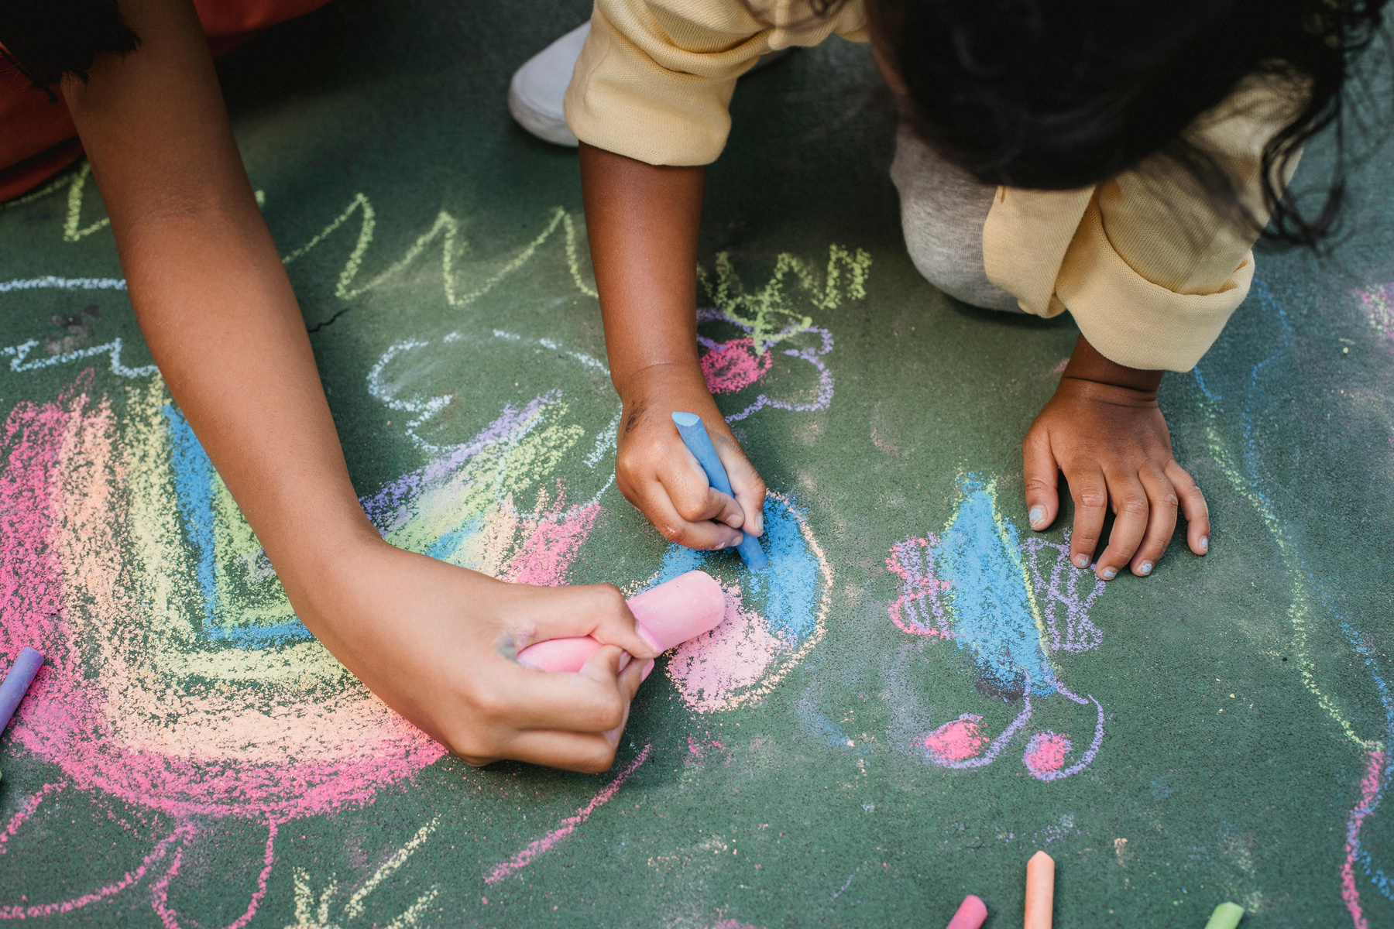
Our strategies
Focus Area 3: Improving youth behavioral health and health outcomes
Lead County efforts to build the expertise and partnerships necessary to:
MAXIMIZE RESOURCES
  Maximize behavioral health and health funding and policy changes that can benefit children, youth, and families.
ADVANCE WHOLE-CHILD AND WHOLE-FAMILY CARE
  Ensure a whole-child and whole-family approach to meeting the health and behavioral health needs of children and youth served by the County, particularly those involved in the child welfare system.
ALIGN POLICIES & ADVOCACY
  Strengthen alignment of behavioral health/health policies with child welfare policies, and advocate as needed with federal, state, and managed-care plan partners to support effective implementation.
Focus Area 3: Improving youth behavioral health and health outcomes

Slide 14

STRATEGIC PLAN 2025-2030
How will we know we’re successful?
UNDERSTANDING THE SYSTEM WE ARE SHIFTING
OCFW’s work is systems change: reshaping the structures and conditions that hold problems in place. Systems change is complex, takes time, and cannot be measured by a single indicator.
Drawing from FSG’s Water of Systems Change, we know progress happens when conditions shift across policies, practices, relationships, power dynamics, and mental models.
DEFINING WHAT WE WANT TO LEARN
We can track progress by asking:
  Are partners working together in new and better ways?
  Are policies and funding moving to support whole-child/whole-family care in flexible and sustainable ways?
  Are communities and families shaping solutions?
  Are narratives about child and family wellbeing shifting toward equity and prevention?
  Are children and families better off as a result?

Slide 15

Conclusion
OCFW is transforming how LA County supports children and families — moving upstream, centering our most vulnerable populations, and aligning systems. This plan builds on past progress and sets a clear path forward: a coordinated network where every child is safe, supported, and able to thrive.
WELLBEING.LACOUNTY.GOV
STRATEGIC PLAN 2025-2030

Slide 16

Acknowledgements
This Strategic Plan reflects the dedication of so many who believe in a brighter future
for LA County’s children and families:
OCFW Staff
Judge Michael Nash (Ret.)
Minsun Meeker
Alaina Moonves-Leb
Barbara Lundqvist
Stefanie Gluckman
Dr. Ramona Merchan
Elizabeth Koenig
Evelyn Hughes
Board of Supervisors’ Offices
Anthony Cespedes
    SD 1, Supervisor Hilda L. Solis
LaJuannah Hills
    SD 2, Supervisor Holly J. Mitchell
Elizabeth Shuster & Savannah Portillo
    SD 3, Supervisor Lindsey P. Horvath
Maral Karaccusian & Nick Holden
    SD 4, Supervisor Janice Hahn
Monica Banken
    SD 5, Supervisor Kathryn Barger
Strategic Planning & Writing
Fractal Strategies
    Debbie Sheen, Breanna Hawkins, & Camille de la Vega
Big Orange Splot, Inc.
    Rochelle Alley
County Departments & Stakeholders
Chief Executive Office
  Anti-Racism, Diversity, and Inclusion Initiative
  Center for Strategic Partnerships
  Chief Information Office
  Homeless Initiative
  Poverty Alleviation Initiative
Commission for Children and Families
Department of Arts and Culture
Department of Children and Family Services
Department of Health Services
Department of Mental Health
Department of Public Health
Department of Public Social Services
Executive Office of the Board of Supervisors
LA County Office of Education
Prevention and Promotion Systems Governing Committee
Youth Commission
System of Care partners and other County commissions and initiatives
Community Stakeholders
Thank you to our many community partners – community-based providers, advocates, philanthropy, managed care plans, school districts, First 5 LA, researchers, community leaders, and people with lived expertise – for their thought partnership and input during our strategic planning process.

Slide 17
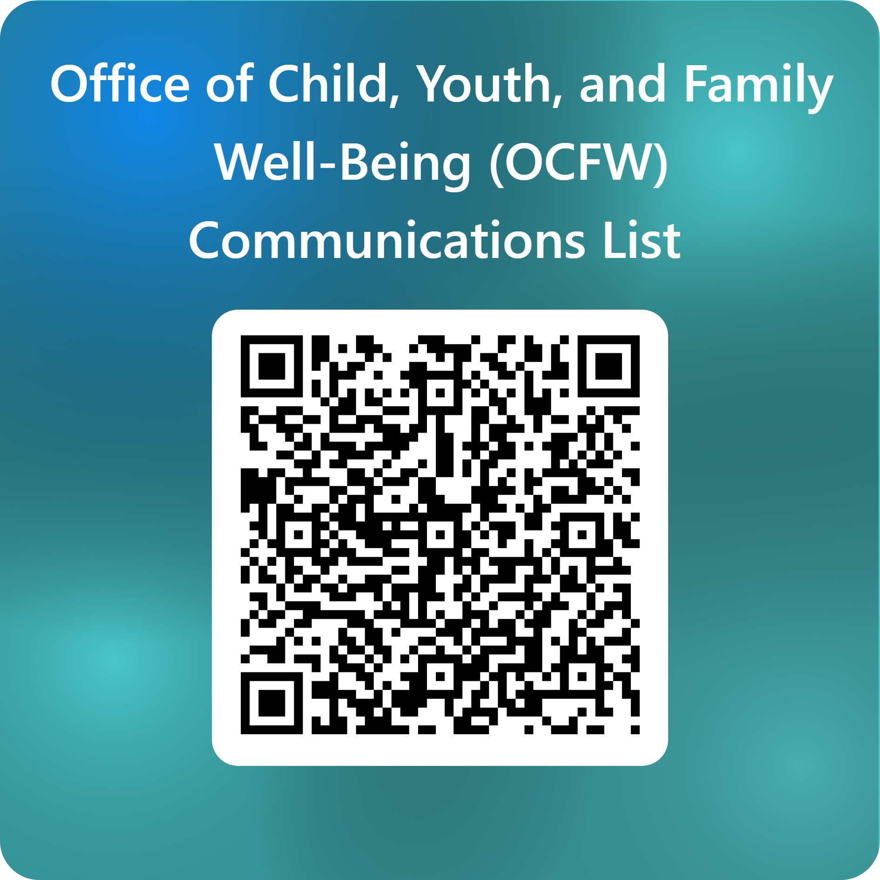
Stay connected.
INFO@WELLBEING.LACOUNTY.GOV
500 WEST TEMPLE ST, ROOM B-26,
LOS ANGELES, CA 90012
WELLBEING.LACOUNTY.GOV
EMAIL
ADDRESS
WEBSITE
SIGN UP FOR OCFW COMMUNICATIONS

