Slide 1

VIRTUAL TRAINING SERIES
Policy Priorities and Legislative Docket Development Process
November 19, 2020
10:00 am – 11:30 am
Via Cisco WebEx
Presented by Public Policy Co-Chairs, Lee Kochems and Katja Nelson

Slide 2
Learning Objectives
Learn about the functions of the Public Policy Committee and how the COH’s policy priorities and legislative positions are developed.
Learn about the Board of Supervisors guidance for Commissions on taking positions on legislative bills.

Slide 3
A Few Requests
The training will be recorded and posted on the Commission on HIV website.
Please hold all questions and comments at the end of the presentation.
You may type your questions and comments in the Chat.
If we are not able to answer all the questions during the allotted time for this virtual training, staff will post answers on the website.

Slide 4
What is policy?

Slide 5

“Public policy” and “policy”: laws, regulations, and executive orders at different levels of government in the United States.
Source: https://climaterealityproject.org/blog/government-101-what-public-policy. Accessed 10/20/20

Slide 6





Examples of Public Health Policies

Slide 7

Examples of Commission on HIV Policy Accomplishments
HIV Names Based Reporting
CD4 Reporting
Ryan White Reauthorizations
Affordable Care Act/1115 Waiver
Local funding for STD response
Medical Care Coordination expansion
Continued advocacy for syringe exchange programs, housing, health equity, and civil rights
Facilitated community meetings and panels on HIV/STD control in the adult film industry
This Photo by Unknown Author is licensed under CC BY-ND

Slide 8
Public Policy Committee
Responsibilities

Slide 9
Public Policy Committee
Resources. Since some PP Committee activities may be construed as outside the purview of the Ryan White Part A or CDC planning bodies, resources other than federal funds cover staff costs or other expenses used to carry out PP Committee activities.

Slide 10
Public Policy Committee Responsibilities
A. Advocating public policy issues at every level of government that impact Commission efforts to implement a continuum of HIV services or a service delivery system for Los Angeles County, consistent with the comprehensive HIV plan;
B. Initiating policy initiatives that advance HIV care, treatment and prevention services and related interests;
C. Providing education and access to public policy arenas for the Commission members, consumers, providers, and the public;

Slide 11
Public Policy Committee Responsibilities
D. Facilitating communication between government and legislative officials and the Commission;
E. Recommending policy positions on governmental, administrative, and legislative action to the Commission, the BOS, other County departments, and other stakeholder constituencies, as appropriate;

Slide 12
Public Policy Committee Responsibilities
F. Advocating specific public policy matters to the BOS, County departments, interests and bodies, and other stakeholder constituencies, as appropriate;
G. Researching and implementing public policy activities in accordance with the County’s adopted legislative agendas;
H. Advancing specific Commission initiatives related to its work into the public policy arena; and
I. Carrying out other duties and responsibilities as assigned by the Commission or the BOS.

Slide 13
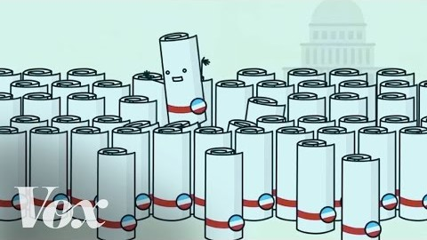
How a bill really becomes a law: What Schoolhouse Rock missed

Slide 14
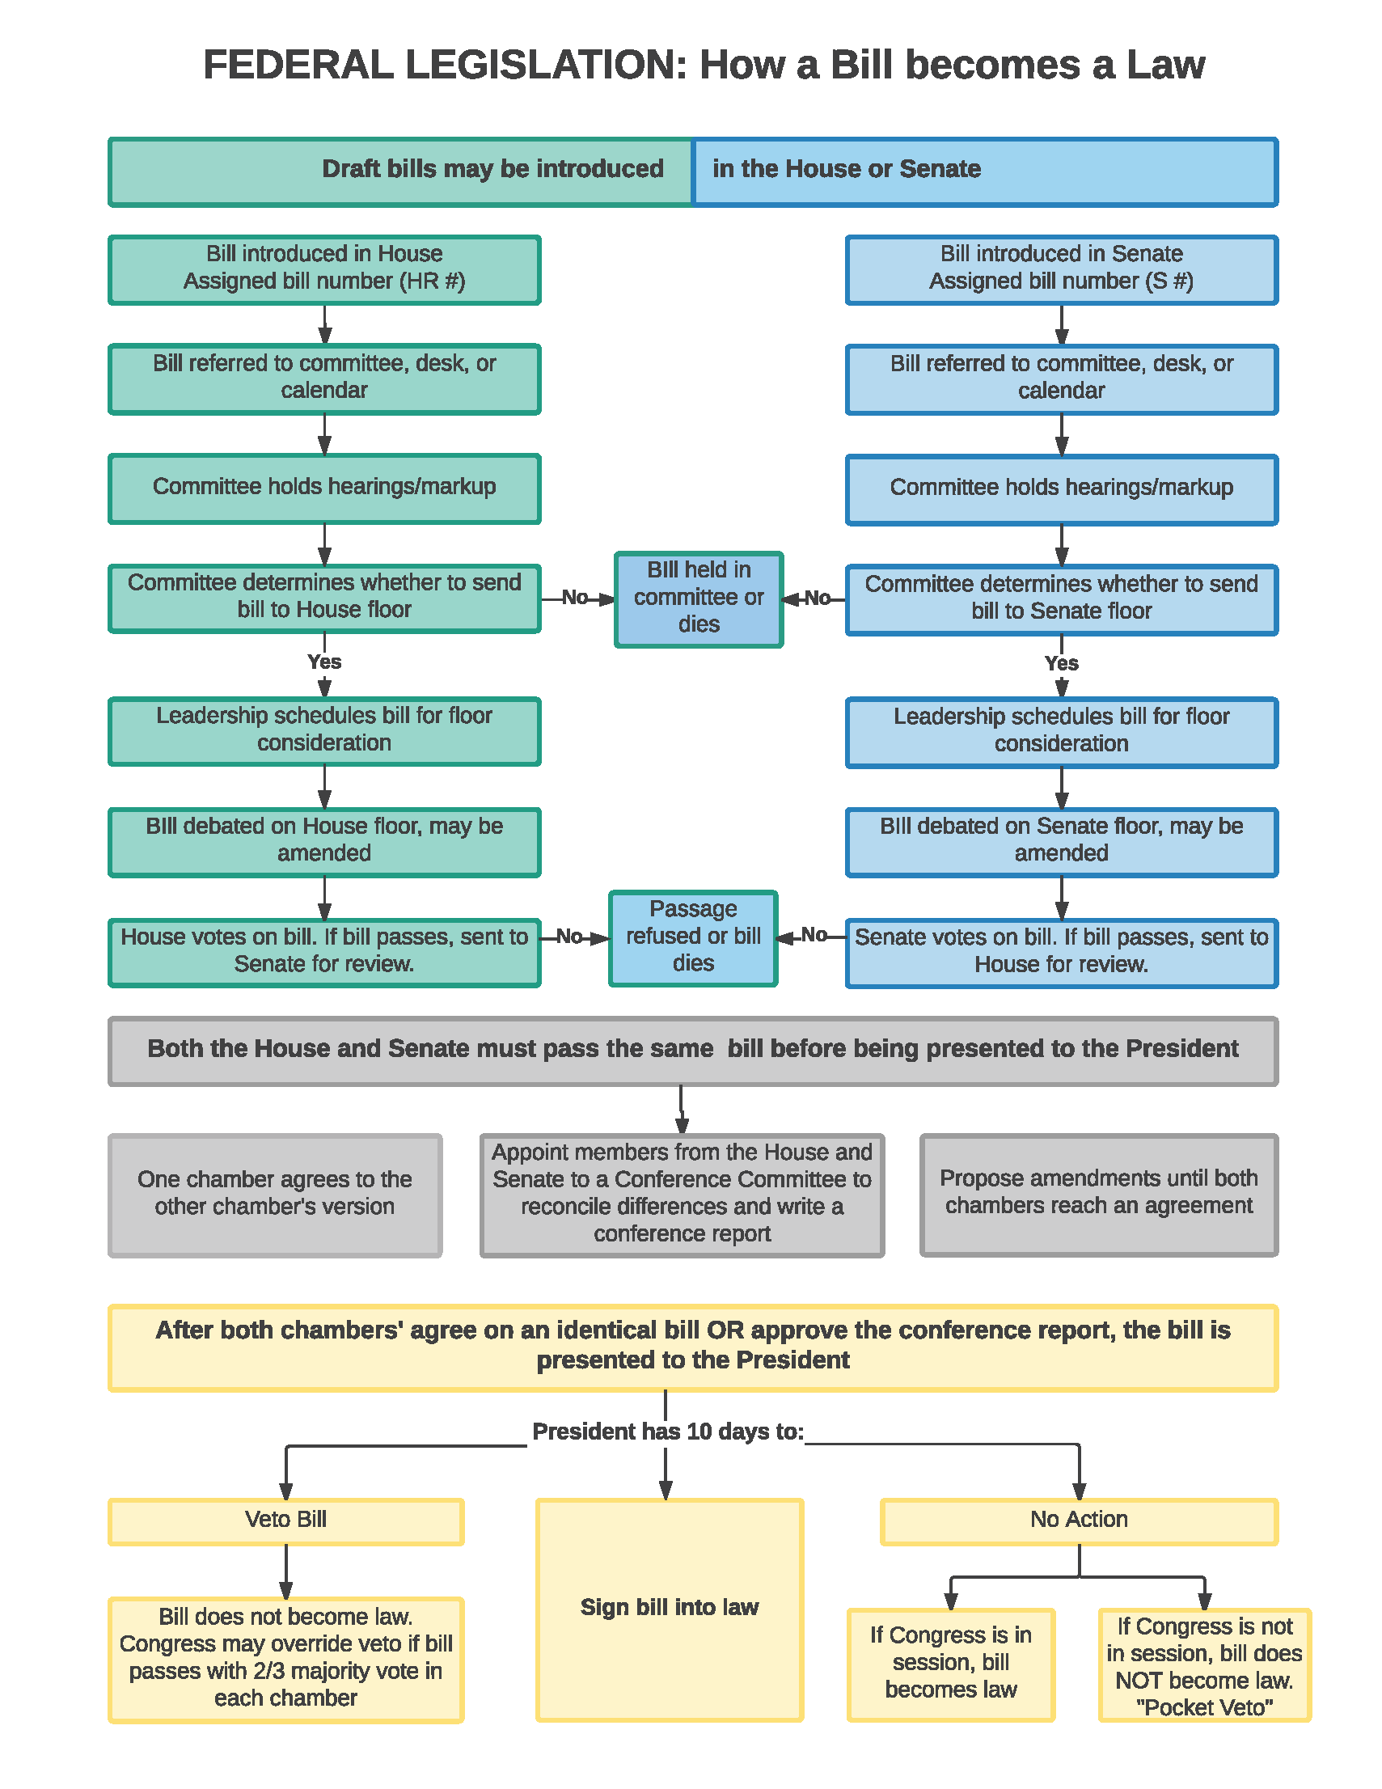

Slide 15
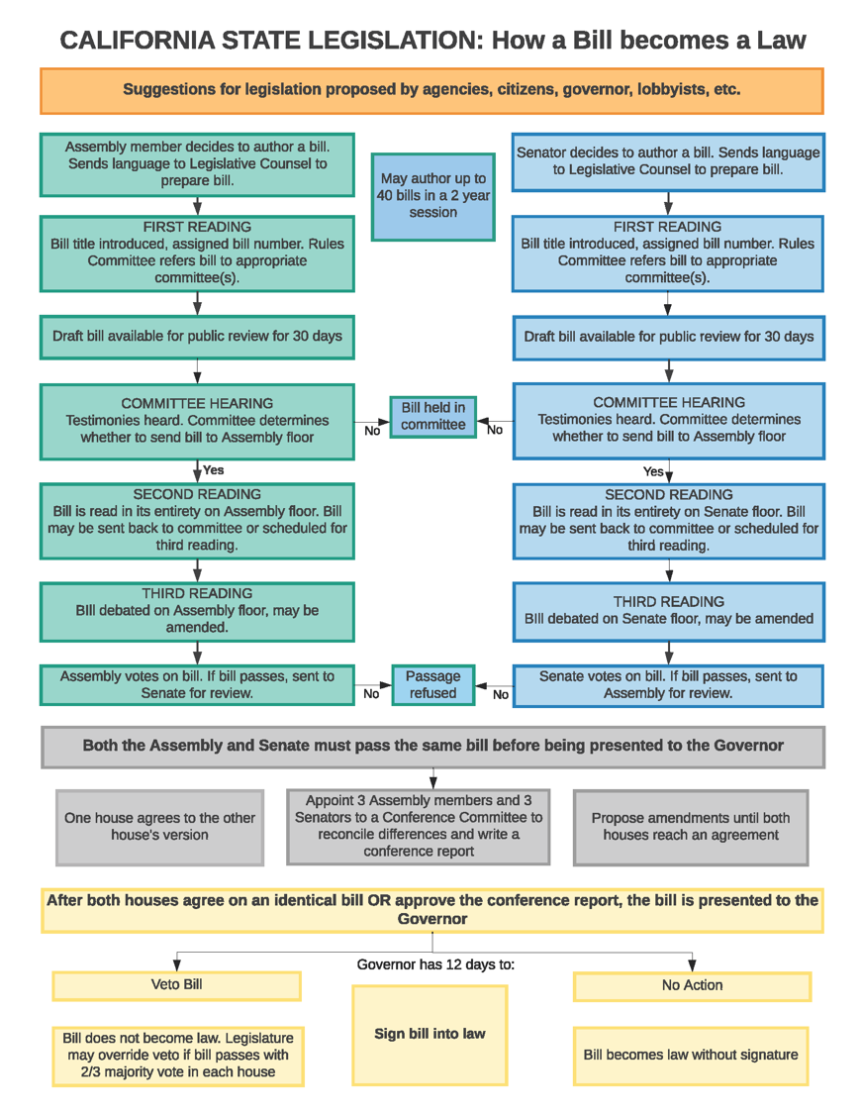

Slide 16
Board of Supervisors Guidance for Commissions on Taking Positions on Legislative Bills

Slide 17
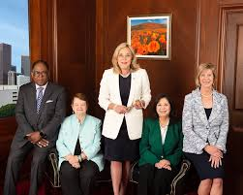
Only the Board of Supervisors (BOS) set policy for the County.
County commissions and other advisory bodies may make recommendations and subject to review and approval by the CEO’s Legislative Affairs Office.

Slide 18
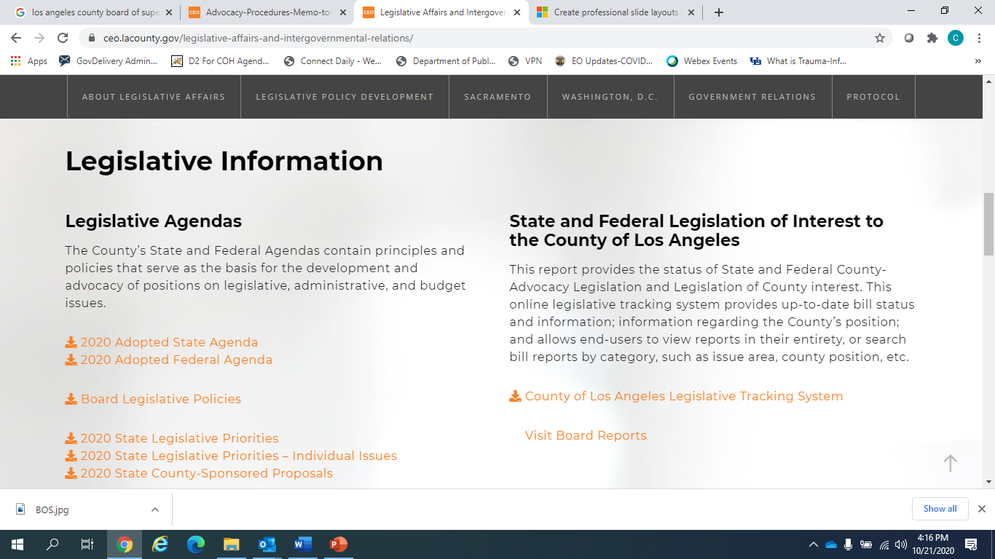
BOS Legislative Agendas
https://ceo.lacounty.gov/legislative-affairs-and-intergovernmental-relations/
Notes:
Note to Katja and Lee: To show audience where BOS leg agendas are posted

Slide 19
How the COH’s Policy Priorities are Developed

Slide 20
Policy Priorities
Guide and focus the Committee’s selection of policy issues to discuss and champion
Ensures that community needs are the focus of policy deliberations
Aligned with service priorities set the Commission through the priority setting and resource allocations process
Broadly worded to allow for swift actions and response to rapidly changing political environment

Slide 21
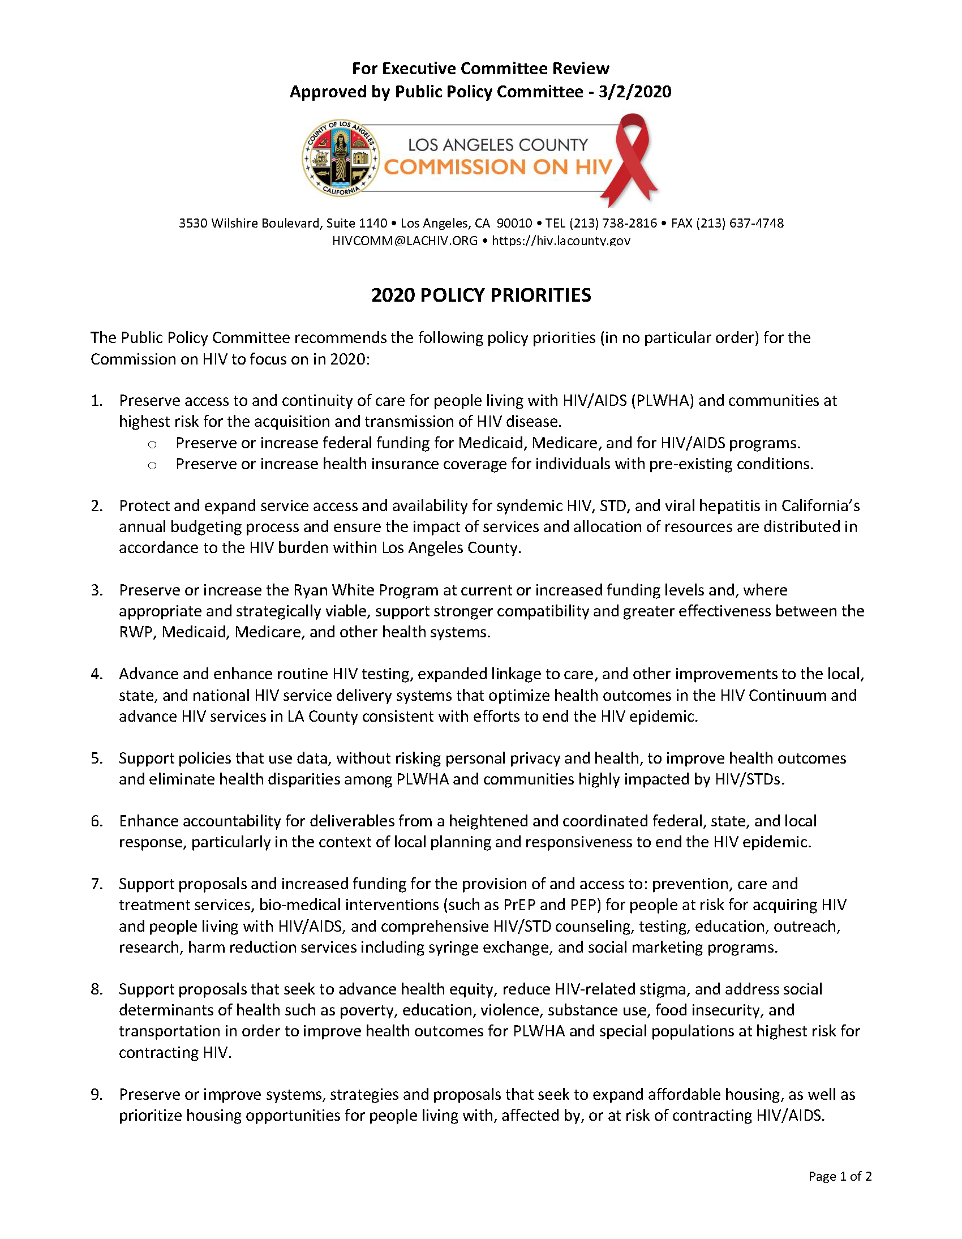
Notes:
Note to Katja and Lee: for illustration purposes

Slide 22
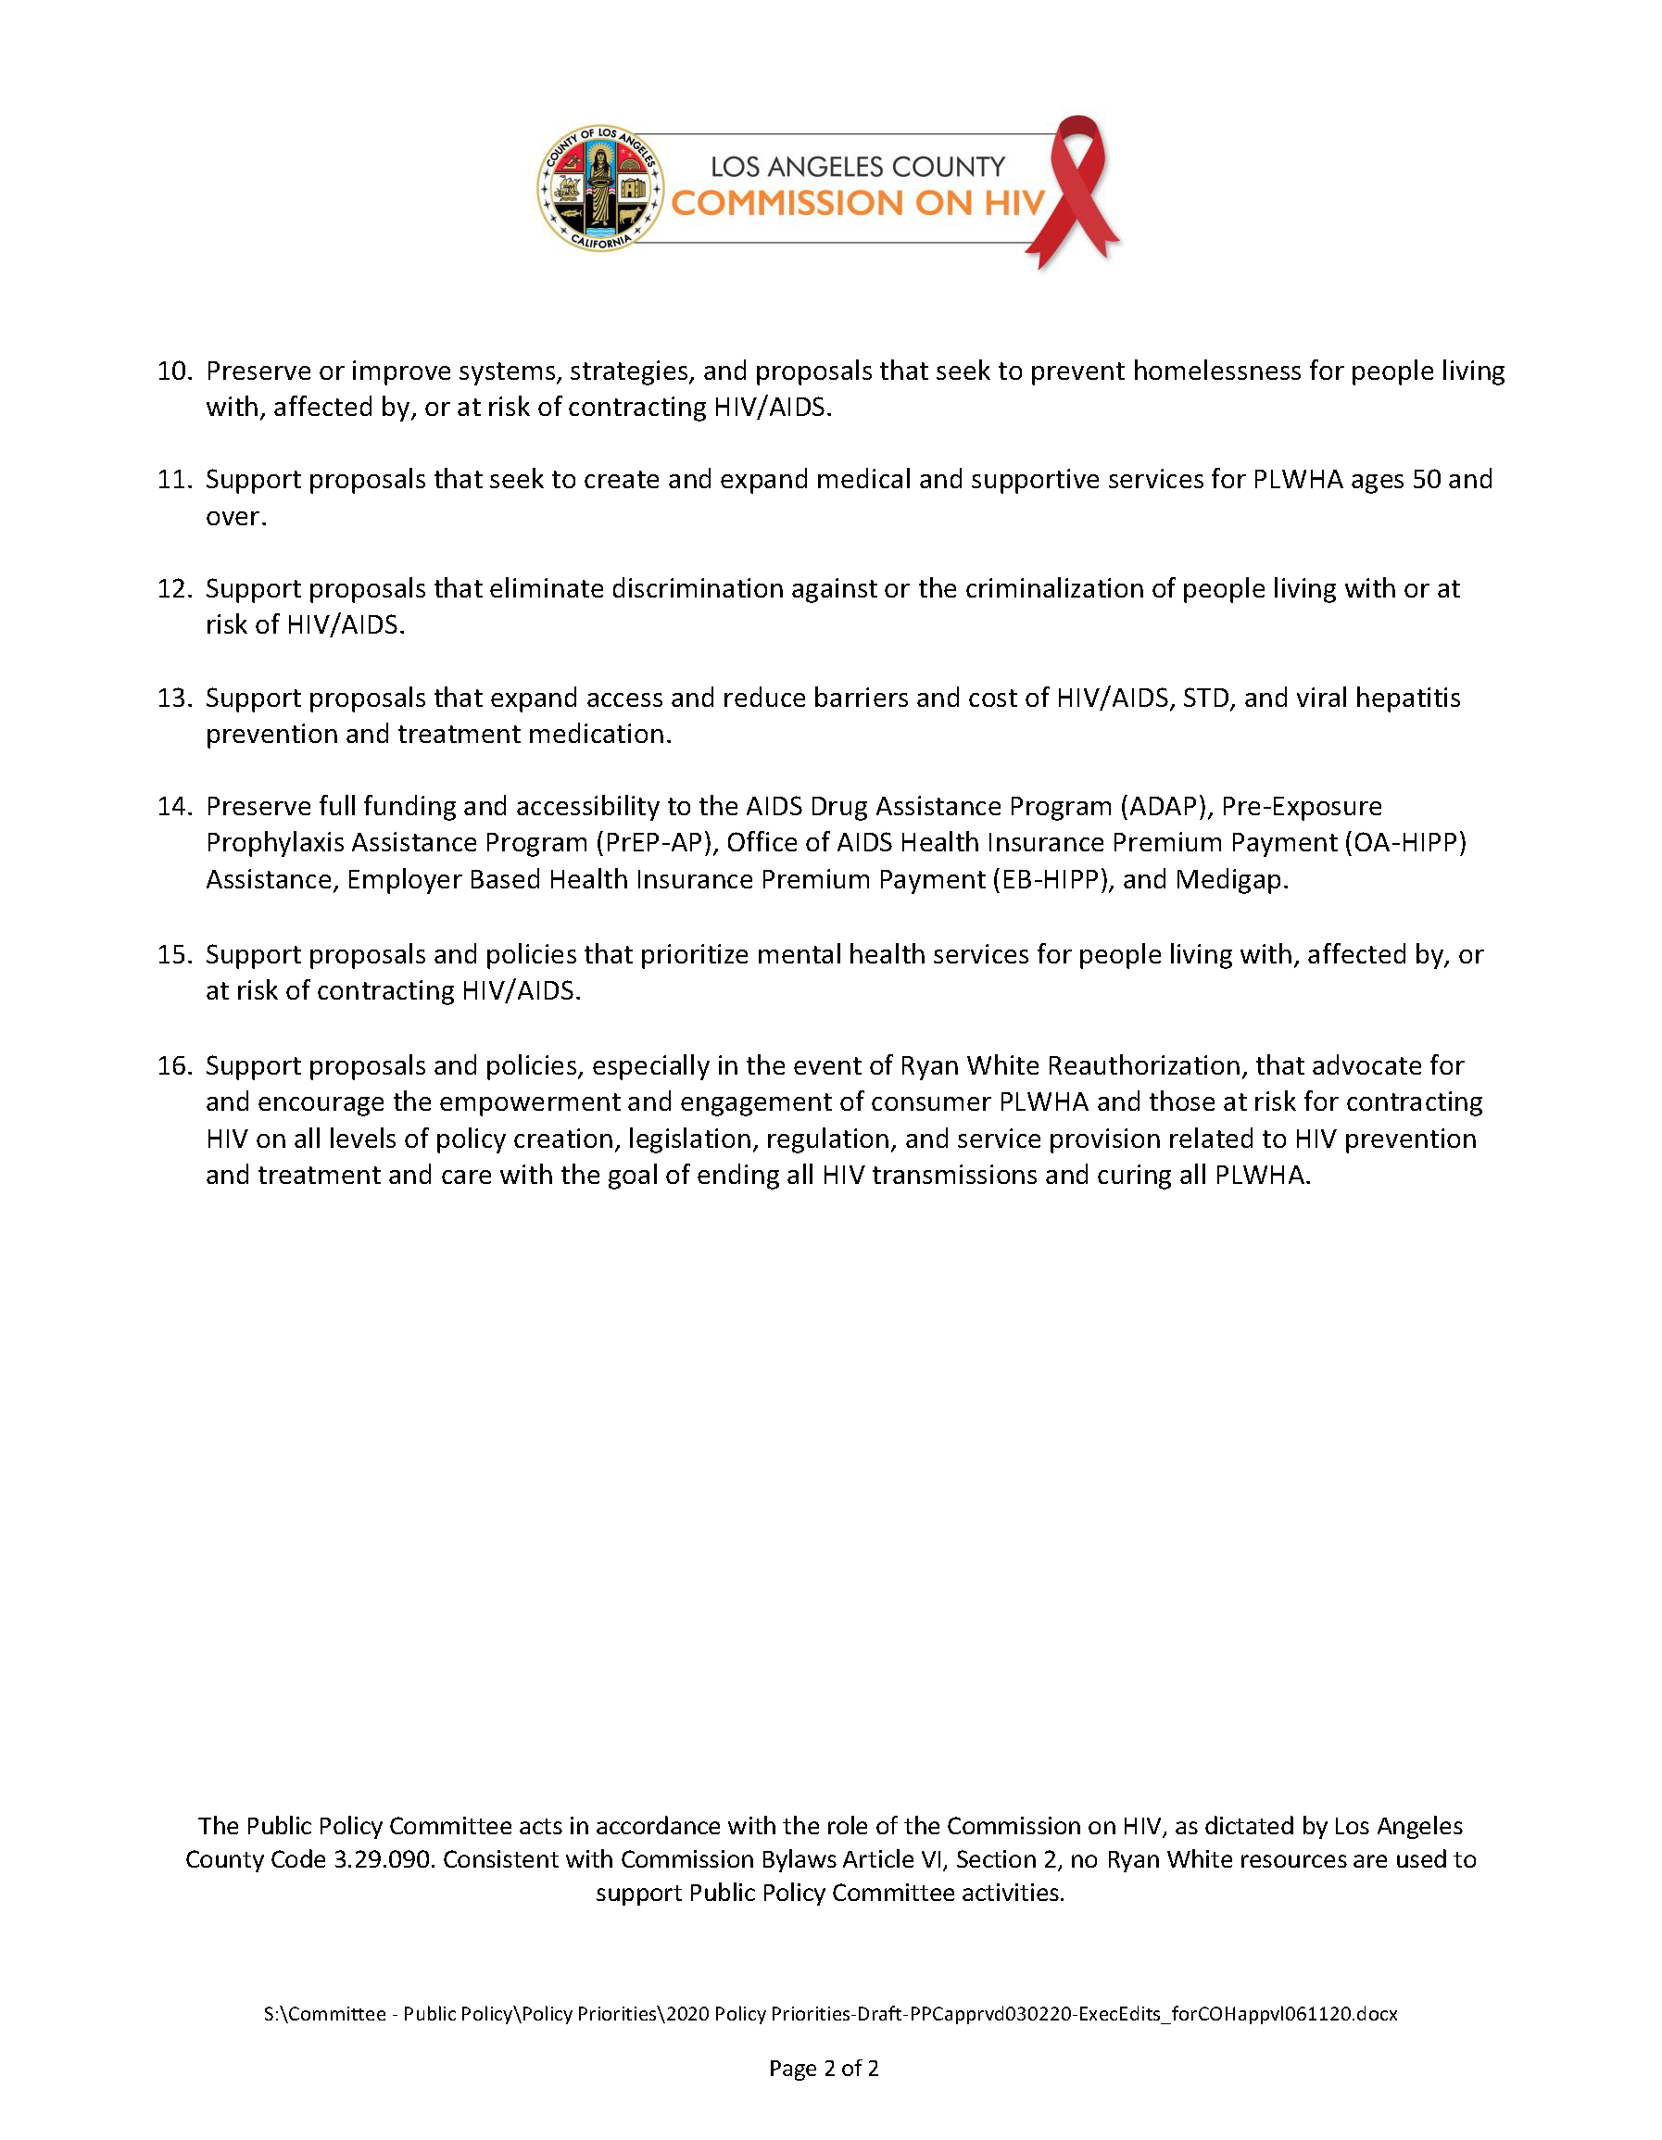

Slide 23
How the Legislative Docket is Developed

Slide 24
Timeline
Follows calendars for both legislative houses of the State of CA
Planning with grassroots coalitions usually occurs in multi-year settings to ensure continuity of policy and advocacy efforts
Track BOS deliberations and legislative agenda decisions
Bills are tracked @ https://leginfo.legislature.ca.gov/
Committee begins to track bills introduced and lists potential bills for consideration by Committee (Jan-Feb)

Slide 25
Timeline
CA budget tracked thru May revise
Collaborates with State Department partners to ensure that implementation of signed bills remain true to their intent
Federal and State bills for Committee deliberations may come from Committee members, community, and other stakeholders
Caucuses and Committees also provide input and highlight policy issues for PPC to discuss

Slide 26

Committee members review bills and other policy issues
Assess pros and cons
Invite speakers to help inform discussion
Request more information from authors
Use policy priorities to guide deliberations
Legislative Docket and Policy Priorities sent to COH for approval

Slide 27
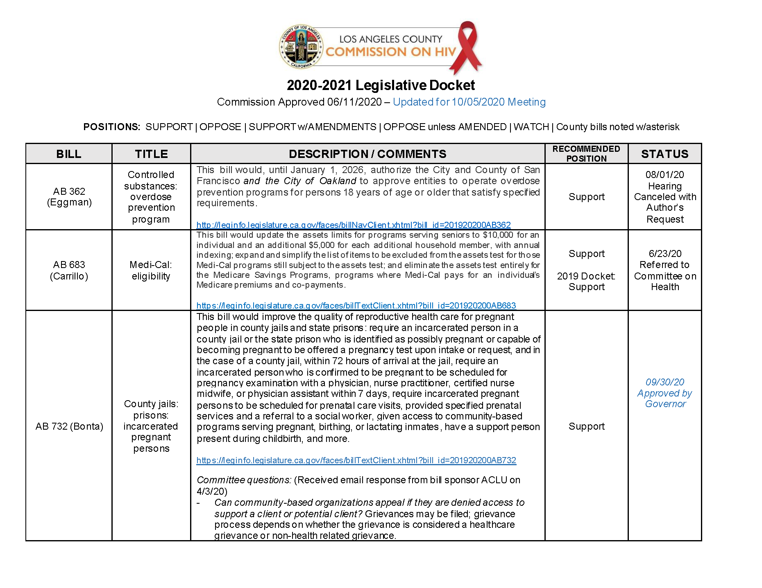
Approved 2020-2021 Legislative Docket *Only Page 1 Provided for Illustration Purposes Only*

Slide 28
Looking Ahead: Commitment to Racial Justice
Supporting the Black/African American Community Task Force
Upholding the Commission’s Solidarity Statement
Ensuring that all efforts to End the HIV Epidemic are rooted in dismantling racism, stigma and achieving optimal health for ALL

Slide 29


Slide 30







https://hivconnect.org/
3530 Wilshire Boulevard, Suite 1140 Los Angeles, CA 90010
hivcomm@lachiv.org
213.738.2816
HIVCommissionLA
@HIVCommissionLA

