Slide 1

VIRTUAL TRAINING SERIES
Membership Structure and Responsibilities
October 1, 2020
10:00am to 11:30am
Via Cisco WebEx
Presented by COH Operations Committee Co-Chairs, Joseph Green & Juan Preciado

Slide 2
A Few Requests
The training will be recorded and posted on the Commission on HIV website.
Please hold all questions and comments at the end of the presentation.
You may type your questions and comments in the Chat.
If we are not able to answer all the questions during the allotted time for this virtual training, staff will post answers on the website.

Slide 3
Learning Objectives
http://hiv.lacounty.gov/About-Us
Learn about the duties of a Commissioner, the 51 seats on the body, and the functions of the Operations Committee.
Learn how different member perspectives help facilitate a sound integrated HIV/STD prevention and care planning process.
Understand the concepts of Parity, Inclusion, Reflectiveness, and Representation.

Slide 4
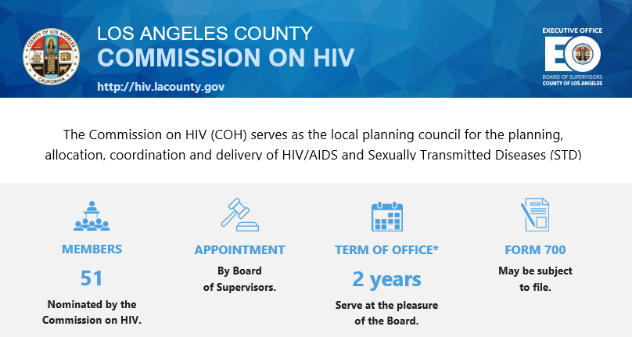

Slide 5
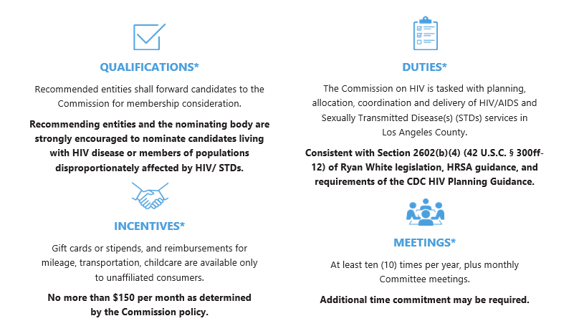

Slide 6
Board of Supervisors
COH
Executive Committee
Operations
Standards and Best Practices
Planning, Priorities and Allocations
Public Policy
Workgroups, Caucuses, Task Forces
Women’s Caucus, Consumer Caucus, Transgender Caucus, Black/African American Community Task Force, Aging Task Force

Slide 7
51 Seats
5 Governmental Representatives
1 DHSP Director/Part A
4 Ryan White Parts
8 Provider Representatives
17 Unaffiliated Consumers
5 Board Office Representatives
1 HOPWA
1 Health or Hospital Planning Agency
1 Behavioral or Social Scientist
8 HIV Stakeholders

Slide 8

Definitions
Consumer: an HIV-positive and/or AIDS-diagnosed individual who uses Ryan White funded services or is the caretaker of a minor with HIV/AIDS who receives those services, or
an HIV-negative prevention services client.
Unaffiliated consumer: an HIV-positive user of Ryan White-funded HIV services who does not serve in a decision-making capacity (including but not limited to an employee, consultant and/or board of directors member) at any Part A funded organization or agency.
This Photo by Unknown Author is licensed under CC BY-SA
This Photo by Unknown Author is licensed under CC BY

Slide 9
Members
Commissioner (Member): appointed by the BOS as full voting members to execute the duties and responsibilities of the Commission
Alternates: appointed by the BOS to substitute for HIV‐positive Commissioners when those Commissioners cannot fulfill their respective Commission duties and responsibilities
Committee-only Member: professional expertise, as a means of further engaging community participation in the planning process.

Slide 10
Committees and Working Units
The Commission completes a majority of its work through a strong committee and working unit structure.
Decision-Making Process
Committee
Executive Committee
Commission

Slide 11

A Commissioner’s Calendar
Attendance requirements:
All regularly scheduled Commission meetings
Monthly Committee meetings
Priority allocation setting meetings
Orientation and training meetings
Annual Meeting (November)
This Photo by Unknown Author is licensed under CC BY-SA

Slide 12
Operations Committee
Membership recruitment, retention, outreach, and engagement
Leadership development and mentorship
Bylaws, policies, and procedures
Ensure parity, inclusion and representation
Promote HIV services
Assessment of Administrative Mechanism (AAM)
Training

Slide 13
Assessment of the Efficiency of the Administrative Mechanism(AAM)
COH responsibility
Legislation requires PC to “assess the efficiency of the administrative mechanism in rapidly allocating funds to the areas of greatest need within the eligible area”
Should be done annually – directly or through a consultant
Involves assessing how efficiently DHSP does procurement, disburses funds, supports the COH’s planning process, and adheres to COH priorities and allocations
Written report goes to DHSP, which indicates what action it will take to address any identified problem areas

Slide 14
DHSP and COH Roles and Responsibilities
DHSP and COH = two independent entities, both with legislative authority and roles
Some roles belong to one entity and some are shared
Effectiveness requires clear understanding of the roles and responsibilities of each entity, plus:
Communications, information sharing, and collaboration between the recipient, COH, and COH support staff
Ongoing consumer and community involvement

Slide 15
COH, DHSP, Roles & Responsibilities
Task | Committee | DHSP | COH
Carry Out Needs Assessment | PP&A | X | X
Do Comprehensive Planning | PP&A | X | X
Set Priorities* | PP&A |  | X
Allocate Resources* | PP&A |  | X
Manage Procurement |  | X
Monitor Contracts |  | X
Evaluate Effectiveness of Planning Activities | PP&A | X | X
Evaluate Effectiveness of Care Strategies | SBP | X | X
Do Quality Management | SBP | X | [Care Standards & Committee Involvement]
Assess the Efficiency of the Administrative Mechanism* | Operations |  | X
Member Recruitment, Retention and Training | Operations |  | X
* Sole responsibility of RWHAP Part A Planning Councils

Slide 16
Parity, Inclusion and Representation (PIR)
Los Angeles County Commission on HIV (COH)

Slide 17
From the COH Ordinance
"Parity, Inclusion and Representation (PIR)" is the CDC principle to ensure that all HIV planning council members can:
participate equally (parity),
that the planning process actively includes a diversity of views, perspectives and stakeholders (inclusion), and that
members should represent the range of ethnicities, gender, backgrounds and other characteristics of people affected by HIV (representation).

Slide 18
Ryan White Legislation: “Reflectiveness”
Planning Council (PC) “shall reflect in its composition the demographics of the population of individuals with HIV/AIDS in the eligible area involved, with particular consideration given to disproportionately affected and historically underserved groups and subpopulations” [Section 2602(b)(1)]

Slide 19
HRSA Expectations: “Reflectiveness”
“Reflectiveness is the extent to which the demographics of the planning council’s membership look like the epidemic of HIV/AIDS in the EMA/TGA.”
Must include “at least the following: race/ethnicity, gender, and age at diagnosis.”
Reflectiveness required for both the whole planning council membership and the consumer membership.
PLWH should be selected “without regard to the individual’s stage of disease.”
“Reflectiveness does not mean that membership must identically mirror local HIV/AIDS demographics.” [p 111]
“The composition of the PC or planning body must reflect the demographics of the HIV/AIDS epidemic in the EMA/TGA.” [FOA HRSA-17-030, RWHAP Part A Continuing Continuation for FY 2017, p 22]
The required PC/B letter that accompanies the RWHAP Part A application must indicate “that representation is reflective of the epidemic in the EMA/TGA” or, if it is not, “Note variations between the demographics of the non-aligned consumers and the HIV disease prevalence of the EMA/TGA and “provide a plan and timetable for addressing each vacancy.” [FOA HRSA-17-030, RWHAP Part A Continuing Continuation for FY 2017, p 24]

Slide 20
This reflectiveness table is reported to HRSA.
Compliance with meeting 1/3 unaffiliated consumers on the PC is a priority for HRSA.
“Unaffiliated consumer" (non-aligned) means:
an HIV-positive user of Ryan White-funded Part A HIV services AND
who does not serve in a decision-making capacity (including but not limited to an employee, consultant and/or board of directors member) at any Part A funded organization or agency.”
The PC Reflectiveness table does NOT address “Parity” or “Inclusion”.

Slide 21
Roe, Kathleen & Montes, Henry & Roe, Kevin. (2008). Parity, inclusion, and representation: Lessons from a decade of HIV prevention community planning for the movement to eliminate health disparities.
Parity refers to true equity in decision-making regardless of education, status, employment, language, or other hierarchical constructs.
Inclusion requires that all process elements respect, reflect, and engage the diversity of participants and perspectives, at all times and without fail
Representation means that all relevant perspectives are present and that those representing a perspective are authentically connected to that community or experience. (Representation not the same as Reflectiveness)

Slide 22
Los Angeles County Policy of Equity
https://ceop.lacounty.gov/policy-of-equity/
SCOPE OF COVERAGE
The Policy applies to all employees, including board members, supervisors, managers, commissioners, applicants, interns, outside vendors, and volunteers.

Slide 23
Protected Status
age (40 and over)
ancestry
color
ethnicity
religious creed (including religious dress and grooming practices)
denial of family and medical care leave
disability (including mental and physical disability)
marital status
medical condition (cancer and genetic characteristics)
genetic information
military and veteran status
national origin (including language use restrictions)
race
sex (including pregnancy, childbirth, breastfeeding, and medical conditions related to pregnancy, childbirth or breastfeeding)
gender
gender identity
gender expression
sexual orientation
any other characteristic protected by state or federal law

Slide 24

Public Statements by Commissioners to Media and Other Organizations
Only Executive Director and Co-Chairs are authorized to speak on behalf of the Commission
When speaking to the media, Commissioners should not imply they are speaking on behalf of the Commission.
Proactively clarify with reporters that they do not speak on behalf of the Commission and are only commenting as an individual affiliated with an outside organization.
Commissioners comments (verbal or written) as a private citizen solely reflect your personal position and not as a representative of the Commission.

Slide 25


Slide 26







https://hivconnect.org/
3530 Wilshire Boulevard, Suite 1140 Los Angeles, CA 90010
hivcomm@lachiv.org
213.738.2816
HIVCommissionLA
@HIVCommissionLA

